Slide 1
CS x476 Project 4
Aaron Lopes
alopes7@gatech.edu
alopes7
903407727

Slide 2
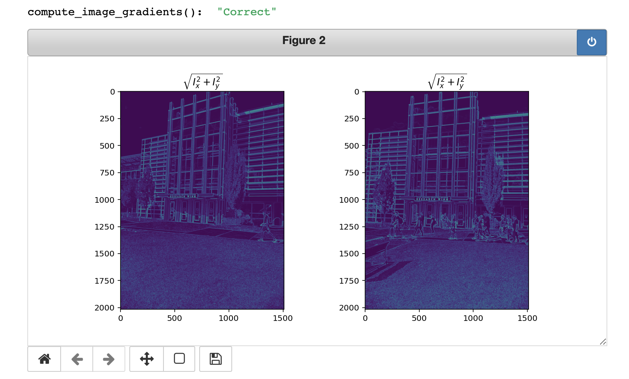
Part 1: Harris corner detector
The area’s with the highest magnitude are the vertical and horizontal edges, because these are the locations of maximum contrast between the surrounding areas with respect to the image orientation; where the gradient is pointing towards the most rapid increase in intensity

Slide 3
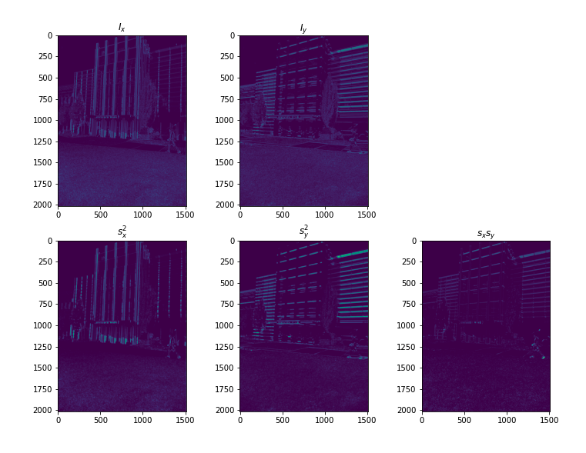
Part 1: Harris corner detector

Slide 4
Part 1: Harris corner detector
First, the black and white image is passed through the Sobel filter and the x and y gradients are obtained. From these gradients, the values of the second moment matrix are calculated by convoluting the squares and mixed gradients with a generated Gaussian filter. Once these values are found, the score can be calculated using the det(M) - alpha(trace(M))^2 where M is the second moment matrix.

Slide 5
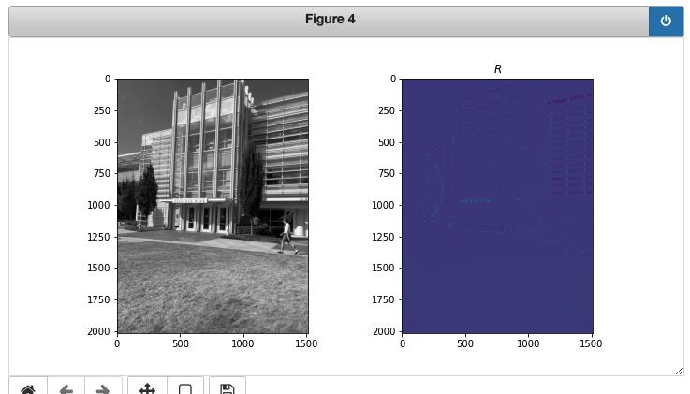
Part 1: Harris corner detector
No, the gradients depend on the intensity of contrast between darker and lighter pixel neighborhoods. Therefore, it is not invariant to

Slide 6
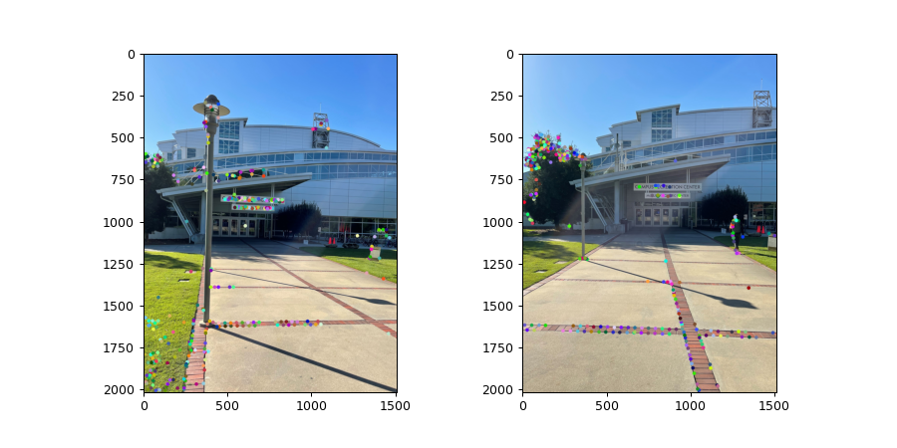
Part 1: Harris corner detector
[insert visualization of CRC interest points from proj2.ipynb here]
[insert visualization of Klaus interest points from proj2.ipynb here]

Slide 7
Part 1: Harris corner detector
[What are the advantages and disadvantages of using maxpooling for non-maximum suppression (NMS)?]

Slide 8
Part 1: Harris corner detector
[What is your intuition behind what makes the Harris corner detector effective?]

Slide 9
Part 2: SIFT feature descriptor
[insert visualization of SIFT feature descriptor from proj2.ipynb here]
[Describe your implementation of SIFT feature descriptors here]

Slide 10
Part 2: SIFT feature descriptor
[Why aren't our version of SIFT features rotation- or scale-invariant? What would you have to do to make them so?]

Slide 11
Part 2: SIFT feature descriptor
[Why are SIFT features better descriptors than simplying normalizing image intensities in a local window?]

Slide 12
Part 3: Feature matching
[insert visualization of matches for Klaus image pair here with num_pts_to_visualize = 30]
[insert visualization of matches for CRC image pair here with num_pts_to_visualize = 30]

Slide 13
Part 3: Feature matching
[Describe your implementation of feature matching here]
[Look at some of the mismatched features in your picture. Why might this have occurred?]

Slide 14
Part 4: SIFT feature descriptor (Extra Credit)
[insert visualization of matches for your own image pair here]
What makes our feature matching pipeline work well or poorly for your image pair?

