Slide 1
Wait, How Many Blunders?
Aaron Bone and Molly Rovinski
DS-160-01 Final Exam
Dr. Kelley

Slide 2

Dataset Introduction
Chess Games played on Lichess.org from September 1 – 9, 2020
40 columns of various datatypes
Over millions of games
Contains various levels of game difficulty, the variety of openings, the move types, and the miscalculations

Slide 3
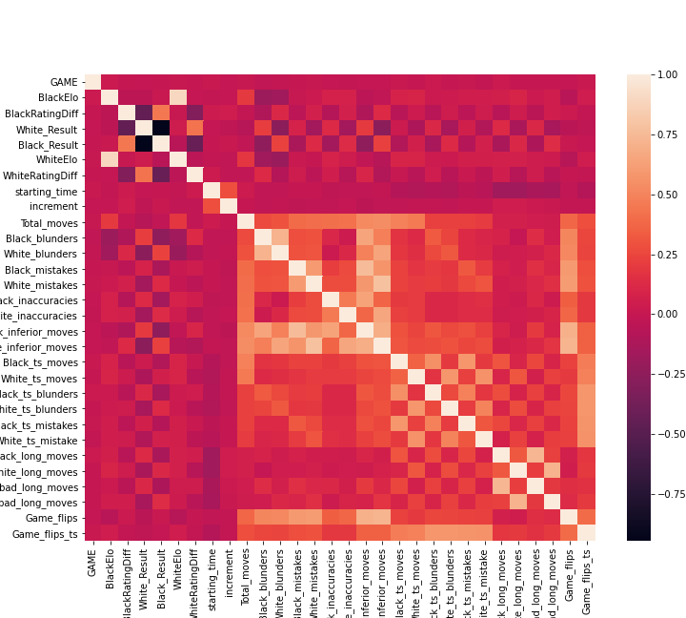
Correlation Heatmap
High correlation between WhiteElo and BlackElo
No correlation between White_Result and Black_Result

Slide 4
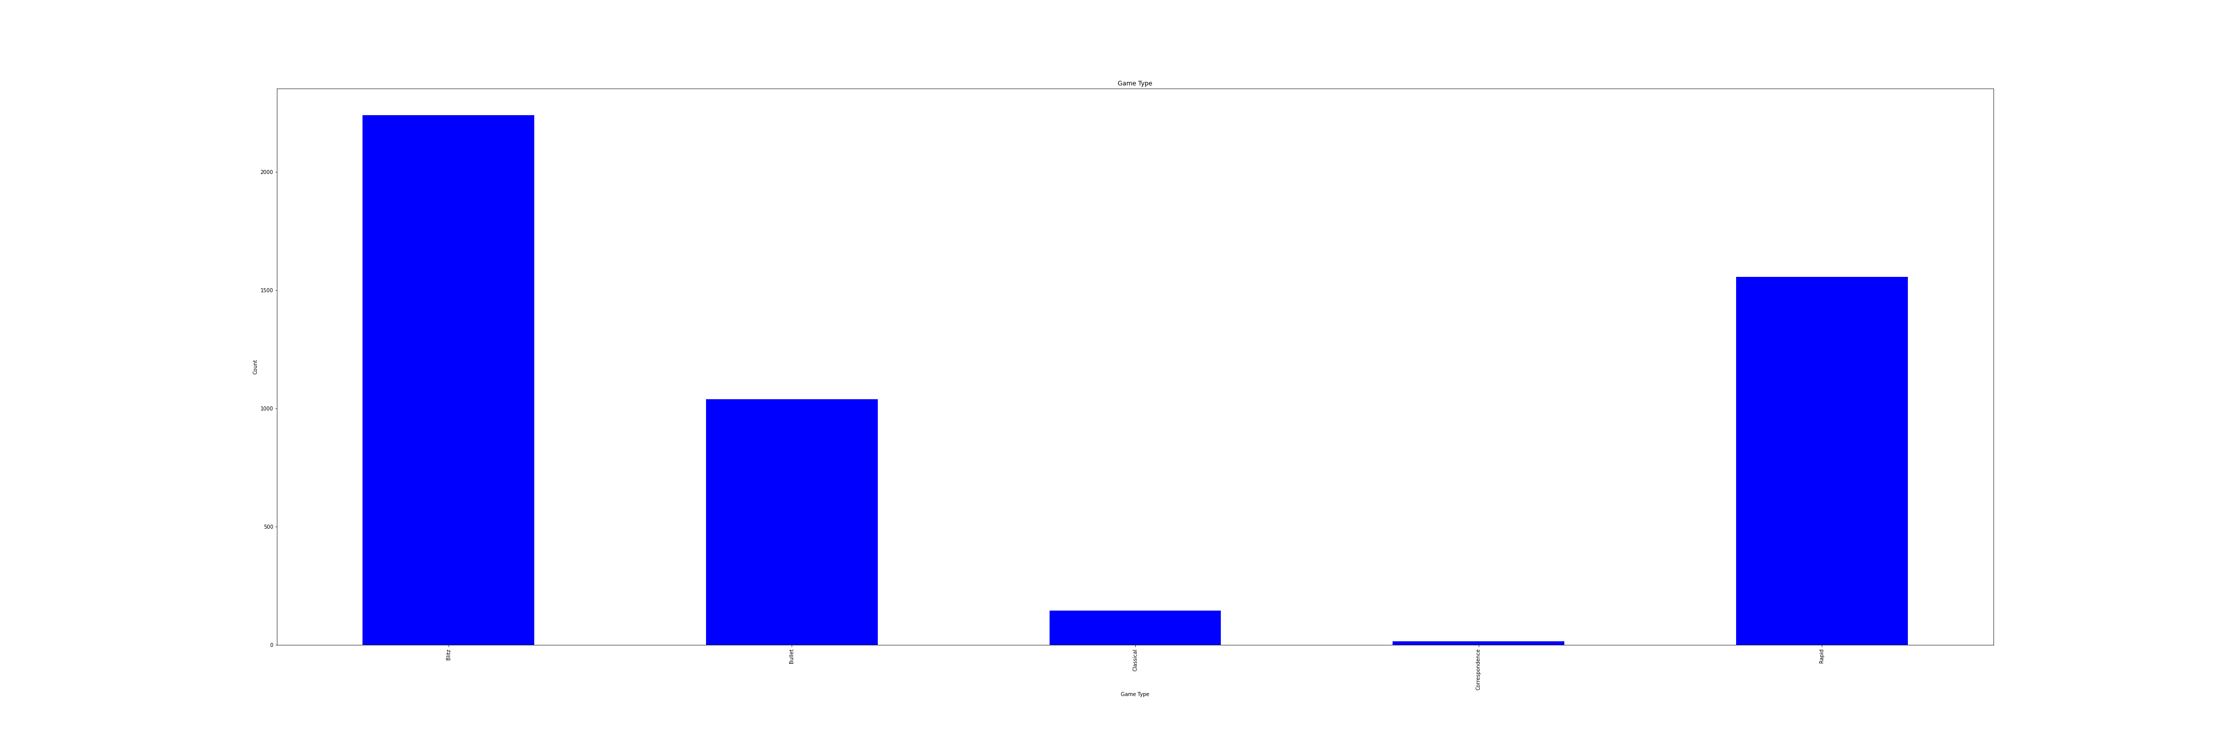
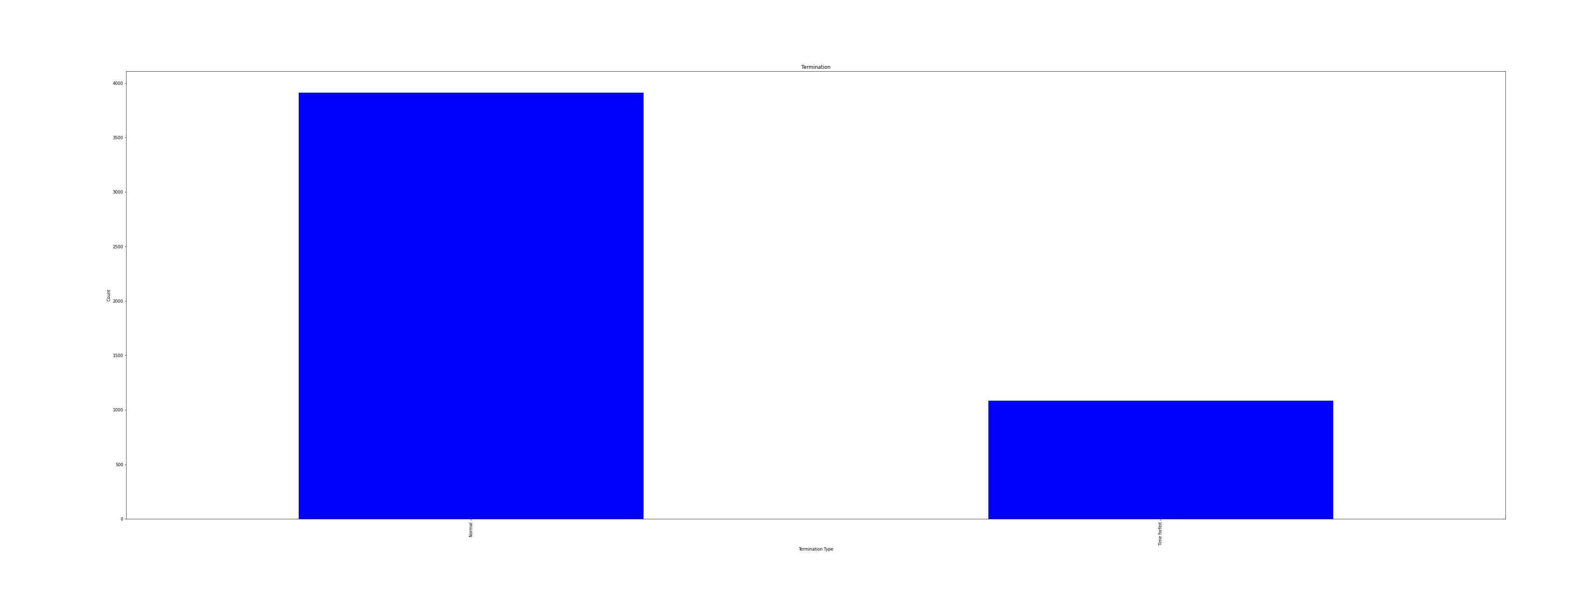
DescriptiveVariables
Most common game type: Blitz
Most common game termination: normal

Slide 5
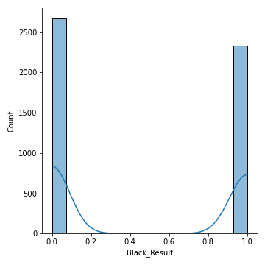
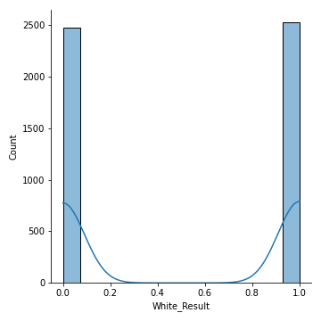
Important Variables
Most wins: White Result

Slide 6
Machine Learning Analysis
K-Nearest Neighbor model
Used SKLearn package within Python
Metric package for accuracy, precision, recall, and f1 scores
Logistic Regression package
Model and predict future variables for the Black_Result
All move variables, the black and white rating variables, and the game flip variable to predict

Slide 7
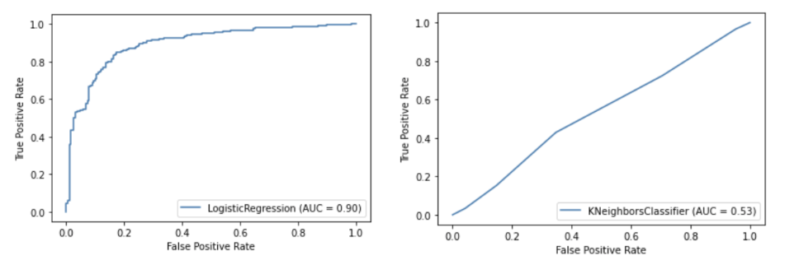
Experiment 1: 80/10/10
Accuracy: 0.529
Precision: 0.489
Recall: 0.419
F1: 0.451

Slide 8
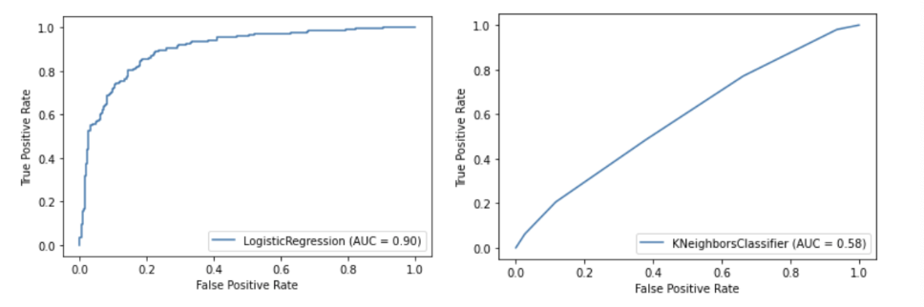
Experiment 2: 70/15/15
Accuracy: 0.521
Precision: 0.484
Recall: 0.425
F1: 0.453

Slide 9
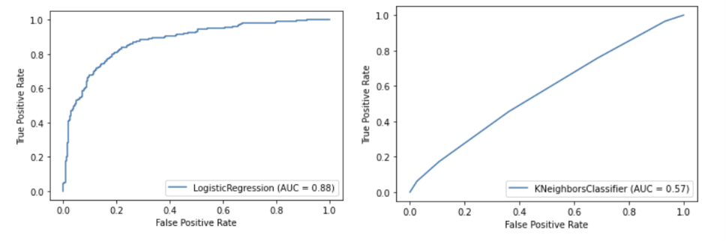
Experiment 3: 60/20/20 (Best Model)
Accuracy: 0.531
Precision: 0.511
Recall: 0.438
F1: 0.472

Slide 10
Conclusion
Problems:
1. None of these models were great fits for the dataset as all the scores were significantly low.
2. Dealing with draws within the results
Limitations:
1. Results column was changed to dates or obscure numbers within Excel
2. Lost some data due to draws
Future:
1. Better ways to manage draws so more data isn't lost
2. Figure out a way to incorporate openings to predict the win
Overall: Not the best model for the dataset.

Slide 11
References
K, George. “Lichess September 2020 Data.” Kaggle, 2 Mar. 2021, www.kaggle.com/noobiedatascientist/lichess-september-2020-data?select=Sept_20_analysis.csv.

