Slide 1
Hexokinase is inhibited by its product G6P
Product Inhibition
General enzymology:
- Structure of the product resembles that of the substrate
- If substrate binds tightly, product likely binds tightly as well.
- Build-up of the product results in competition with substrate for the active site

Slide 2
eg. G6P is structurally similar to glucose, and competes with glucose for active site of hexokinase
P

Slide 3
Hexokinase (Glucose → G6P)
In Muscle:
K_{m}^{Glucose} ~ 0.1 mM
Potently inhibited by product, G6P
PFK → ↑F6P → ↑G6P → Hexokinase
ATP, pH
Glucose
In Muscle
∆G= +0.6
PFK
HK
Glucose
G6P
F6P
F 1,6 BP
In Liver
Glycogen

Slide 4
In Liver:
Glucokinase is not inhibited by G6P (K_{m}^{Glucose} = 5mM).
↑Km of glucokinase gives brain and muscle first dibs on fuel.
Reason: - Liver is a glucose buffer
- When blood glucose is high, liver continues to
convert glucose → G6P to make glycogen.

Slide 5
Pyruvate Kinase
O
OH
OH
O
O
P
O
ADP
ATP
3
O
CH₂
CH₂
PEP
Pyruvate

Slide 6
Regulation of Pyruvate Kinase
Glucose
HK
PFK
F1,6 BP
ATP
+
PEP
Blood Glucose
PK
Pyruvate
Alanine
Glucagon
(Liver only)

Slide 7
F1,6BP
ATP (or Alanine)
PK
Activity
[PEP]

Slide 8
Pancreas
Adrenal Medulla
+
Glucagon
Epinephrine
Muscle
Liver
Brain
Glycogen
Glycogen
+
+
+
+
Glucose
(Blood)
Glucose
Glucose
+
F6P
F2,6BP
F6P
F2,6BP
+
+
PFK
PFK
F1,6BP
F1,6BP
PK
PK
Pyruvate
Pyruvate

Slide 9
Classification of the nervous system
Joints, skin, skeletal muscle
Skeletal muscle
somatic
motor
CNS
visceral
autonomic
Glands, smooth muscle, cardiac
Viscera

Slide 10
Autonomic
Sympathetic
Parasympathetic
acetylcholine
acetylcholine
Norepinephrine
acetylcholine

Slide 11
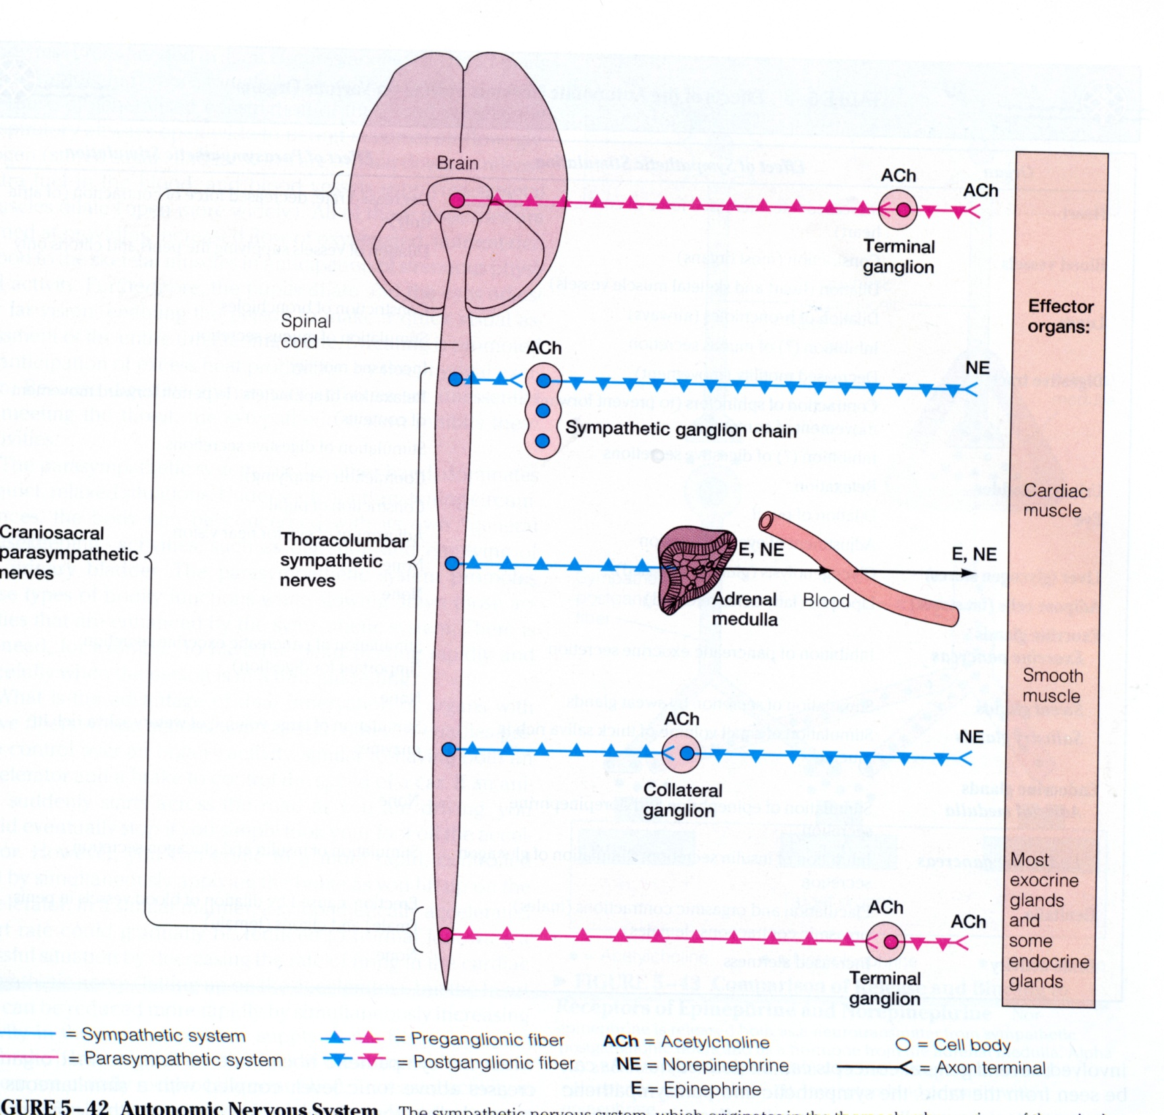

Slide 12
Pancreas
Adrenal Medulla
+
Glucagon
Epinephrine
Muscle
Liver
Brain
Glycogen
Glycogen
+
+
+
+
Glucose
(Blood)
Glucose
Glucose
+
F6P
F2,6BP
F6P
F2,6BP
+
+
PFK
PFK
F1,6BP
F1,6BP
PK
PK
Pyruvate
Pyruvate

Slide 13
Metabolic Profile of the Major Organs
Tissue Fuels
Brain
Sole fuel source is glucose: cannot use FFA’s directly.
No glycogen storage
During starvation – uses “ketone bodies” derived from FFA’s
K_{m}^{glucose} of hexokinase is very low (50 uM).
RBC’s
Sole fuel source is glucose
No glycogen storage
No Mitochondria and no FFA metabolism

Slide 14
Muscle
Major fuels are: glucose during exercise &
FFA’s at rest.
Large Glycogen Stores.
Ratio of glucose:FFA utilization depends on mitochondrial density and exercise intensity
Adipose Tissue
Glucose is required for synthesis TAG’s
Glucose → DHAP → glycerol-3-P + FFA (from liver)
TAG

Slide 15
Liver
Primary function is glucose storage and release.
Principal organ which RELEASES glucose into blood
Large glycogen storage
Principal purpose of glycolysis in this tissue is for synthesis of macromolecules
Glucose
FFA’s
Pyruvate
Acetyl-CoA
TCA Cycle

Slide 16
End of Glycolysis

