Slide 1
Metabolic Consequences of Starvation

Slide 2
Glucose
Glucose
Alanine
Palmitate
Pyruvate
Ketone bodies
Pyruvate
Oxaloacetate
2 Acetyl-CoA
2 CO₂
In liver

Slide 3
Glucose
Glucose
Alanine
Palmitate
Pyruvate
Ketone bodies
Pyruvate
Oxaloacetate
Acetyl-CoA
CO₂
In Brain

Slide 4
Glucose
Glucose
Alanine
Palmitate
Pyruvate
Ketone bodies
Pyruvate
Oxaloacetate
Acetyl-CoA
2CO₂
In Skeletal Muscle

Slide 5
Oxidation of Fuels by Peripheral tissues (Skeletal Muscle & Heart) in order of preference:
Ketone Bodies
FFA’s
Glucose

Slide 6
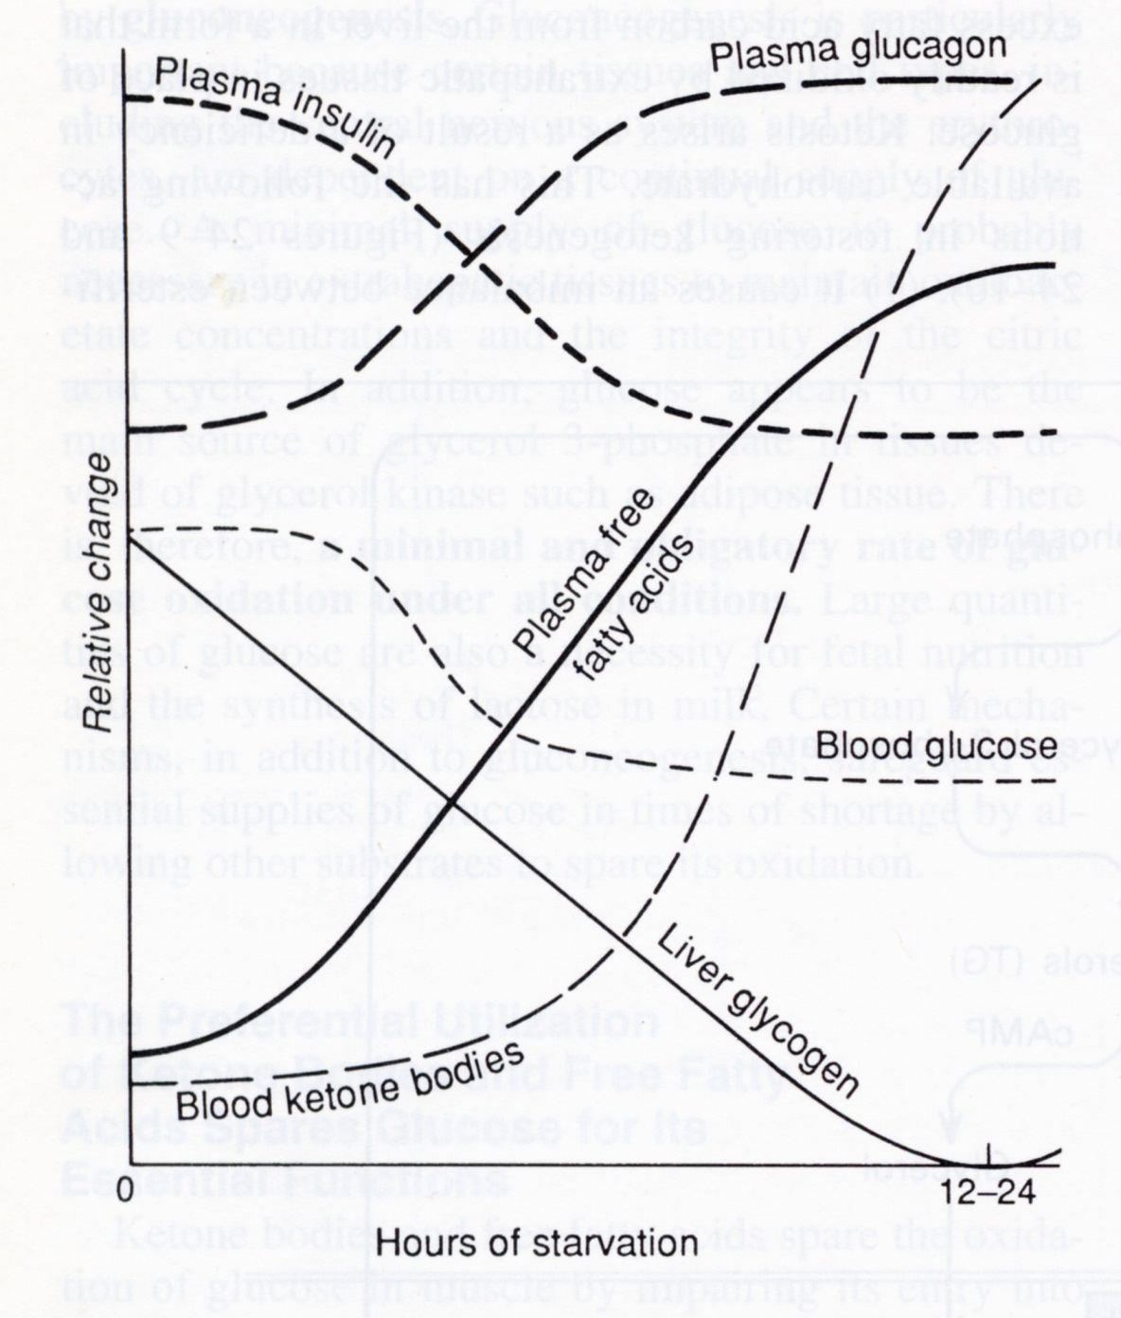

Slide 7
Major Ketone Bodies
O
O
O
O
H
O
H
C
C
O
H
C
C
H
H
C
C
O
3
H
3
3
3
H
2
2
Acetoacetate
Acetone
B- OH butyrate

Slide 8
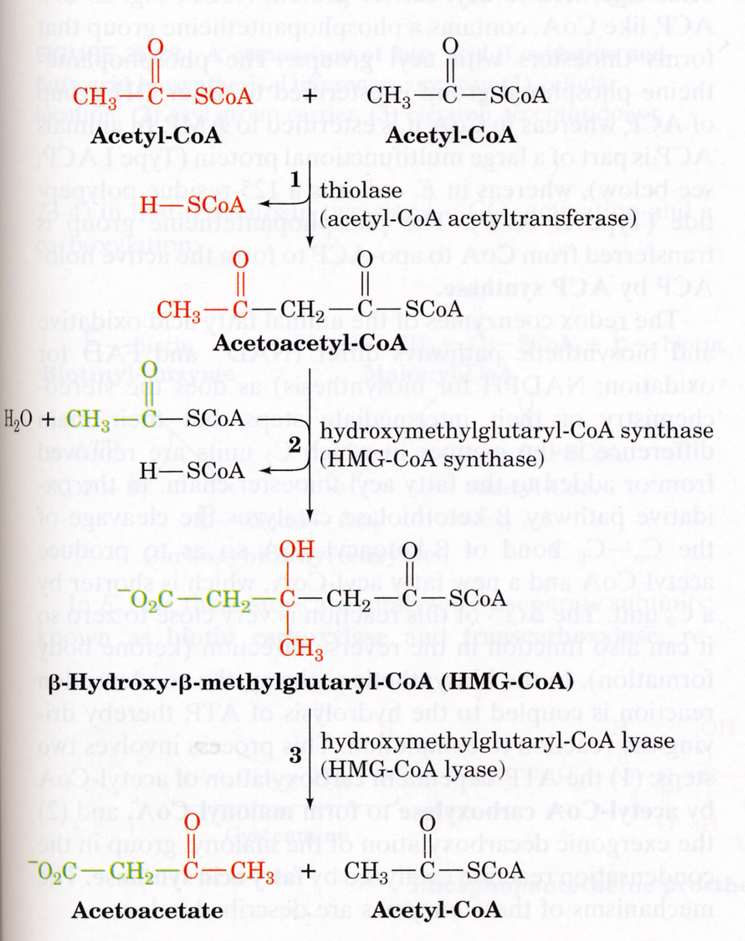
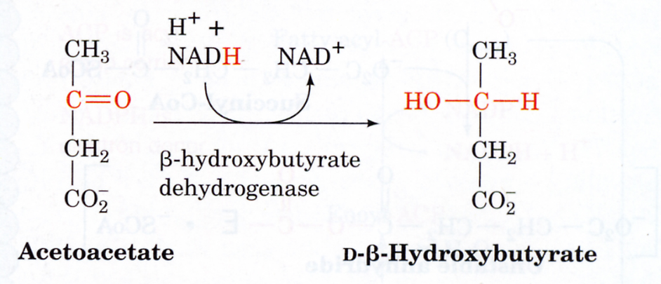
Enzymatic Pathway for Formation of Ketones in Humans

Slide 9
In the Fed State:
12-24 hrs fasting:
↑ blood glucose
↓Blood Glucose
↑ insulin
↑Glucagon
+
+
↓lipolysis
↑Lipolysis
–
Ad Cyc
PDE
↓Glycogen
ATP
cAMP
5’ AMP
HSL
TAG
FFA’s + glycerol
protein
Brain
pyruvate
Ketones
Acetyl-CoA
oxaloacetate
Heart
Muscle
glucose
Brain,RBCs
TCA

Slide 10
Starvation
TAG
Lipolysis (from adipose tissue)
Ketosis
CO₂
Protein degradation (from muscle)
Alanine
Liver
Glucose
Muscle
Pyruvate

Slide 11
Utilization of Ketone Bodies
Succinyl CoA
Succinate
CoA
Acetoacetate
Acetoacetyl-CoA
2 Acetyl-CoA
Sources of Oxaloacetate:
Brain – blood glucose
Heart – blood glucose
Muscle – endogenous glycogen, protein

Slide 12
