Slide 1
Gluconeogenesis

Slide 2
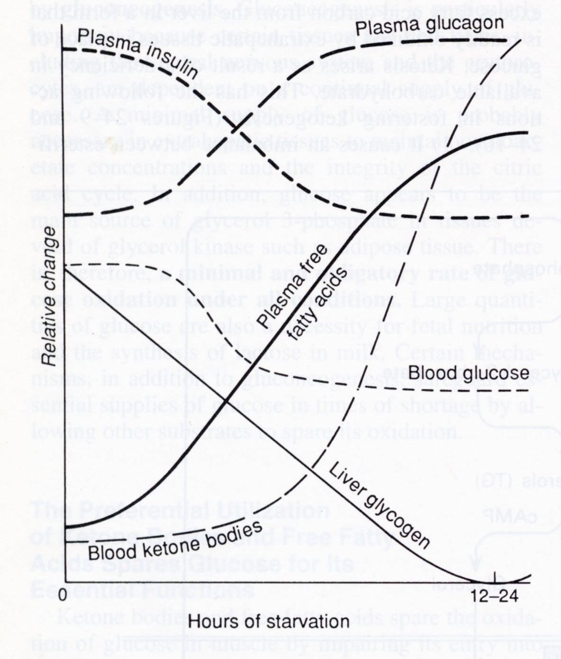

Slide 3
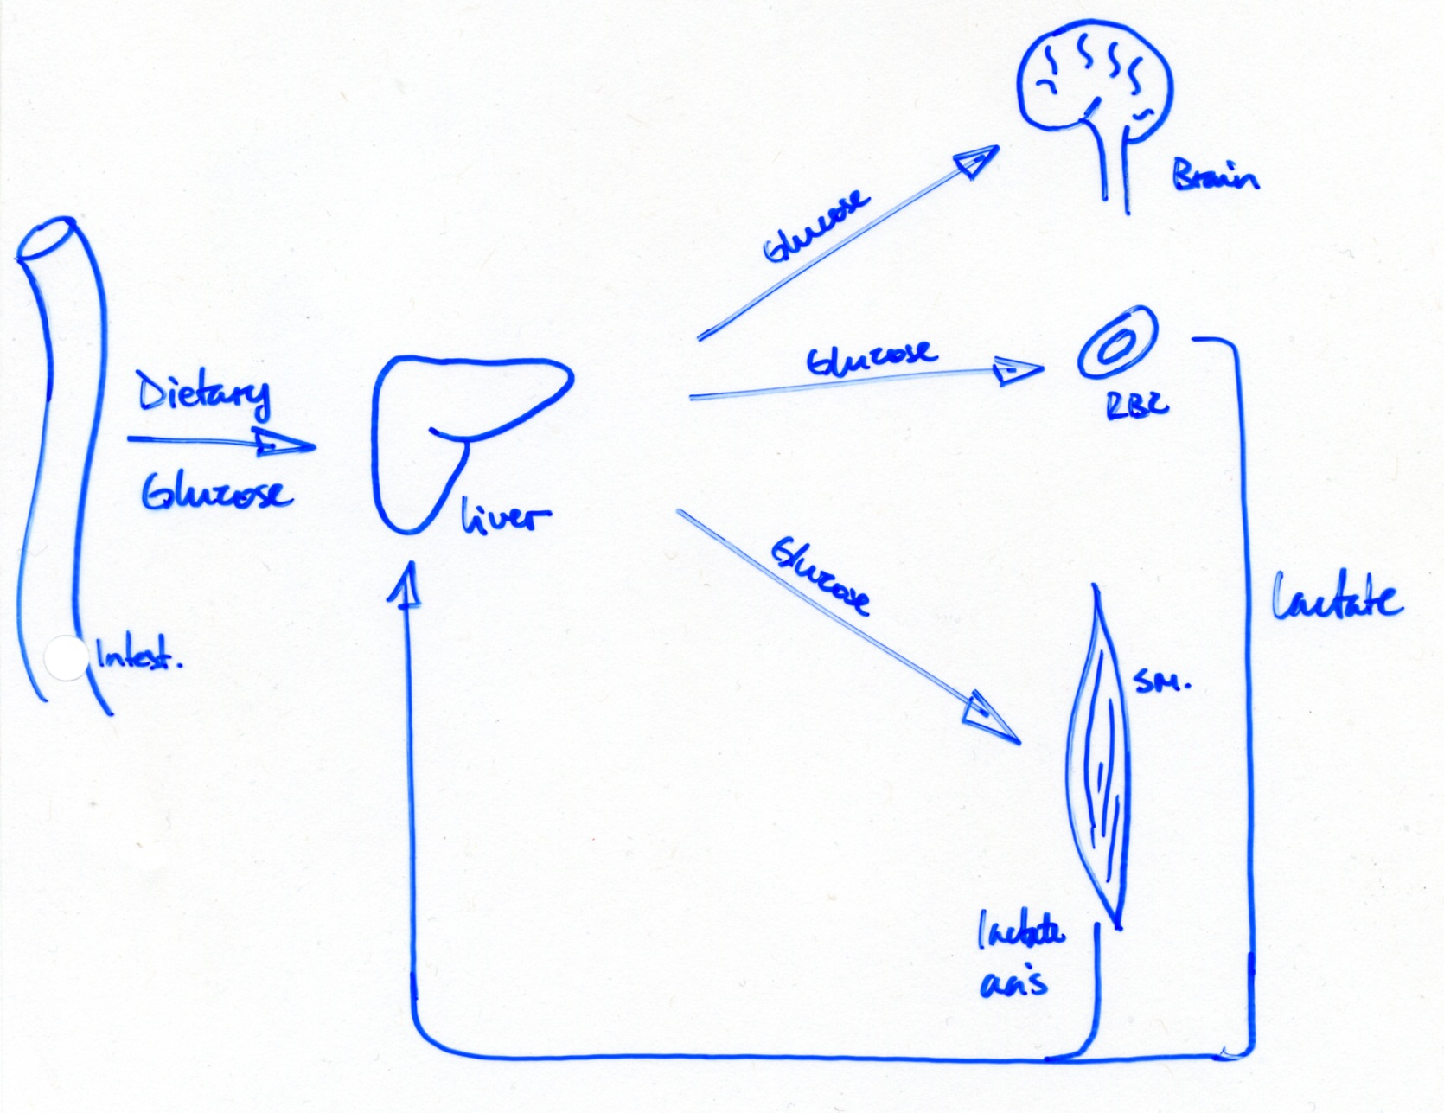
Gluconeogenesis

Slide 4
Gluconeogenesis
-Metabolic Pathways are Irreversible
∆G between the 1st & last metabolite is large (huge) & neg.
- If metabolite 1 and 2 are interconvertible (metab 1 metab 2), the path from Metab 1 → Metab 2 must be different from that of Metab 2 → Metab 1
A
B
Metab₁
Metab₂
Y
X

Slide 5
For example:
Glucose → 2 Pyruvate ∆G = - 42.3 kcal/mol
2ADP + 2P_{i} → 2ATP ∆G = 24 kcal/mol
∆G = -18.3 kcal/mol
ΔG for glucose → pyruvate ≈ -20 kcal/mol!
Gluconeogenesis is not the reverse reaction of glycolysis, rather it must use a different pathway that is coupled to the input of energy

Slide 6
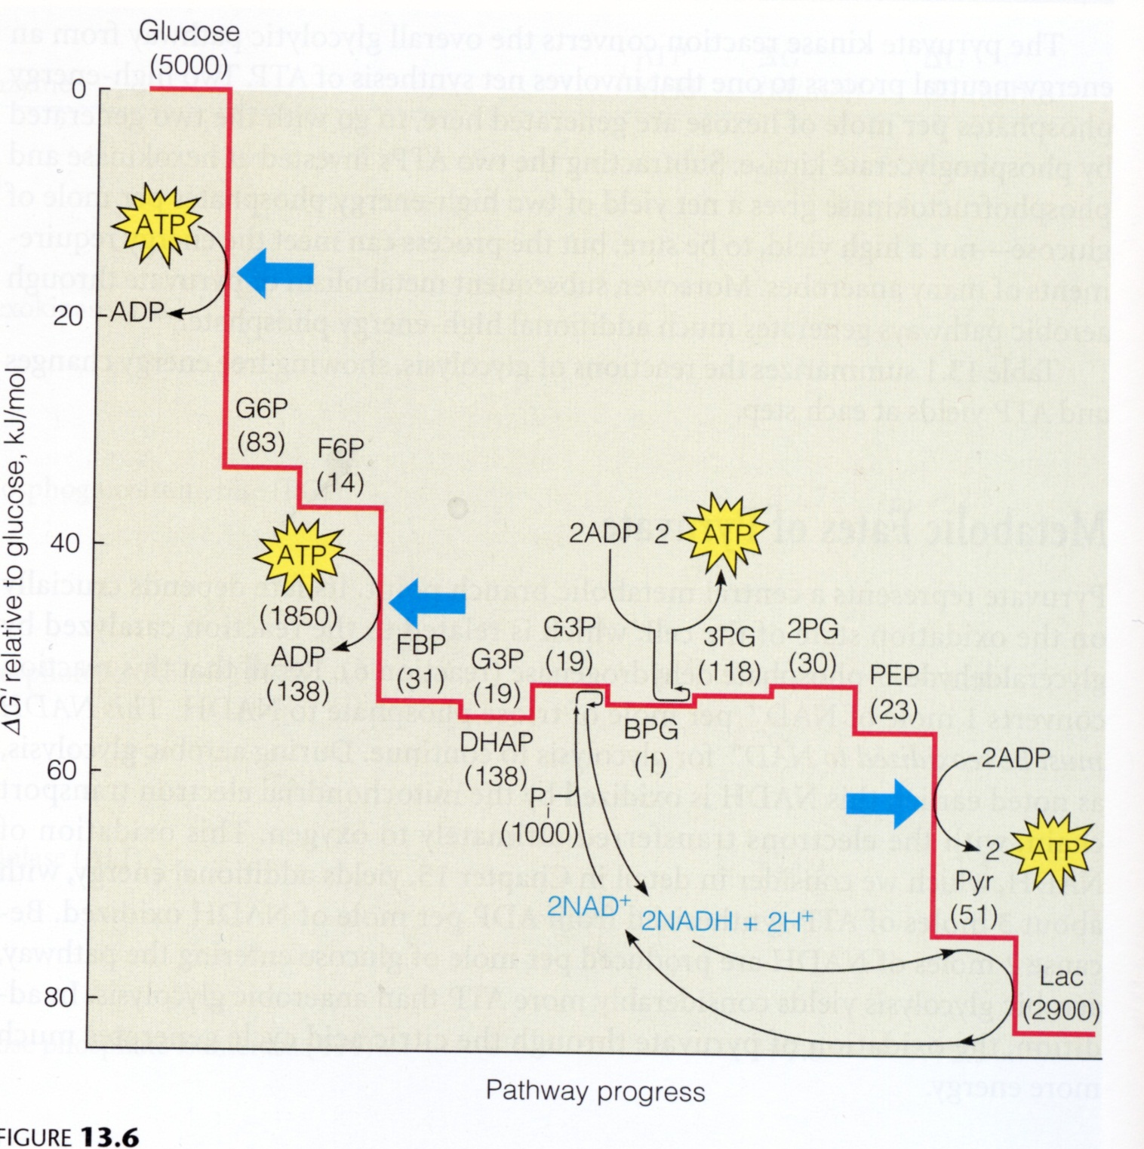

Slide 7
Gluconeogenesis can use most of the enzymes of glycolysis in reverse, except for 3:
A. Pyruvate kinase
B. PFK
C. Hexokinase
The starting point for gluconeogenesis is pyruvate.

Slide 8
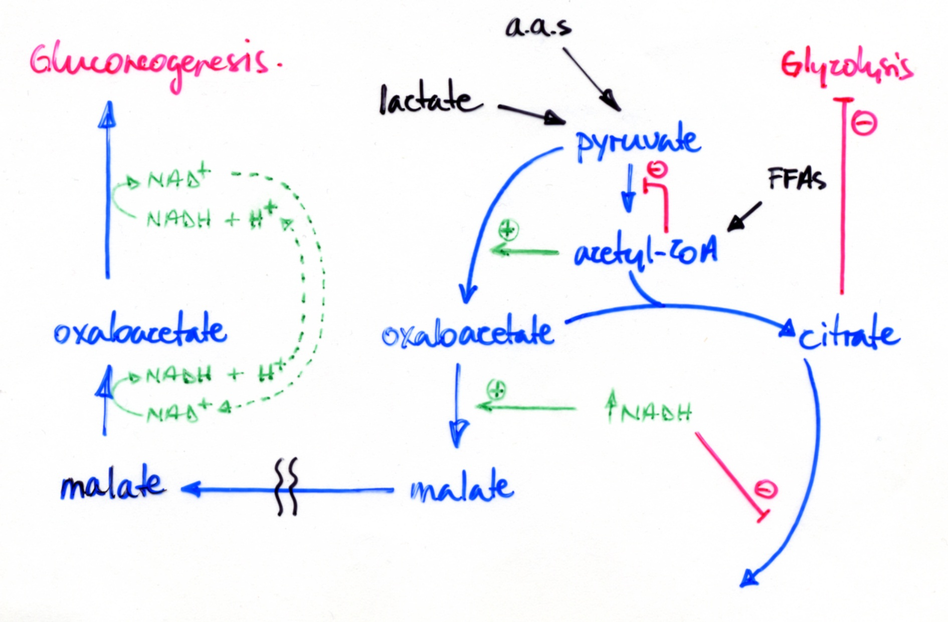
Pyruvate enters the mitochondria to initiate Gluconeogenesis

Slide 9
A. Circumventing Pyruvate Kinase - Conversion of Pyruvate to Phosphoenolpyruvate
Carboxylation of pyruvate to oxaloacetate √
Transport of oxaloacetate out of mitochondria
Oxaloacetate
cyto
mito
Oxaloacetate
NADH + H⁺
NADH + H⁺
NAD⁺
NAD⁺
Malate
Malate
Inner mito. Memb.
Notes:
Why the malate shuttle and not an oxaloacetate shuttle? Its b/c we want gluconeogenesis only if mitochondrial NADH levels are high. This signals no need for the TCA cycle. Under these conditions, its malate that predominates, not oxaloacetate.

Slide 10
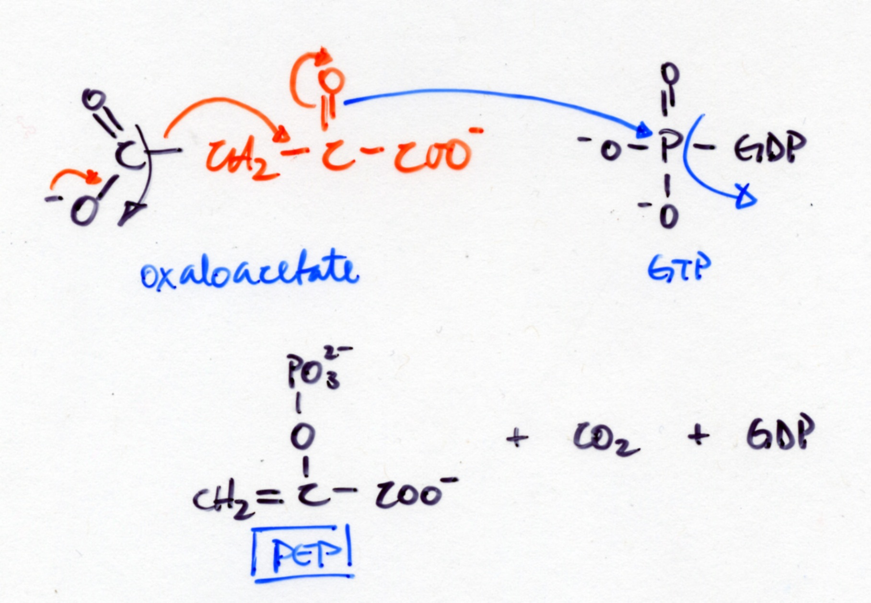
3. Decarboxylation of Oxaloacetate followed by phosphorylation yields PEP

Slide 11
4. Overall Reaction
Pyruvate + P_{i} PEP ∆G°= 14.8 kcal/mol
ATP ADP + P_{i} ∆G°= -7.3
GTP GDP + P_{i} ∆G°= -7.3
+0.2 kcal/mol

Slide 12
High NADH favors Gluconeogenesis

Slide 13
B. Circumventing PFK – dephosphorylation of F1,6BP by F1,6BPase
ATP
ADP
PFK
P
O
C
H
C
H
OH
P
O
C
H
2
O
2
2
O
C
H
O
P
2
H
H
O
H
H
O
H
H
OH
OH
O
H
H
O
H
H
F6P
F1,6BP
F1,6BPase
PO₄³⁻
H₂O

Slide 14
PFK reverse reaction:
F1,6 BP + ADP F6P + ATP ∆G° = +3.4 kcal/mol
Phosphoryl grp is transferred to ADP (to form ATP)
Dephosphorylation:
F1,6 BP + H₂O F6P + PO₄ ∆G° = -3.9 kcal/mol
Phosphoryl grp is transferred to H₂O (to form PO₄³⁻ )

Slide 15
C. Circumventing Hexokinase – dephosphorylation of G6P
Mediated by G6Pase
G6Pase is present only in liver and kidney
Hence, these are the only tissues that can synthesize and secrete glucose into the blood

Slide 16
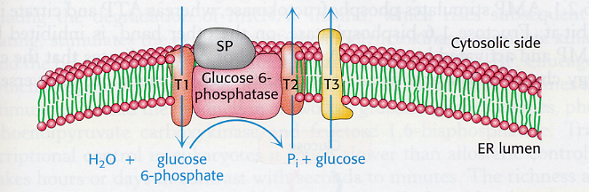
Glucose-6-phosphatase activity relies on multiple components.

Slide 17
A Defect in G6Pase Activity can be due to:
Defect in G6Pase itself
Defect in T1 transporter
Can Be distinguished by biochemical analysis:
Liver extracts treated by freeze-thawing results in release of ER proteins.
G6Pase Activity
Before F/T
After F/T
– –
– +
Defect in G6Pase
Defect in T1

Slide 18
Stoichiometry of Gluconeogenesis
2 Pyruvate
2 ATP – Carboxylation of Pyruvate
2 GTP – Synth. of PEP from oxaloacetate
2 ATP – P’n of 3-PG to form 1,3 BPG
2 NADH – reduction 1,3 BPG to Gly-3P
2 PO₄³⁻ - are generated
Glycolysis generates 2 ATP
Gluconeogenesis uses 6 ATP/GTP
Diff. of 4 ATP’s
4 ATP → ADP + P_{i} ∆G = - 48 kcal/mol
2 Pyruvate → 1 Glucose ∆G = +42
- 6 kcal/mol

Slide 19
Regulation of Gluconeogenesis
Energy charge
Levels of biosynthetic precursors
Hormonal Control
1. Allosteric Regulation
Glucagon
+
+
PFK
F2,6 BP
F1,6BPase
SO: Blood Glucose → glucagon → - Glycolysis
+ Gluconeogenesis

Slide 20
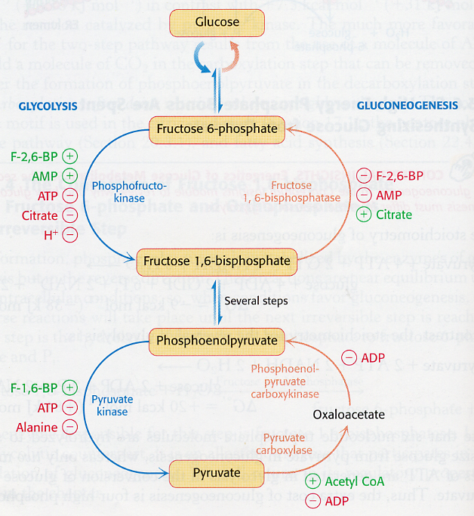

Slide 21
2. Transcriptional Regulation
Allosteric Control – achieved in seconds to minutes.
Transcriptional Control – hours to days.
mRNA levels of PFK PK PFK2/FBPase
PEP CK F1,6BPase
Glucagon
( Blood Glucose)
+
Insulin
( Blood Gluc.)
+
Thus Insulin promotes synthesis of glycolytic enzymes
Glucagon inhibits synthesis of glycolytic enzymes, and promotes snythesis of gluconeogenic enzymes.

Slide 22
The Gluconeogenic Response is Activated Largely by the State of Feeding/Fasting
Glycogen
Blood Glucose
Blood Glucose
Glucose
Blood Glucose
Pyruvate
Alanine
Acetyl CoA
FA’s

Slide 23
"Transamination"
C
H
α-Ketoglutarate
C
H
3
3
N
H
O
2
C
O
O
glutamate
C
O
O
Alanine
Pyruvate
*** The main substrate for gluconeogenesis in the fasting/starvation state is ALANINE***

Slide 24
Gluconeogenesis & Glycolysis can Occur at the Same Time in Different Organs
IN LIVER
IN MUSCLE
Glucose
Glucose
B L OO D
Gluconeo.
Glycolysis
Pyruvate
Pyruvate
Lactate
Lactate
*** The main substrate during exercise is LACTATE***

Slide 25
Main producers of lactate:
Fast twitch muscle
Red blood cells
Main consumers of lactate:
Liver: gluconeogenesis
Heart: oxidation as fuel
Slow twitch muscle: oxidation as fuel

