Slide 1
Reaction steps for conversion of
Substrate to Product
K_{m}
k_{cat}
Substrate
Binding
Chemical
conversion
Product
Release

Slide 2
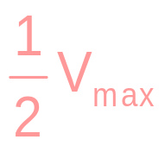
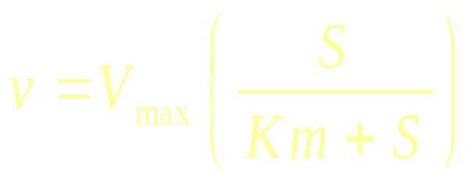
V_{max}
v
[S]
K_{m}

Slide 3
⎛
S
⎞
At any S:
v
=
V
⎜
⎟
max
⎝
Km
+
S
⎠
If S << Km:
V
v
=
max
S
Km
If S = Km:
V
v
=
max
2
If S >> Km:
v
=
V
max

Slide 4
v = ES x k_{cat}
V_{max}= E_{tot} x k_{cat}
If E_{tot} = 10 uM
V_{max} = 20 uM sec⁻¹
Then:
k_{cat} = 2 sec⁻¹

Slide 5
V_{max}
v
10 20 30
[S] uM

Slide 6
Regulation of Metabolic Enzymes
Common Themes:
1. Allosteric Control
-The binding of small molecules to a
site distinct from the active site.
+
A
B
C
D
E

Slide 7
2. Covalent Modification
-Reversible Phosphorylation – the most common mechanism.
P
ATP
+
ADP
Protein Kinase
Inactive
Active

Slide 8
3. Gene Regulation
(Enzyme Synthesis/Degradation)
4. Availability of Substrate

Slide 9
Allosteric
Modification
Covalent
Modification
E
⋅
kcat
⋅
S
v
=
Km
+
S
Substrate
Availability
Enzyme
Synthesis

Slide 10
High Energy Phosphoryl Compounds

Slide 11
High Energy Phosphoryl Compounds
Catabolism of Food Molecules Serves 2 Purposes:
Generation of precursors for synthesis of macromolecules.
2. Generation of free energy for energy-requiring processes.
Free energy is required for:
1. Mechanical work (muscle contraction)
2. Active Transport of molecules and ions.
3. Synthesis of macromolecules.

Slide 12

High Energy Phosphoryl Compounds
The free energy for these processes is ultimately supplied by ATP
Triphosphate
N
H
2
O
N
N
O
O
Adenine Base
O
P
O
P
O
P
O
C
H
N
N
2
O
O
O
O
HOH
Ribose
O
H
O
H
ATP ADP + Pi ∆G° = -7.3 kcal/mol

Slide 13
High Energy Phosphoryl Compounds
The free energy for these processes is ultimately supplied by ATP
Triphosphate
N
H
2
O
N
N
O
O
Adenine Base
O
P
O
P
O
P
O
C
H
N
N
2
O
O
O
O
HOH
Ribose
O
H
O
H
ATP ADP + Pi ∆G° = -7.3 kcal/mol
ATP AMP + PPi ∆G° = -7.3 kcal/mol

Slide 14
Chemical Basis for the large ∆G° associated with ATP hydrolysis
Aden
•
•
•
Aden
•
•
•
O
O
O
O
O
O
-
-
-
-
O
P
O
P
O
P
O
•
P
O
•
+
•
O
P
O
•
O
P
O
-
-
-
-
-
-
O
O
O
O
O
O
•
•
•
•
•
•
ADP is strongly electron withdrawing, which makes the γ-PO4 a better electrophile.
Greater Resonance Stability of the P’s in ADP + Pi versus ATP
Electrostatic Repulsion

Slide 15
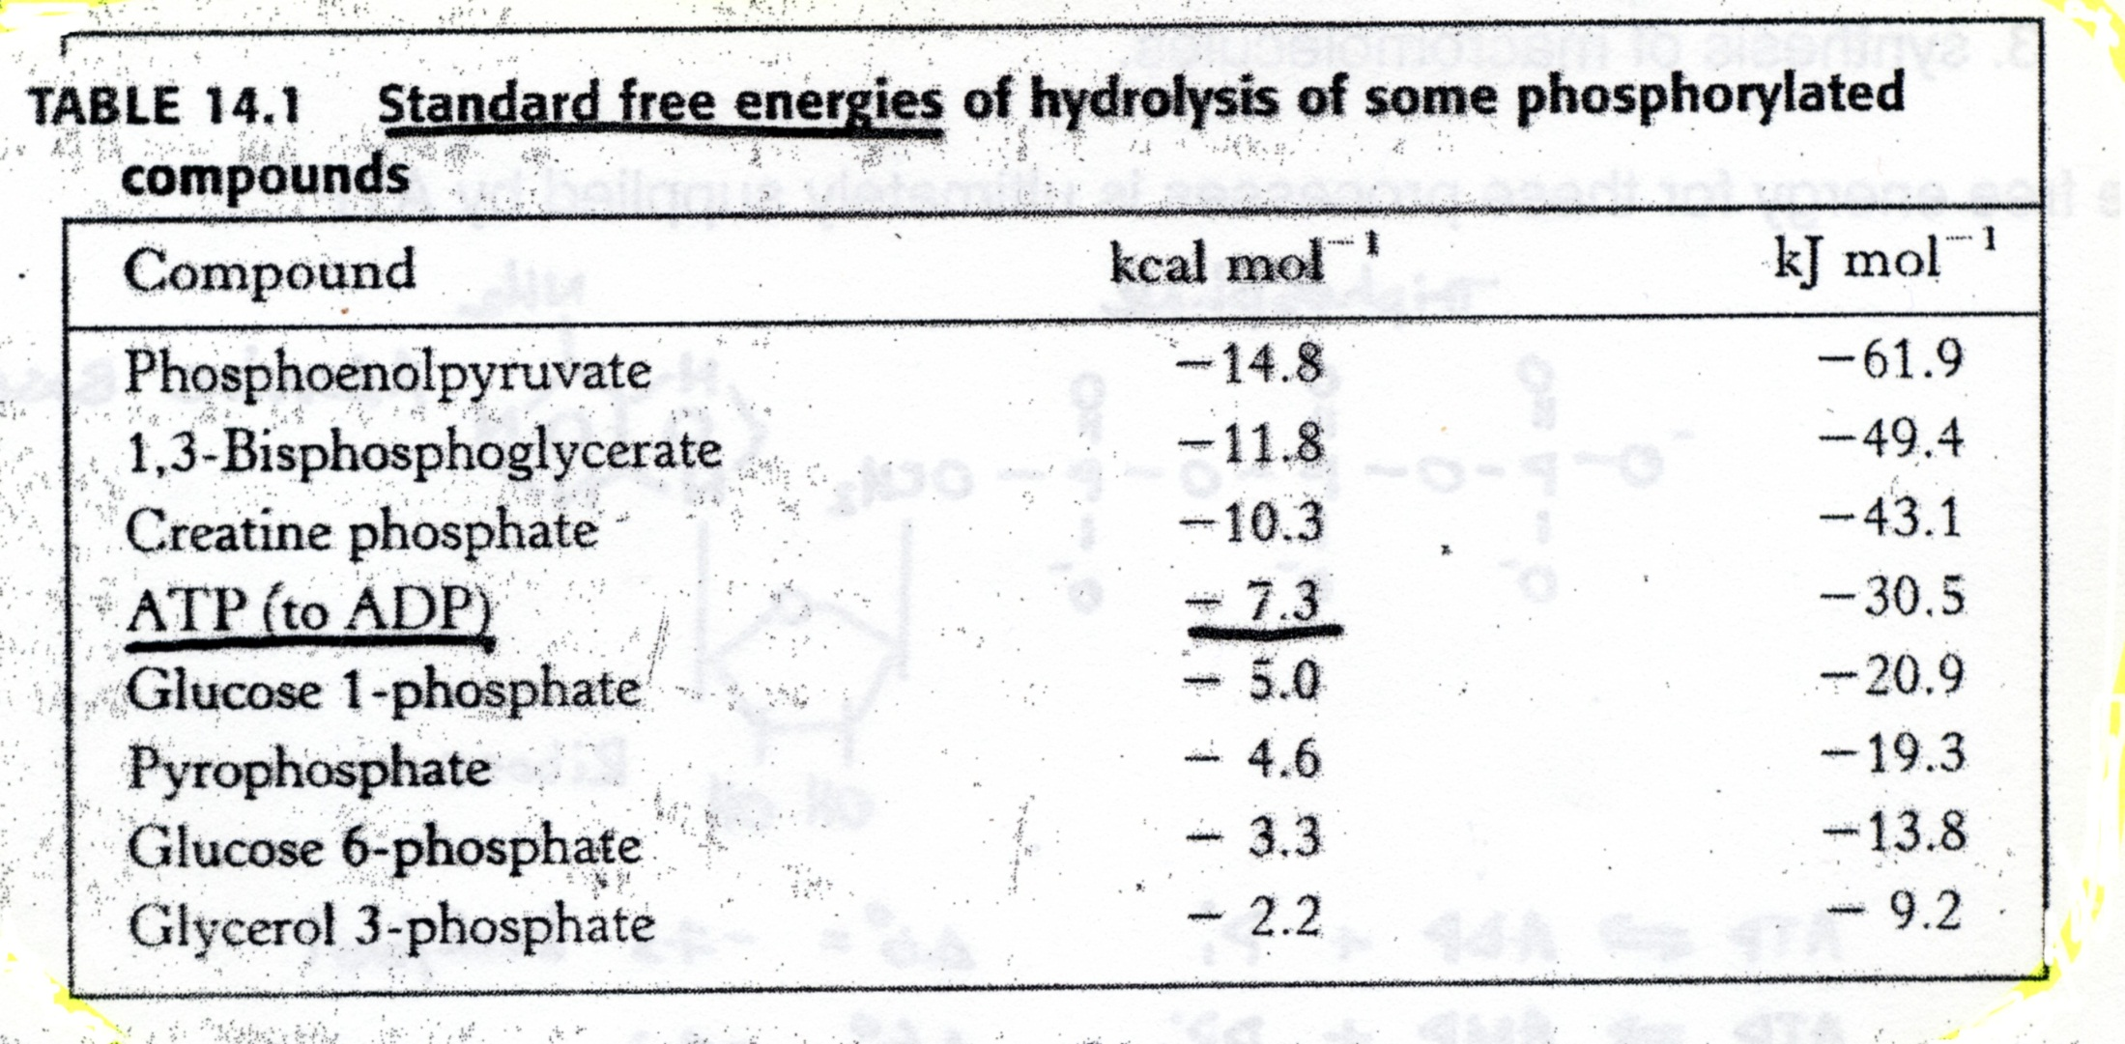

Slide 16





Coupled Reactions
Highly favorable reactions can drive moderately unfavorable reactions
=
+ 5 kcal/mol
A B + C ∆G° A→B+C
∆G° C→D
=
D
-8 kcal/mol
A B + D
∆G° A→B+C
=
-3 kcal/mol
A B + C is “coupled” to C D

Slide 17


PHYSICAL coupling.
ATP ADP + Pi may be coupled to
a) a conformational change which results in mechanical work. eg. ATP hydrolysis by myosin results in movement of the myosin head along actin.
ATP
ADP + Pi

Slide 18
b) Active transport of ions against a chemical gradient. eg. Ca²⁺ pump driven by ATP hydrolysis.
Ca²⁺
Ca²⁺
Ca²⁺
Ca²⁺
ADP + P_{i}
ATP
Ca²⁺

Slide 19
2. CHEMICAL coupling.
∆G° kcal/mol
a) Glucose + P_{i} Glucose-6-P +H₂O +3.3
ATP + H₂O ADP + P_{i} -7.3
ATP + Glucose Glucose-6-P + ADP -4.0
b) ADP + Pi ATP + H₂O +7.3
Creatine-P + H₂O Creatine + Pi -10.3
Creatine-P +ADP Creatine + ATP -3.0

