Slide 1
Carbohydrates

Slide 2
**You are responsible for reading on your own:**
7.1 Monosaccharides and Disaccharides - p235-6*.
The two families of monosaccharides are aldoses and ketoses – p236*.
Monosaccharides have asymmetric centers – p236-8*.
*Lehninger 5th ed.

Slide 3
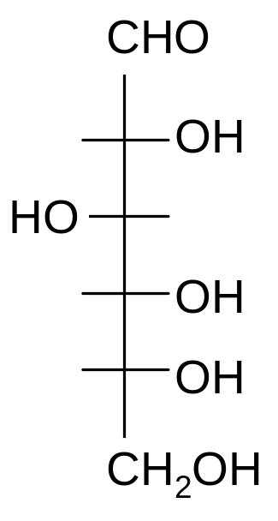
Glucose
4 chiral centers, therefore 2⁴ = 16 stereoisomers:
8 D, 8 L
D-Glucose

Slide 4
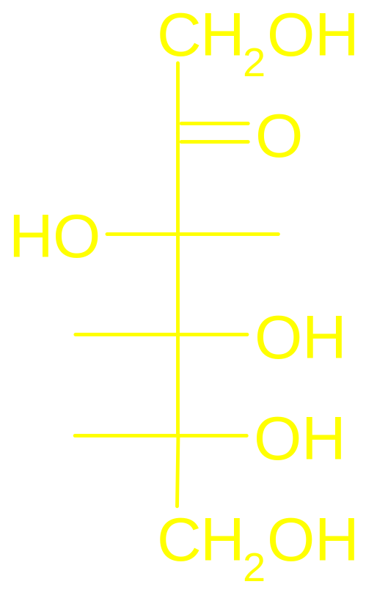
Fructose
The most important Ketose.
Occurs Widely in Fruits
A component of table sugar (sucrose), (sweeter than glucose).
6 C sugar (2-ketohexose)
3 Chiral centers, therefore only 8 stereoisomers
1
2
3
4
5
6
D-Fructose

Slide 5
Cyclization
Historically, two crystals forms of D-glucose could be demonstrated:
One with mp = 146°
One with mp = 150°
When A was dissolved in water, specific rotation of plane polarized light gradually changed from +112° to +52.7°.
When B was dissolved, the specific rotation changed from +19° to +52.7°.

Slide 6
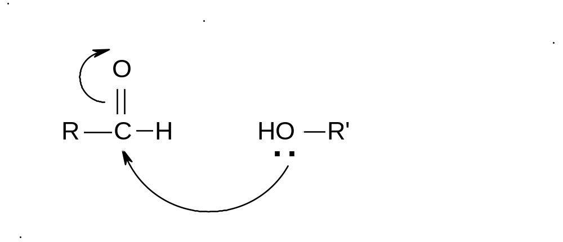
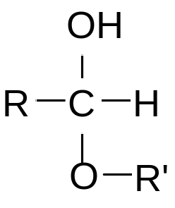

Explanation:
aldehyde
alcohol
hemiacetal

Slide 7
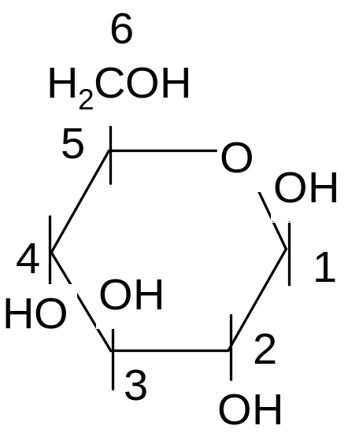

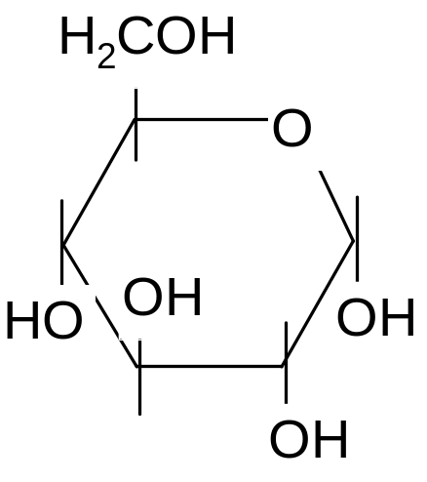
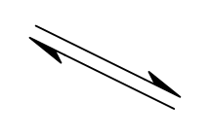
•
•
β
•
D-glucose
α
See Figs 7-5, 7-6 Lehninger

Slide 8
β and α stereoisomers are called anomers
β, α, and open chain are in equilibrium:
68% β, 32% α, <1% open chain.
Optical rotation of plane polarized light by:
β-D-Glucose = +19° mp 150 °
α-D-Glucose = +112 ° mp 146 °
Equilibrium mix = +52.7 °
Interconversion of α and β is called “Mutarotation.”

Slide 9
The aldehyde or ketone function of the open chain form of monosaccharides can reduce Tollen’s (Ag[NH₃⁺]) or Fehlings reagent (Cu II). See Fig. 7-10 Lehninger.
This is a test for the open chain form

Slide 10
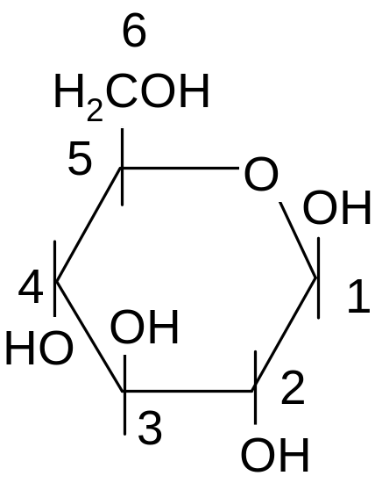
Stereochemistry
•
•
β
•
D-glucose
α

Slide 11
Designation of cyclic stereoisomers
Standard orientation is the Haworth projection.
-ring O at top, anomeric C on R hand side.
If C6 is above the ring plane, then isomer is D; if below, then isomer is L
If anomeric OH is on the same side as C6, then OH group is β; if on opposite side then OH is α.

Slide 12
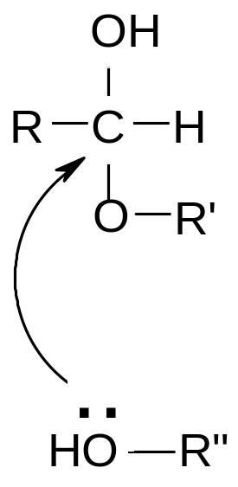
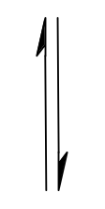
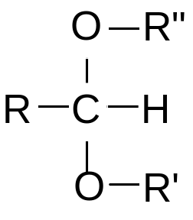
hemiacetal
aldehyde
full acetal

Slide 13
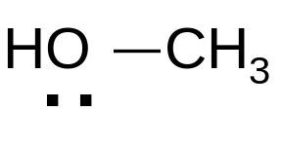
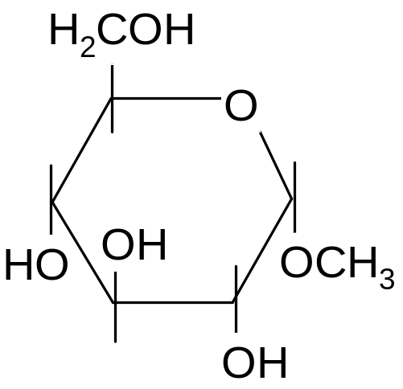
Glycoside (full acetal) formation

Slide 14
The glycosidic bond does not undergo mutarotation.
Conversion to a full acetal locks the sugar in ring form.
Thus, the open chain form does not exist in solution, and such sugars are non-reducing.

Slide 15
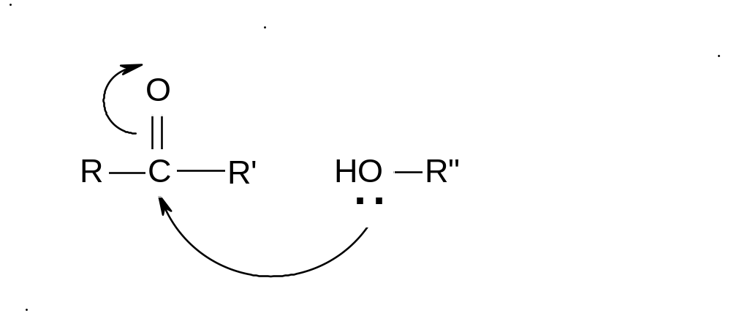
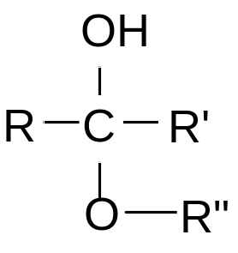
aldehyde
alcohol
hemiacetal
ketone
alcohol
hemiketal

Slide 16
For homework:
Show the mechanism for cyclization of D- fructose.
What are the products?
Show the mechanism for reaction of β-D-fructose with CH₃OH.
What are the products?
See Handout: Cyclization of Fructose.

Slide 17
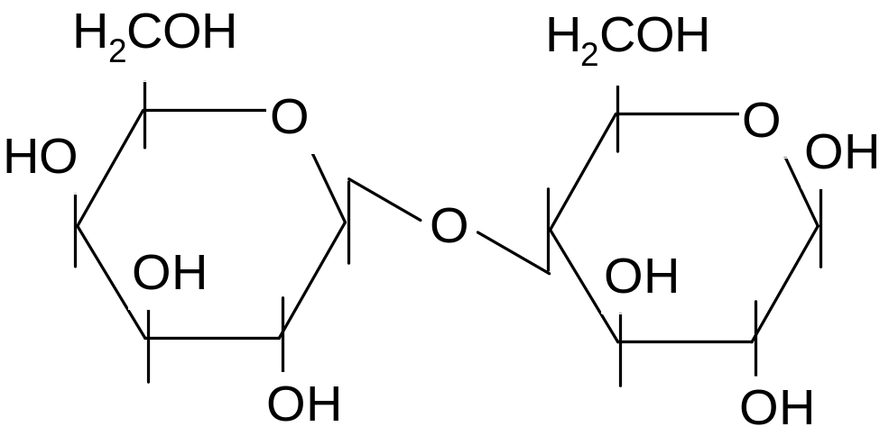
Disaccharides
6
6
5
5
4
1
4
1
3
2
3
2
β-D-galactopyranosyl
(β1-4)
β-D-glucopyranoside

Slide 18
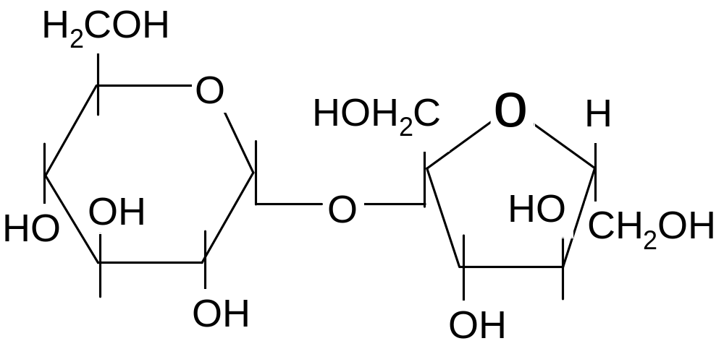
6
5
1
4
1
5
2
2
6
3
3
4
α-D-glucopyranosyl β-D-fructofuranoside
(α1-β2)

Slide 19
Sucrose is non-reducing because the glycosidic bond involves the anomeric carbon from both glucose and fructose.
Relative Sweetness of Sugars
Sucrose 100
Fructose 170
Glucose 50
Sorbitol 50
Lactose 20

Slide 20
Polysaccharides
Glycogen, starch, cellulose - all are repeating units of D-glucose
Glycogen
-The storage form of glucose in animal cells.
-Main chain linkage between glucosyl units is (α1,4)
-Branch point every ~10 residues

Slide 21
Starch
The equivalent of glycogen in plants
Two Forms:
-Amylose – Unbranched, (α1,4) linkages of glucose
-Amylopectin – Structurally equivalent to glycogen, but lower degree of branching. (branch pt ~ every 30 units).

Slide 22
Cellulose
• (β1,4) linkages of glucose as opposed to (α1,4)
• plays a structural, rather than nutritional, role in plants
• (β1,4) linkage leads to formation of straight polymer chains – ideal for forming structural fibers of high tensile strength.
• cf. (α1,4) linkage which leads to formation of hollow helix
• Mammals lack (β1,4) cellulases, therefore cellulose cannot be digested by mammals.

