Slide 1
Transport of Carbohydrates
Digestion
Starch is the major form of digestible CHO for humans.
α-amylase (salivary & pancreatic) hydrolyses internal (α1,4) linkages of amylose & amylopectin to yield maltose, maltotriose, α-dextrin
- Maltotriose is 3 glucose residues in (α1,4) linkage
-α-dextrin is several glucose residues linked in both (α1,4) & (α1,6) (branch point) linkage
Maltase cleaves maltose & maltotriose to A-D-glucose
α-dextrinase cleaves α-dextrin to α-D-glucose
So: complex CHO’s are cleaved to D-glucose in the intestine prior to absorption into the blood.
Notes:
1

Slide 2
2. Absorption of Glucose
Glucose is absorbed into intestinal epithelial cells against a concentration gradient thru a Na⁺ / glucose symporter
The transport of glucose (thermodynamically unfavorable) is coupled to the flow of Na⁺ from high con. (extracellular) to low conc. (intracellular) which is favorable.
The concentration gradient of Na⁺ is maintained by constantly pumping Na⁺ out of the cell by an ATP – driven Na⁺ pump.
Na⁺ + Glucose
Glut 5
Symport
Glucose
Na⁺
ATP
ADP
Na-K ATPase
Na+
Notes:
2

Slide 3
For example:
ΔG
Gluc_{out} Gluc_{in} +3 kcal/mol
Na_{out} Na_{in} - 5
__________________________________________
Gluc_{out} + Na_{out} Gluc_{in} + Na_{in} -2 kcal/mol
Notes:
3

Slide 4
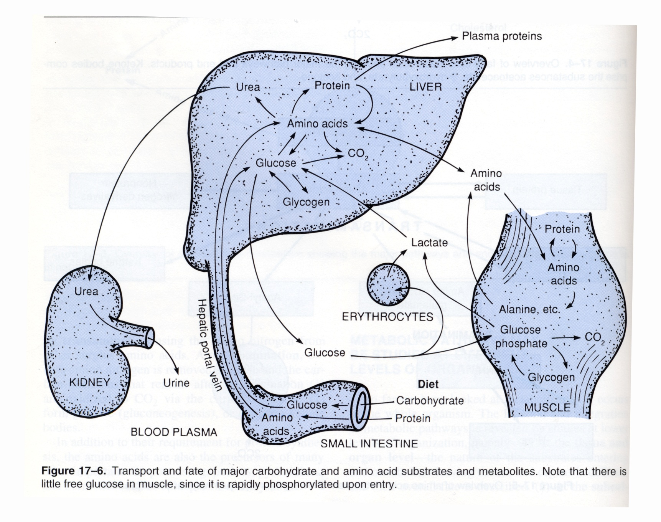
Notes:
4

Slide 5
3. Transport of Glucose to Liver and Tissues
Glucose flows down a concentration gradient out of the epithelial cell into the blood by facilitated diffusion, thru the GLUT5 transporter.
Glucose → Small intestine → Hepatic Portal Vein → Liver → Target Cells
Liver is a glucose buffer because it contains the high K_{m} GLUT2 transporter (K_{m} = 15-20 mM)
Target Cells take up glucose from the blood via the low K_{m} GLUT1 & 3 transporters (K_{m} = 1mM)
Notes:
5

Slide 6
Kinetics of Glucose Transport
GLUT 1,3
(peripheral tissues)
V_{max}
v
GLUT 2
(liver)
1 10 20 30
[blood glucose] mM
Notes:
6

Slide 7
Glucose is taken up by liver for storage only if blood glucose levels are high.
If blood glucose is low, peripheral tissues get first “dibs” on glucose.

Slide 8
Overview of Energy Metabolism
FATS POLYSACCHARIDES PROTEINS
Digestion
Fatty Acids and Glucose and Amino Acids
Glycerol other sugars
Anaerobic
Acetyl CoA
Aerobic
CO₂ + H₂O

Slide 9
Energy Production from Glucose Oxidation
Biological Oxidation
The oxidation of CHO’s and fatty acids by molecular O₂ is highly exergonic.
C₆H₁₂O₆ + 6O₂ 6CO₂ + 6H₂O ∆G° = -686 kcal/mol
Nature chose O₂ because it is highly electronegative compared to C and H, which directly contributes to the large neg. ∆G°.
Energy released from biologic oxidation is used to drive the synthesis of ATP

Slide 10
Initial cleavage of glucose into 3-C units:
GLYCOLYSIS
HC
O
OH
CHO
CH
3
HO
2
2
O
OH
OH
CH
O
P
COOH
OH
2
CH
OH
2
Glucose
G3P
Pyruvate

Slide 11
Proteins are conserved
The same 20 amino acids are always used, which are sufficient for life.
There are 20³⁰⁰ (~10³⁹⁰) possible different proteins (more than the mass of the universe!)
only 100,000 proteins used in humans

Slide 12
Small molecules are also conserved in biology
Most small molecules in biology seem to be <500 Da
>10⁶⁰ in chemical space!
simplest organisms use 100; humans a few thousand
Selection??:
- atoms (C,H,O,N and others) were abundant on earth
- solubility: carboxylic acids, organic amines, phosphate are predominant

Slide 13
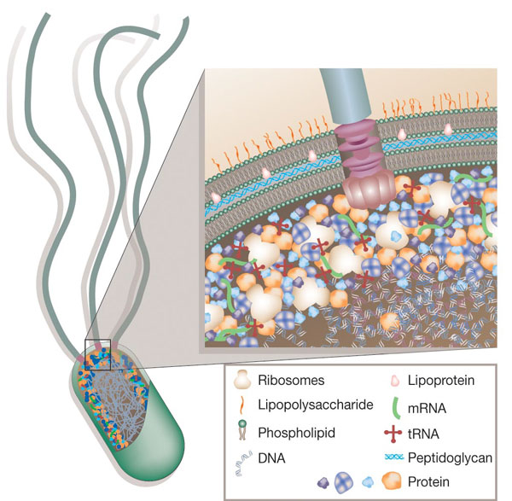
How crowded is it inside a cell?
70% water
30% macromolecules (300 mg/ml !!)

