Slide 1
Life elsewhere in the solar system
Aaron Miller
Writ 109ST
University of California, Santa Barbara

Slide 2
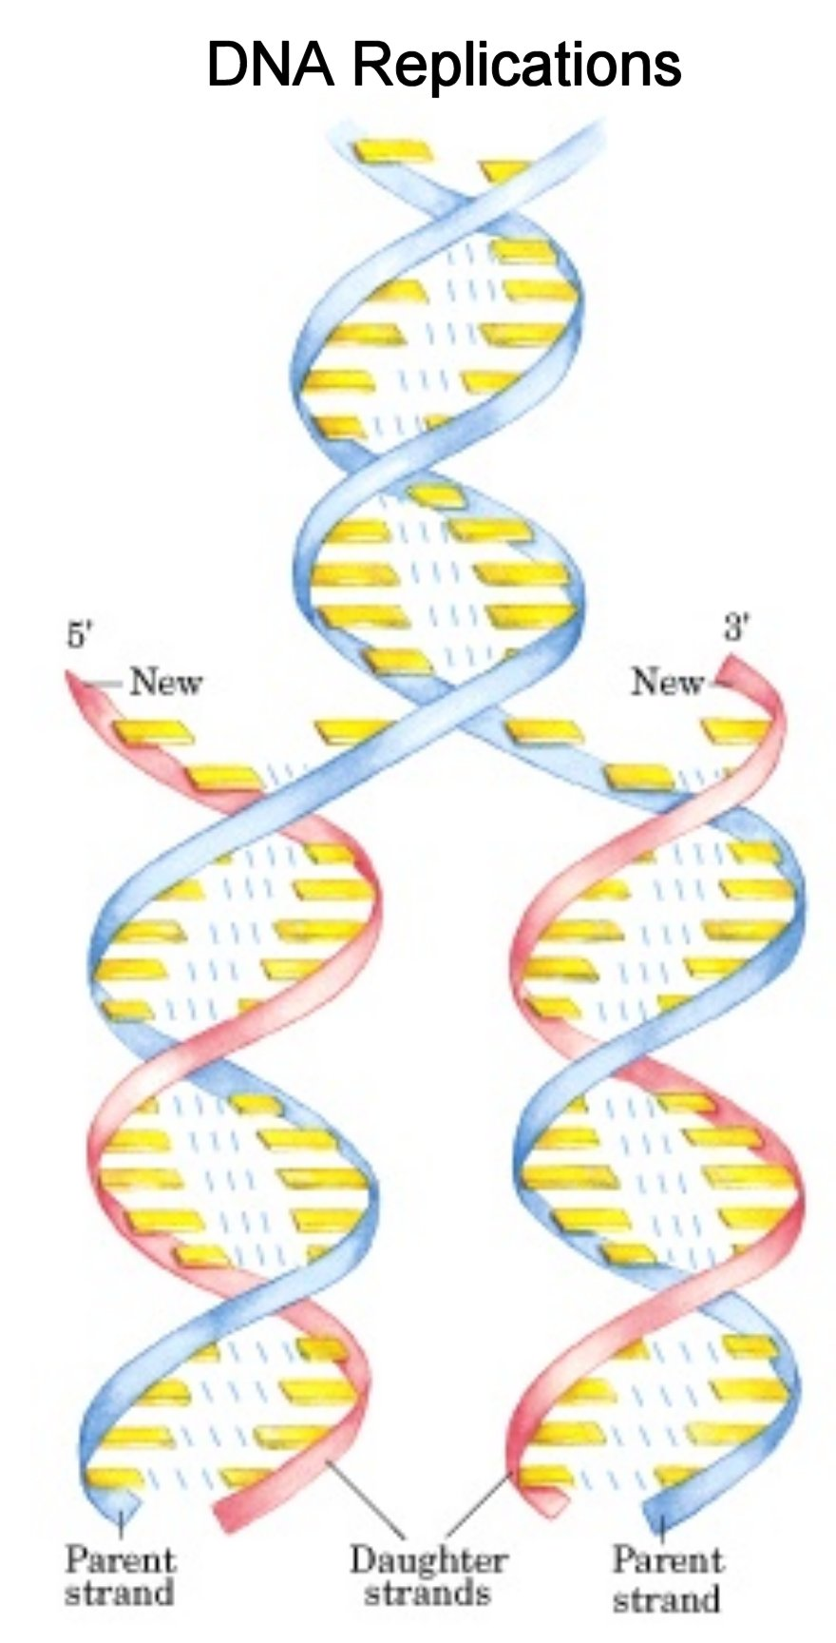
Fundamental characteristics of life
Replication
The cell contains blueprints (almost certainly a copolymer; DNA in the case of Earth life)
All components of the cell except the blueprints themselves are produced by interpreting the blueprint’s instructions (in the case of Earth life, this process is protein translation; many other processes are possible)
During replication, the blueprints are copied
Metabolism
Source: biochem.co

Slide 3
Fundamental characteristics of life
Replication
Metabolism
Without some source of energy (the Sun, or chemical energy from an undersea vent), all chemical systems eventually reach equilibrium—no further change will occur
Life requires an energy source to make the amounts of different chemicals out of equilibrium with respect to each other; they “want” to get back to equilibrium
Living things harness this “desire,” using it to make useful but complex molecules that would not appear spontaneously

Slide 4
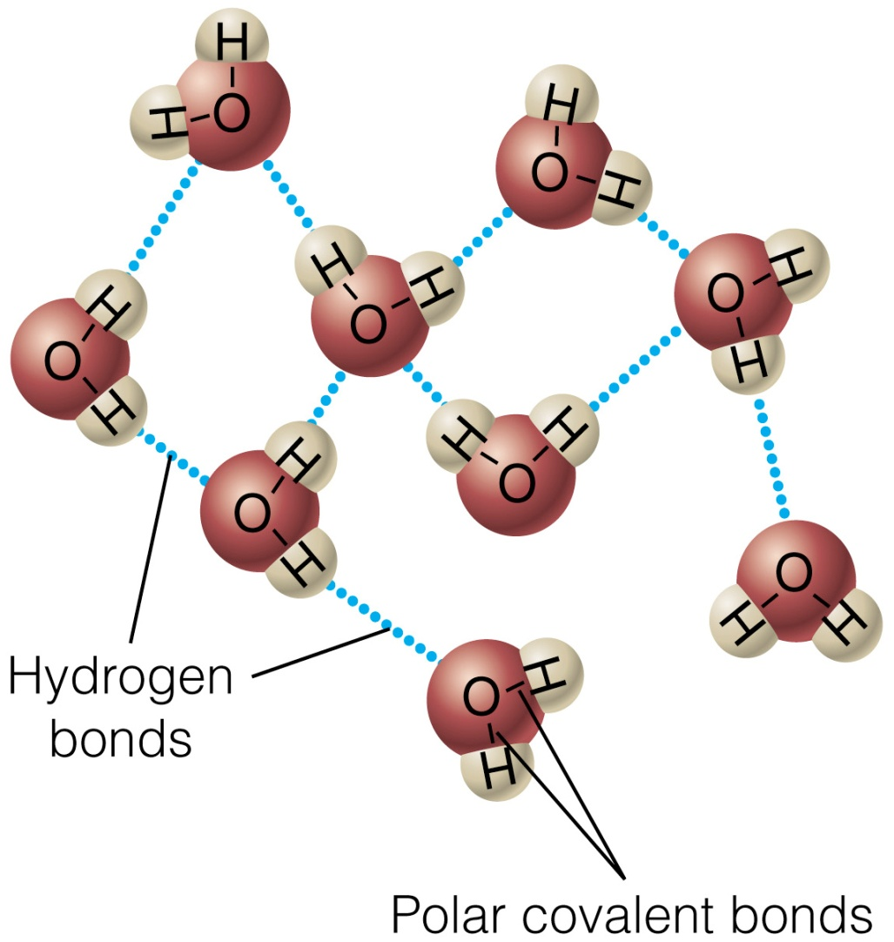
Water
All known life on Earth uses water as a solvent for its biochemistry
Unique properties
Very large liquid range: 100 degrees Celsius
Large dielectric constant
Solid phase less dense than liquid phase
Most of these properties are due to hydrogen bonding
Very abundant in Universe
Source: Israel Inst. Of Tech.

Slide 5
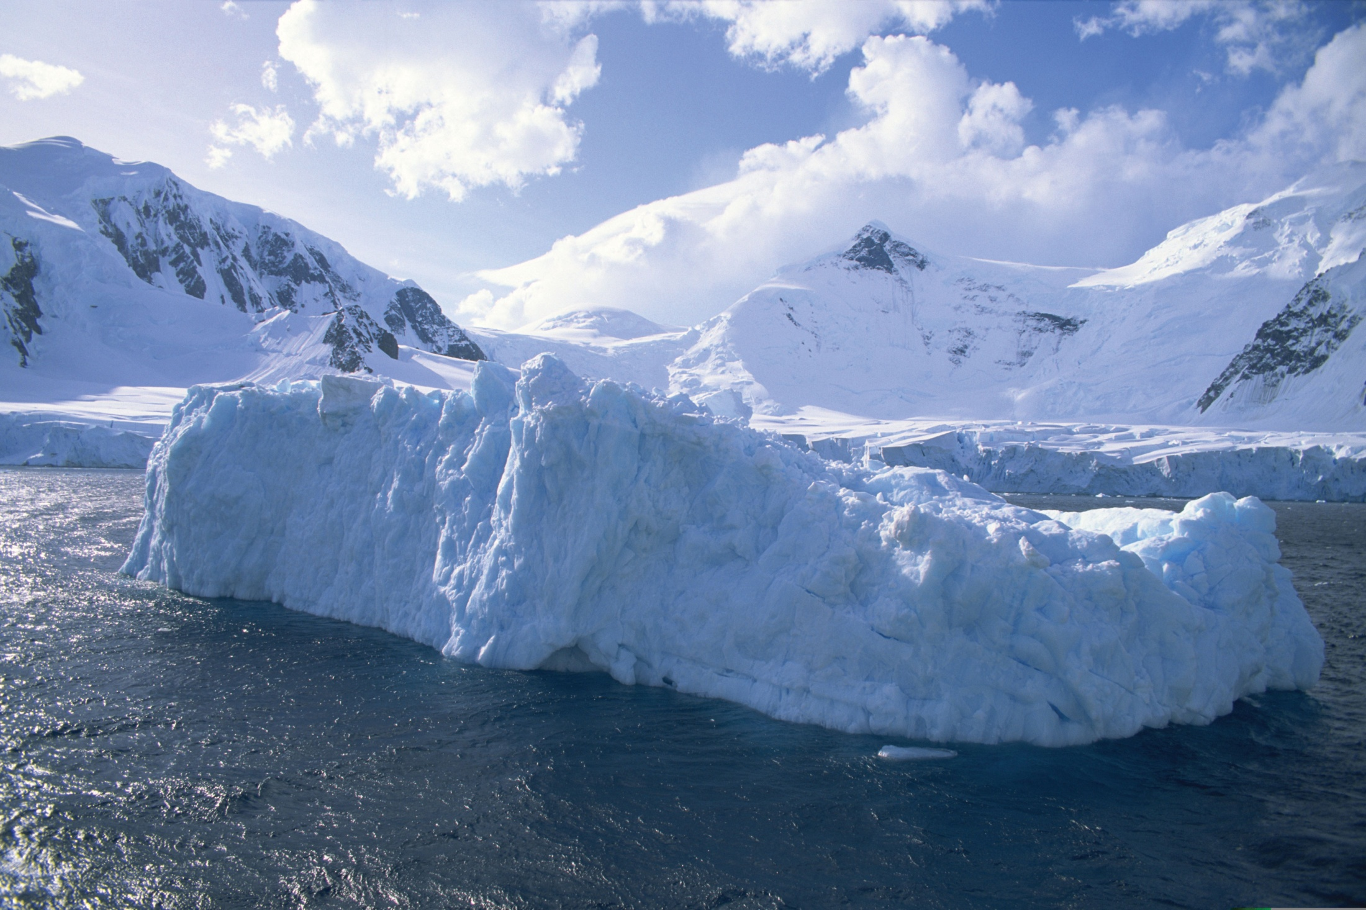
Water
It is a good assumption that extraterrestrial life also uses water as a solvent!

Slide 6
Idea: to find life, look for (liquid) water
Venus?
No, sorry!
Small amounts in gas phase; no liquid
Billions of years ago: had much more water than Earth
Mars
~3.8 bya: on the surface, like Earth at present
Present: probably several km underground
Europa (and Ganymede, and Callisto?)
Huge oceans beneath the ice are highly likely
Titan
Possibly water-ammonia oceans beneath the ice
Liquid methane above the ice (non-water biochemistry?)
Enceladus
Lakes or oceans—water geyser eruptions have been observed

Slide 7
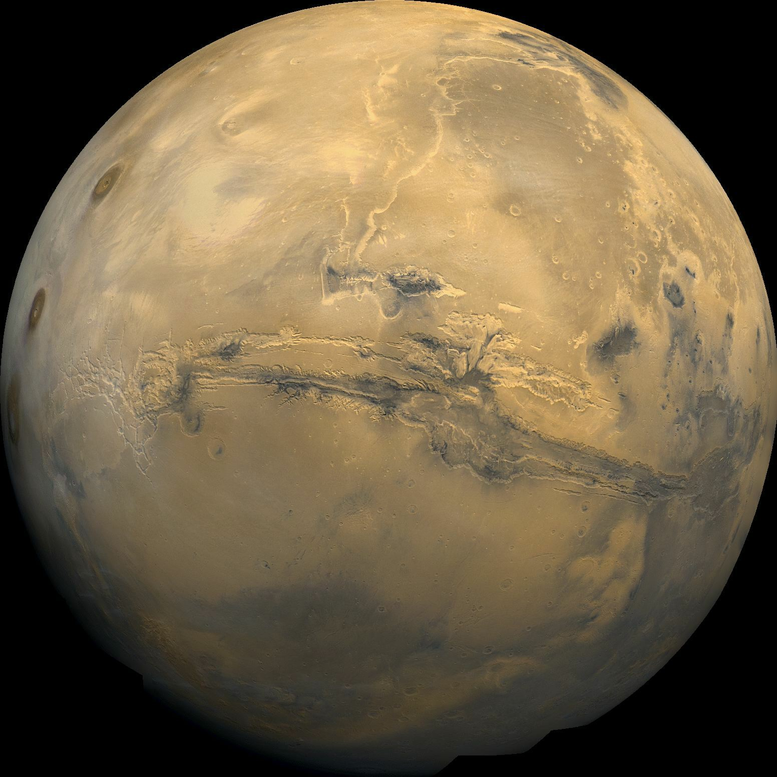
Mars
Cold!
Highs of 10 °C, lows of -80 °C at mid-latitudes
Enormous temperature variation between night and day: ~100 °C
Thin atmosphere
Less than 1% of Earth sea level pressure
Water not stable as a liquid: ice sublimes to a gas instead of melting as temperature rises
Radiation
Damages genetic material
Few Earthly life-forms could survive it
Source: NASA

Slide 8
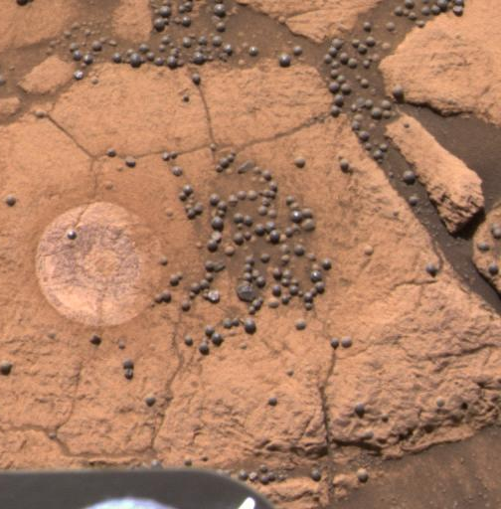
Water on Mars
Surface: frozen, except possibly for very short time periods of liquid water (minutes to hours)
Enormous amounts at polar caps
Under the soil in many places
Underground: probably liquid!
Heat from the interior
Pressure
In the past, there was definitely liquid water on the surface
Hematite “blueberries”
Dry river beds
Source: JPL/NASA/Cornell University

Slide 9
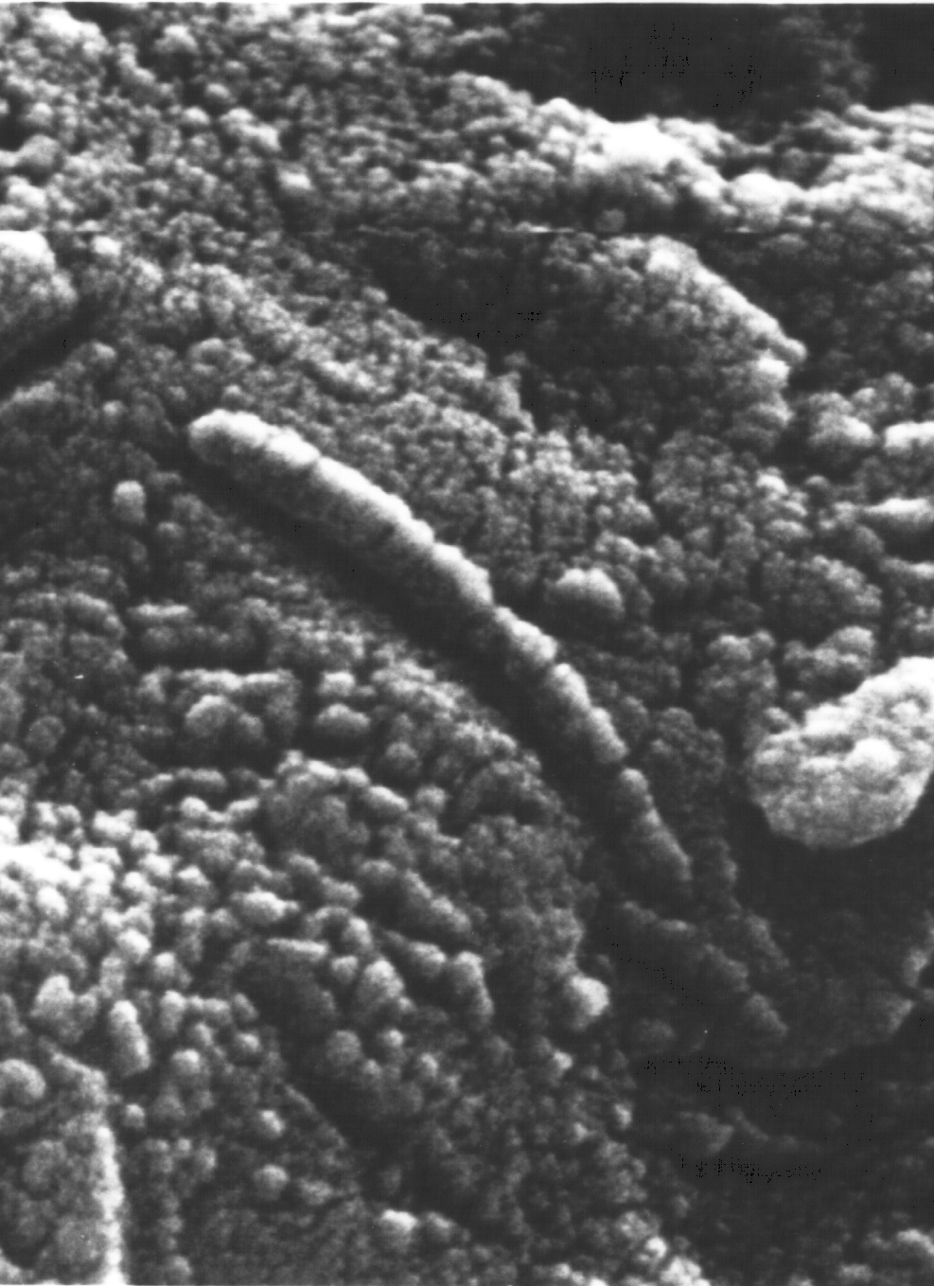
Life on Mars
ALH84001
Mars meteorite found in Antarctica
In 1996, “fossils” of nanobacteria found
Formed when Mars was wet
Contamination from Earth ruled out
Magnetite crystals of apparently biological origin
Results disputed
formed without biology?
Diameter only about 100nm – too small?
Source: NASA

Slide 10
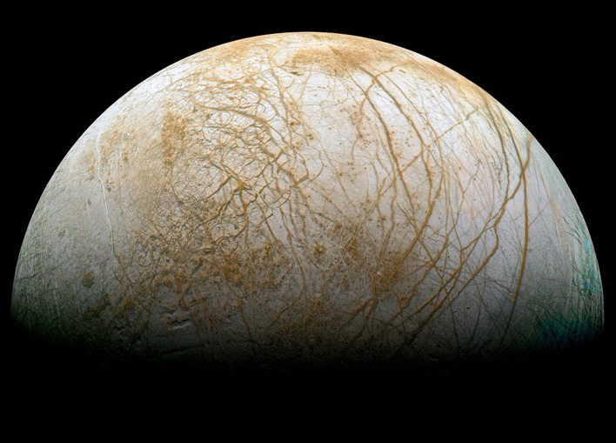
Europa
4th largest moon of Jupiter
Only Ganymede, Callisto, and Io are larger
Tidally locked: same side always faces Jupiter
Surface is mostly water ice
Extremely cold surface: -170 °C
Surface radiation lethal to a human in about one day
Source: NASA/JPL/Ted Stryk

Slide 11

Europa’s warm interior
Earth’s interior is warm because of leftover heat from its formation (kinetic energy -> thermal energy) as well as radioactive decay
Small bodies like Europa would lose most of their heat by now (4.5 billion years after formation)
Europa still has enough warmth to have a sub-surface ocean…
WTF?

Slide 12
Tidal heating
Europa’s interior is constantly being squeezed and stretched by tidal effects from Jupiter and its other large moons
The resulting friction warms up the interior
Source: Matma Rex (Wikipedia user)

Slide 13
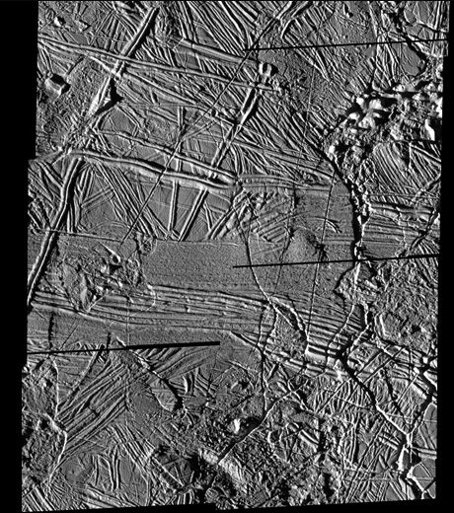
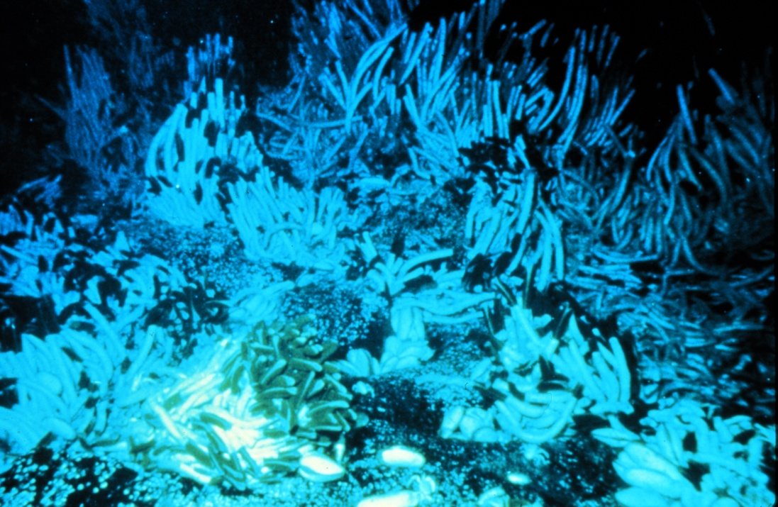
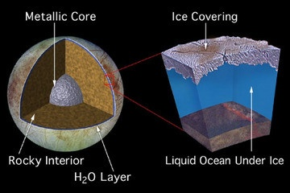
Life on Europa
If present, probably on bottom of ocean
May be similar to life found around hydrothermal vents on Earth
Ice probably about 10km thick
“meltprobes” have been proposed to melt through the ice and observe the ocean
At present, we know almost nothing!
Sources: NASA/NOAA

Slide 14
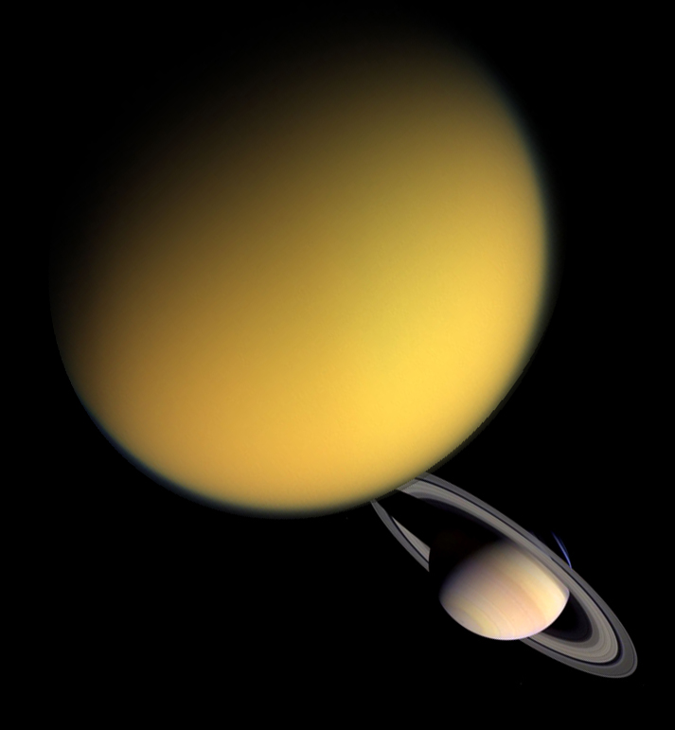
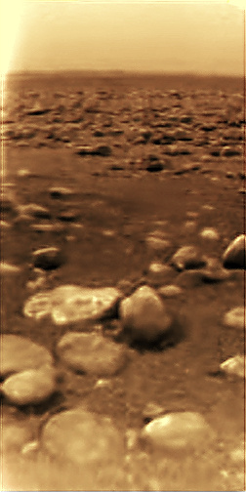
Titan
Largest moon of Saturn
Only moon in the Solar System with a dense atmosphere: about 50% more pressure than Earth at sea level
Extremely cold: -180 °C
Methane plays a similar role on the surface as water does on Earth: present as solid, liquid, and vapor
Lakes of methane (or other hydrocarbon) have been detected on the surface
Like Europa, also predicted to have a subsurface ocean
Ammonia-rich, unlike Europa’s ocean
Source: NASA

Slide 15

Sources
http://www.sciencebuzz.org/blog/blueberries_add_to_martian_water_evidence
http://mars.jpl.nasa.gov/programmissions/overview/
http://www2.jpl.nasa.gov/snc/alh.html
http://solarsystem.nasa.gov/europa/overview.cfm
http://saturn.jpl.nasa.gov/science/index.cfm?SciencePageID=75

