Slide 1
MCDB 108B
Energy Metabolism

Slide 2
Energy Requirements For Humans

Slide 3
1. Basal Metabolic Rate (BMR)
- Energy Required for basic physiological functions.
- Subject is at rest, awake, 12 hr postprandial, non-shivering.
- Proportional to lean body weight and surface area.

Slide 4
1. BMR
Males: ~ 1.0 kcal/kg body wt / hr
Females: ~ 0.9 kcal/kg body wt / hr
For a 70 kg male:
1 kcal/hr x 70 kg x 24 hrs = 1680 kcal/day

Slide 5
Tissue contributions to BMR
% body mass %BMR BMRrel
Liver 2 17 8.5
GI 2 10 5
Kidney 0.5 6 12
Lung 0.9 4 4.4
CNS 2 20 10
Heart 0.4 11 27.5
Muscle 42 25 0.6
Hochachka 2002, 27

Slide 6
Processes contributing to BMR
% total BMR
Protein turnover 23
Na+ pump 7.5
Ca+ pump 6
Hochachka 2002, 27

Slide 7
2. Physical Activity
Light work – walking, housework, golf
~ 2.5-5 kcal/min
Extremely Heavy Work – Marathon running & other intense exercise
    > 10 kcal/min
Avg. work per day for an avg. size, moderately active person
~ 500 kcal/day

Slide 8
3. Thermogenic Effect of Food
- aka “Specific Dynamic Action of Food”
- Energy required to digest food
- ~5-10% of total energy expenditure
= 10% x (1680 + 500 + TEF)
= ~250 kcal/day

Slide 9
Total caloric expenditure
= ~ 2500 kcal/day

Slide 10


2500 kcal!

Slide 11
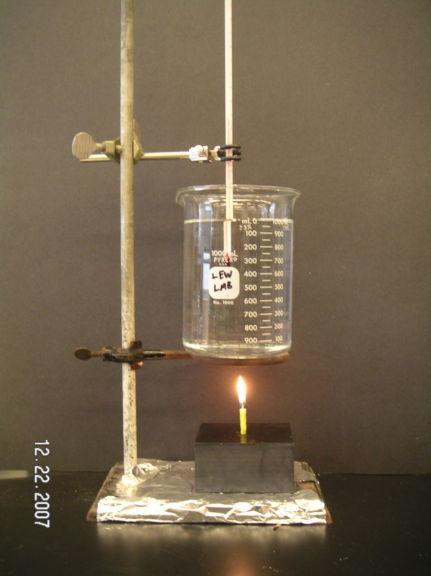
1 kcal raises the temperature of
1 kg water 1ºC.

Slide 12
Sources of Fuel
Carbohydrates 4.1 kcal/g
Fats 9.3
Protein 4.1
Alcohol (Ethanol) 7.1

Slide 13
Carbohydrates & Fats are, by far, the largest sources of fuel (under non-starving conditions).
Proteins are normally used for other purposes (structural, enzymatic functions) and cannot be stored.
1 lb of fat = ~4000 kcal
To burn off 300 kcal (1 donut, 1 candy bar, 1 serving of ice cream) requires moderate cycling (10 mph) for ~ 1hr.

Slide 14
Composition of Humans…?
What are little boys made of?
What are little boys made of?
Slugs and snails and puppy-dogs tails;
That’s what little boys are made of.
What are little girls made of?
What are little girls made of?
Sugar and spice and everything nice;
That’s what little girls are made of.

Slide 15
…true composition of humans:
Protein 17 %
Fat 13.8
Carbohydrate 1.5
Water 61.6
Minerals 6.1

