Slide 1
Oxidative Phosphorylation

Slide 2
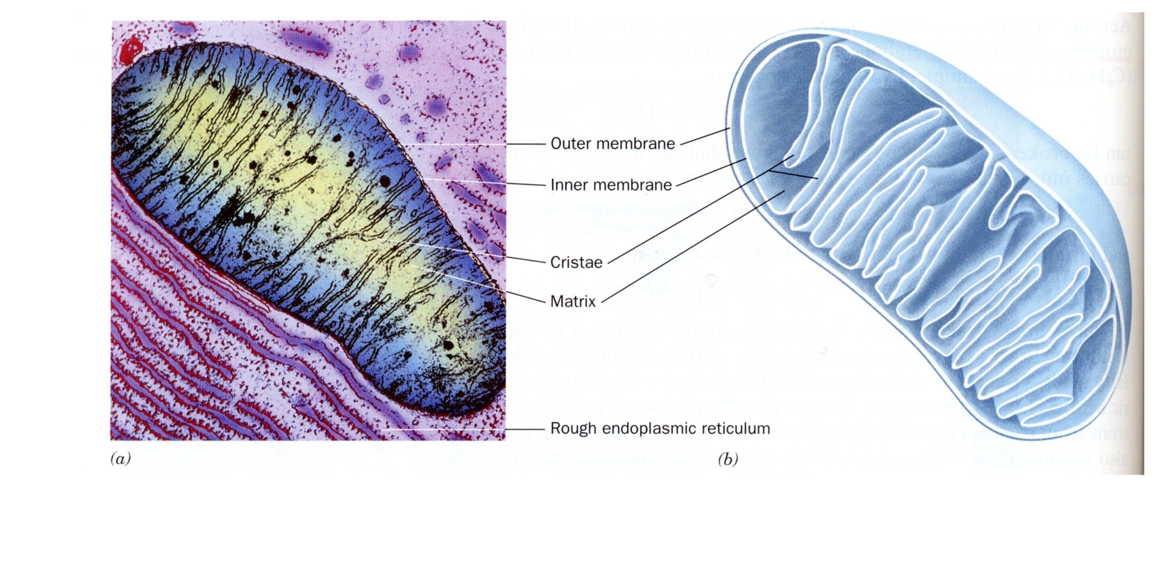

Slide 3
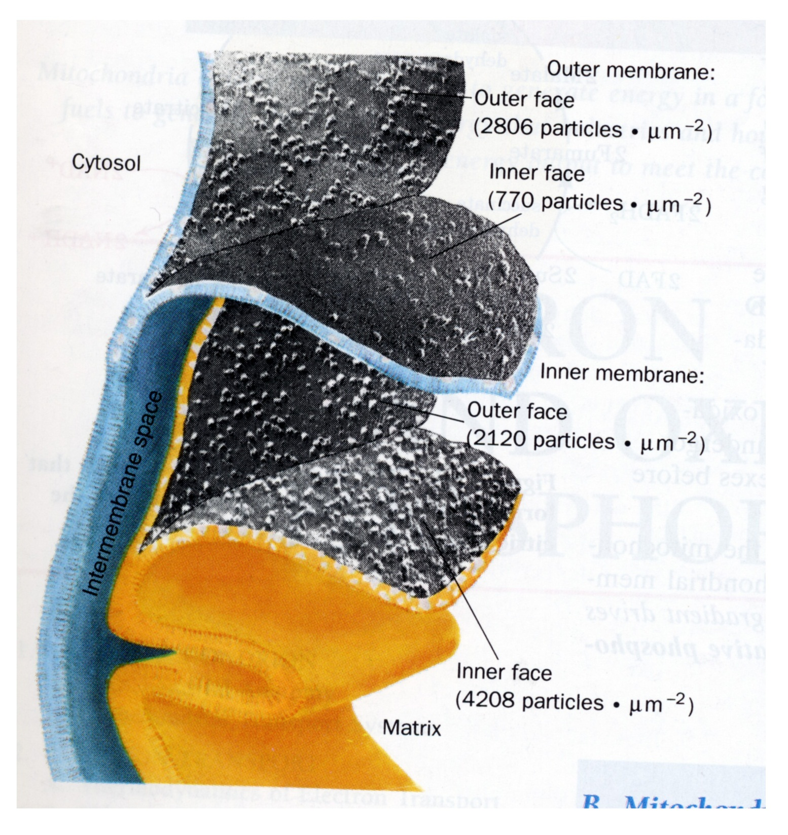

Slide 4
C
H
O
H
2
O
O
H
+ 6H₂O
6CO₂ +
2 FADH₂
10 NADH
O
H
O
H
O
H
2 FADH₂
10 NADH
+ 6O₂
12H₂O

Slide 5
Thermodynamics of Electron Transport
Example: Malate/oxaloacetate
NADH + H⁺ → NAD⁺ + 2e- + 2H⁺
Oxaloacetate + 2e- + 2H⁺ → Malate
Oxaloacetate + NADH + H⁺ → Malate + NAD⁺
ΔGº = -7 kcal/mol
ΔG = 0

Slide 6
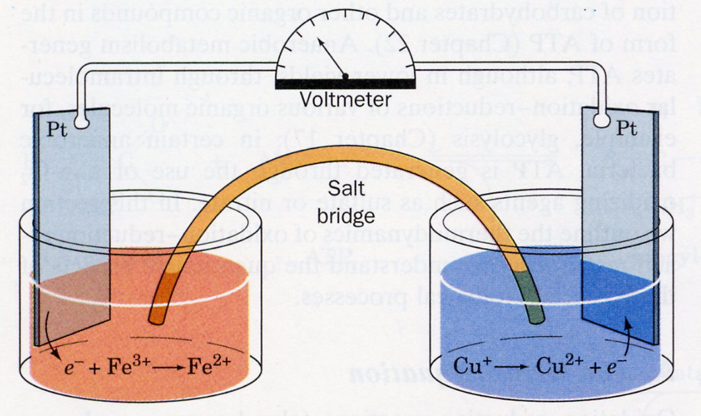
2e- + oxal→ mal.
NADH→NAD⁺ + 2e-

Slide 7
Thermodynamics of Electron Transport
Oxidation – Reduction
Oxaloacetate + 2e- + 2H⁺ → Malate
NAD⁺ + 2e- + 2H⁺ → NADH + H⁺
NADH + H⁺ → NAD⁺ + 2e- + 2H⁺
Oxaloacetate + 2e- + 2H⁺ → Malate
Oxaloacetate + NADH + H⁺ → Malate + NAD⁺
Eº
- 0.166 V
- 0.315 V
+ 0.315 V
- 0.166 V
+ 0.149 V

Slide 8
So: the progress of any redox reaction toward equilibrium, can be monitored either chemically or electrically.
A²⁺_{ox} + B_{red} A_{red} + B²⁺_{ox}
If monitored Chemically:
⎛
A
B
2
+
⎞
⎛
A
B
2
+
⎞
Δ
G
=
2
.
3
RT
log
⎜
red
ox
⎟
−
2
.
3
RT
log
⎜
red
ox
⎟
⎜
2
+
⎟
⎜
2
+
⎟
⎝
A
B
⎠
⎝
A
B
⎠
ox
red
init
ox
red
eq
If monitored Electrically:
2
.
3
RT
⎛
A
B
2
+
⎞
2
.
3
RT
⎛
A
B
2
+
⎞
−
E
=
log
⎜
red
ox
⎟
−
log
⎜
red
ox
⎟
⎜
2
+
⎟
⎜
2
+
⎟
nF
⎝
A
B
⎠
nF
⎝
A
B
⎠
ox
red
init
ox
red
eq
n = # of e- transferred
F = faraday constant ( 23 kcal/mol/V )
∆G = -nFE
Notes:
1 V = 1 J/C = 1J/6.2x10^18 charges. 4.2 kJ= 1 kcal;1 kJ = 0.23 kcal. 1 V = 23 kcal/mol.

Slide 9
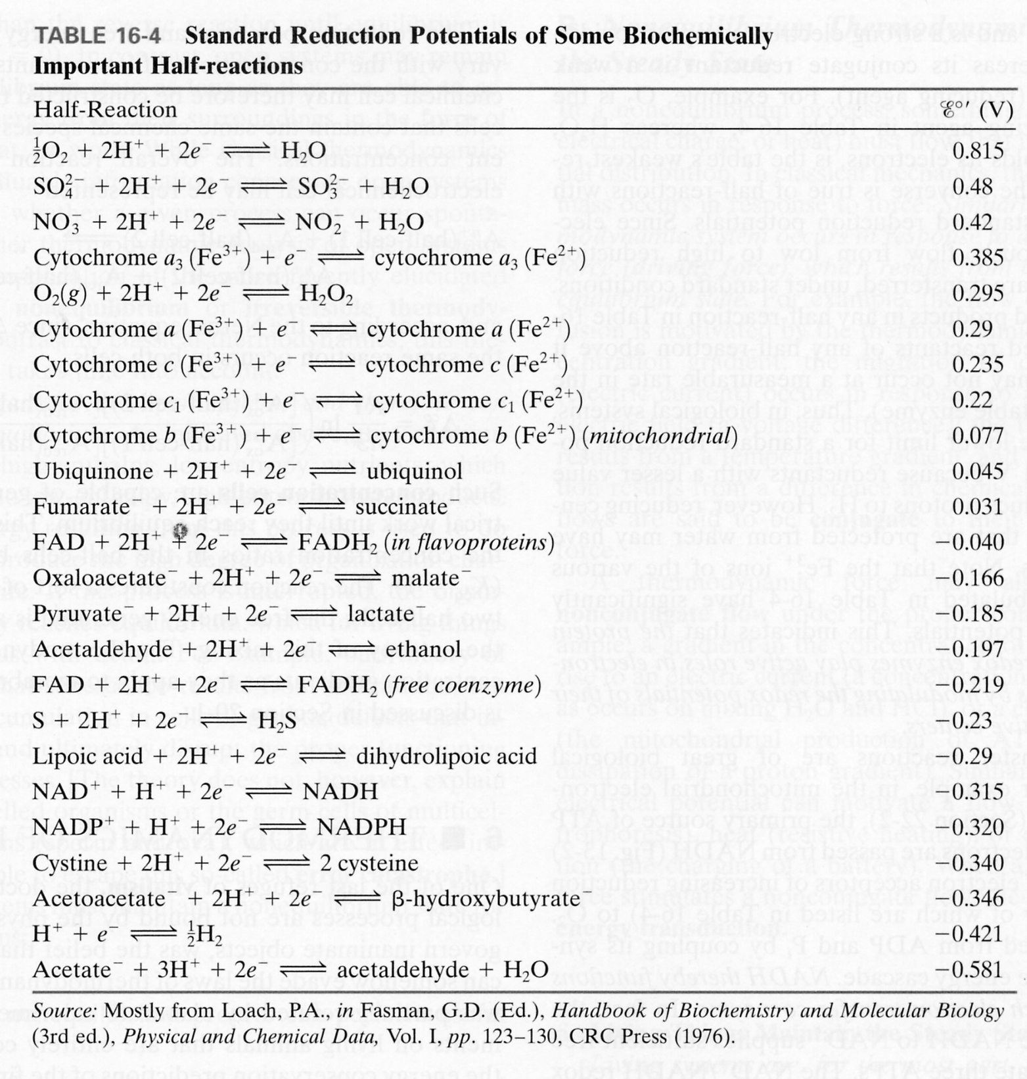

Slide 10
Oxidation of NADH by O₂ is Highly Exergonic
NADH → NAD⁺ + H⁺ + 2e- E° = +0.32
½ O₂ + 2e + 2H⁺ → H₂O E° = +0.82
½ O₂ + NADH + H⁺ H₂O + NAD⁺ E° = +1.14 V
therefore:
∆G° = -nFE° = -2 x 23 kcal/mol/V x 1.14 V = -53 kcal/mol

