Slide 1
Metabolic Pathways
A
B
C
D
E
Anabolic Pathways – synthesize molecules, often require energy
Catabolic Pathways – degrade molecules, often liberate energy

Slide 2
Equilibrium
A  B
Initially

Slide 3
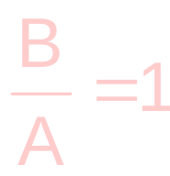
Equilibrium
A  B
At equil^{m}

Slide 4
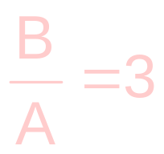
Equilibrium
A  B
At equil^{m}

Slide 5
Equilibrium
A  B
At equil^{m}

Slide 6
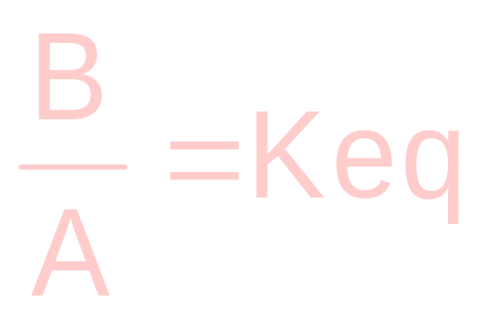
At Equilibrium
Value of K_{eq} does not change

Slide 7
The approach to equilbrium is associated with the ability to do work.
A  B
Initially
K_{eq} = 3

Slide 8
The approach to equilbrium is associated with the ability to do work.
A  B
At equil^{m}
K_{eq} = 3

Slide 9
If Keq is greater, more work can be done.
A  B
Initially
K_{eq} = 30

Slide 10
If Keq is greater, more work can be done.
A  B
At equil^{m}
K_{eq} = 30

Slide 11
If the initial conditions are further displaced from equilibrium, more work can be done.
A  B
K_{eq} = 30

Slide 12
If the initial conditions are further displaced from equilibrium, more work can be done.
A  B
K_{eq} = 30

Slide 13
The energy available to do work is called free energy, ΔG.
Terms to know:
MAR
Keq
-4 -3 -2 -1 0 1 2 3 4 5 6 7 8
B
A
Log (B/A)
B
A

Slide 14
If the MAR_{init} is 1, then ΔG is called ΔGº
Terms to know:
MAR
Keq
-4 -3 -2 -1 0 1 2 3 4 5 6 7 8
B
A
Log (B/A)
B
A

Slide 15
IF ΔGº = 0, Keq = 1!
Terms to know:
MAR
Keq
-4 -3 -2 -1 0 1 2 3 4 5 6 7 8
B
A
Log (B/A)
B
A

Slide 16
Only ΔG tells if a reaction will proceed in real life!
ΔGº tells only the value of Keq.

Slide 17
If B increases during the approach to equil^{m}, then ΔG is negative, ie the forward reaction is favorable.
A  B
K_{eq}~ 4

Slide 18
If B increases during the approach to equil^{m}, then ΔG is negative, ie the forward reaction is favorable.
A  B
K_{eq}~ 4

Slide 20
If A increases during the approach to equil^{m}, then ΔG is positive, ie the reverse reaction is favorable.
A  B
K_{eq}~ 0.25

Slide 21
If A increases during the approach to equil^{m}, then ΔG is positive, ie the reverse reaction is favorable.
A  B
K_{eq}~ 0.25

Slide 22
ΔG = 2.3RT log (B/A)_{init} - 2.3RT log (B/A)_{eq}
2.3RT = 1.4 kcal/mol
B/Ainit
B/Aeq
ΔG = 1.4 kcal/mol x log

Slide 23
Every 10-fold displacement from equilibrium requires 1.4 kcal/mol
10 init
100 eq
ΔG = 1.4 kcal/mol x log
ΔG = 1.4 kcal/mol x log 0.1
ΔG = -1.4 kcal/mol

Slide 24
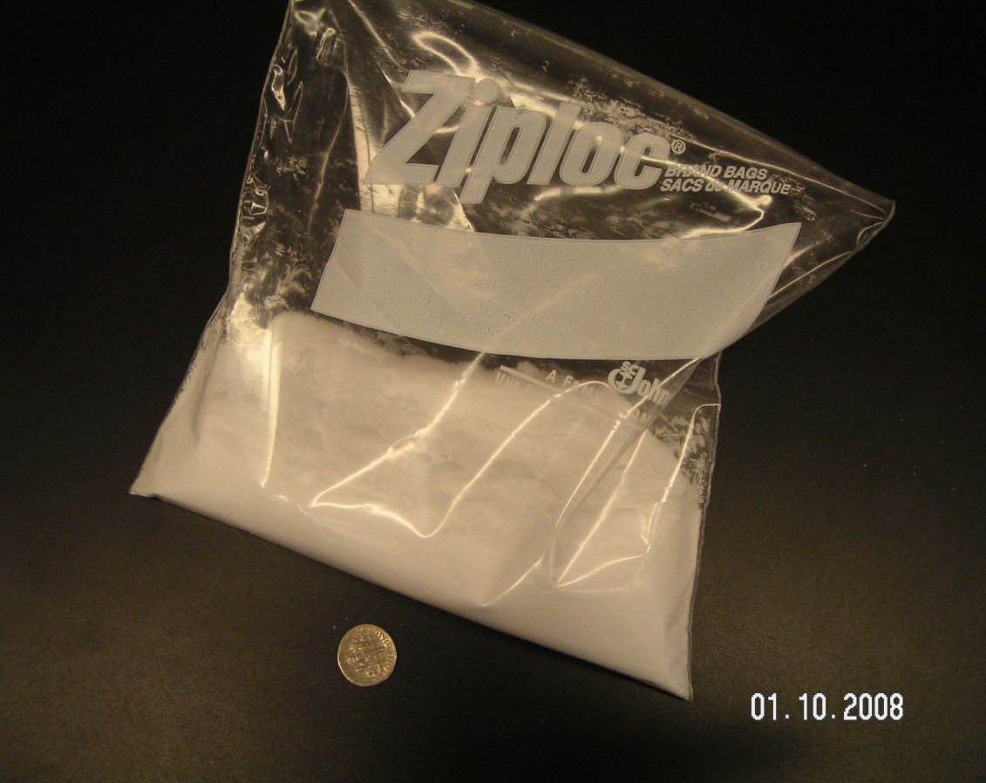
1 mole of glucose

Slide 25
What drives chemical reactions?

Slide 26
All processes favor:
minimum energy
All processes favor:
maximum randomness.

Slide 27
ΔE = ΔH + w
Energy
Heat
-PΔV
kinetic
energy
potential
energy
molecular motion
bond
breakage/formation
temperature

