Slide 1
Biochemistry of Oxidative P’n
Pathway of the e- from NADH → O₂
Chemiosmotic Hypothesis
Synthesis of ATP

Slide 2
The Chemiosmotic Hypothesis
- The accepted model for coupling oxidation to P’n.
- Free energy of electron transport is harnessed by pumping H⁺ from the matrix to the intermembranal space (cytosol) to create a proton gradient.

Slide 3
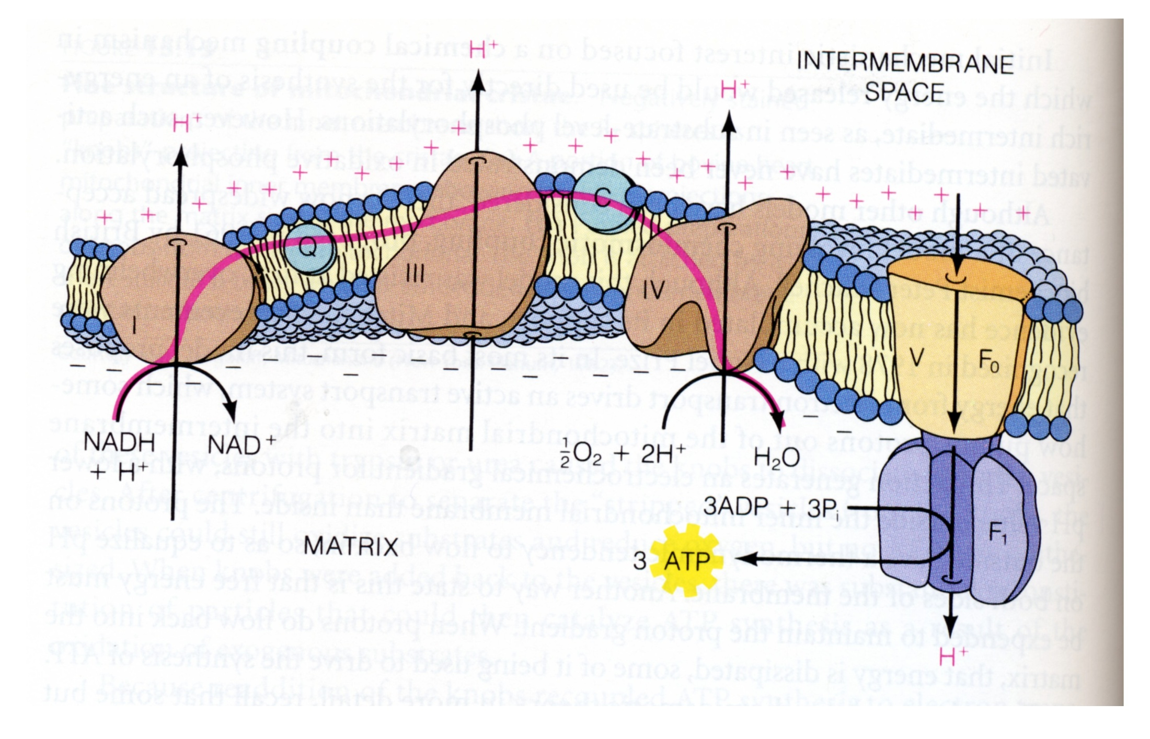
II

Slide 4
Evidence that supports the chemiosmotic hypothesis:
1. e- transport correlates with generation of a proton gradient
2. An artificial pH gradient leads to ATP synthesis in intact mitochondria
3. Complex I,III, and IV are proton pumps
4. A closed compartment is essential
5. Proton carriers (across IMM) “uncouple” oxidation from P’n.
Con’t

Slide 5
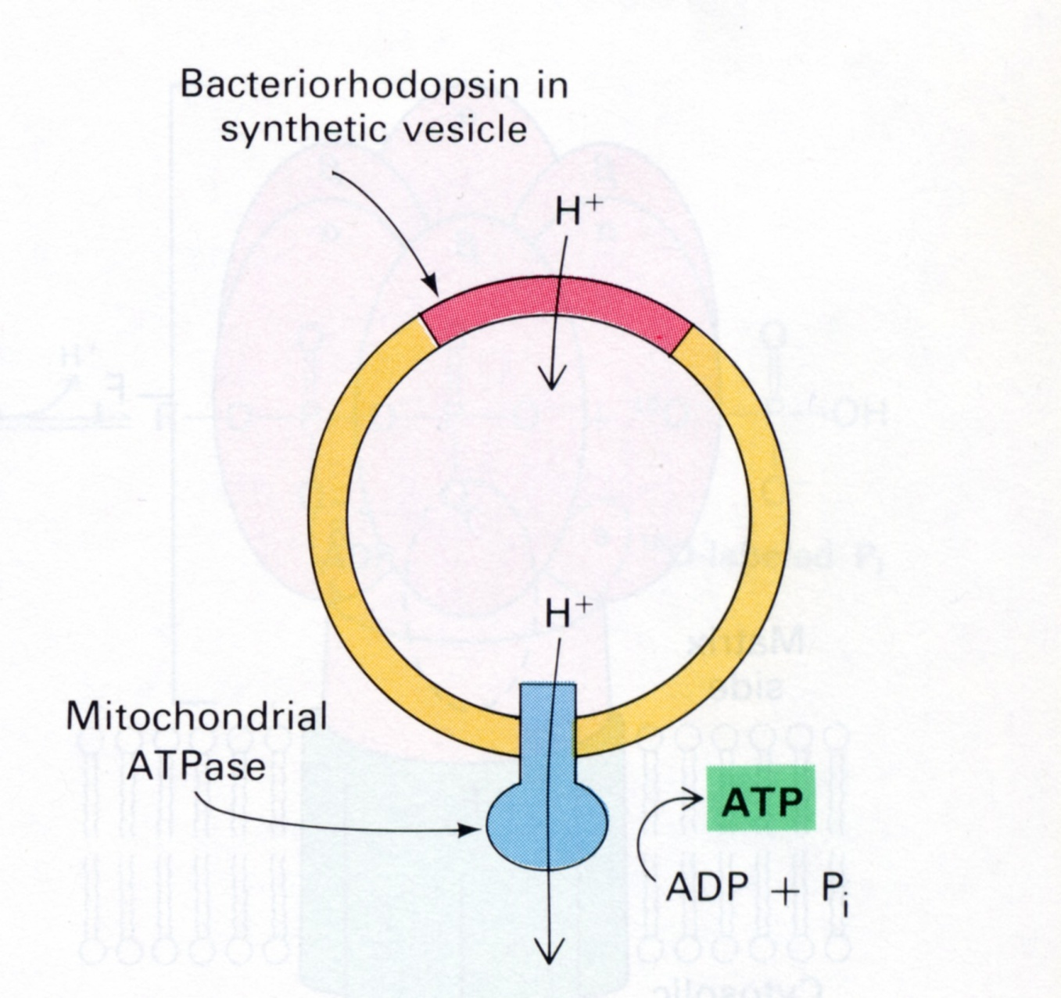
6. ATP Synthesis occurs in artificial liposomes in response to light, if the ATP sythase is reconstituted with bacterial rhodopsin

Slide 6
Free Energy Associated with Electrochemical Gradients
H⁺
H⁺
H⁺
H⁺
H⁺
H⁺
H⁺
H⁺
H⁺
H⁺
H⁺
H⁺
H⁺
H⁺
H⁺
H⁺
H⁺
H⁺
H⁺
H⁺

Slide 7
Free Energy Associated with Electrochemical Gradients
H⁺
H⁺
H⁺
H⁺
H⁺
∆G = -mF∆Ψ -2.3RT∆pH
H⁺
H⁺
H⁺
H⁺
H⁺
H⁺
H⁺
+
−
H⁺
H⁺
H⁺
H⁺
H⁺
H⁺
H⁺
H⁺

Slide 8
Free Energy Associated with Electrochemical Gradients
H⁺
H⁺
H⁺
H⁺
H⁺
∆G = -mF∆Ψ -2.3RT∆pH
H⁺
H⁺
H⁺
H⁺
H⁺
m = ion charge F = Faraday constant = 23 kcal/mol/V Ψ = membrane potential (V)
H⁺
H⁺
+
−
H⁺
H⁺
H⁺
H⁺
H⁺
H⁺
H⁺
H⁺

Slide 9
∆G = -mF∆Ψ -2.3RT∆pH
In respiring mitochondria:
∆Ψ = ~0.18 V
∆ pH = ~1 pH unit
So: ∆G = -(1)( 23 kcal/mol/V)( 0.18 V) – ( 1.4 kcal/mol)(1) = -5.5 kcal/mol (23.3 kJ/mol)
Therefore: pumping 1 mole of H⁺ requires 5.5 kcal
Assuming that oxidation of 1 mol NADH results in 10 mol H⁺ being pumped, 55 kcal is required.
Synthesis of ATP requires 12 kcal/mol. Therefore 2.5 mol ATP’s can easily be made from 1 mol NADH.

Slide 10
Biochemistry of Oxidative P’n
Pathway of the e- from NADH → O₂
Chemiosmotic Hypothesis
Synthesis of ATP

Slide 11
II
FADH₂
FAD

Slide 12
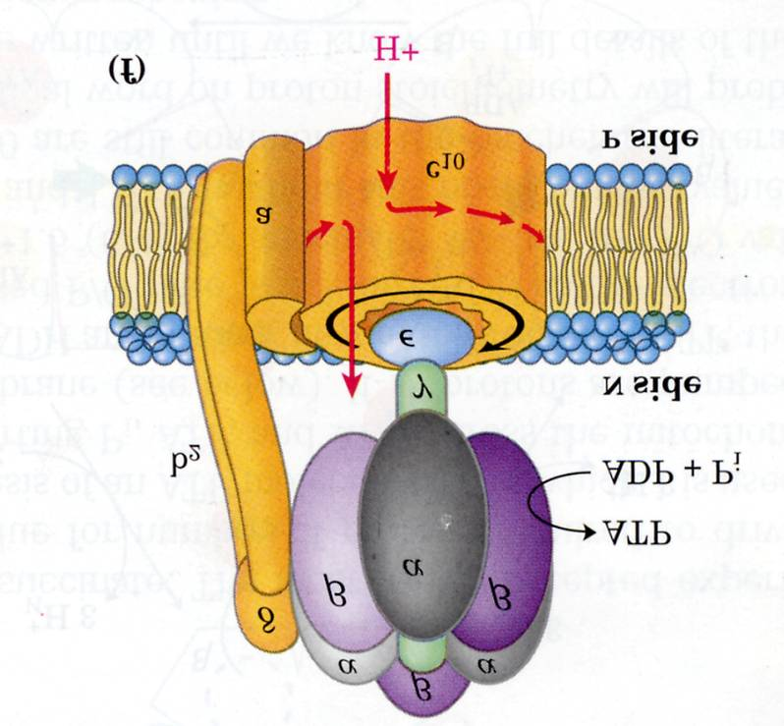
ATP Synthase
cytosol
matrix
ADP + Pi
ATP

Slide 13
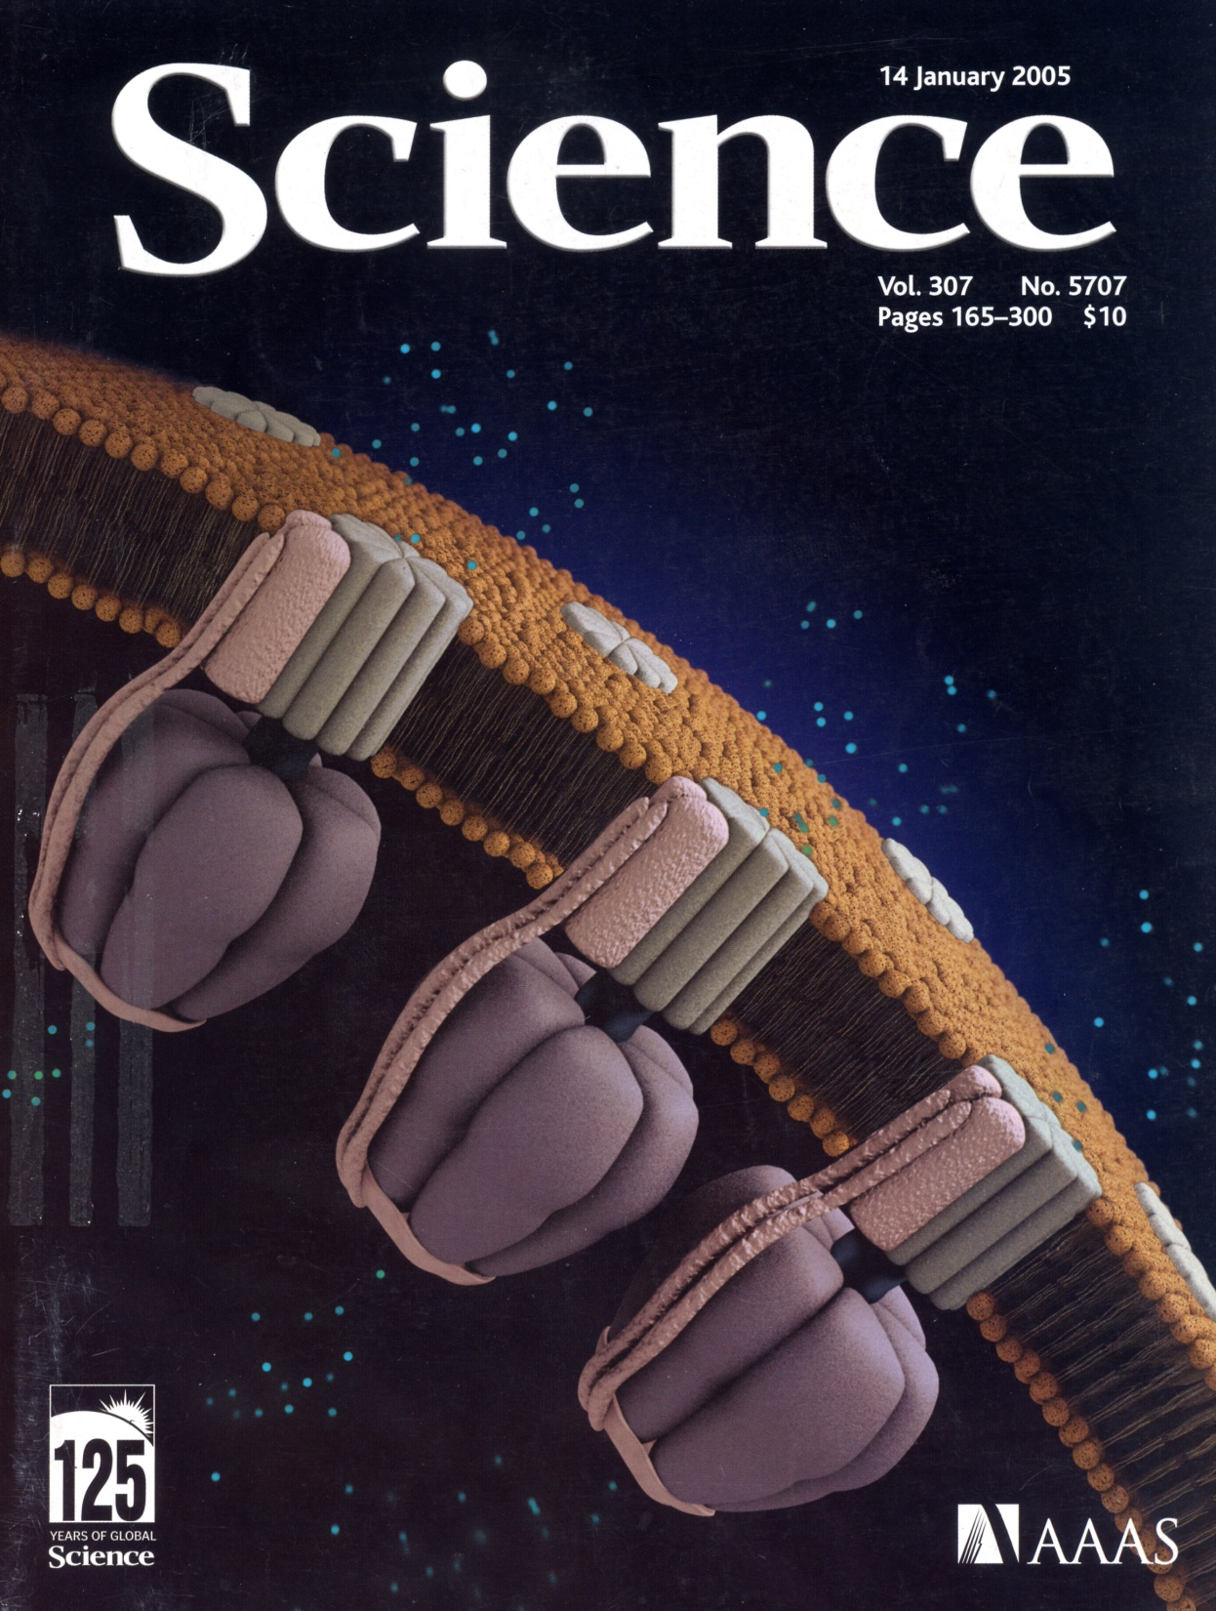

Slide 14
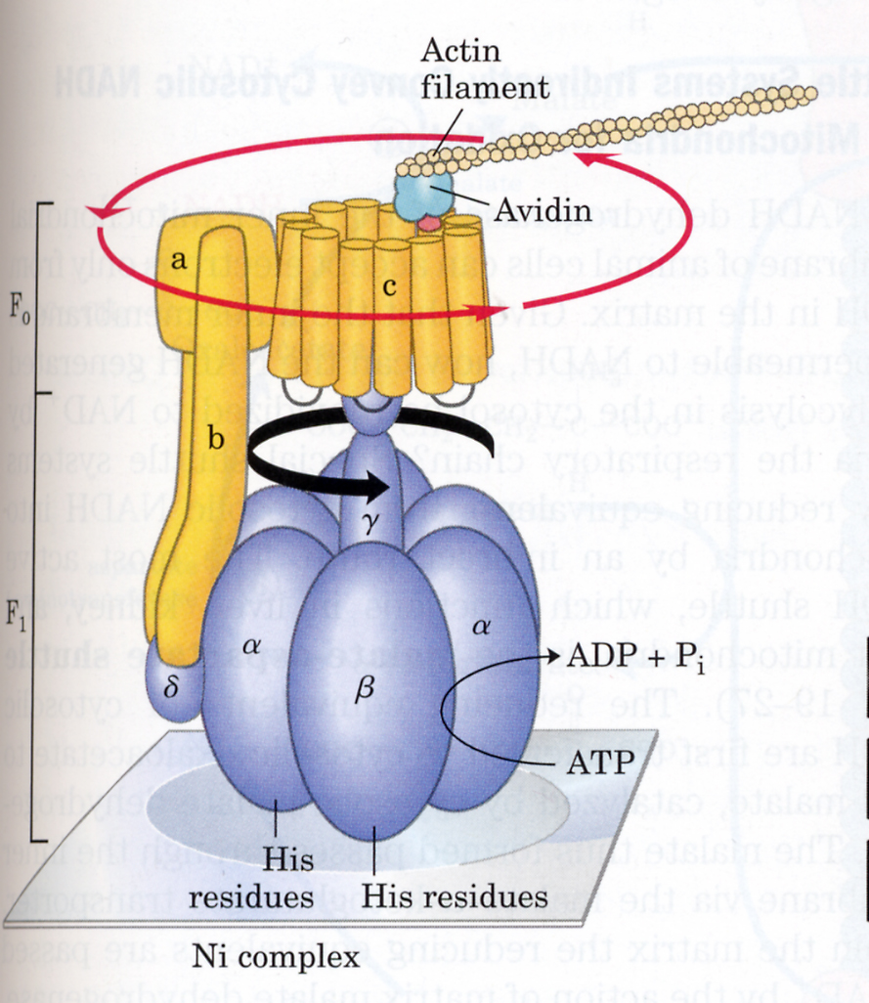
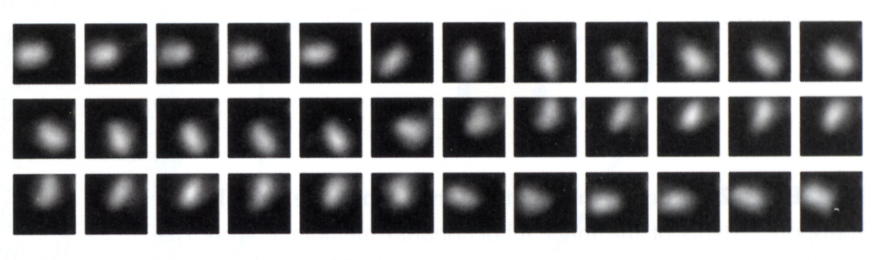

Slide 15
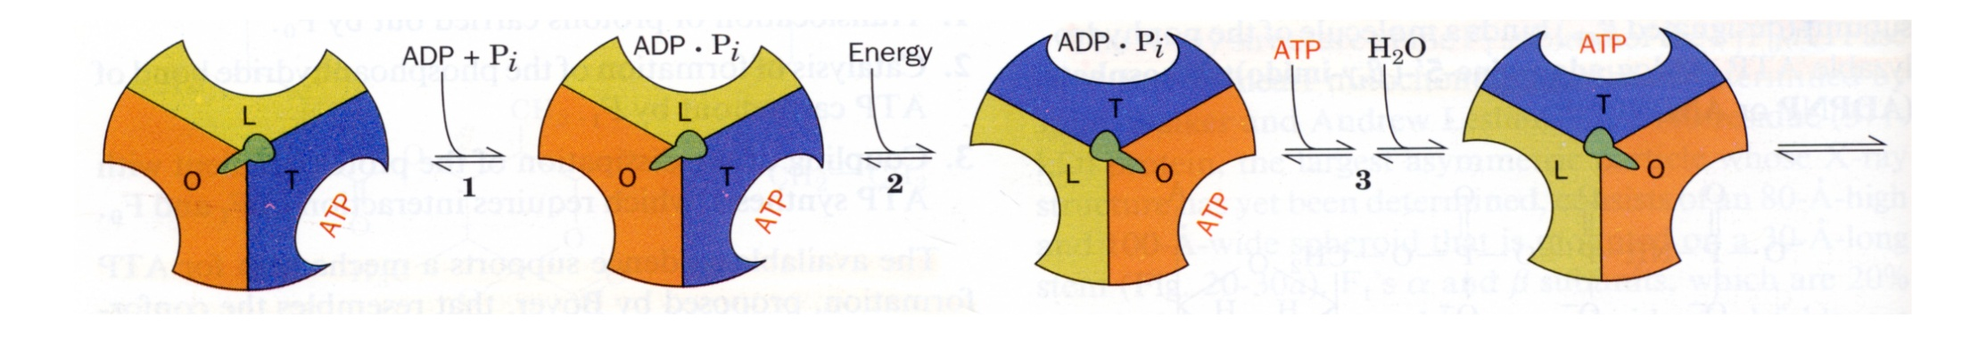
Coupling H⁺ translocation through ATP Synthase with ATP synthesis
Free energy of H⁺ translocation “forces” an internal cam shaft to rotate, which changes the conformation of each subunit during one complete turn.

Slide 16
Inhibitors of Oxidative Phosphorylation
Inhibitors of Complexes I, III, & IV.
Oligomycin – antibiotic which binds to ATP synthase and blocks H⁺ translocation.
Uncouplers:
a) Dinitrophenol (DNP).
H⁺
O
O
H
O
N
O
N
2
2
O
N
O
N
2
2
IMS
MATRIX

Slide 17
II

Slide 18
b) Ionophores
i) Valinomycin – carries charge but not H⁺’s. - Dissipates electrical gradient.
ii) Nigericin – carries protons but not charge.
- Dissipates chemical gradient. (due to H⁺)
M⁺
H⁺
M⁺
M⁺ = K⁺ >> Na⁺
M⁺ = K⁺ >> Na⁺

Slide 19
c) Thermogenin – active component of brown fat.
- acts as a H⁺ channel in the IMM of brown fat mitochon. - effect: P/O << 1.
Regulation of Thermogenin Conductance
H⁺
H⁺
H⁺
+
+
FFA’S
glycerol
HSL
+
TAG
Norepinephrine
**Uncoupling (and heat generation) occur only if plenty of FFA substrate is available. If not, ATP synthesis prevails.

Slide 20
ATP Inventory
For homework: Rationalize the following:
From 1 Glucose
10 NADH 25 ATP 2 FADH₂ 3 ATP 2 GTP 2 ATP
2 ATP
32 ATP

Slide 21
Fates of cytosolic NADH
Glucose
2 G-3-P
5 ADP
5 ATP
2 NAD⁺ + PO₄
O₂
2 NADH + H⁺
Oxidative P’n
2H₂O
2 Pyruvate
2 NAD⁺
2 Lactate
C
O
O
H
C
O
O
H
O
H
O
H
C
H
LDH
C
H
3
3

Slide 22
Cytosolic NADH enters the mitochondria via the malate-aspartate shuttle
Aspartate
Aspartate
Oxaloacetate
Oxaloacetate
NADH+H⁺
NADH+H⁺
NAD⁺
NAD⁺
Malate
Malate

Slide 23
End of Oxidative Phosphorylation

Slide 24
Glycogen Breakdown and Synthesis
Chapter 15 Lehninger
Please read on your own:
Figures 25, 27, 29, 30, 34, 37

