Slide 1
Pancreas
Adrenal Medulla
+
Glucagon
Epinephrine
Muscle
Liver
Brain
Glycogen
Glycogen
+
+
+
+
Glucose
(Blood)
Glucose
Glucose
+
F6P
F2,6BP
F6P
F2,6BP
+
+
PFK
PFK
F1,6BP
F1,6BP
PK
PK
Pyruvate
Pyruvate

Slide 2
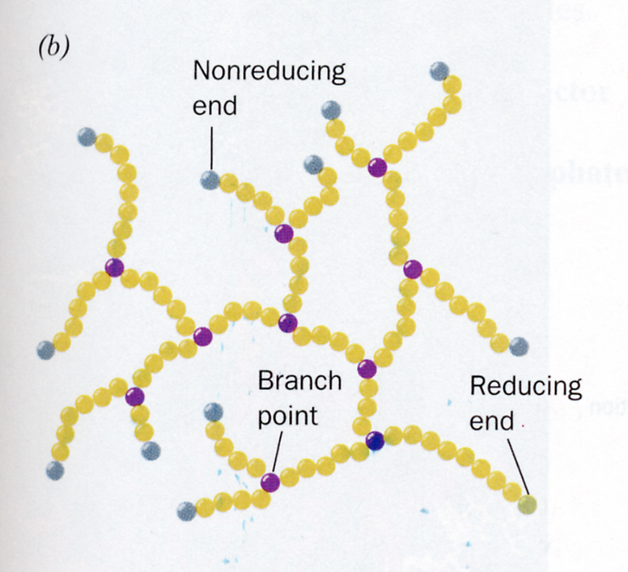
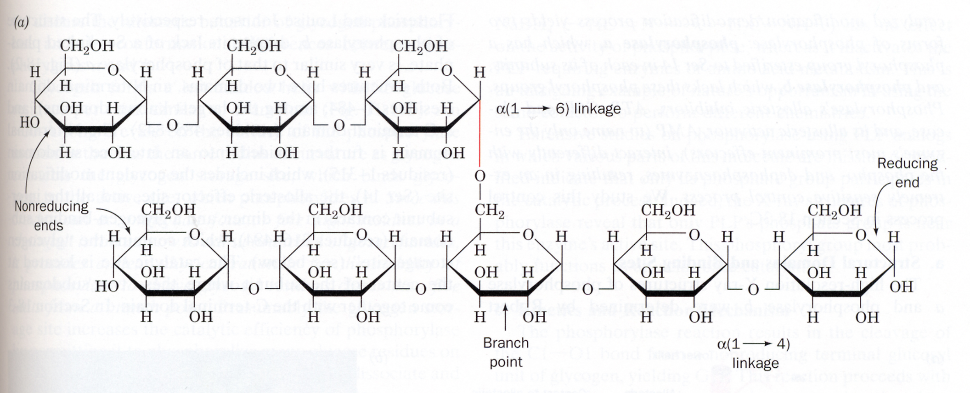
Glycogen
Branch Point
Branch points occur at ~ 1:10 glycosyl residues

Slide 3
Glycogen Breakdown
• α1-4 linkages are broken by phosphorylase, starting from the non- reducing ends. Breakdown is phosphorylytic.
• Product is G-1-P and glycogen_{n-1}
O
O
O
O
O
+
O
P
O
+
O
O
R
O
H
O
P
O
HO
O
R
∆G° = +0.73 kcal/mol
G-1-P
3
• α1-6 debranching is HYDROLYTIC, as opposed to phosphorylytic.
• Carried out by an α1-6 glucosidase

Slide 4
α1-4: phosphorylysis gives G1P → G6P
α1-6: hydrolysis gives glucose → G6P
ATP
Branch Point
Notes:
Inorganic PO4 can be as much as 10 mM in heart tissue (Newsholme BJ (1964) 93, 641 (see p647)

Slide 5
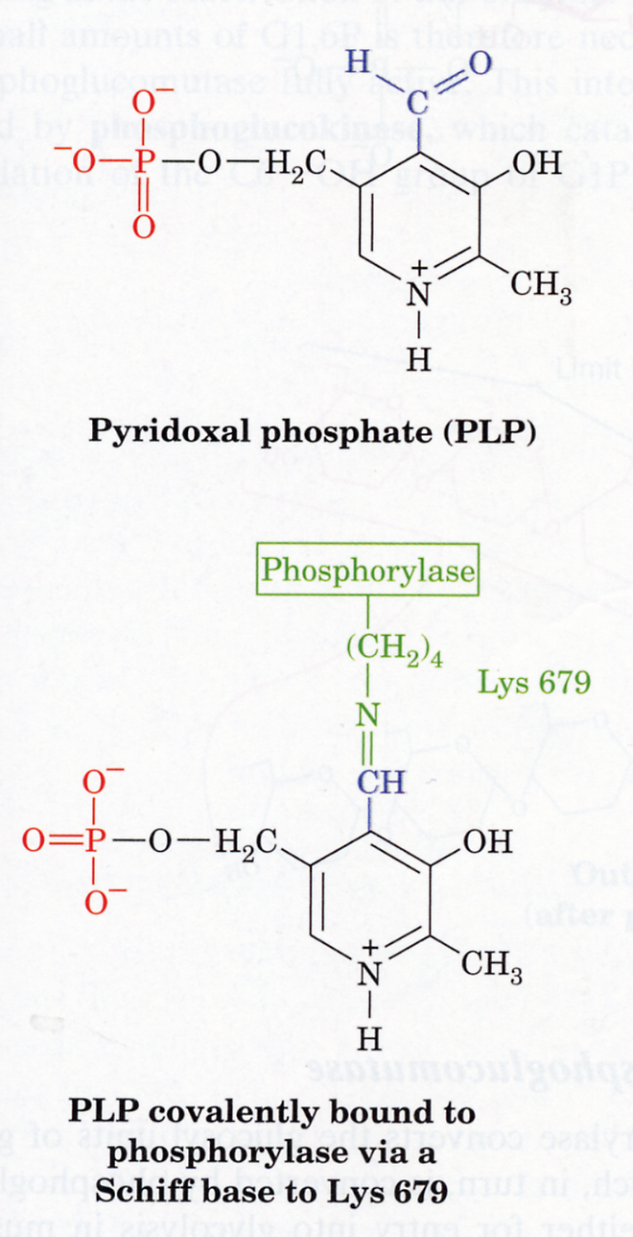
Glycogen Phosphorylase requires pyridoxal phosphate (vit. B6) as an active site cofactor.
The phosphate group probably acts as an acid-base catalyst.
This is not the same phosphate molecule that is incorporated into glucose

Slide 6
Glycogen Synthesis
O
O
+
OH
OH
O
H
O
(glycogen)_{n}
O
O
OH
O
O
(glycogen)_{n+1}

Slide 7
Activation of Glucose-1-P
Examples of “activated molecules” :
PO₄+ ADP + energy → ATP (activated PO₄)
2. Energy → Acetyl-CoA
(Activated Acetyl)
3.
O
H
C
O-
+
H
S
C
o
A
+
3
O
+
P
P
P
Uridine
+
Energy
O
P
O
3
O
P
P
Uridine + PPi
UDP-glucose
(Activated Glucose)

Slide 8
UDP-glucose
pyrophosphorylase
G1P + UTP UDP-Glucose + PP_{i}
∆G° = -8 kcal/mol
P_{i} + P_{i}
Glycogen Synthase
O
O
O
O
+
UDP
+
O
O
H
O
R
O
O
(glycogen)_{n+1}
P
P
Uridine
(glycogen)_{n}

Slide 9
Where does G1P come from?
Glycogen
G1P
G6P
Glucose
Pentose Phos. Path
Glycolysis

Slide 10
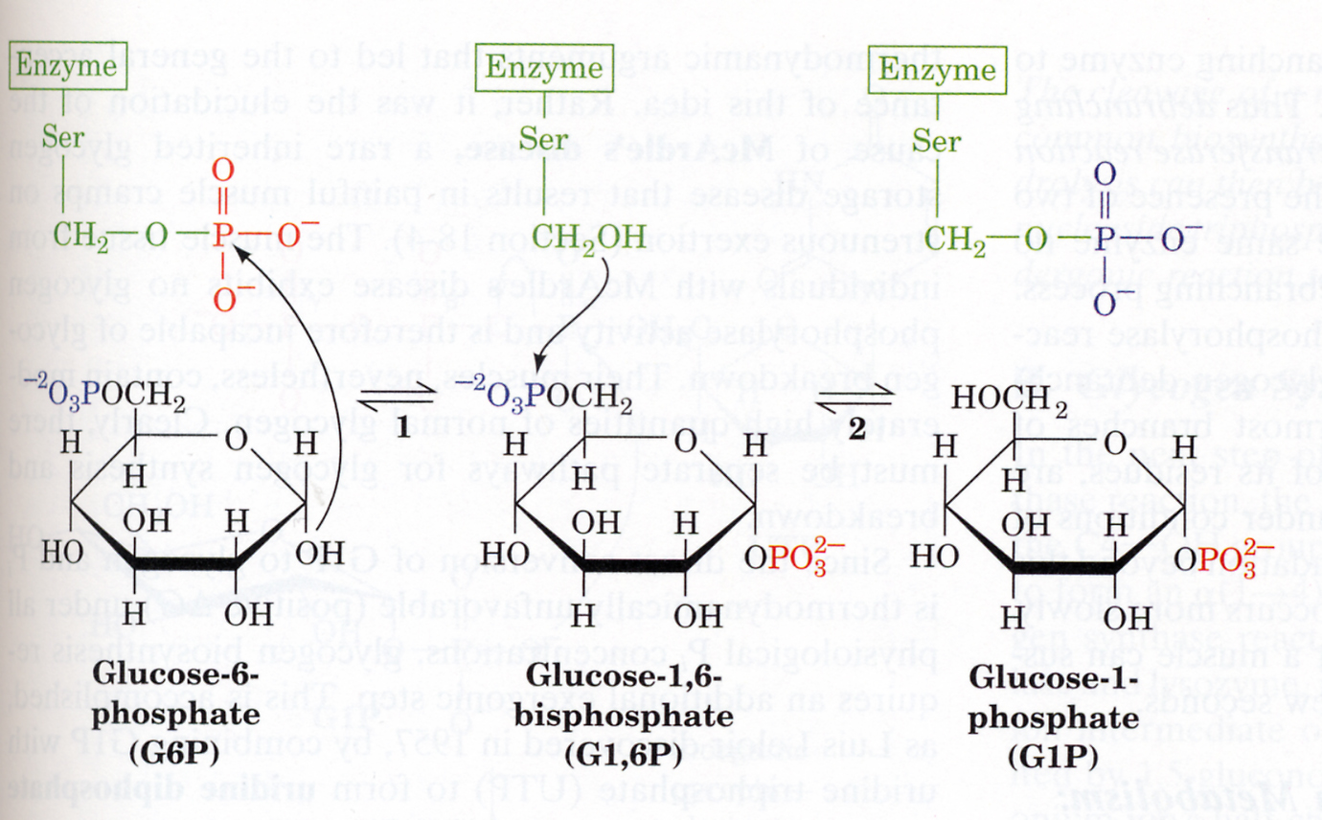
Isomerization of G6P to G1P

Slide 11
Details on Glycogen Breakdown/Synthesis
1. Glucose-1-P + Glyc_{n} → Glyc_{n+1}
- requires 1 ATP (UDP + ATP → UTP + ADP)
2. Glyc_{n} → Glyc_{n-1} + Glucose-1-P
- 90% no energy cost
- 10% 1 ATP per Glucose

Slide 12
Efficiency of storing G6P as glycogen
G6P UDP-glucose glycogen 1 ATP
glycogen G6P 0.1 ATP
1.1 ATP
G6P CO₂ + H₂O 31 ATP
96%

Slide 13
Enzyme Regulation – Levels of Complexity
Michaelis-Menten
Cooperative (T vs R)
- regulated by substrate conc’n
- regulated by allosteric ligands
- regulated by phosphorylation

Slide 14
Glucagon/Epinephrine
In Muscle/Liver:
P
P
Phosphorylase
Synthase
R
T
T
R
In Muscle:
AMP
R
T
ATP

Slide 15
Control by Phosphorylation
- Brought about by glucagon (liver) or epinephrine (liver & muscle).
- extracellular “sensor” of environmental conditions
- In muscle : GP is activated for “fight or flight”
- In liver: GP is activated in response to fasting
Allosteric Control
- In muscle: “intracellular sensor” of energy charge.

