Slide 1
cAMP Signal Transduction Cascade
B-adrenergic receptor, or
Glucagon receptor
Adenylate Cyclase
G-Protein
–
Caffeine
PDE
ATP
cAMP
5’ AMP
+
PKA
+
Phosphorylase kinase
–
+
Glycogen Synthase
Glycogen Phosphorylase
Glycogen
Glucagon Epinephrine
Insulin
Glucose

Slide 2
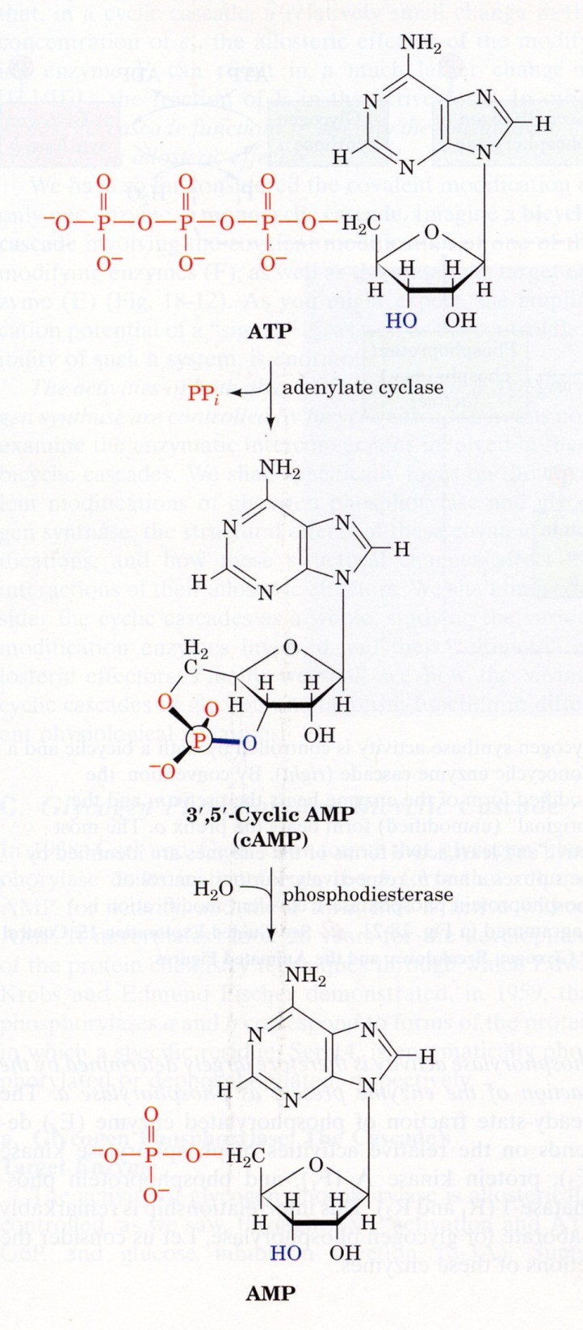

Slide 3
Direct targets of PKA:
Phosphorylase kinase
Glycogen synthase
Pyruvate Kinase
PFK2 / F2,6BP
Hormone-sensitive lipase

Slide 4
Fatty Acid Oxidation
Structure of FA’s
O
β
α
O
Ω
H
C
(
C
H
)
_{n}
C
C
O
R1
3
2
H
H
2
2
O
H
O
O
R2
O
O
O
R3
H
C
C
C
C
(
C
H
)
_{n}
3
H
H
H
2
O
H
2

Slide 5
HSL (adipose tissue specific)
O
O
H
O
O
O
H
+
O
FFA’s
O
H
O
glycerol
O
Liver
C
H
O
H
C
H
O
H
2
GPDH
2
Glycerol kin
O
Glycerol
C
H
O
H
ATP
NAD⁺
C
H
O
P
O
C
H
O
P
O
2
3
2
3
3P-glycerol
DHAP

Slide 6
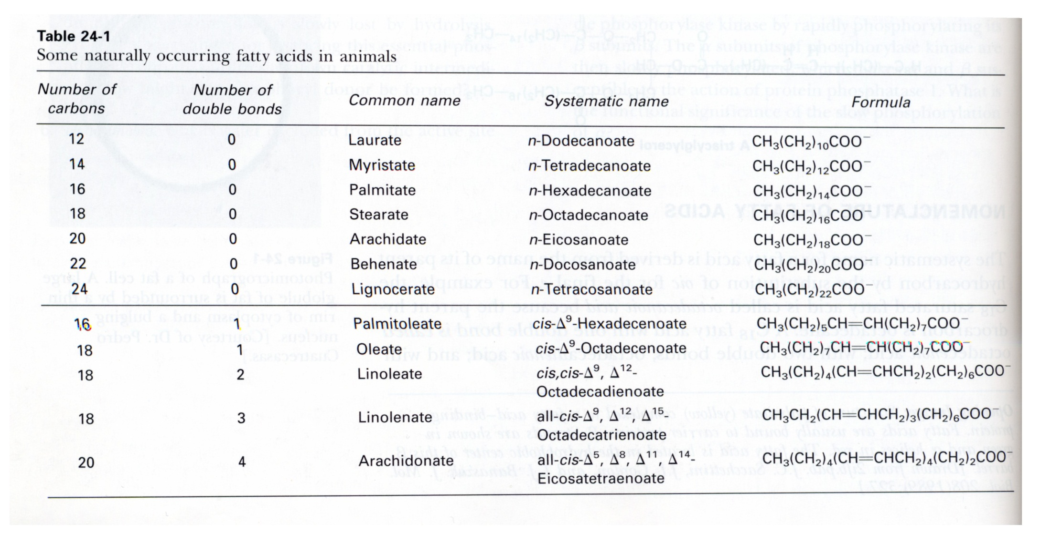

Slide 7
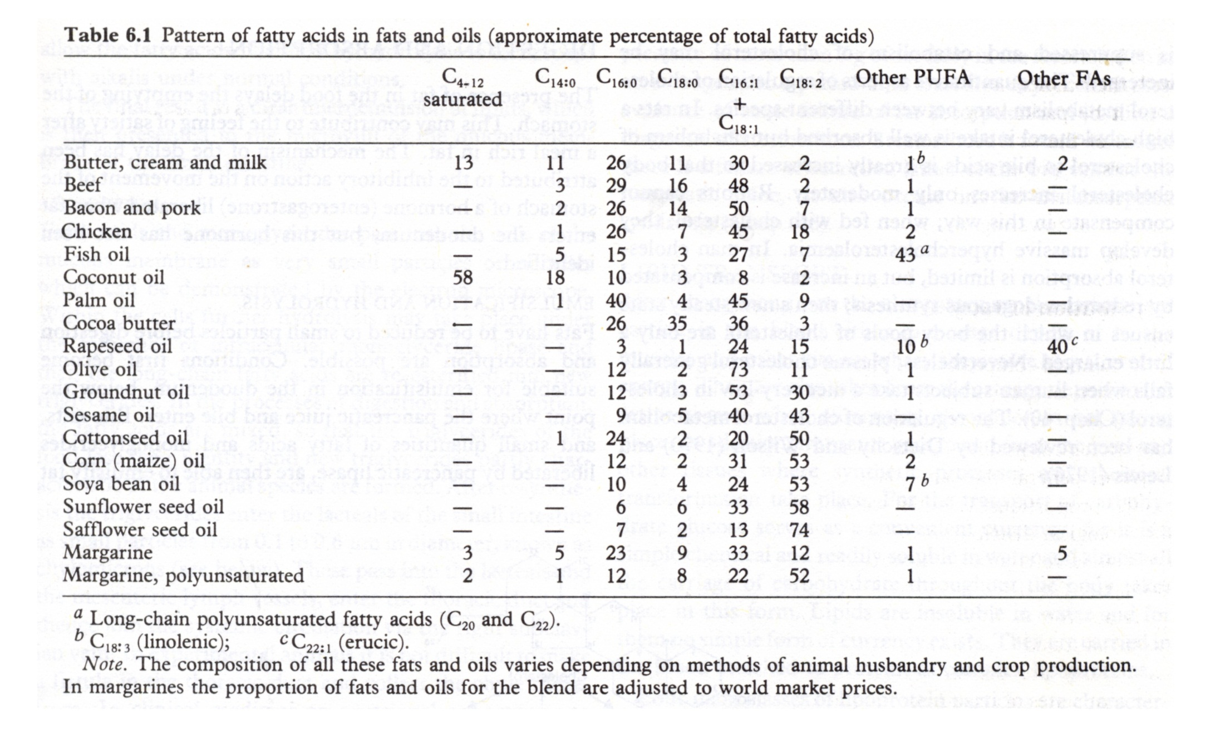

Slide 8
Synthesis & Storage of FA’s occurs in the cytosol
Oxidation of FA’s is carried out in the mitochondria
Activation of FFA’s for oxidation (cytosolic)
O
O
+
R
+
ATP
R
A
M
P
P
P
i
O
Fatty Acid
Acyl Adenylate
Pi + Pi
O
O
R
A
M
P
+
H
S
C
o
A
R
S
C
o
A
+
AMP
Acyl CoA

Slide 9
Acyl-CoA
CoA
Carnitine
Acyl-Carnitine
Translocase
Carnitine
Transporter
Carnitine
Acyl-Carnitine
Acyl-CoA
CoA

Slide 10
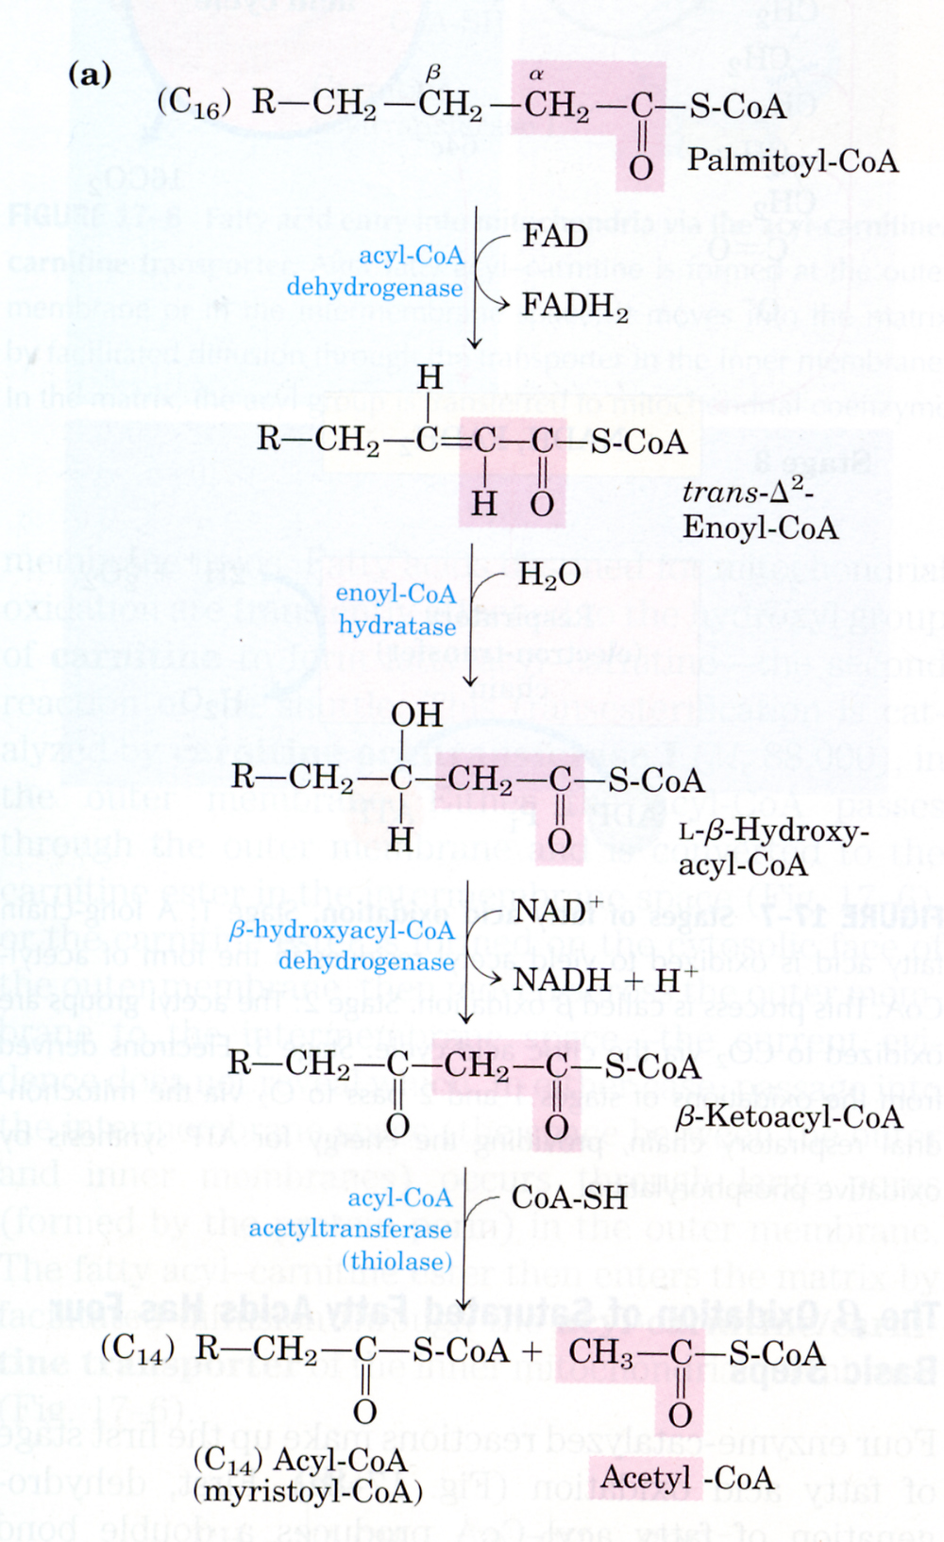
β-oxidation of fatty acids
Compare with reactions of TCA cycle.

Slide 11
Stoichiometry for the Oxidation of Palmitate (16:0)
For each cycle of β-oxidation, the following are produced:
1 FADH₂ 1.5 ATP
1 NADH 2.5 ATP
1 Acetyl-CoA 10 ATP
For Palmitate:
7 FADH₂ 10.5 ATP
7 NADH 17.5 ATP
8 Acetyl-CoA 80 ATP
Activation of Palmitate requires energy equivalent to 2 ATP, therefore:
-2 ATP
106 ATP per molecule of Palmitate

Slide 12
Ethanol Metabolism
Occurs only in Liver
O
O
Alcoh. DH
Aldehyde DH
C
H
C
H
O
H
H
C
H
H
C
O
H
3
2
3
3
NAD⁺
NAD⁺
NADH + H⁺
NADH + H⁺

Slide 13
Metabolic consequences of EtOH overload
Glucose
Blood
Ketones + FA’s
NADH
+
Lactate
Pyruvate
Amino Acids
Pyruvate
Acetyl CoA
Oxaloacetate
Oxaloacetate
NADH
NADH
Malate
Malate
Notes:
NADH inhibits gluconeo from lactate, ala, ser, but not pyruvate.

Slide 14
O
O
"Thiokinase"
SCoA
H
C
O
H
H
C
3
3
CoA
ATP
AMP + PPi
Lactate accumulates
Acetate Accumulates leading to excess acetyl-CoA
Acetyl CoA → Fatty Acids (FA’s).
Acetyl CoA → Ketone Bodies (acids).
Gluconeogenesis reduced – attenuated source of blood glucose.

Slide 15
Microsomal EtOH oxidizing system:
- Utilizes the P450 cytochrome system
- requires O₂ to generate CH₃CHO & CH₃COOH
- Therefore generates O₂ free radicals → tissue damage
Three phases of liver damage:
Fatty liver
Alcoholic hepatits – cell death, inflamation
Cirrhosis – fibrous scar tissue further impairs liver function
NH₃
Urea
Impaired brain function, coma, death

