Slide 1
Amino Acid Catabolism

Slide 2
2 sources of cellular amino acids:
Dietary protein – stomach pepsin, pancreatic peptidases; (trypsin, chymotrypsin, elastase) digest proteins in the small intestine to amino acids which get absorbed.
Turnover of body protein – Humans turnover 1-2% of total body protein per day.
- 75% -80% is recycled, 20-25% is degraded to metabolic intermediates and urea.
Unlike glucose and FA’s, excess amino acids are degraded, not stored!
The products of aa degradation are:
1. N → Urea
2. carbon skeletons → metabolic intermediates.

Slide 3
1. α-amino groups are removed by transamination
N
H
O
2
O
O
R
R’
O
O
O
N
H
2
O
O
R
R’
O
O
All transaminases require pyridoxal phosphate (vit B₆) as cofactor

Slide 4
Most transaminases transfer amino groups from
an α-amino acid to α-ketoglutarate
α-ketoglutarate
α-amino acid
glutamate
α-keto acid

Slide 5
NAD(P)
NAD(P)H
GDH
NH₃
Urea
Glutamate
α- Ketoglutarate
2 ATP
O
A
S
P
-
N
H
O
3
HCO₃
+
N
H
H
N
O
P
O
H
N
N
H
4
2
3
2
2
Carbamoyl-P
Urea

Slide 6
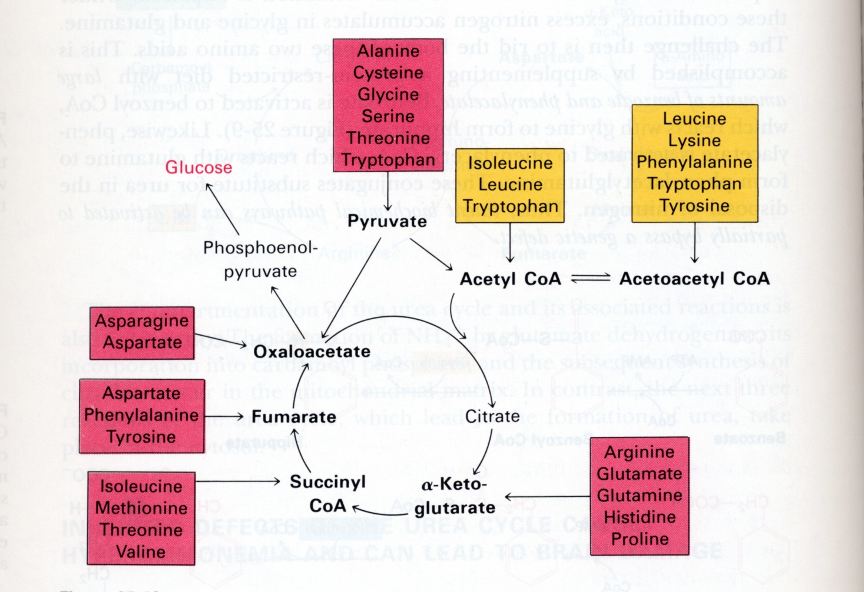
2. Degradation of the carbon skeletons
Lys & Leu are the only ketogenic aa’s
All others are glucogenic or both.

Slide 7
Isoleucine
HCO₃
Methionine
Propionyl – CoA (3C)
Methylmalonyl CoA (4C)
ATP
Valine
H
H
H
H
Vit B₁₂
H
C
O
O
H
C
O
O
H
C
C
H
O
S
C
o
A
O
S
C
o
A
Methymalonyl CoA
Succinyl CoA

Slide 8
Vitamin B12 (cobalamine) required in group exchange rxn.
H
R
R
H
C
C
C
C
H
H
H
H
Deficiency in Vit. B₁₂ is rare – found in all foods of animal source. However…
Pernicious Anemia
Epithelial Cell
B12
B12
Intrinsic Factor
I.F

Slide 9
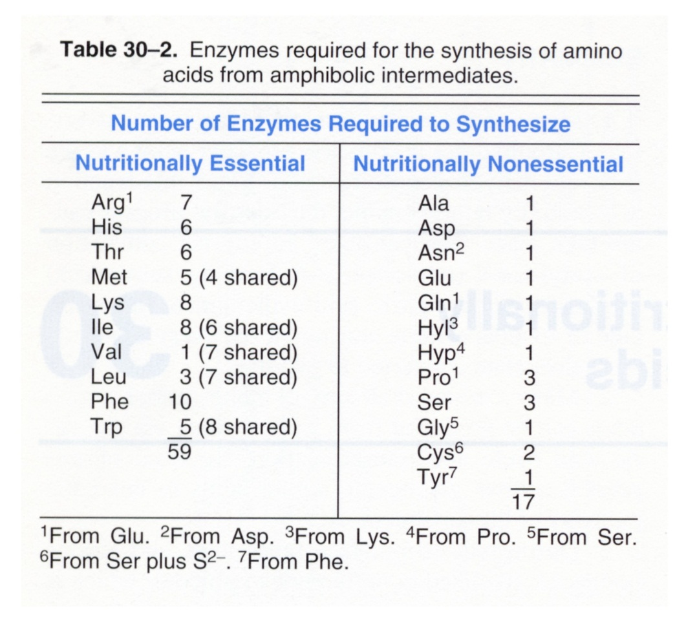
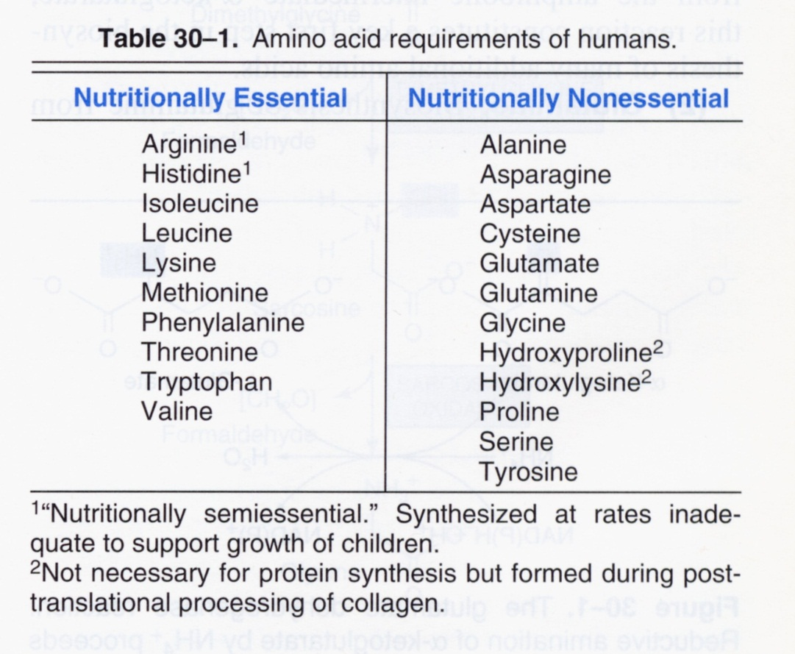

Slide 10
The Requirement for Dietary Protein
In 1889, two physiologists, Fick and Wislicenus, climbed the Faulhorn in Switzerland (1956 meters). On the climb and during recovery, they excreted in their urine 5.7 and 5.5 g N, respectively, per 13 hr period. This rate of N turnover falls within a range no greater than that expected for a day of light activities. Thus, there is no evidence to support the old, common view that the working man is entitled to an undue portion of meat from the family rations.

Slide 11
Obligatory N loss – the total N loss on a N-free diet which otherwise meets all other nutritional requirements. For a 65 kg man, this is 3.5 -10 g N per day, which corresponds to a protein requirement between 21 and 70 g per day in order to maintain N balance
The fraction of protein in the ‘prudent’ diet is thus 10-15% of the total caloric intake (that from fat should be no more than 30%; the balance being from complex CHO).

Slide 12
The need for dietary protein is two-fold:
- to supply total N
- to supply the essential amino acids

Slide 13
Protein Quality – the daily requirement for protein assumes that this protein is ‘complete.’ If one or more of the essential amino acids is lacking, then protein cannot be made from the amino acid pool derived from the diet. The dietary amino acids are useless for making functional body proteins, and are degraded.

Slide 14
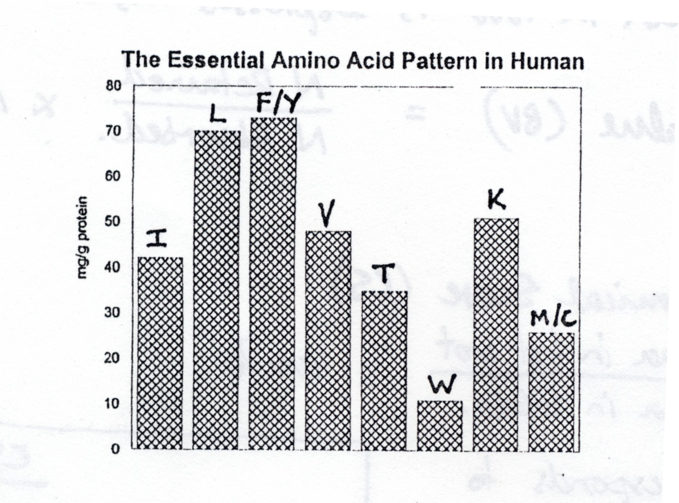
The Pattern of Essential Amino Acids required by humans corresponds to the percentage of each of the essential amino acids in human proteins.

Slide 15
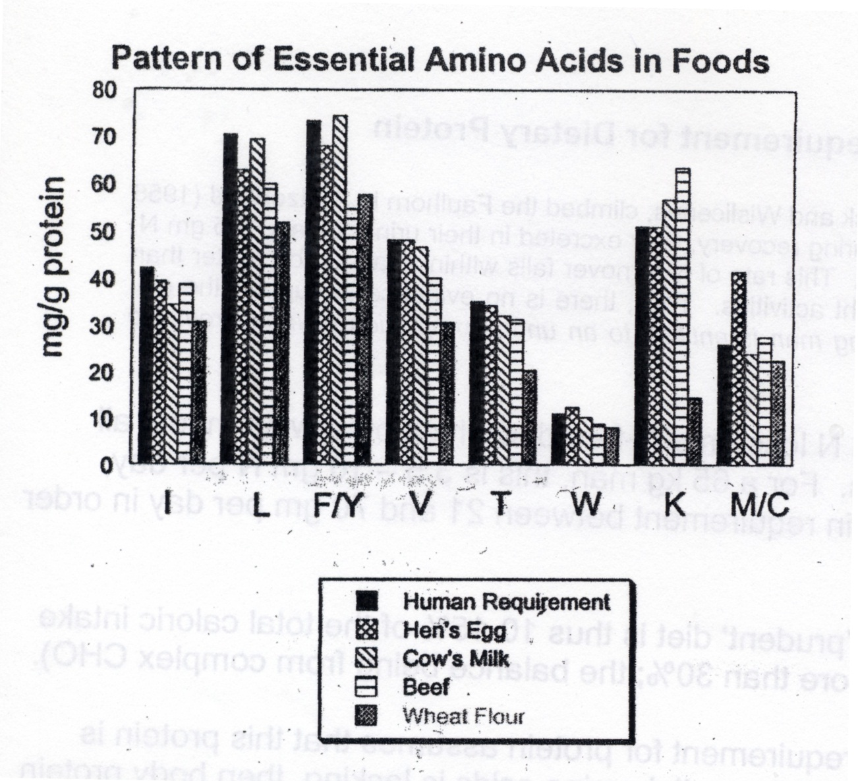
1) K is the limiting aa in wheat & other grains
M/C is limiting in beans & other legumes
Therefore grains & legumes are generally aa “complementary”.
2) The essential aa’s in wheat are generally lower in proportion relative to total protein.

Slide 16
*** In order to obtain the human requirement for Lys from wheat ~ 3x more protein (total protein) must be consumed.
The quality of protein in food is expressed as:
1. Biological Value (BV) = (N retained / N absorbed) x 100%
2. Amino Acid Chemical Score (CS) =
(mg aa in test prot / mg aa in EGG) x 100%

Slide 17
The CS of a protein corresponds to the particular amino acid with lowest CS.
CS
Maize
49
Rice
67
Soy
74
Hen’s egg
100

