Slide 1
Enzymes lower ∆G^{o‡} , not ∆Gº
A/B‡
∆G^{o‡}
A/B‡
∆G^{o‡}
A
∆G°
B
Enzymes have no effect on K_{eq}

Slide 2
ENZYMES HAVE NO EFFECT ON ∆G°
Both the forward & reverse reactions are accelerated to the same degree.

Slide 3
Basic Enzymology

Slide 4
Reaction steps for conversion of
Substrate to Product
K_{m}
k_{cat}
Substrate
Binding
Chemical
conversion
Product
Release
Overall velocity = kcat x # S bound E’s

Slide 5
Dependence of Enzyme Velocity
On Substrate Concentration

Slide 6
•
•

Slide 7
•
•
•
•

Slide 8
•
•
•
•
•
•

Slide 9
•
•
•
•
•
•
•
•

Slide 10
•
•
•
•
•
•
•
•
•
•

Slide 11
•
•
•
•
•
•
•
•
•
•
•
•

Slide 12
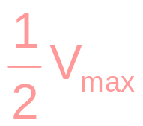
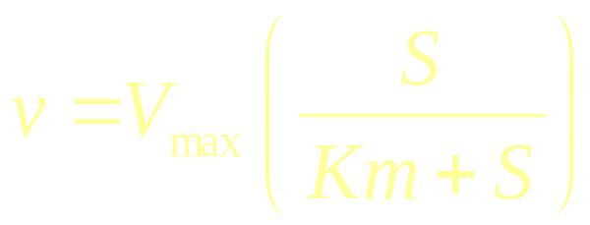
V_{max}
v
[S]
K_{m}

Slide 13
⎛
S
⎞
At any S:
v
=
V
⎜
⎟
max
⎝
Km
+
S
⎠
If S << Km:
V
v
=
max
S
Km
If S = Km:
V
v
=
max
2
If S >> Km:
v
=
V
max

Slide 14
V
=
E
•
kcat
max
If E = 10 uM
V_{max} = 20 uM sec⁻¹
Then:
k_{cat} = 2 sec⁻¹

Slide 15
Reaction steps for conversion of
Substrate to Product
K_{m}
k_{cat}
Substrate
Binding
Chemical
conversion
Product
Release

Slide 16
V_{max}
v
10 20 30
[S] uM

Slide 17
Regulation of Metabolic Enzymes
Common Themes:
1. Allosteric Control
-The binding of small molecules to a
site distinct from the active site.
+
A
B
C
D
E

Slide 18
2. Covalent Modification
-Reversible Phosphorylation – the most common mechanism.
P
ATP
+
ADP
Protein Kinase
Inactive
Active

Slide 19
3. Gene Regulation
(Enzyme Synthesis/Degradation)
4. Availability of Substrate

Slide 20
Allosteric
Modification
Covalent
Modification
E
⋅
kcat
⋅
S
v
=
Km
+
S
Substrate
Availability
Enzyme
Synthesis

