Slide 1
Glycolysis
Two arms to the glycolytic pathway:
1. Conversion of 1 molecule of glucose to 2 molecules of glyceraldehyde -3-P (G3P).
- requires energy input
2. Breakdown of G3P to pyruvate
- energy liberating

Slide 2
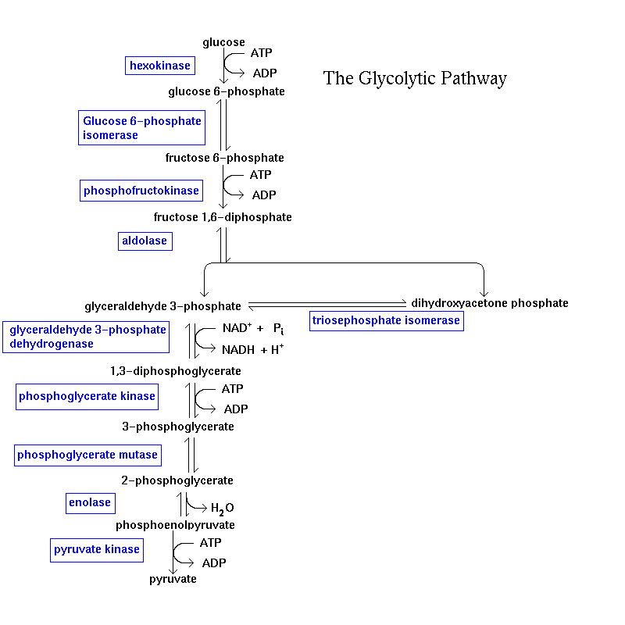
•Phosphorylation
•C-C cleavage
1
ADP
ATP
2
• Synthesis of
Chemical Energy
ADP
ATP

Slide 3
Chemical strategy for C-C cleavage
CH₂•
• CH₂
O
-
+
C
CH₂
CH
CH₂•
• CH₂
•
•
O
-
-
O
CH
C
CH₂
O
O
-
C
CH₂

Slide 4
HC
O
CH
OH
2
OH
O
HO
HO
OH
OH
OH
OH
CH
OH
CH
OH
2
2
Glucose
Fructose
Notes:
4

Slide 5
HC
O
CH
O
PO₃²⁻
2
OH
O
HO
HO
OH
OH
OH
OH
CH
O
PO₃²⁻
CH
O
PO₃²⁻
2
2
Glucose
Fructose

Slide 6
Glycolysis
Step 1 Phosphorylation of Glucose
C
H
O
P
2-
C
H
O
H
2
O
3
2
H
O
H
Hexokinase
H
O
H
+
H
+
+
H
+
H
ATP
ADP
O
H
H
O
H
H
O
H
O
H
O
H
O
H
H
O
H
H
O
H
Phosphorylation prevents exit of glucose from the cell.
Donor Phosphate for synthesis of ATP
Catalyzed by Hexokinase
- K_{m} is low to ensure a supply of G6P, even when glucose levels are low.
In Liver Catalyzed by glucokinase.
- K_{m} is high (>5mM) to ensure that liver doesn’t deplete blood glucose, at low blood glucose concentrations.

Slide 7
Step 2 Aldehyde/Ketone Isomerization
C
H
2
O
P
O
3
Phosphoglucose
O
P
O
H
C
H
O
H
Isomerase
3
2
C
H
O
H
O
2
H
H
H
O
O
H
H
H
O
H
O
H
O
H
H
O
H
O
H
H
Glucose-6-Phosphate
Fructose 6-Phosphate
Required for aldo cleavage to generate two 3-carbon compounds
Mechanism involves ring opening, isomerization, ring closure. Homework: Explain why?

Slide 8
Step 2 – Aldehyde/ketone Isomerization
O
H
C
H
O
H
H
O
H
2
O
H
O
H
Phosphoglucose
Isomerase
H
O
H
H
O
H
H
O
H
H
O
H
H
O
H
C
H
O
P
O
C
H
O
P
O
2
3
2
3
Glucose 6-Phosphate
Fructose 6-Phosphate
(An aldose)
(An ketose)
See Lehninger Fig. 14-4

Slide 9
Step 3 Phosphorylation at C₁
O
3
P
O
H
2
C
C
H
O
H
O
P
O
H
C
O
2
PFK
3
2
O
C
H
2
O
P
O
3
H
H
O
H
H
O
+
+
H
+
H
+
ATP
H
ADP
O
H
O
H
O
H
H
O
H
H
Fructose 6-Phosphate
Fructose-1,6-Bisphosphate
Ultimately required for phosphorylation of ADP to generate ATP
Catalyzed by PFK

Slide 10
Step 4 Cleavage (aldo cleavage)
CH
O
PO₃²⁻
2
O
C
H
O
P
O
2
3
H
O
Aldolase
O
HO
H
O
H
+
H
O
H
OH
H
C
H
O
P
O
OH
2
3
CH
O
PO₃²⁻
2
Dihydroxyacetone
Glyceraldehyde
Fructose 1,6 Bisphosphate
Phosphate
3-Phosphate
Mechanism requires carbonyl group at C₂ and Hydroxyl group at C₄.

Slide 11
•Phosphorylation
•C-C cleavage
1
ADP
ATP
2
• Synthesis of
Chemical Energy
ADP
ATP
Notes:
11

Slide 12
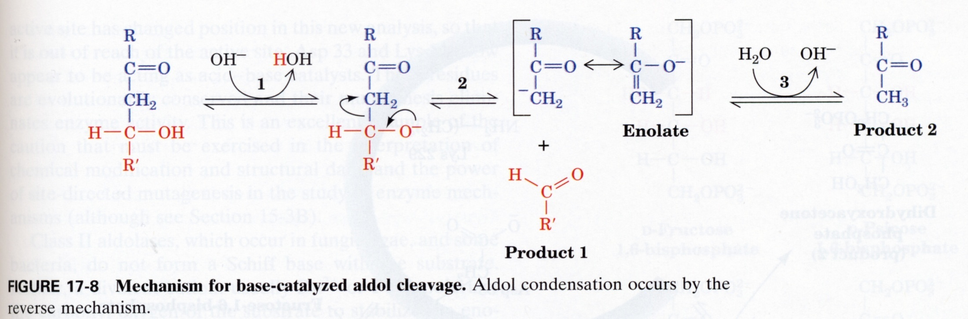
Base-catalyzed aldo cleavage
Notes:
12

Slide 13
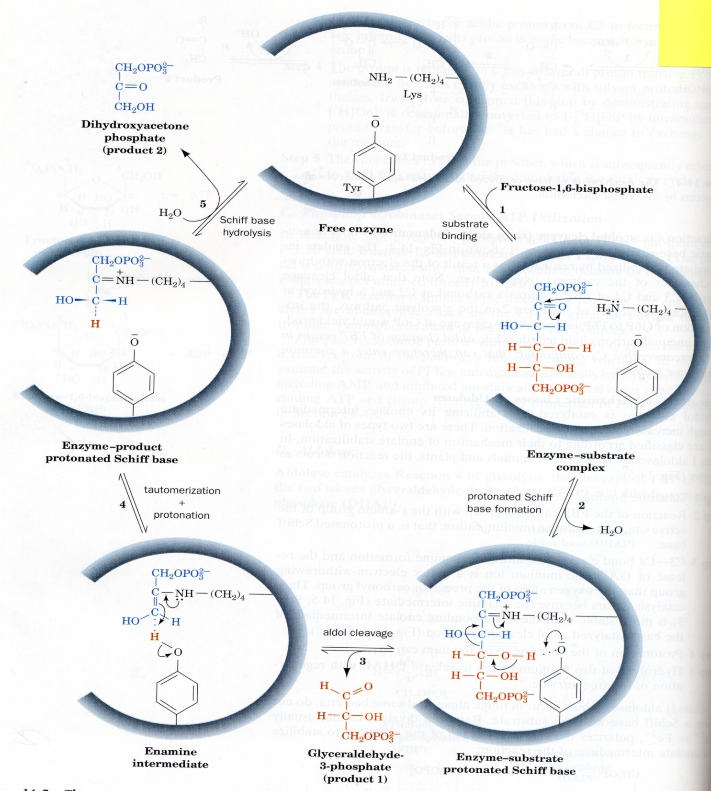
Notes:
13

Slide 14
Step 5 Isomerization of DHAP to G3P
O
H
C
H
O
H
2
O
H
O
H
C
H
O
P
O
C
H
O
P
O
2
3
2
3
Dihydroxyacetone -P
Glyceraldehyde -3P
Catalyzed by Triose Phosphate Isomerase
K_{eq} = 4/96
Notes:
14

Slide 15
Glycolysis – phase 1 (summary)
P’n of glucose at C₆ → G6P
2.
3. P’n of F6P at C₁ → F1,6BP
4. Aldo Cleavage of F1,6BP → DHAP + G3P
5. Isomerization of DHAP → G3P
O
H
CH₂OH
O
O
H
Notes:
15

Slide 16
•Phosphorylation
•C-C cleavage
1
ADP
ATP
2
• Synthesis of
Chemical Energy
ADP
ATP
Notes:
16

