Slide 1
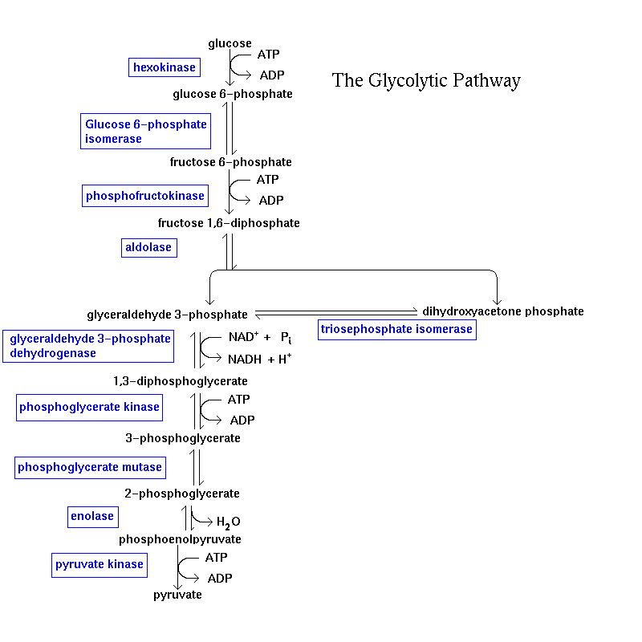
•Phosphorylation
•C-C cleavage
1
ADP
ATP
2
• Synthesis of
Chemical Energy
ADP
ATP
Notes:
1

Slide 2
2nd Phase of Glycolysis
O
N
H
2
+
O
N
O
P
O
C
H
2
O
H
H
Generation of ATP
Biological Oxidations involving NAD⁺/NADH (Dehydrogenations)
H
H
O
H
O
H
N
H
2
O
N
N
N
N
O
P
O
C
H
2
O
O
H
H
H
H
O
H
O
R
Notes:
2

Slide 3
NAD⁺ is the electron acceptor in reactions of the type:
H
NAD⁺
+
+
+
H
+
R
R
'
NADH
R
R
'
O
H
O
Notes:
3

Slide 4
Mechanism
H
..
H⁻
..
H⁺
+
+
+
-
O
H
H
H
C
O
..
H
H
H
..
-
C
O
N
H
C
O
N
H
H
2
2
..
+
N
N
R
R
NAD⁺
NADH
Notes:
4

Slide 5
Acid/Base vs. Redox
BH B⁻ + H⁺
NADH NAD⁺ + H⁺ + 2e⁻
acid/base
redox
Notes:
5

Slide 6
•Phosphorylation
•C-C cleavage
1
ADP
ATP
2
• Synthesis of
Chemical Energy
ADP
ATP
Notes:
6

Slide 7
O
OPO₃⁻²
ADP +
∆G° = -4.5
R
1,3BPG
ATP
∆G° = 7.3
ADP + OPO₃⁻³

Slide 8
GA3P
GA3PDH
1,3BPG
O
H
O
OPO₃⁻²
SH
R
S
HO
H
PO₄⁻³
-2H
O
R
S
H₂O
R
R
HO
PO₄⁻³
HO
H
R
-2H
O
OH
R
Notes:
8

Slide 9
O
OPO₃⁻²
ADP +
∆G° = -4.5
R
1,3BPG
ATP
∆G° = 7.3
ADP + OPO₃⁻³

Slide 10
Structural basis for high PO₄-transfer potential of acyl phosphates
∆G°= -11.8 kcal/mol
O
O
O
R
O
H
+
Pi
R
O
P
O
+
O
H
2
O
Similar reasons as for hydrolysis of ATP:
e- withdrawing ability of group.
Differential resonance energies between reactants and products.
Charge repulsion
O
O

Slide 11
•Phosphorylation
•C-C cleavage
1
ADP
ATP
2
• Synthesis of
Chemical Energy
ADP
ATP

Slide 12
Phosphorylation of ADP by PEP
O
OH
O
OH
OH
O
OH
O
O
P
O
ADP
ATP
H
O
H
+1.06
H
O
P
O
+0.44
3
O
3
H
O
P
O
3
H
O
H
CH₂
PK
CH₃
H
H
PEP
Pyruvate
-4
-14.8
O
OH
O
OH
H
O
H
O
H
O
H
CH₃
H
+
+
PO₄³⁻
PO₄³⁻

Slide 13
Structural Basis for high PO₄ transfer potential of PEP
C
O
O
H
C
O
O
H
C
O
O
H
O
P
O
O
H
O
3
-4.8
C
H
-10
C
H
C
H
3
2
2
PEP
Pyruvate
Pyruvate
(enol)
(keto)
+
PO₄²⁻

Slide 14
Net Reaction of Glycolysis
Glucose + 2 P_{i} + 2ADP + 2NAD⁺ → 2Pyruvate + 2ATP + 2NADH + 2H⁺ + 2H₂O
Glucose
2ATP
2ADP
2 G-3-P
5 ADP
5 ATP
2 NAD⁺
O₂
4ADP
2 NADH + H⁺
Oxidative P’n
2H₂O
4ATP
2 Pyruvate
2NAD⁺
2 Lactate
C
O
O
H
C
O
O
H
O
H
O
H
C
H
LDH
C
H
3
3

Slide 15
During exercise, purpose of glycolysis is to deliver energy (ATP) FAST!!!
Glycolysis generates ATP 100x faster than aerobic pathways (ie. oxidative P’n).
However, under these conditions, NAD⁺ is depleted and NADH builds up.
NAD⁺ must be replenished – by re-oxidation of NADH.

Slide 16
Reduction of Pyruvate to Lactate serves to replenish NAD⁺.
Glucose
2ATP
2ADP
2 G-3-P
5 ADP
5 ATP
2 NAD⁺ + PO₄
O₂
4ADP
2 NADH + H⁺
Oxidative P’n
2H₂O
4ATP
2 Pyruvate
2NAD⁺
2 Lactate
C
O
O
H
C
O
O
H
O
H
O
H
C
H
LDH
C
H
3
3

Slide 17
Fermentation in Yeast
Glucose
2NAD⁺
2NADH + 2H⁺
2ATP
C
O
+
+
NAD⁺
N
A
D
H
H
2
O
H
H
C
O
O
H
LDH
H
O
H
Lactate
O
C
H
Pyruvate
3
Alcohol
C
H
C
H
Decarboxylase
Dehydrogenase
3
3
Pyruvate
Acetaldehyde
Ethanol

Slide 18
Glucose
CO₂ prod.
2ATP
+ ATPase
2ADP
2 G-3-P
4ADP
2 NAD⁺ + PO₄
2 NADH + H⁺
4ATP
+PO₄
+PO₄
CO₂
+ inh. of ADH
COO⁻
O
minutes
CH₃
PDC
Add excess glucose to start glyc.
+ ATPase
Pyruvate

Slide 19
Fermentation in Yeast
Glucose
2ATP
2ADP
2 G-3-P
2 NAD⁺ + PO₄
4ADP
2 NADH + H⁺
+
+
NAD⁺
N
A
D
H
H
4ATP
CO₂
H
COO⁻
O
H
H
O
H
O
PDC
C
H
ADH
C
H
C
H
3
3
3
Pyruvate
Acetaldehyde
Ethanol

