Slide 1
ΔGº = -2.3RT logK_{eq}
A
B
C
D
E
Keq
5
0.8
2.5
0.5
ΔGº
-0.98
0.13
-0.56
0.42
ΔG = 2.3RT logMAR_{in} -2.3RT logK_{eq}
A
B
C
D
E
MAR_{in}
~5
0.1
~2.5
~0.5
ΔG
~0
-1.26
~0
~0

Slide 2
Kinetics of Glucose Transport
GLUT 1,3
(peripheral tissues)
V_{max}
v
GLUT 2
(liver)
1 10 20 30
[blood glucose] mM
Notes:
2

Slide 3
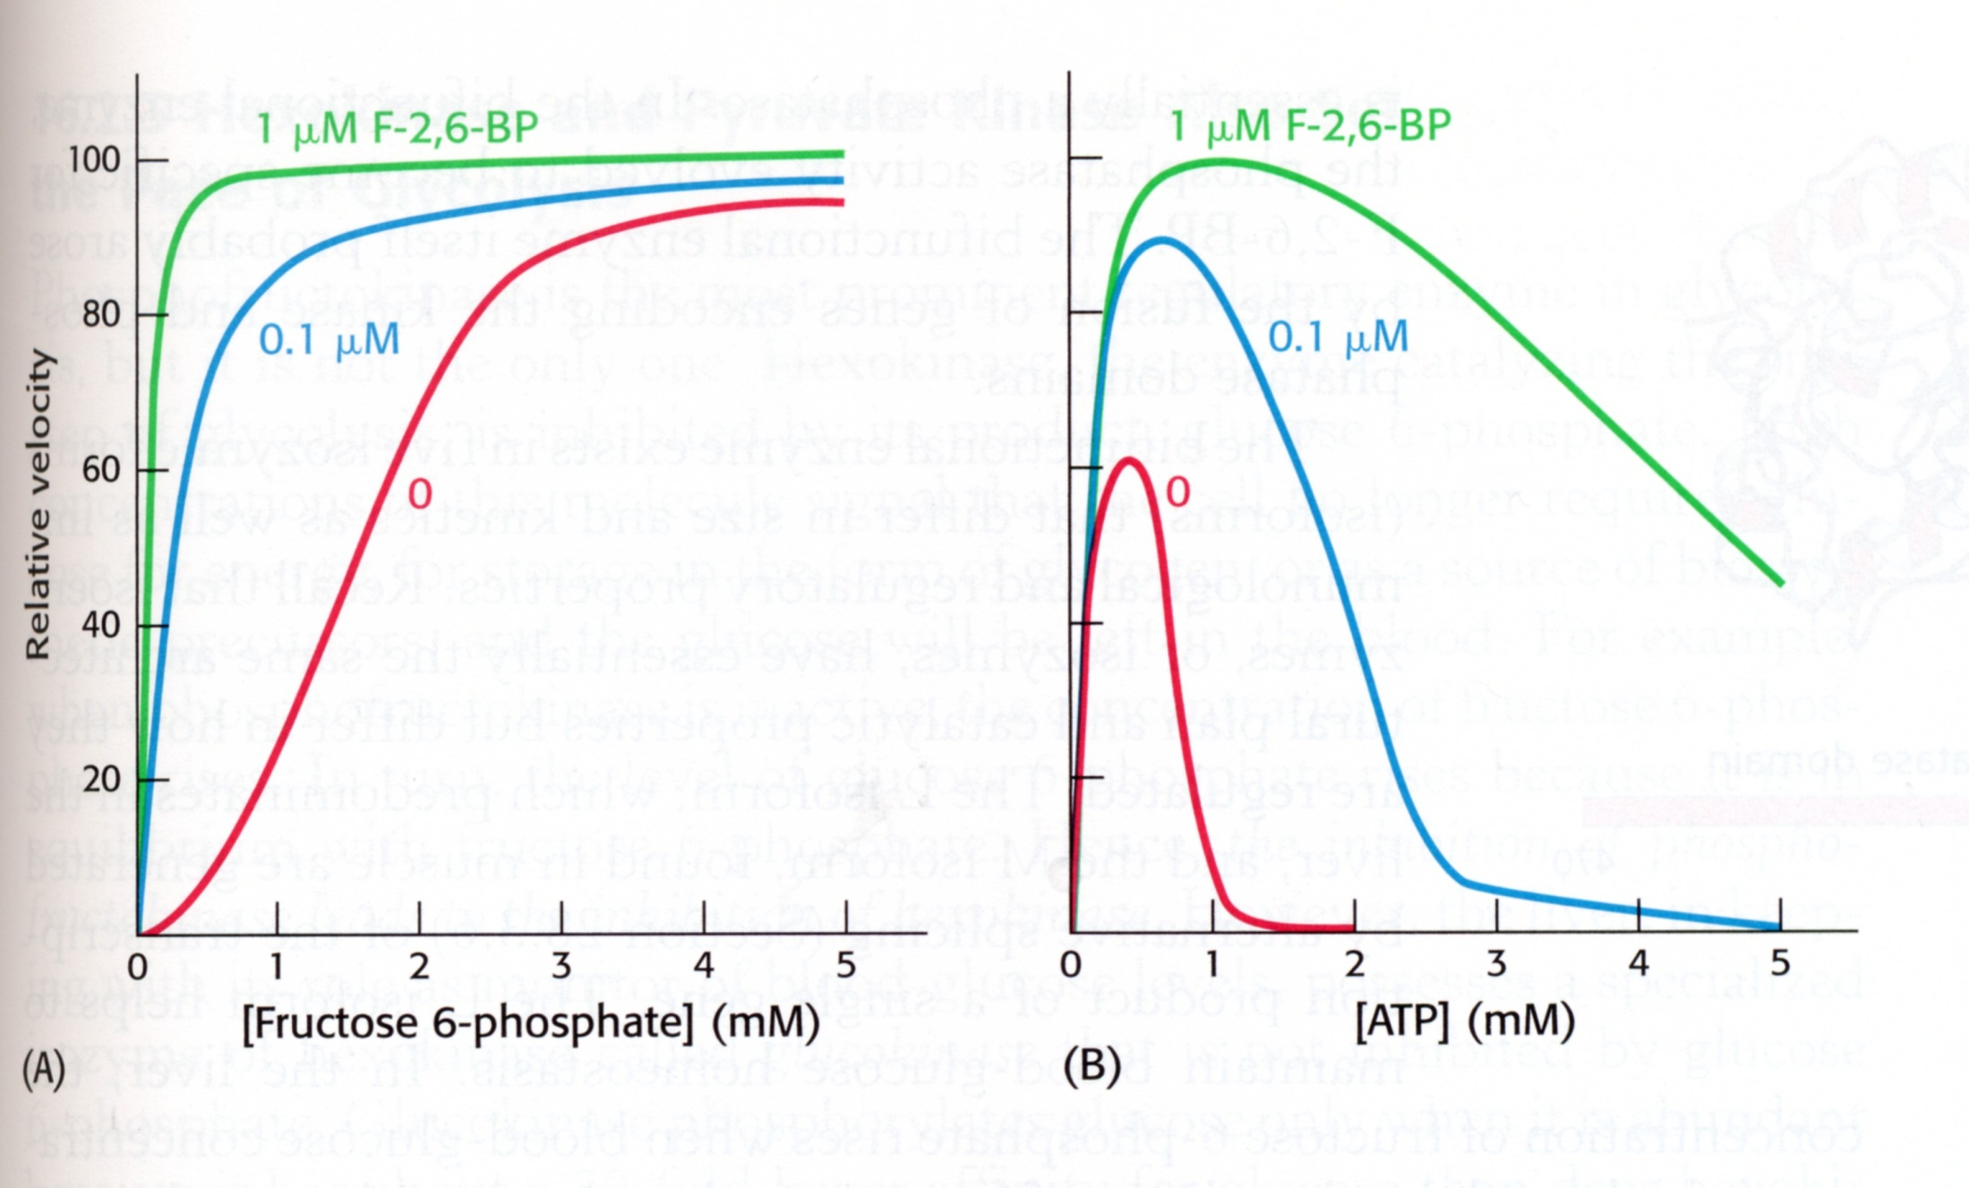

Slide 4
Chemical strategy for C-C cleavage
CH₂•
• CH₂
O
-
+
C
CH₂
CH
CH₂•
• CH₂
•
•
O
-
-
O
CH
C
CH₂
O
O
-
C
CH₂

Slide 5
General Decarboxylation
O
O
β
C
CH₂
–
CO₂
C
CH₂
+
CO₂
O
O
α
CH₃
C
–
+
CO₂
CH₃
C
•
CO₂
•
pyruvate

Slide 6
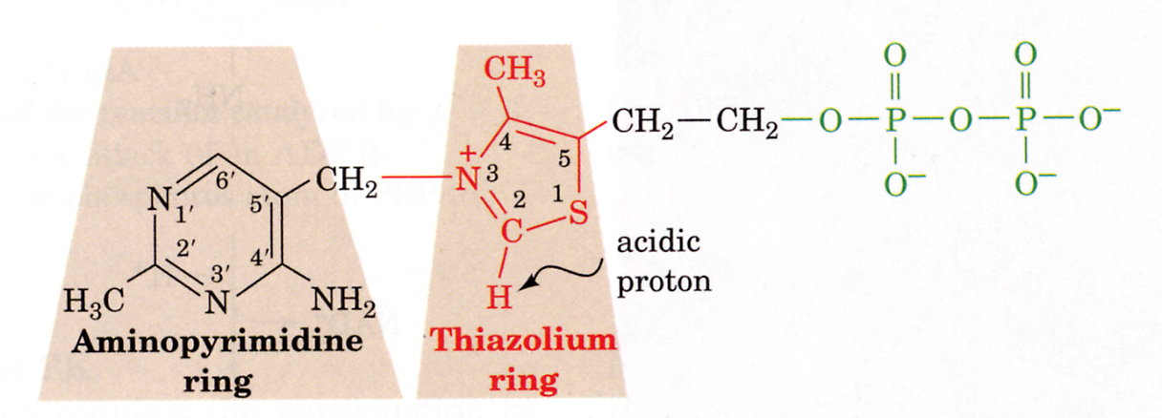
Thiamine Pyrophosphate
Voet & voet 3rd ed.

Slide 7
2. Combination with O
- Removal of e⁻’s by O which “pulls” e-’s away from the C or H nucleus. C or H becomes oxidized ; O becomes reduced.
- These reactions are catalyzed by oxidases
O
H
O
O
C
H
C
H
H
C
H
H
O
H
O
C
O
4
3
8
6
4
2
0

Slide 8
Mechanism
H
..
H⁻
..
H⁺
+
+
+
-
O
H
H
H
C
O
..
H
H
H
..
-
C
O
N
H
C
O
N
H
H
2
2
..
+
N
N
R
R
NAD⁺
NADH
Notes:
8

Slide 9
Glucose
CO₂ prod.
2ATP
+ ATPase
2ADP
2 G-3-P
4ADP
2 NAD⁺ + PO₄
2 NADH + H⁺
4ATP
+PO₄
+PO₄
CO₂
+ inh. of ADH
COO⁻
O
minutes
CH₃
PDC
Add excess glucose to start glyc.
+ ATPase
Pyruvate

Slide 10
Phosphofructokinase
ATP
AMP
F2,6BP
F6P
R
T
R ( ATP, AMP)
PFK
Activity
T ( ATP, AMP)
Fructose-6-P

Slide 11
Pancreas
Adrenal Medulla
+
Glucagon
Epinephrine
Muscle
Liver
Brain
Glycogen
Glycogen
+
+
+
+
Glucose
(Blood)
Glucose
Glucose
+
F6P
F2,6BP
F6P
F2,6BP
+
+
PFK
PFK
F1,6BP
F1,6BP
PK
PK
Pyruvate
Pyruvate

Slide 12
Logic of TCA cycle
CoA
CO₂
C=O
1
COO⁻
CO₂
CH₃
6
CH₂
acetyl-CoA
+
HC—COO⁻
5
1
H₂C—COO⁻
H₂C—COO⁻
2
C=O
C=O
C=O
1
COO⁻
COO⁻
oxalsuccinate
COO⁻
oxaloacetate
oxaloacetate

Slide 13
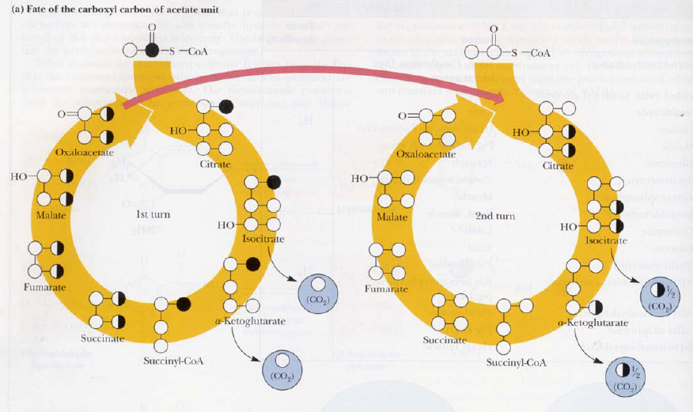

Slide 14
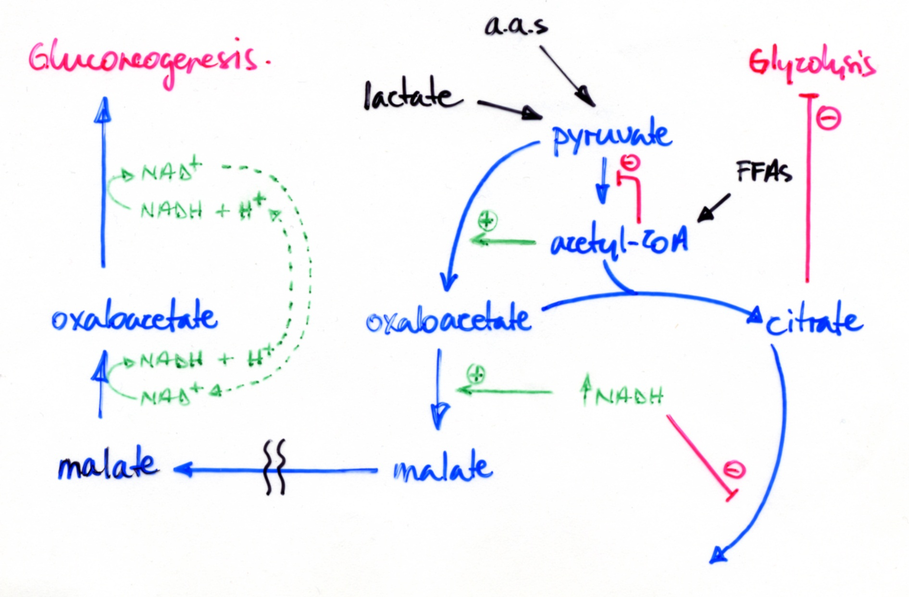
High NADH favors Gluconeogenesis

Slide 15
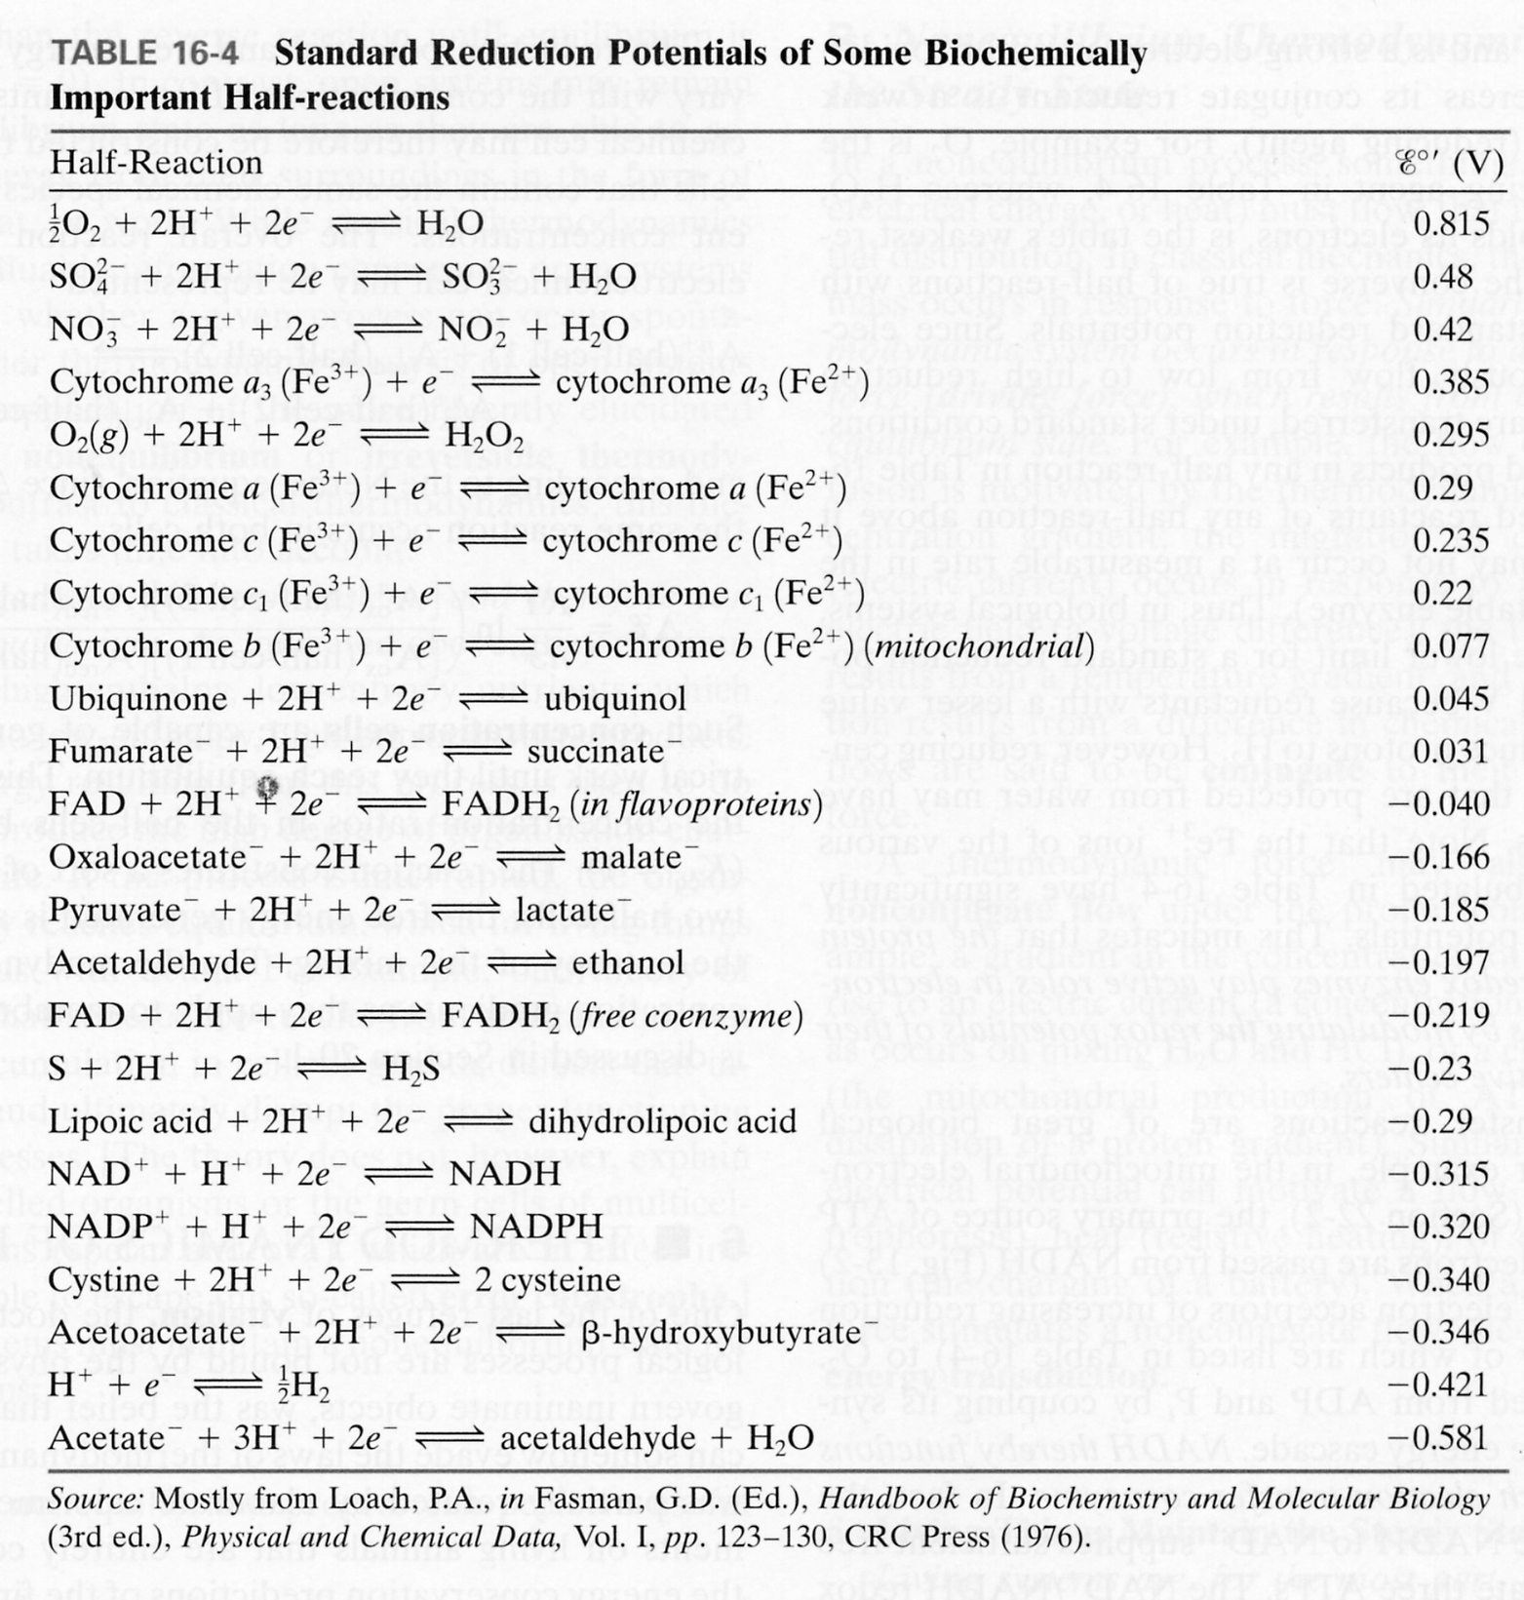

Slide 16
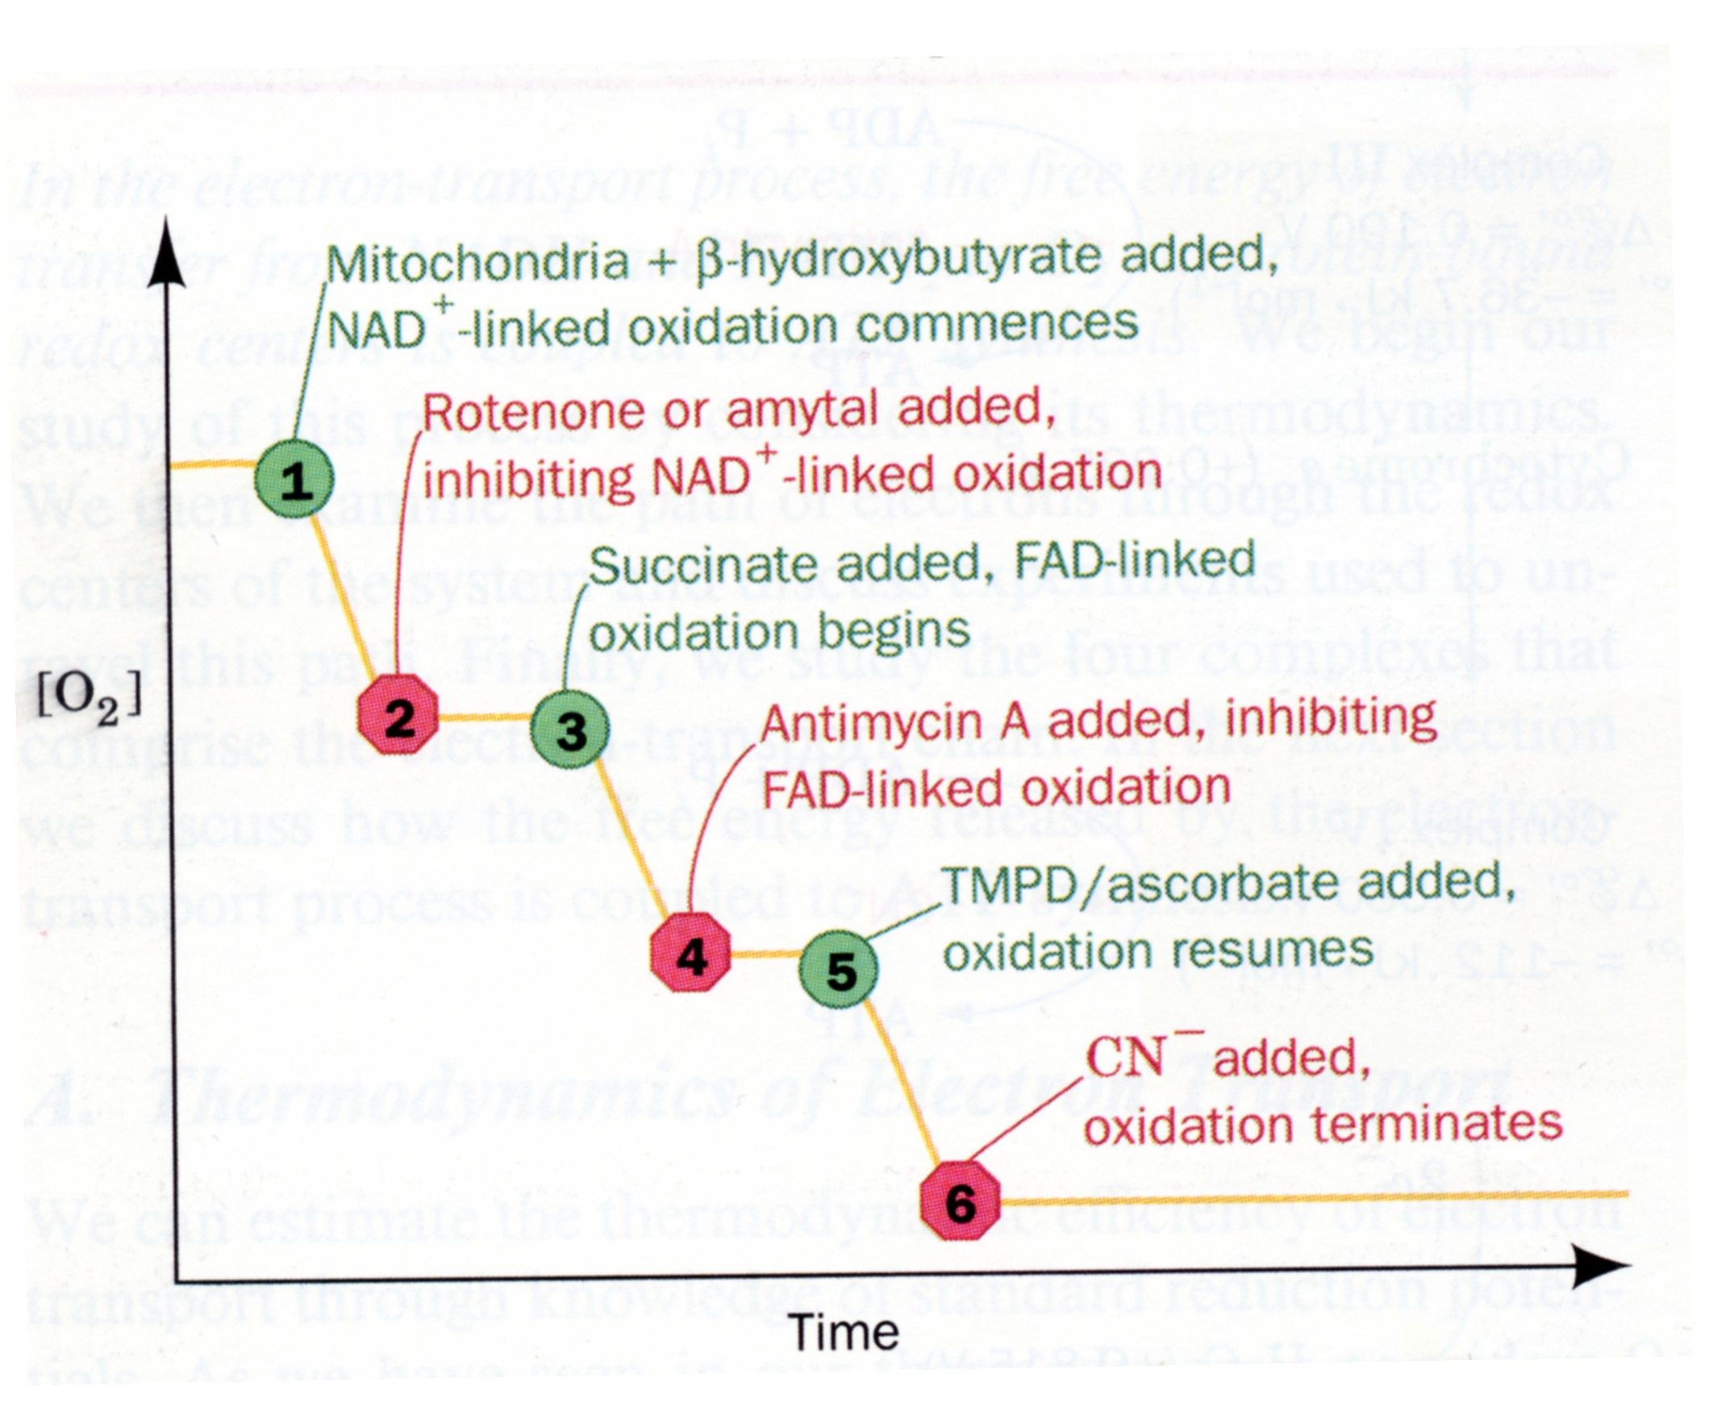

Slide 17
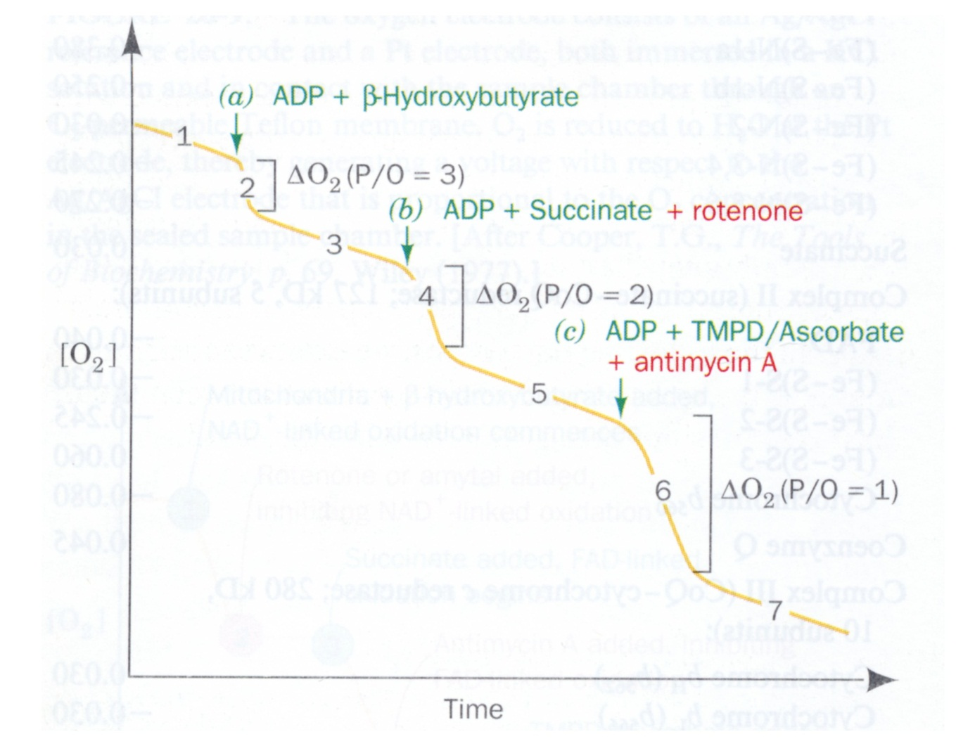
O₂ Consumption as a function of ADP P’n
ADP=90 umoles
(90 micromoles)
18 umoles
30 umoles
45 umoles
Conditions: Isolated mitochondria in buffer containing excess PO₄. Reaction is initiated by addition of ADP and e- donor.

Slide 18
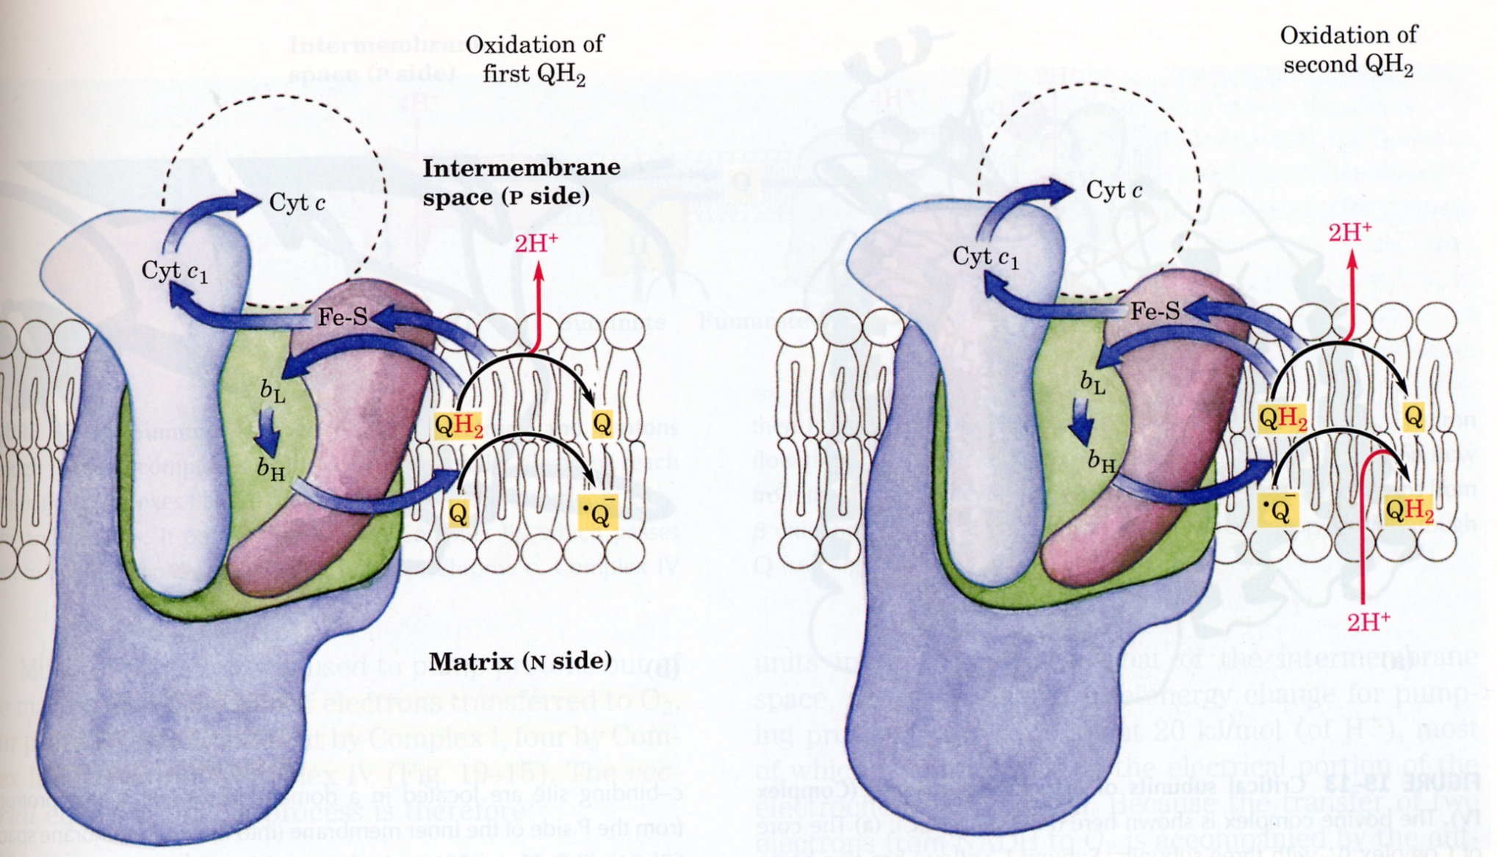
Complex III
Lehninger Fig 19-12

Slide 19
Inhibitors of Oxidative Phosphorylation
Inhibitors of Complexes I, III, & IV.
Oligomycin – antibiotic which binds to ATP synthase and blocks H⁺ translocation.
Uncouplers:
a) Dinitrophenol (DNP).
H⁺
O
O
H
O
N
O
N
2
2
O
N
O
N
2
2
IMS
MATRIX

Slide 20
b) Ionophores
i) Valinomycin – carries charge but not H⁺’s. - Dissipates electrical gradient.
ii) Nigericin – carries protons but not charge.
- Dissipates chemical gradient. (due to H⁺)
M⁺
H⁺
M⁺
M⁺ = K⁺ >> Na⁺
M⁺ = K⁺ >> Na⁺

Slide 21
Glucose
Glucose
Alanine
Palmitate
Pyruvate
Ketone bodies
Pyruvate
Oxaloacetate
2 Acetyl-CoA
2 CO₂
In liver

Slide 22
Glucose
Glucose
Alanine
Palmitate
Pyruvate
Ketone bodies
Pyruvate
Oxaloacetate
Acetyl-CoA
CO₂
In Brain

Slide 23
Glucose
Glucose
Alanine
Palmitate
Pyruvate
Ketone bodies
Pyruvate
Oxaloacetate
Acetyl-CoA
2CO₂
In Skeletal Muscle

Slide 24
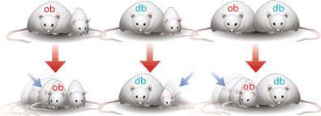

Slide 25
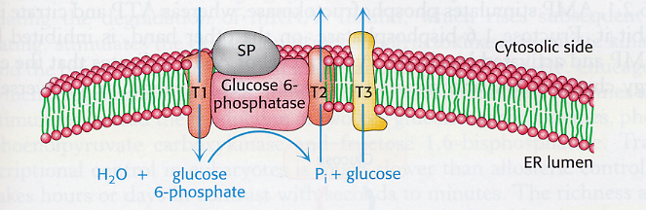
Glucose-6-phosphatase activity relies on multiple components.

Slide 26
WHY?
HOW?
WHAT?

