Slide 1
Insulin
1st molecule shown to have hormone effects
1st protein to be sequenced
1st protein to be crystallized
1st protein to be chemically synthesized
1st hormone to be made clinically available by recombinant DNA technology
Insulin is an anabolic hormone – leads to:
Increased glycogenesis
Increased lipogenesis
Increased protein synthesis

Slide 2
Insulin is the single hormone which opposes the effects of: glucagon, epinephrine, norepinephrine, and others.
Insulin deficiency (glucagon excess)
Decreased glucose uptake
Increased glucose production
Increased protein breakdown
Increased Lipolysis
Increased plasma amino acids, nitrogen loss in urine
Increased plasma FFA, ketogenesis
Hyperglycemia

Slide 3
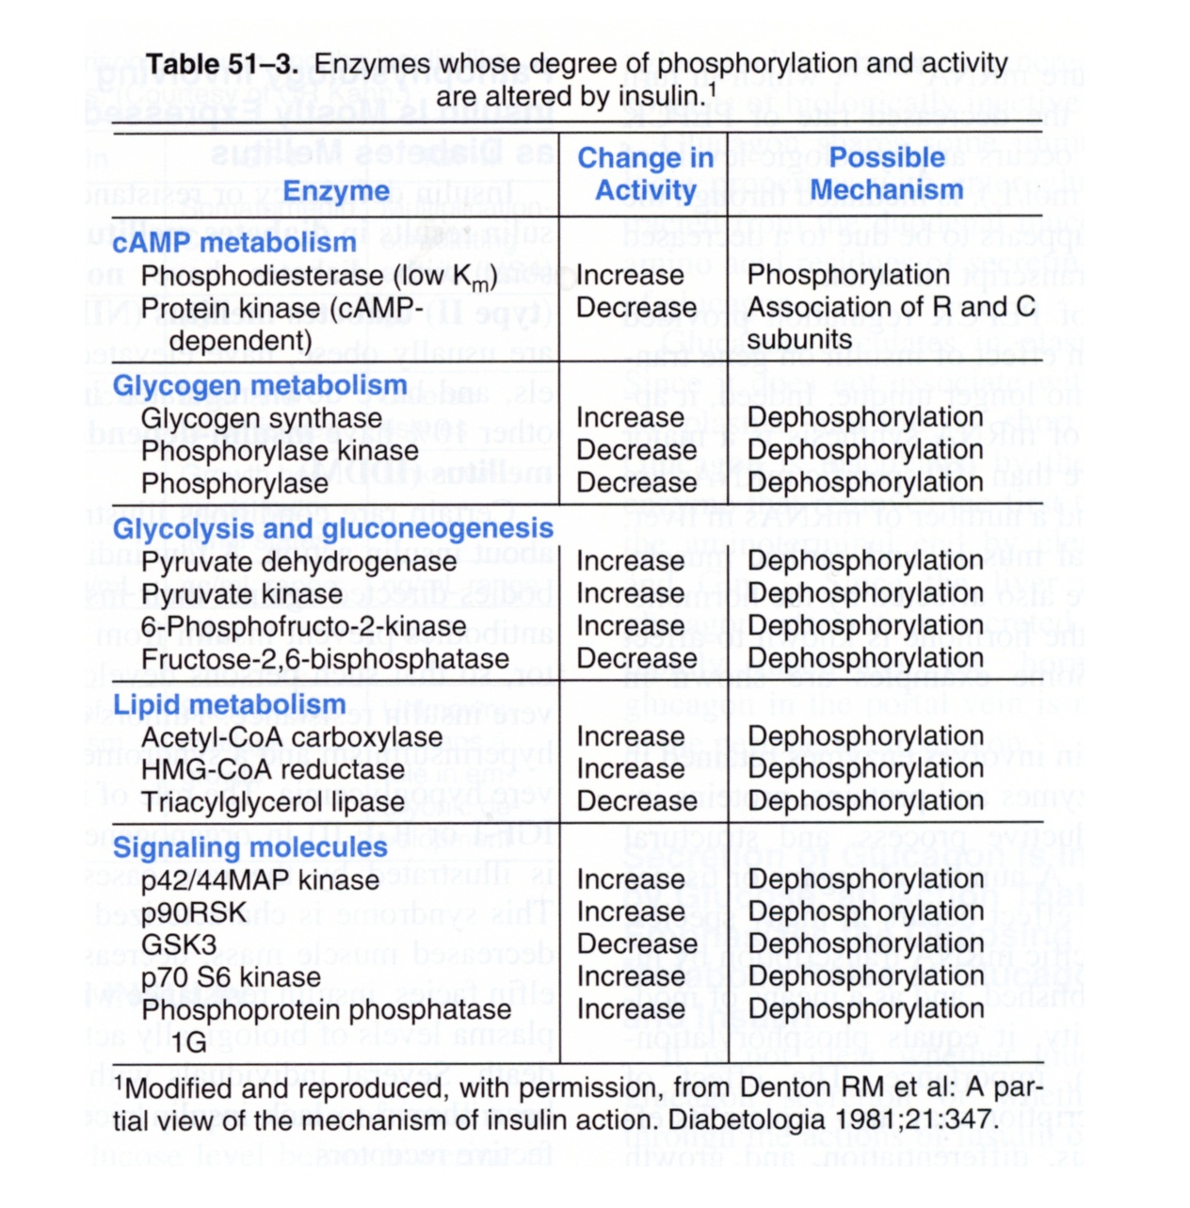
Also: ↑glucose transporters
↑PFK, PK, PFK2/FBPase mRNA

Slide 4
Insulin Deficiency – Diabetes Mellitus
Biochemistry –
The cells (the body) starve for glucose under conditions of severe HYPERGLYCEMIA!!!
Body Fuels are broken down constantly to increase lipolysis, increase glycogenolysis increase protein degradation.
Ketone bodies are formed → metabolic acidosis

Slide 5
Causes and Types of Diabetes
I Insulin Dependent – juvenile onset ~ 10%
- defect in insulin production
- autoimmune disease against pancreas
II Non-Insulin Dependent – adult onset ~ 90%
- defect in insulin receptor?
- can be autoimmune disease
- often associated with obesity
- can be controlled be diet, exercise

Slide 6
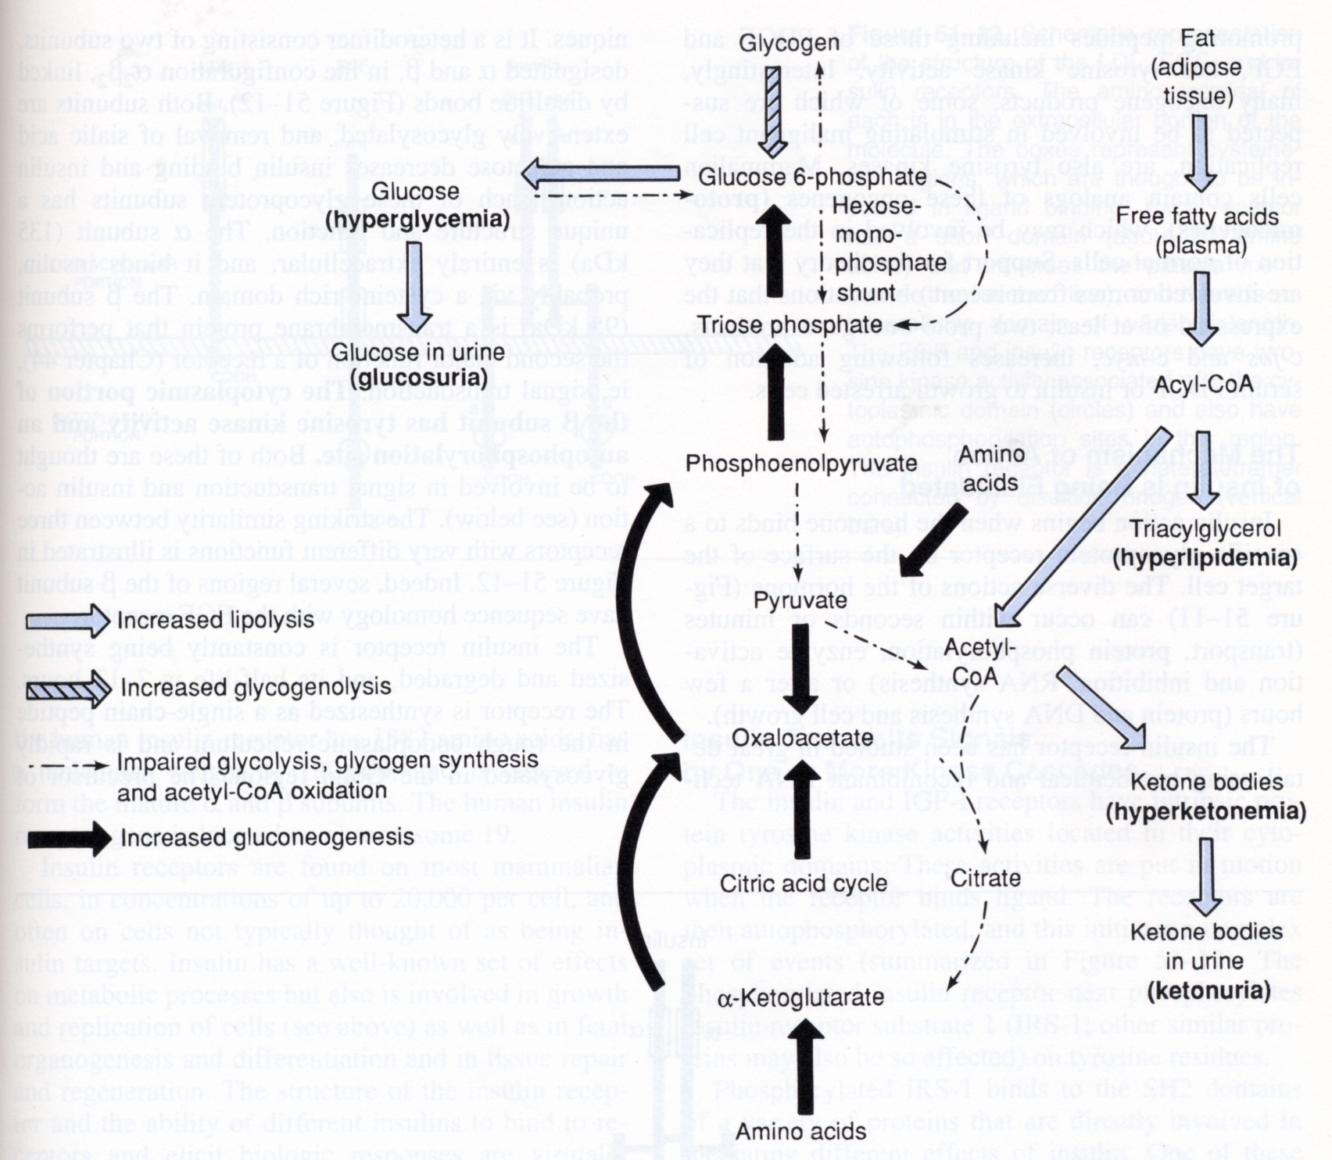
Metabolic Responses to Insulin Deficiency
In response to insulin deficiency:

Slide 7
Fatty Acid Synthesis

Slide 8
Glucose
Fatty Acid
NADP⁺
GA3P
NADPH
NAD⁺
NADH + H⁺
Pyruvate
Malonyl-CoA
Acetyl-CoA
Intracellular: NADH / NAD⁺ ~ 1/1000
NADPH / NADP⁺ ~ 100/1

Slide 9
Pentose Phosphate Pathway
2 Functions: 1) generate NADPH
2) generate ribose-5-phosphate
Substrate is Glucose-6-P:
C
H
O
ATP
O
H
2NADPH + 2H⁺
C
H
O
NAD⁺
H
O
O
H
O
H
O
H
FAD
O
H
O
H
2NADP⁺
CoA
C
H
O
P
O
C
H
O
P
O
2
3
2
3
G6P
R5P
RNA,DNA

Slide 10
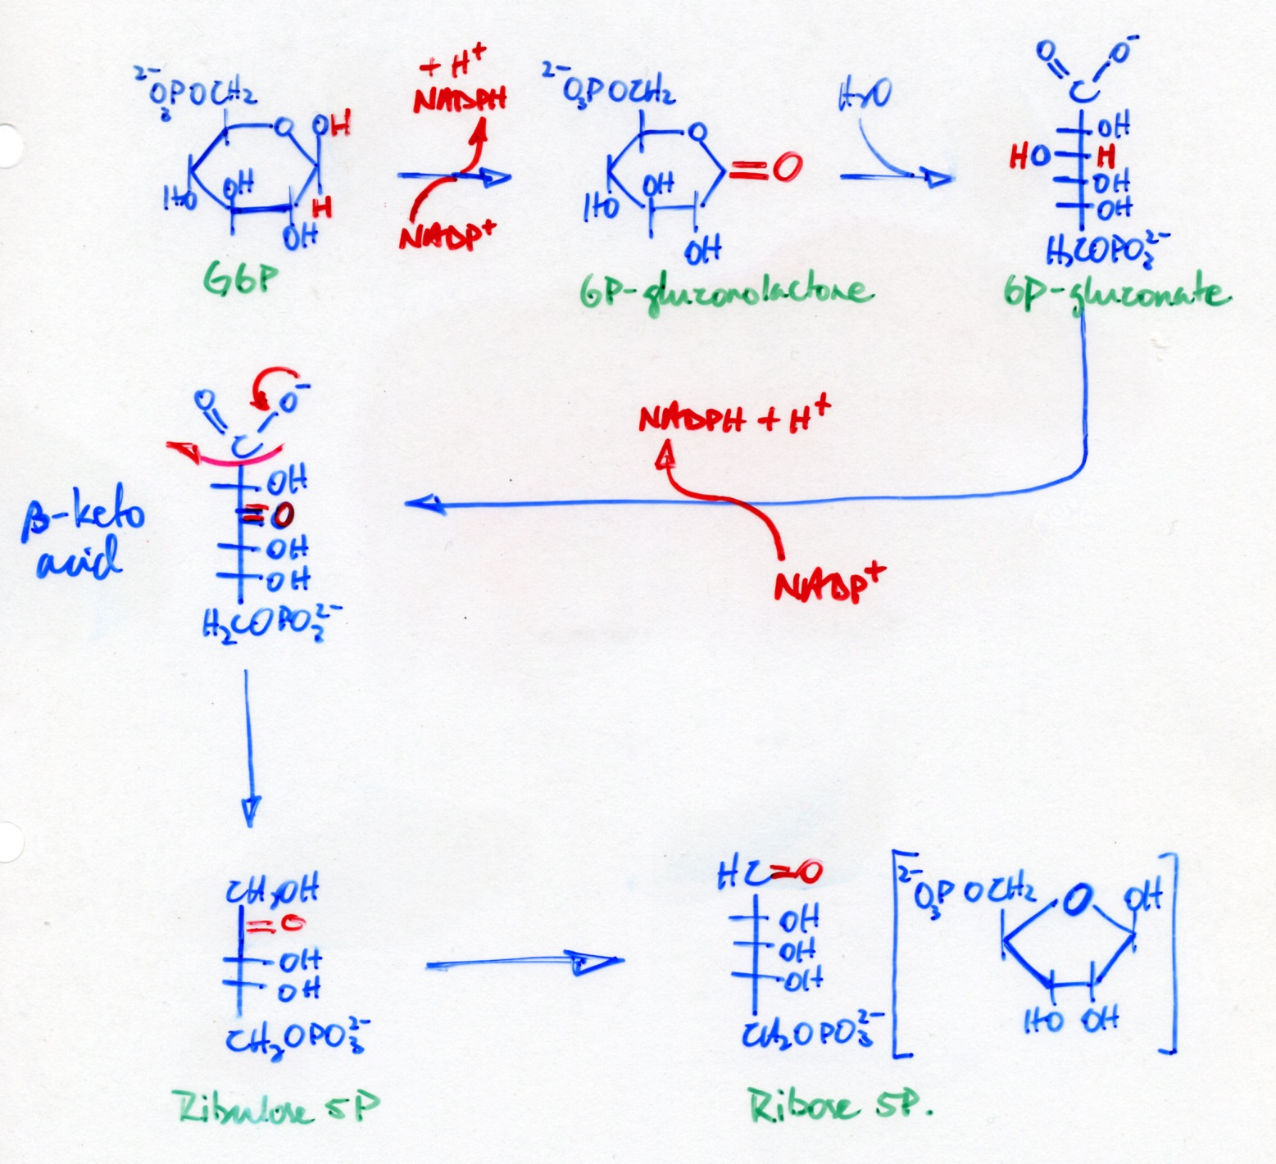
Pentose Phosphate Pathway

Slide 11
Fatty acid synthesis occurs in the cytosol
Acetyl CoA is the substrate, and therefore acetyl CoA must be transported out from the mitochondria.
FA synthesis requires NADPH – which comes from the pentose phosphate pathway.

Slide 12
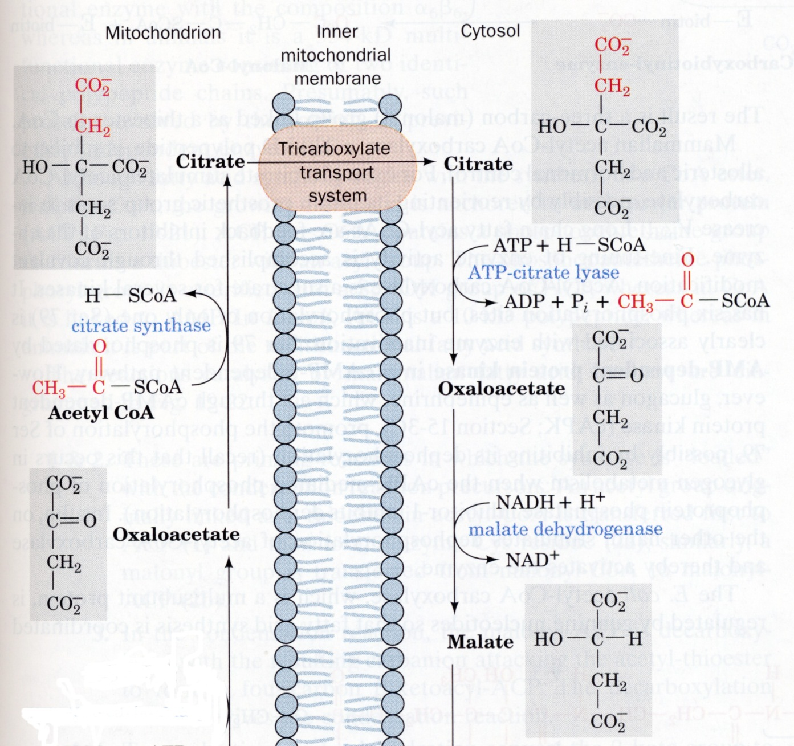
The Tricarboxylate Transporter
Acetyl-CoA
NADH + H⁺
NAD⁺
Malate

Slide 13
Glucose
Fatty Acid
NADP⁺
GA3P
NADPH
NAD⁺
NADH + H⁺
Pyruvate
Malonyl-CoA
Acetyl-CoA
Intracellular: NADH / NAD⁺ ~ 1/1000
NADPH / NADP⁺ ~ 100/1
NADH is maintained low, while NADPH is maintained high to drive glycolysis and fatty acid synthesis at the same time.

Slide 14
Activation of Acetyl-CoA
ATP
O
O
+
H
C
S
C
o
A
H
C
O
O
O
C
C
S
C
o
A
3
3
H
2
Acetyl-CoA
Malonyl-CoA
• See mechanism of pyruvate carboxylase

Slide 15
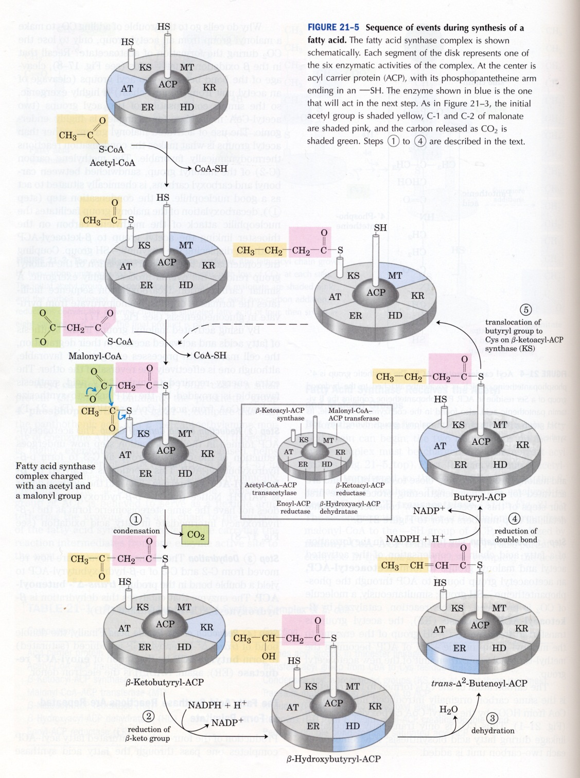
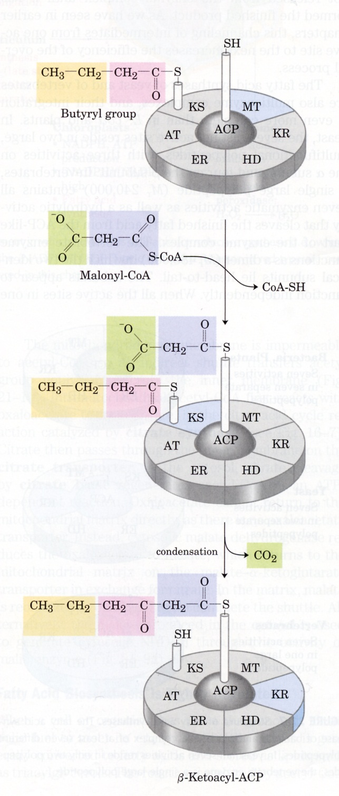
FA Chain Elongation

Slide 16
Desaturation
occurs on the membrane of the ER.
involves oxidation carried out by a mini e- transport chain
O₂ is the final e- acceptor
Requires NADH!
H⁺ + NADH
E - FAD
Fe²⁺
Fe³⁺
C
C
+ H₂O
H
H
NAD⁺
E – FADH₂
Fe³⁺
Fe²⁺
C
C
+ O₂
H
H
2
2
O
C
H
Oleic acid [C18:1]
2
O

Slide 17
Mammals cannot introduce double bonds further out than C₉.
Hence, linoleic acid (18:2 cis ∆⁹ ,∆¹² ) and linolenic acid (18:3 cis ∆⁹ ,∆ ¹² , ∆¹⁵ ) cannot be made.
They must be obtained from the diet.

Slide 18
Acetyl CoA Carboxylase
Control of FA Synthesis
ADP
ATP
Acetyl-CoA
AMP-activated PK
Citrate
P
+
–
Palmitoyl CoA
Active Carboxylase
Inactive Carboxylase
Acetyl CoA carboxylase
–
AMP
–
Glucagon
–
Epinephrine
Insulin
–
P
+
–
P’ase 2A
cAMP
Malonyl CoA
H₂O
PO₄
Fatty Acids
cAMP

Slide 19
Synthesis of Palmitate Requires:
8 Acetyl-CoA
7 ATP
14 NADPH

Slide 20
Synthesis of Triacylglycerol
NADH
C
H
O
H
C
H
O
H
2
2
O
O
H
C
H
O
P
O
C
H
O
P
O
2
3
2
3
DHAP
Glycerol-3P
In adipose tissue, glucose is required to generate DHAP, the direct precursor of glycerol-3P

Slide 21
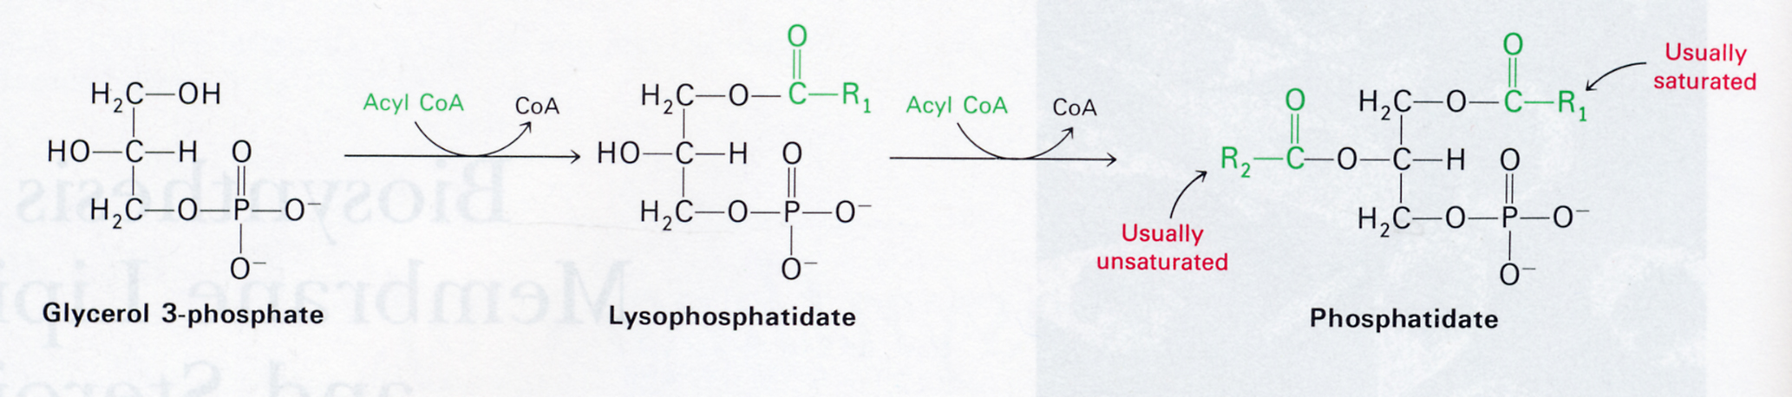
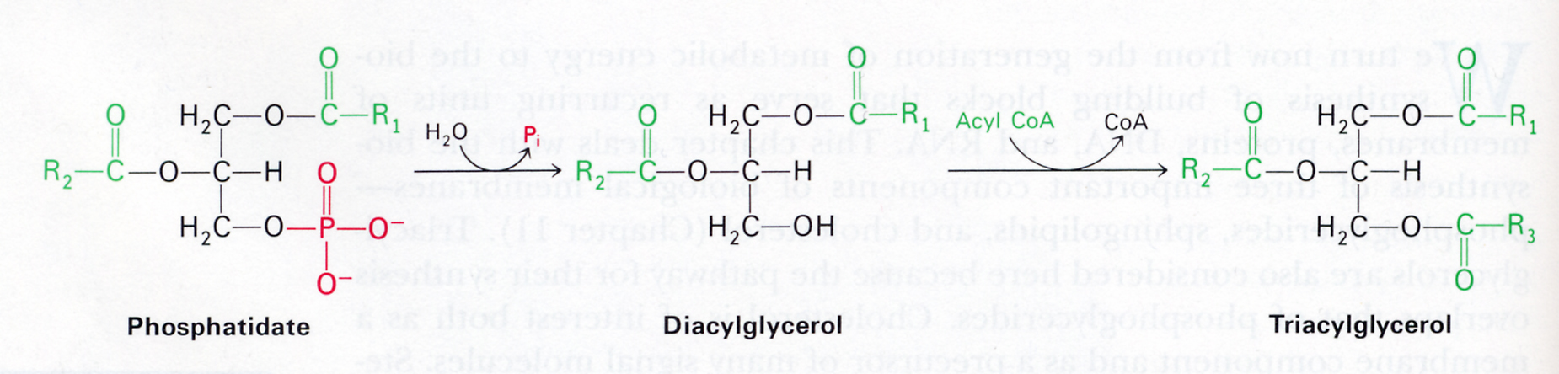
FA synthesis occurs primarily in LIVER, some in adipose tissue, some in skeletal muscle.
TAG is made in LIVER & adipose tissue. Main function of adipose tissue is TAG STORAGE.

Slide 22
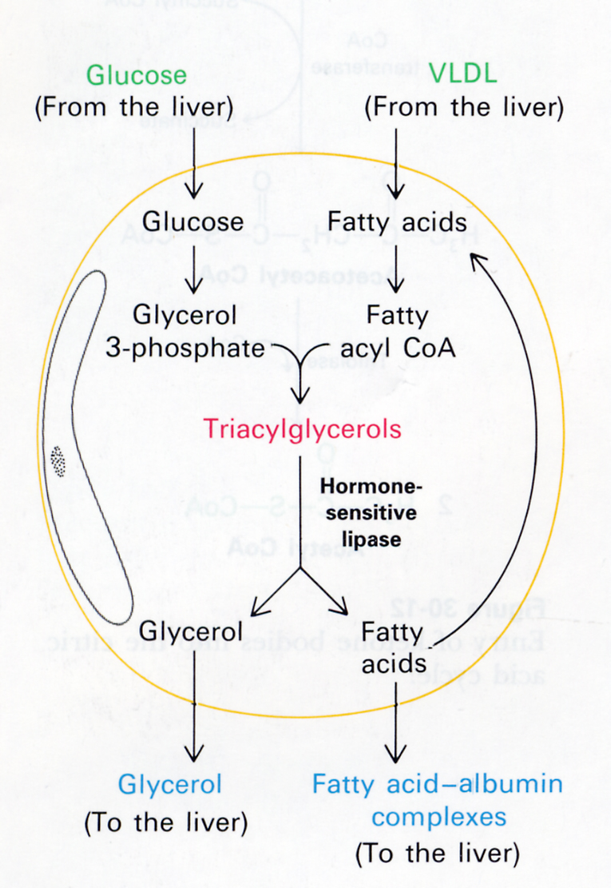
In adipose tissue, G3P must be made from glucose.
G3P cannot be made from glycerol.
Thus, glucose is required in adipose tissue for synthesis of TAG.

