Slide 1
Regulation of Body Weight
Obesity
Current criteria is based on Body Mass Index (BMI)
BMI = body mass (kg) / height² (m²)
Ideal BMI – life expectancy is maximal
BMI 18.5-24.9 healthy
25-29.9 overweight
≥ 30 constitutes “obesity”.
Health risk associated with obesity is largely due to diabetes, hypertension, heart disease.

Slide 2
Ob gene and Leptin
1950 - ob⁻/ob⁻ mouse discovered; resembles obesity in humans
- db⁻/db⁻ mouse also discovered; resembles ob⁻/ob⁻ mouse

Slide 3
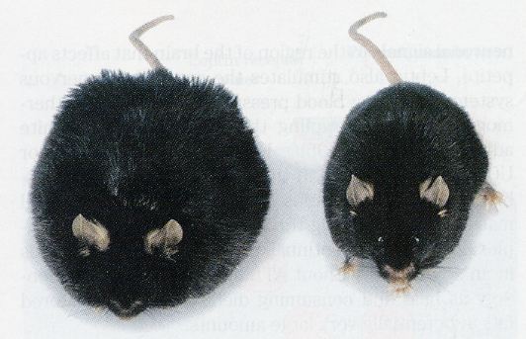

Slide 4
Ob gene and Leptin
1950 - ob⁻/ob⁻ mouse discovered; resembles obesity in humans
- db⁻/db⁻ mouse also discovered; resembles ob⁻/ob⁻ mouse
1973 - Cross circulation (parabiotic) experiments performed – normal mice encode a factor that can rescue ob⁻/ob⁻ BUT NOT db⁻/db⁻ mice.

Slide 5
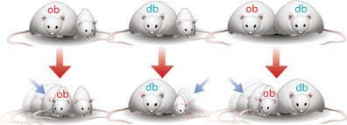
Parabiotic mice. Two mice are sutured together to form a shared circulatory system: a) ob/ob;normal, b) db/db;normal, c) ob/ob;db/db. In a) the obese mouse lost weight (suggesting a circulating ob hormone), in b) the normal mouse lost weight (suggesting that the db component does not circulate, and the ob factor is overexpressed by the db mouse), and in c) the ob mouse lost weight (suggesting that the ob factor was produced by the db mouse and circulates).

Slide 6
Ob gene and Leptin
1950 - ob⁻/ob⁻ mouse discovered; resembles obesity in humans
- db⁻/db⁻ mouse also discovered; resembles ob⁻/ob⁻ mouse
1973 - Cross circulation (parabiotic) experiments performed – normal mice encode a factor that can rescue ob⁻/ob⁻ BUT NOT db⁻/db⁻ mice.
1994 - ob gene is isolated at Rockefeller; encodes a protein of 167 aa’s secreted into the blood – LEPTIN. Licensed to Amgen for $20 million.

Slide 8
Leptin is absent in ob⁻/ob⁻ mice, but is elevated 20-fold in db⁻/db⁻ mice.
db gene encodes the receptor for leptin.
Circulating leptin levels are highly correlated with adipose tissue mass.
Leptin is the hormone that regulates body weight.

Slide 10
Both mice are ob⁻/ob⁻. The mouse on the R was injected with leptin daily and weighs 35 g. The mouse on the L received no leptin and weighs 67 g.

Slide 11
Leptin is absent in ob⁻/ob⁻ mice, but is elevated 20-fold in db⁻/db⁻ mice.
db gene encodes the receptor for leptin.
Circulating leptin levels are highly correlated with adipose tissue mass.
Leptin is the hormone that regulates body weight.

Slide 12
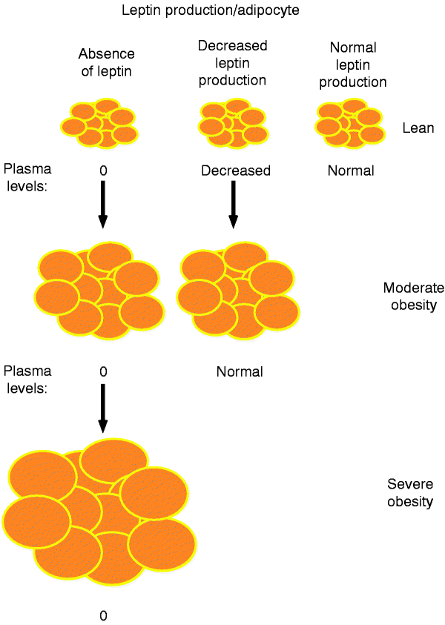

Slide 13
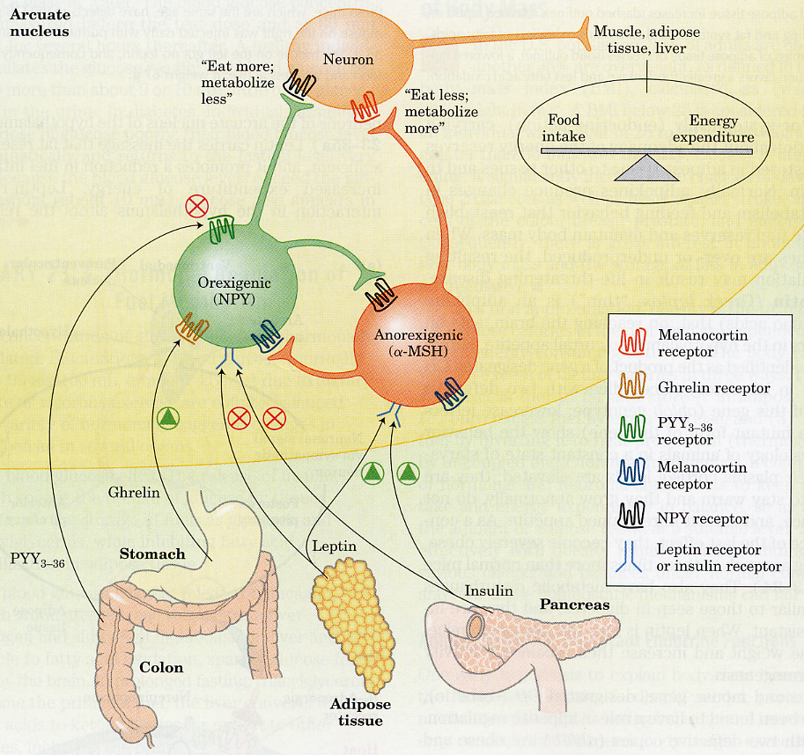
Target of Leptin - Leptin is secreted by adipose tissue, and targets the arcuate nucleus in the hypothalamus – the center for appetite control.

Slide 14
Leptin and obesity
In humans – all obese subjects express some leptin, most express high levels
Therefore not due to mutation in ob, but rather is due to some form of leptin resistance – exact basis unknown.

Slide 16
Role of leptin in obesity
ob gene encodes leptin; db encodes the leptin receptor
Leptin is absent in ob⁻/ob⁻ mice, but is elevated 20-fold in db⁻/db⁻ mice. Why?
Circulating leptin levels are highly correlated with adipose tissue mass.
Leptin is the hormone that regulates body weight. Demonstrated by injecting leptin into ob⁻/ob⁻ mice.

