Slide 1
Regulation of Glycolysis

Slide 2
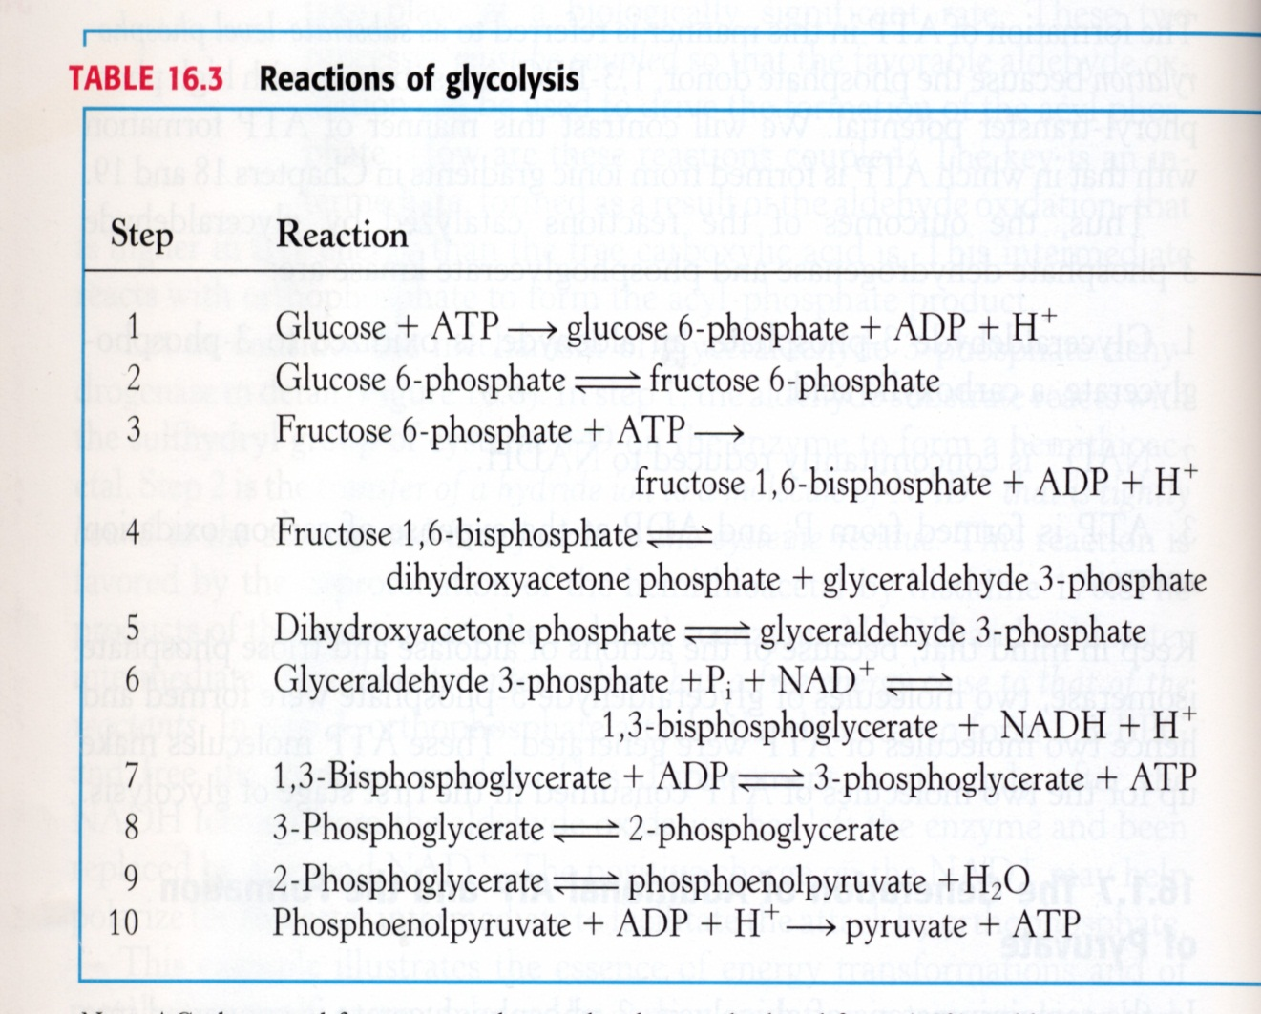
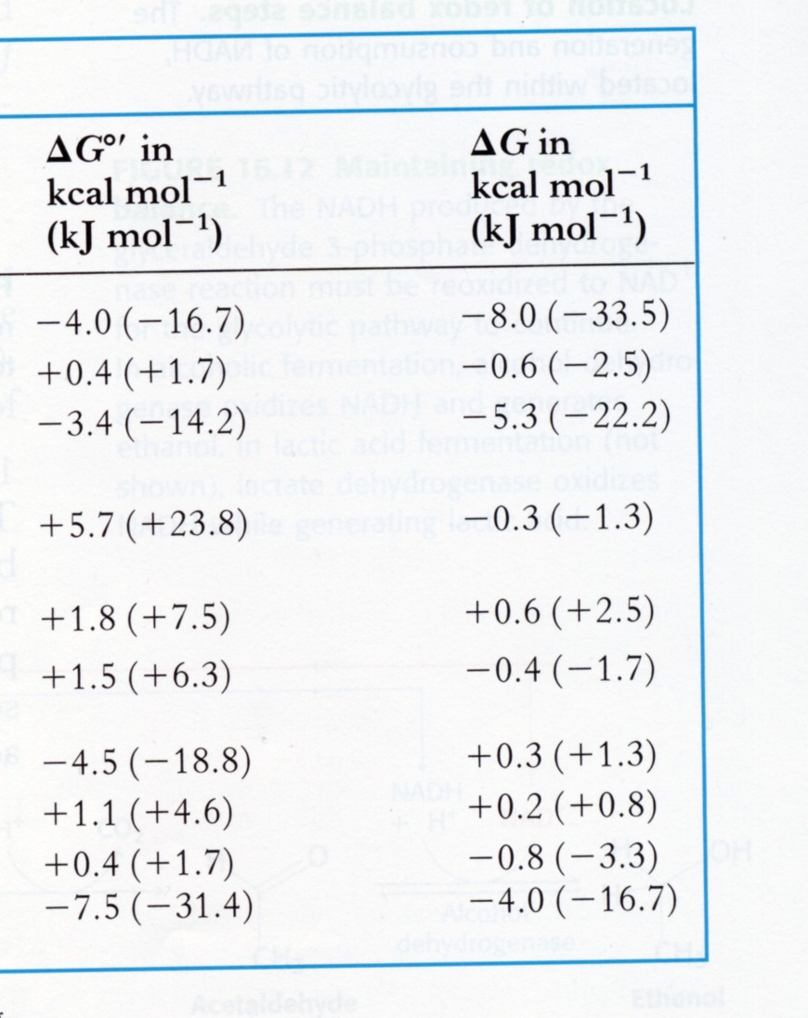
HK
PFK
PK
-8.5
-18.3 kcal/mol

Slide 3
Regulation of Metabolic Pathways by Energy Charge
ATP generating (catabolic) pathways are inhibited by high energy charge, whereas ATP-utilizing (anabolic) pathways are stimulated by high energy charge.
The energy charge in cells can vary from 0 (all AMP) to 1 (all ATP)
[ATP] + ½ [ADP]
Energy Charge =
[ATP] + [ADP] + [AMP]

Slide 4
ATP-consuming pathway
Relative
Velocity
ATP-generating pathway
Energy Charge

Slide 5
Regulation of Phosphofructokinase (PFK):
Cooperativity

Slide 6
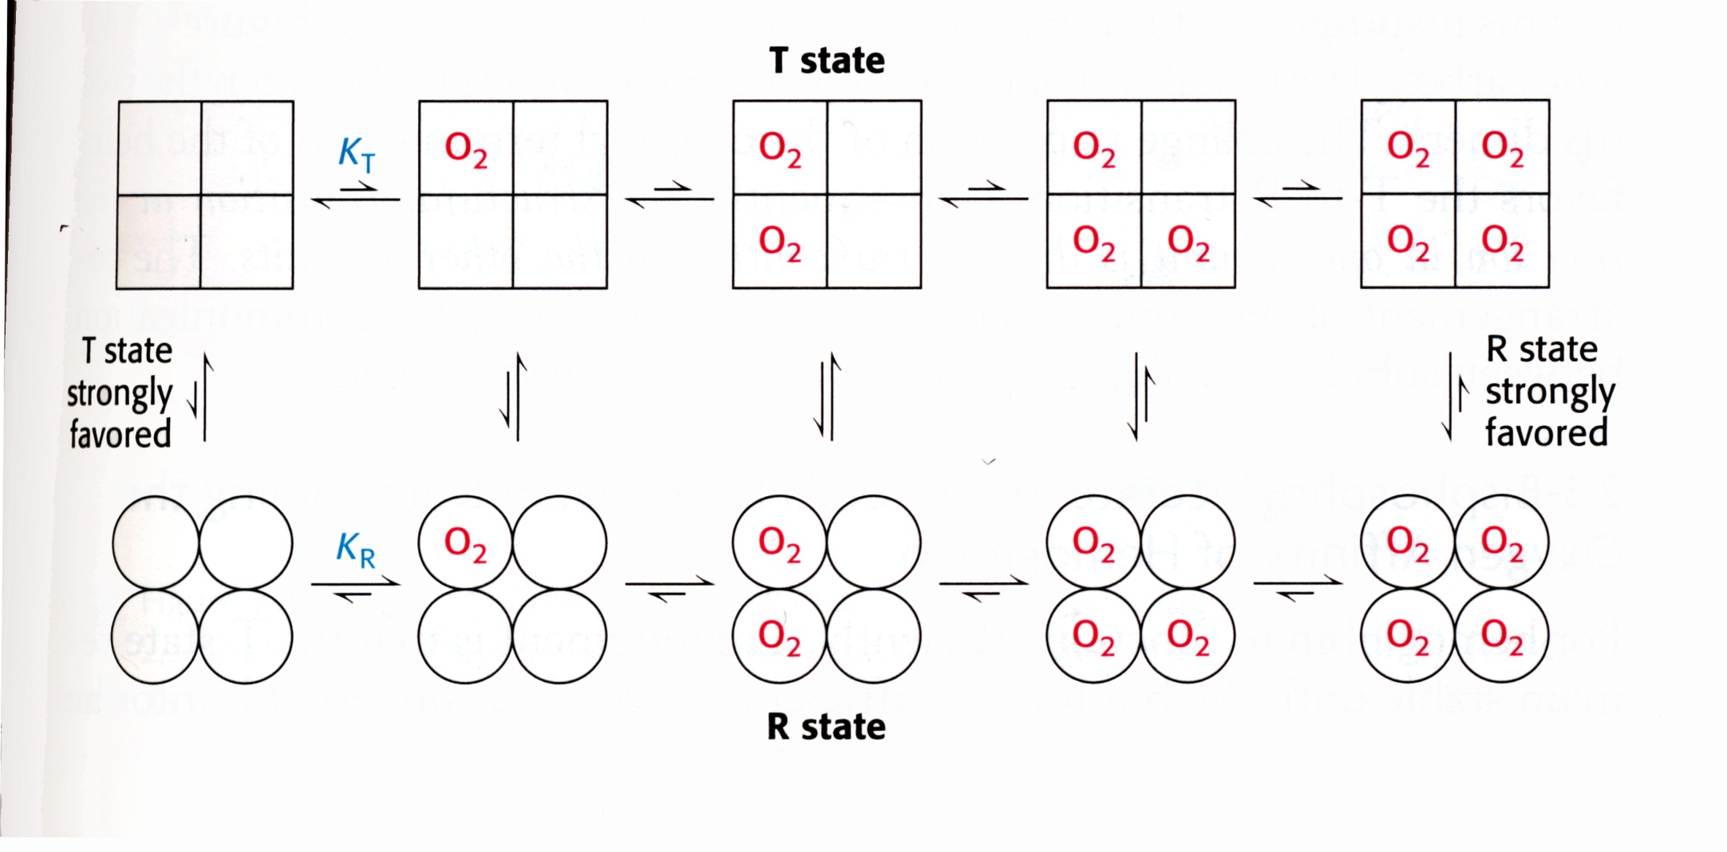
Cooperativity – The concerted model

Slide 7
Cooperativity – The concerted model

Slide 8
Cooperativity – The concerted model

Slide 9
Cooperativity – The concerted model

Slide 10
Cooperativity – The concerted model
90
70
50
30
10
10
30
50
70
90

Slide 11
Bound receptor
[O₂ (or substrate)]

Slide 12
For Cooperativity:
1) T₀/R₀ is large
2) Affinity of S for R >> S for T

Slide 13
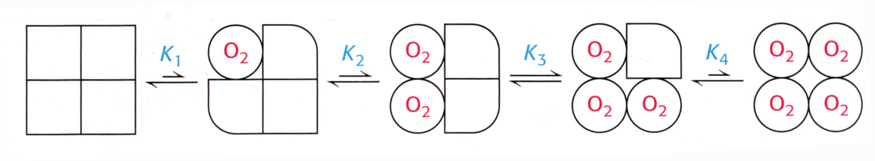
The Sequential Model
?

Slide 14
Cooperativity – The concerted model
Ligand
Ligand
R
T
Bound
Ligand
Ligand

Slide 15
Phosphofructokinase
ATP
AMP
F6P
R
T
R ( ATP, AMP)
PFK
Activity
T ( ATP, AMP)
Fructose-6-P

Slide 16
PFK
Allosteric site
AMP
F6P
ATP
Active site

Slide 17
Allosteric site
AMP
PFK
F6P
ATP
Active site

Slide 18
Phosphofructokinase
ATP
AMP
F2,6BP
F6P
R
T
R ( ATP, AMP)
PFK
Activity
T ( ATP, AMP)
Fructose-6-P

Slide 19
Allosteric site
ATP
PFK
F6P
ATP
Active site

Slide 20
Regulation of PFK by F-2,6-BP
Glucose
PFK2
P
O
C
H
C
H
O
H
2
O
2
F-6-P
F-2,6-BP
H
H
O
H
O
P
FBPase 2
O
H
H
α-D-F2,6BP
PFK
+
F-1,6-BP

Slide 21
PFK2 & FBPase2 are encoded within the same protein!
PFK2
FBPase2
P
↑Glucose → ↑glycolytic flux is desirable
↑Glucose → ↑insulin → deP’n of PFK2/FBPase2 → +PFK2/−FBPase2 → ↑F2,6BP → +PFK
↓Glucose → ↓glycolytic flux is desirable
↓Glucose → ↑glucagon → P’n of PFK2/FBPase2 → −PFK2/+FBPase2 → ↓F2,6BP → −PFK

Slide 22
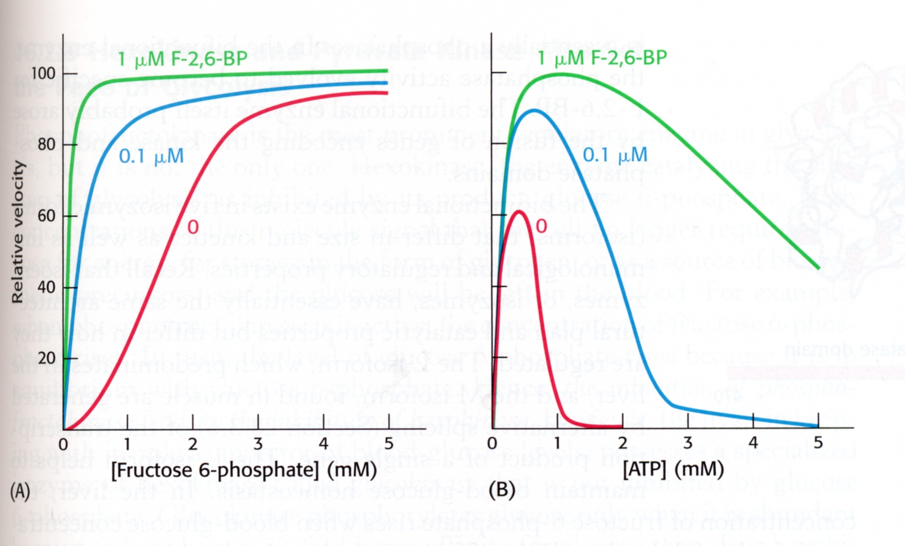

Slide 23
The sigmoidal binding of F6P at high energy charge emphasizes inhibition of PFK at low F6P concentrations.
Other Effectors of PFK activity:
1. Low pH inhibits
2. High citrate inhibits

Slide 24
Inhibition of PFK by H⁺ & Citrate
Glucose
Anaerobic
PFK
Lactate
(H⁺ + CH₃CHOHCOO-)
Pyruvate
Acetyl CoA
Aerobic
Citrate
Oxaloacetate

Slide 25
To engineer cooperativity:
>1 substrate binding site
sites talk to each other
For the concerted model:
3) R and T forms exist in equil^{m}
4) T₀/R₀ is large
5) Affinity of S for R >> for T
9

