Slide 1
My Love for technology by Aaron Larsen

Slide 2
Why I love technology
The Reason why I Love technology is because it is always improving!
Technology is being used in every field across the World!
I love to play video games, make 3D projects with friends, and discuss problems with them

Slide 3
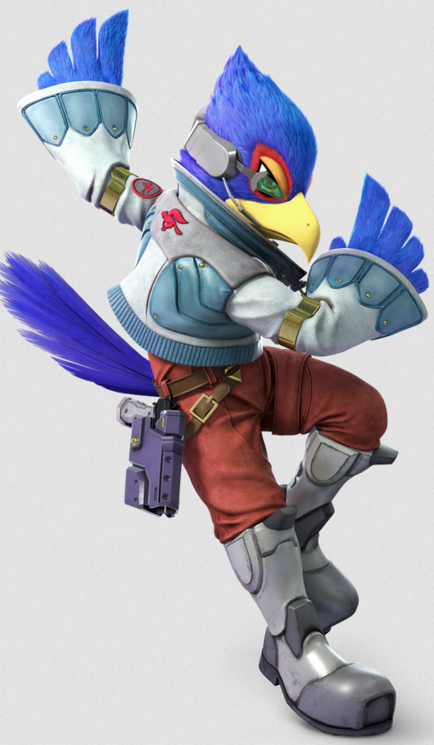
Personal Experience
I started playing video games around the age of 5 and with the years passing I had started from playing the Playstation 2 to PC gaming
I am a competitive Super Smash Bros player who plays Falco Lombardi
I had built personal computers for friends and family with the reason why we chose particular parts besides “IT FITS IN THE BUDGET”-

Slide 4
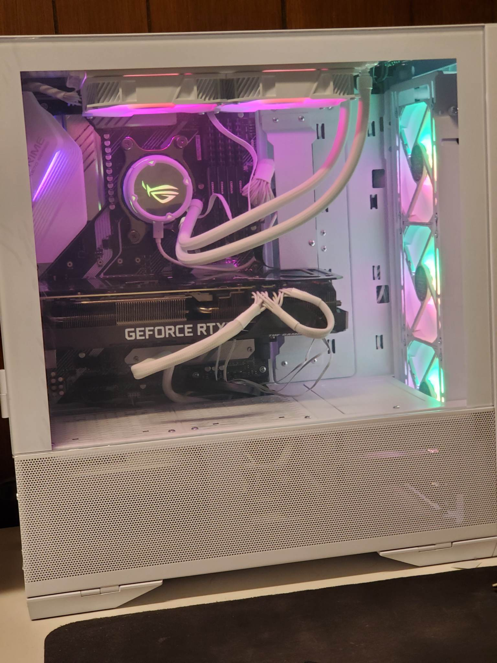
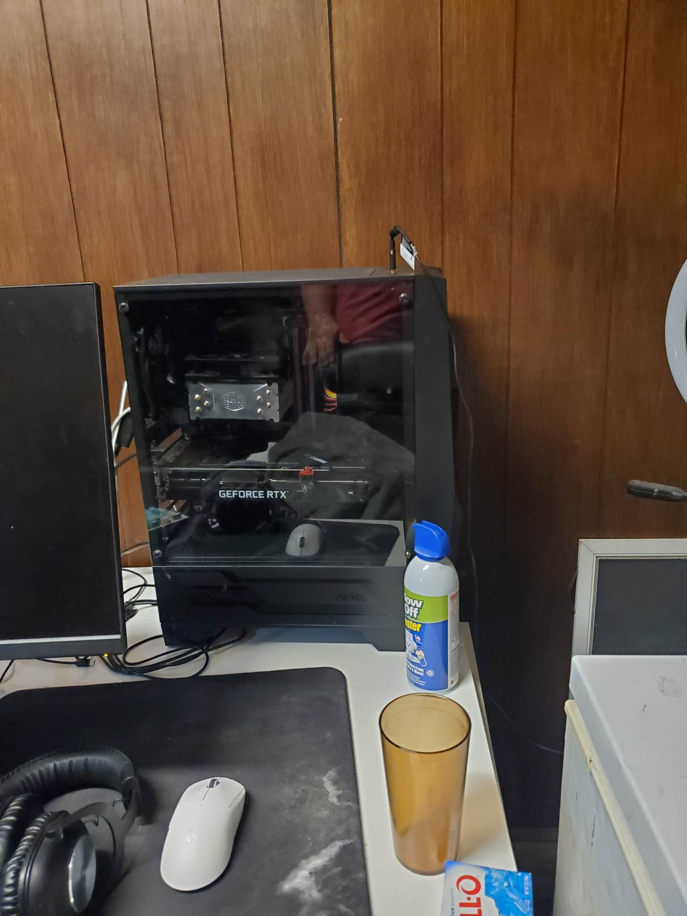
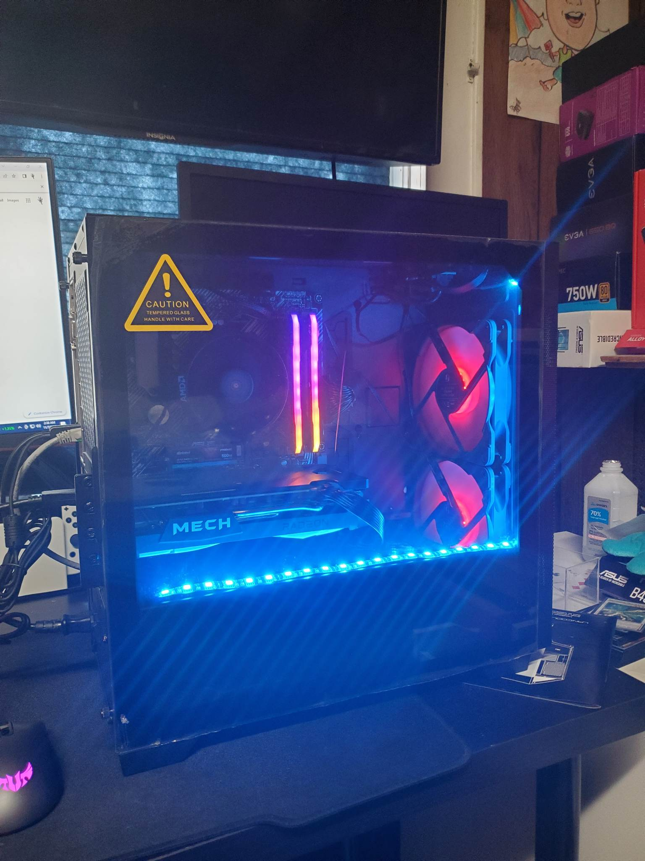
Pictures

