Slide 1

ACE logbook
Made by Remy Ligeon, Aaron Struikenkamp, Owen Kopetzky and Stan van Meijeren (CV5TB)

Slide 2
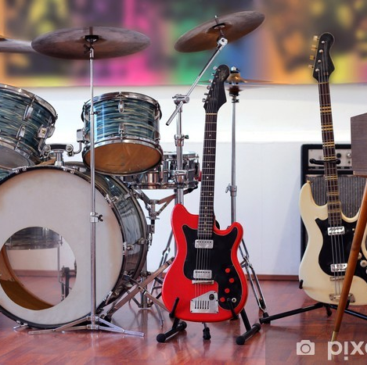
Index
All our lessons
What are the current plans?
Summary
Planning

Slide 3

4-9-2023
Today we looked at the options we had to choose between for the project. After quite a while we came to an agreement to remake a song. We didn’t know what song to choose so after 40-50 minutes of brainstorming we still didn’t know which song we to choose so that was going to be a problem for the next lesson. We did talk about who can play what. Aaron could play guitar because he is already a guitarist so he has experience, Owen could play the drums because he's already a drummer, Remy could play bass because he's already a bassist and then finally we concluded that Stan could play keyboard because he has one at home so he can practice. Although there was still the question whether Aaron could learn Stan how to play the guitar, we all knew it would be better if he didn’t due to our limited time.

Slide 4

11-9-2023
Today we spent most of the lesson on deciding which song was both a good fit for our group and achievable with the musical capabilities of our group. After we settled on Another one bites the dust by Queen it was time to decide who was going to do what instrument, for the most part this was easy because Aaron is already a guitarist, so he is going to perform the guitar while Remy who is already a bassist is going to take care of the bass and Owen is taking the drums because he is already a drummer. The hard part was to think of what Stan could do because he doesn't have a musical background, eventually we settled on a keyboard as Stan has one of those at home so he can practice.

Slide 5

Song Lyrics
Here is a website that shows the lyrics and the meaning behind Another One Bites The Dust: Queen – Another One Bites the Dust Lyrics | Genius Lyrics

Slide 6


Current plans
After a lot of discussion and possibilities, we settled on another one bites the dust by the band Queen. All of us will play the instrument we are most familiar with(as mentioned before). We need to practice as a band a lot more, seeing how little time we have. We have never made any music together so I believe it will be a very interesting process. Currently we have only practiced solo. We do not need a lot, except for the instruments and a space to practice. I expect us to play as a band in the next Ace lesson if we get a pass.

Slide 7
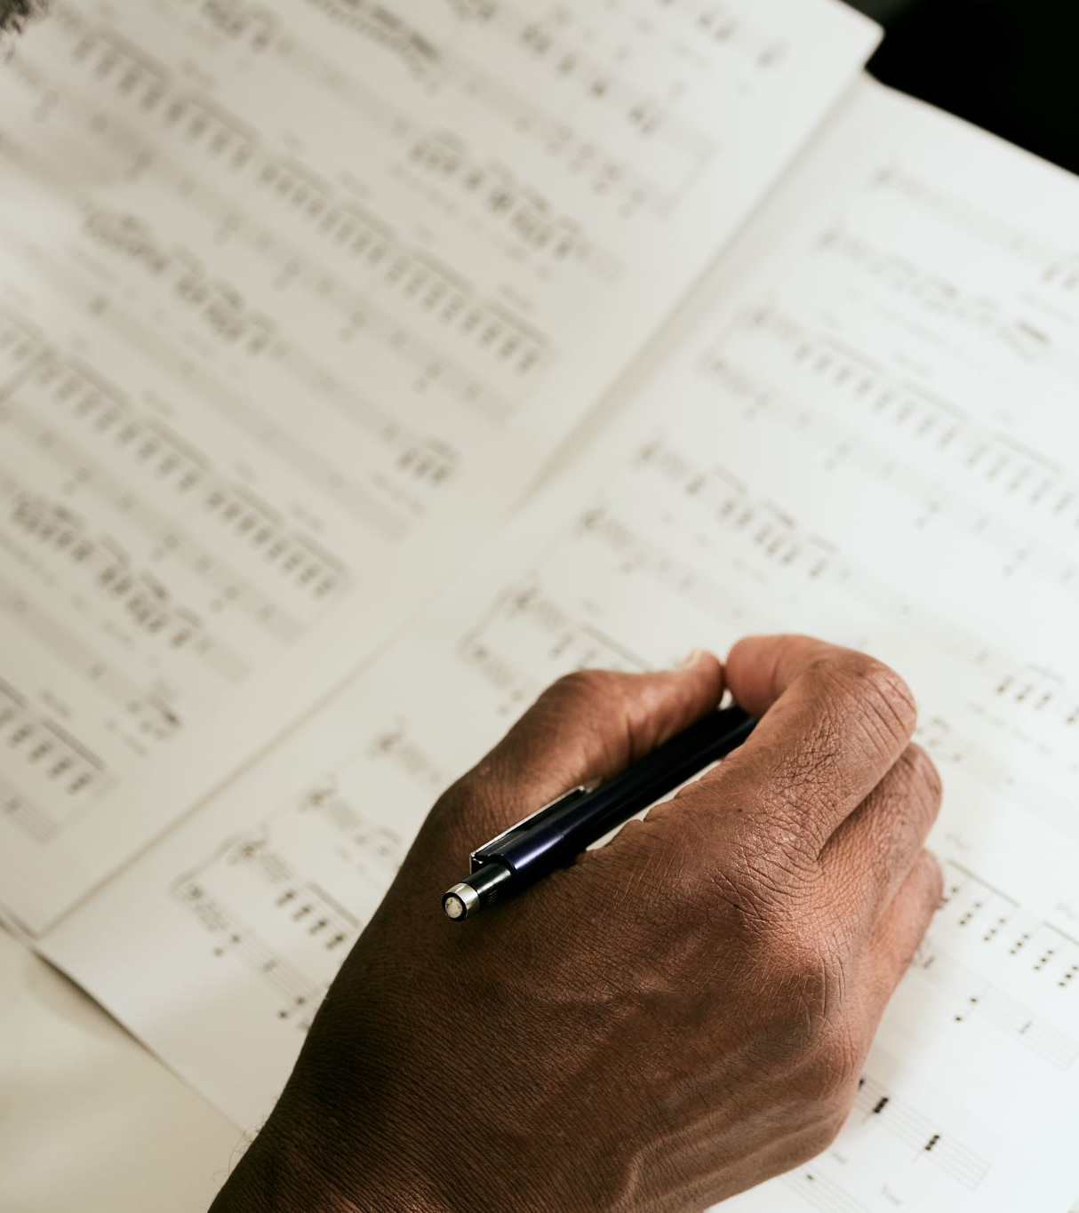
Summary
To sum it all up, we have chosen a song to practice and therefore a goal to work towards in this project. We have divided the tasks equally and everyone can practice at home to make the song come together with some practice in school. We definitely need some practice but luckily we have enough time to make this work. We still need to figure out how to get vocals, but we are sure to come up with a solution in time.

Slide 8
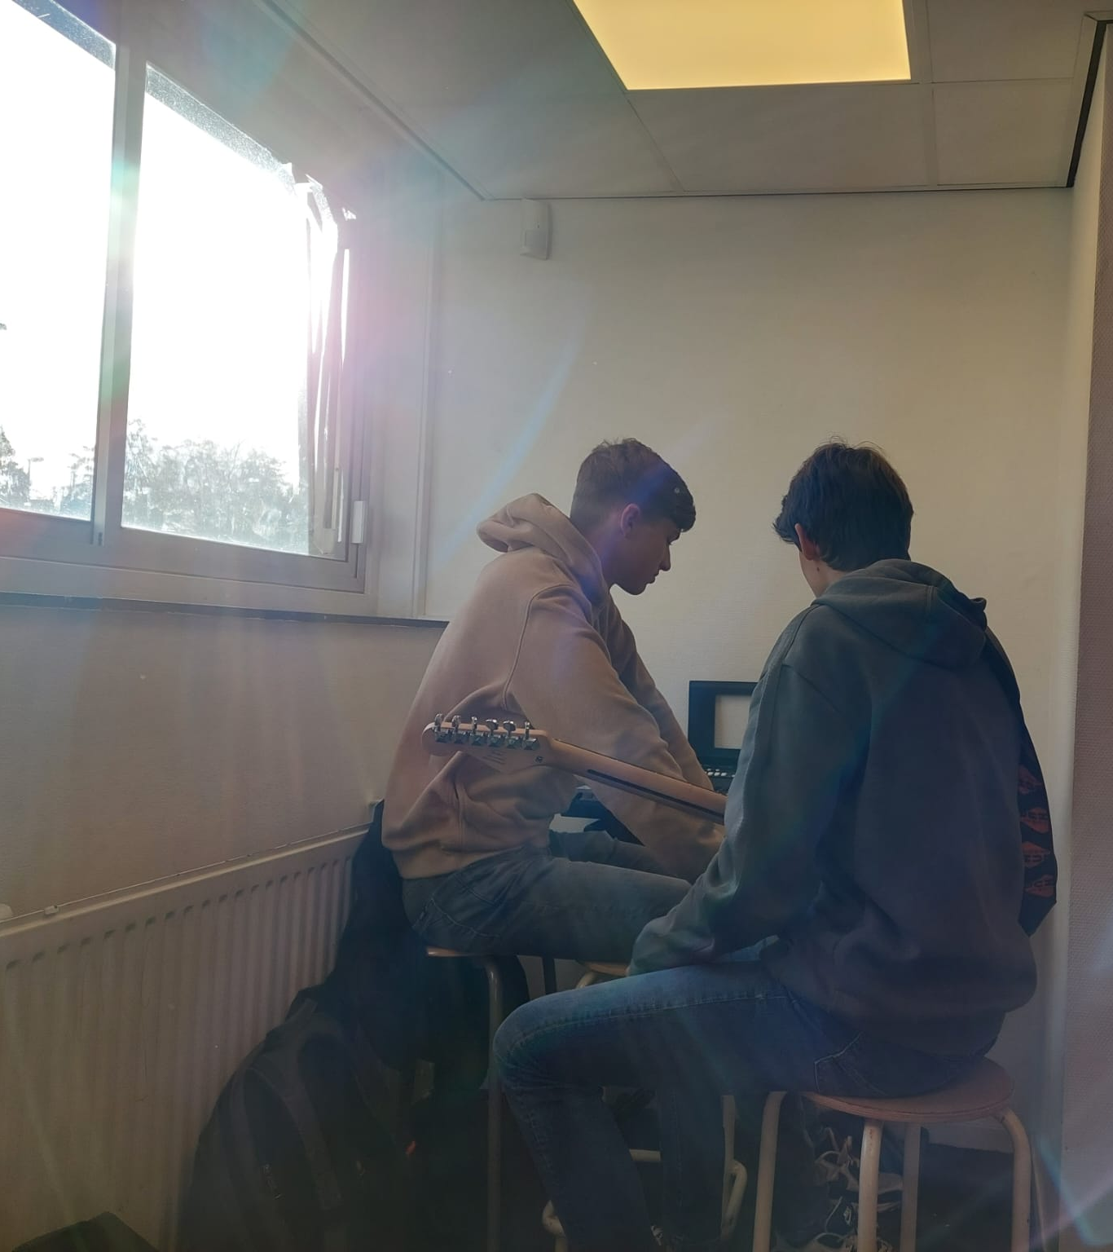
18-9-2023
Today we practiced a bit and Aaron and Stan looked at the online options for keyboard pieces to play in the song. We considered doing solos in the middle piece and decided it probably wouldn’t work. We left this idea, but we might come back to it later. While Stan and Aaron were searching, they also looked at pieces of guitar that Stan could possibly cover with his keyboard. They found nothing, so Aaron decided that Stan could take over some of his pieces. This idea was fine with all of us.

Slide 9

25-9-2023
Today, there was a lot of uncertainty. We doubted about our song since we had no idea how we were going to do it without vocals since the song would be boring without them. Owen told us about a song called Green Onions by Booker T. & the M.G.'s. It was a song without any vocals, and it was fairly easy. Too easy perhaps. At the end of the lesson, it wasn't clear which song we were going to do. Thus, nobody practiced

Slide 10
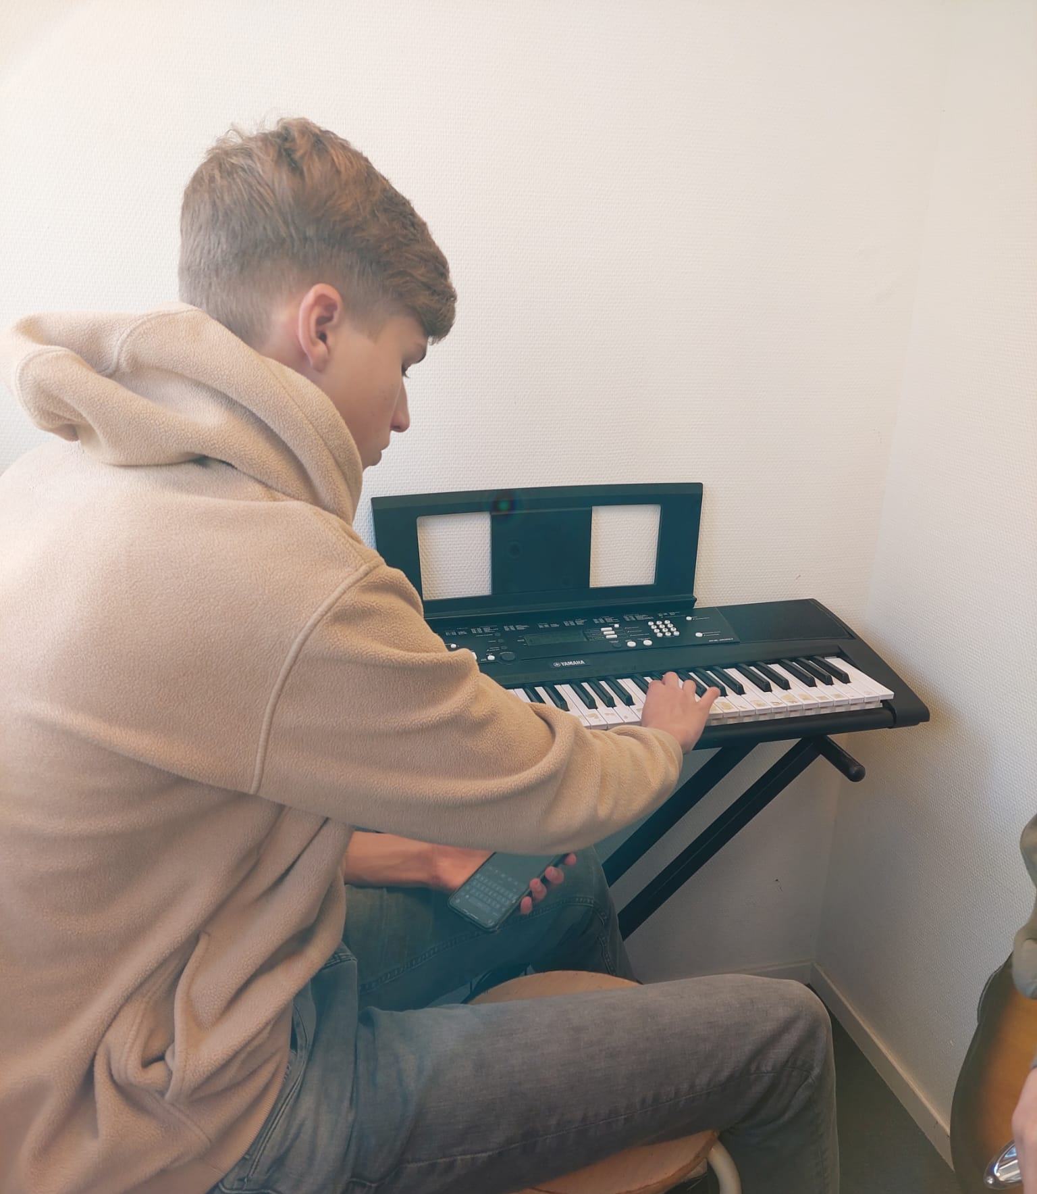
2-10-2023
Coming into this lesson, we weren't sure what we were going to practice. Eventually our teacher came to check up on us and we shared our doubts with him about the songs. He told us that Stan would be able to do the melody on the keyboard or just fragments if it was too difficult. We agreed that this would be the best option. So, we started practicing again with this knowledge. Unfortunately Stan doesn’t have the notes yet and Owen isn't able to practice on the drumkit since other people are using the kit during our ACE lessons

Slide 11
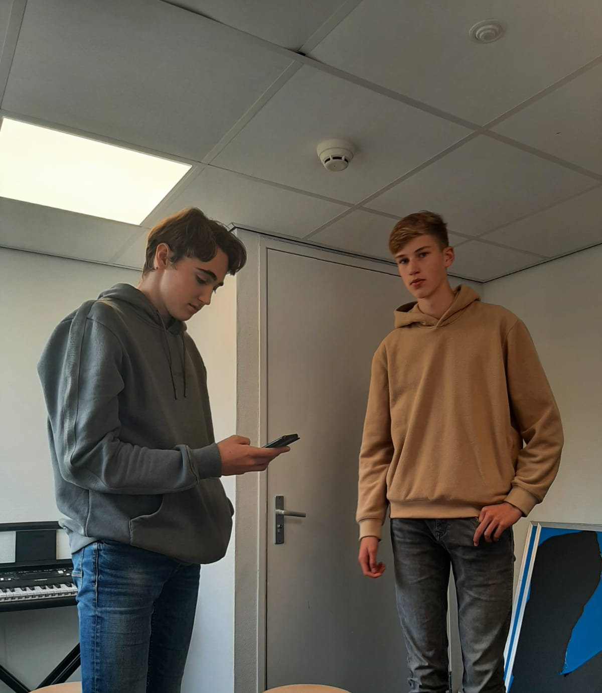
23-10-2023
In today's jam session, Remy was on a mission, perfecting his bass part. On the flip side, Aaron and Stan were deep in detective mode, trying to crack the code of what the piano notes were going to be. Teamwork makes the dream work, right? So, we're all just vibing and figuring it out as we go in this musical journey.

Slide 12
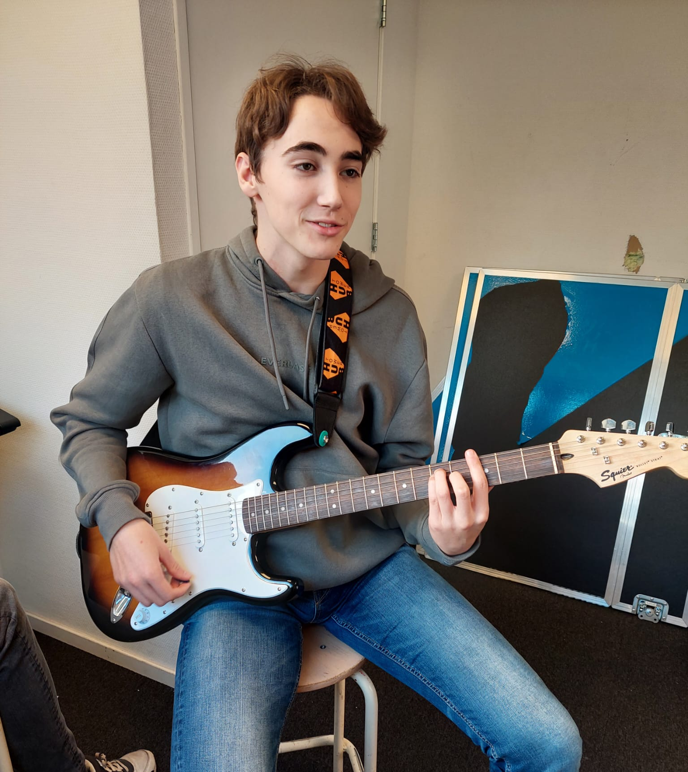
30-10-2023
After finishing the detective work Aaron and Stan had found the correct notes Stan needed to play for the song. So he started practicing it. Remy had almost perfectionised his part. Owen worked on his part but did it on his chair since we had no drumset in the room we practiced.

Slide 13
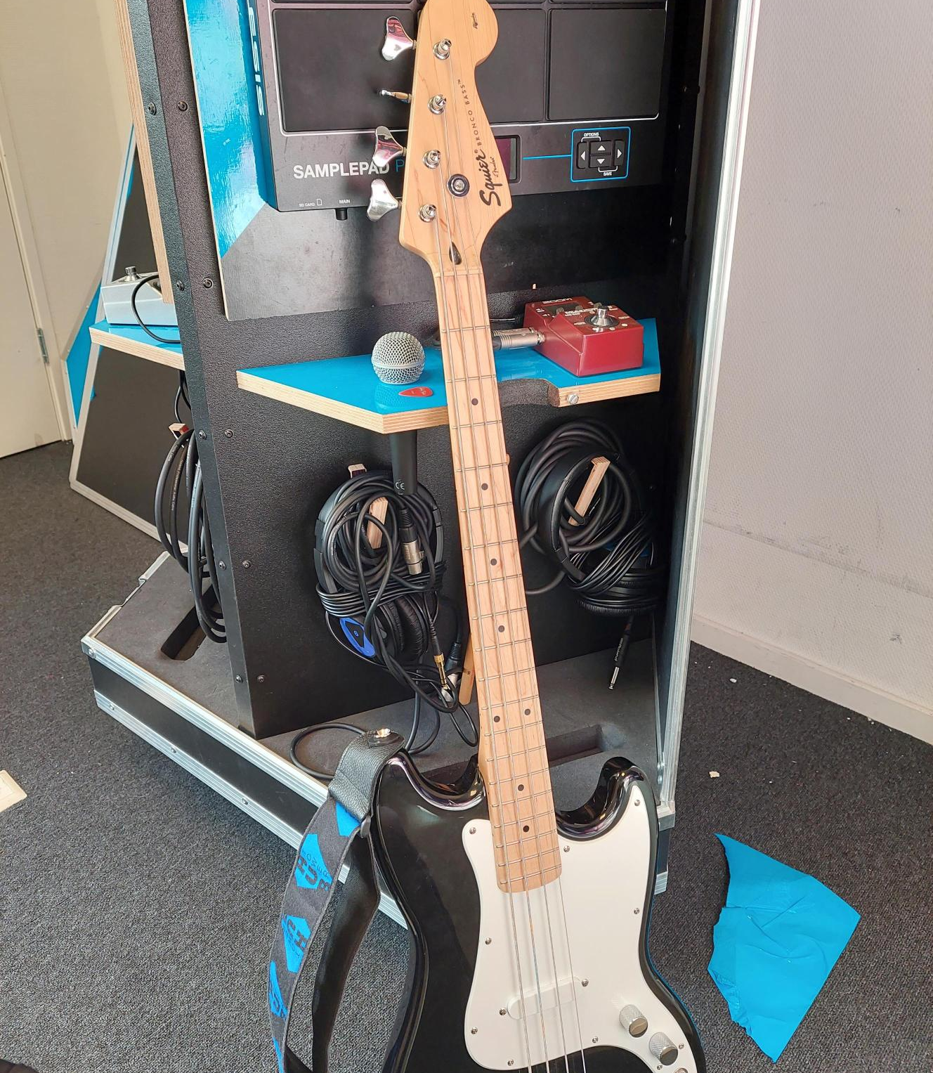
6-11-2023
Today everyone tried to perfect the part they needed to do so we could try and start recording our song for the final product. After some time of practicing, we came to the conclusion that we needed more time before recording it so we practiced this lesson, hoping we could finish it the next time.

Slide 14
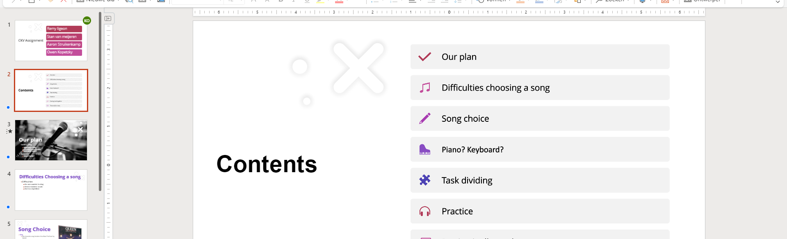
20-11-2023
Today we presented our Pitch and we got a 7.5. This was a relief to all of us since it gave us hope for our final project. We worked on the log and practiced a little bit. We decided where we would end the song and then the lesson ended. In the coming week all of us would have to send our piece in our groups app so that Aaron and Owen could edit

Slide 15
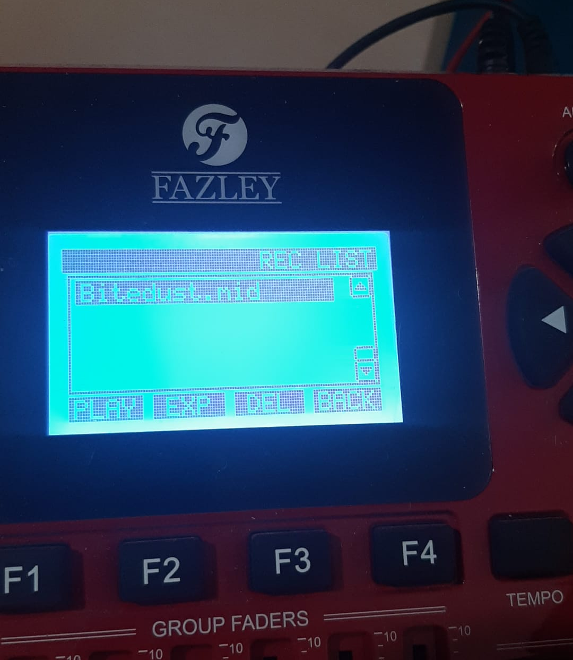
13-11-2023
We decided that it would be best if we all recorded our pieces separately because we didn’t have time to practice as a band. We agreed that this would mean Stan and Remy would finish the final presentation and log while Aaron and Owen would edit the song and our final presentation slides with voiceovers

Slide 16
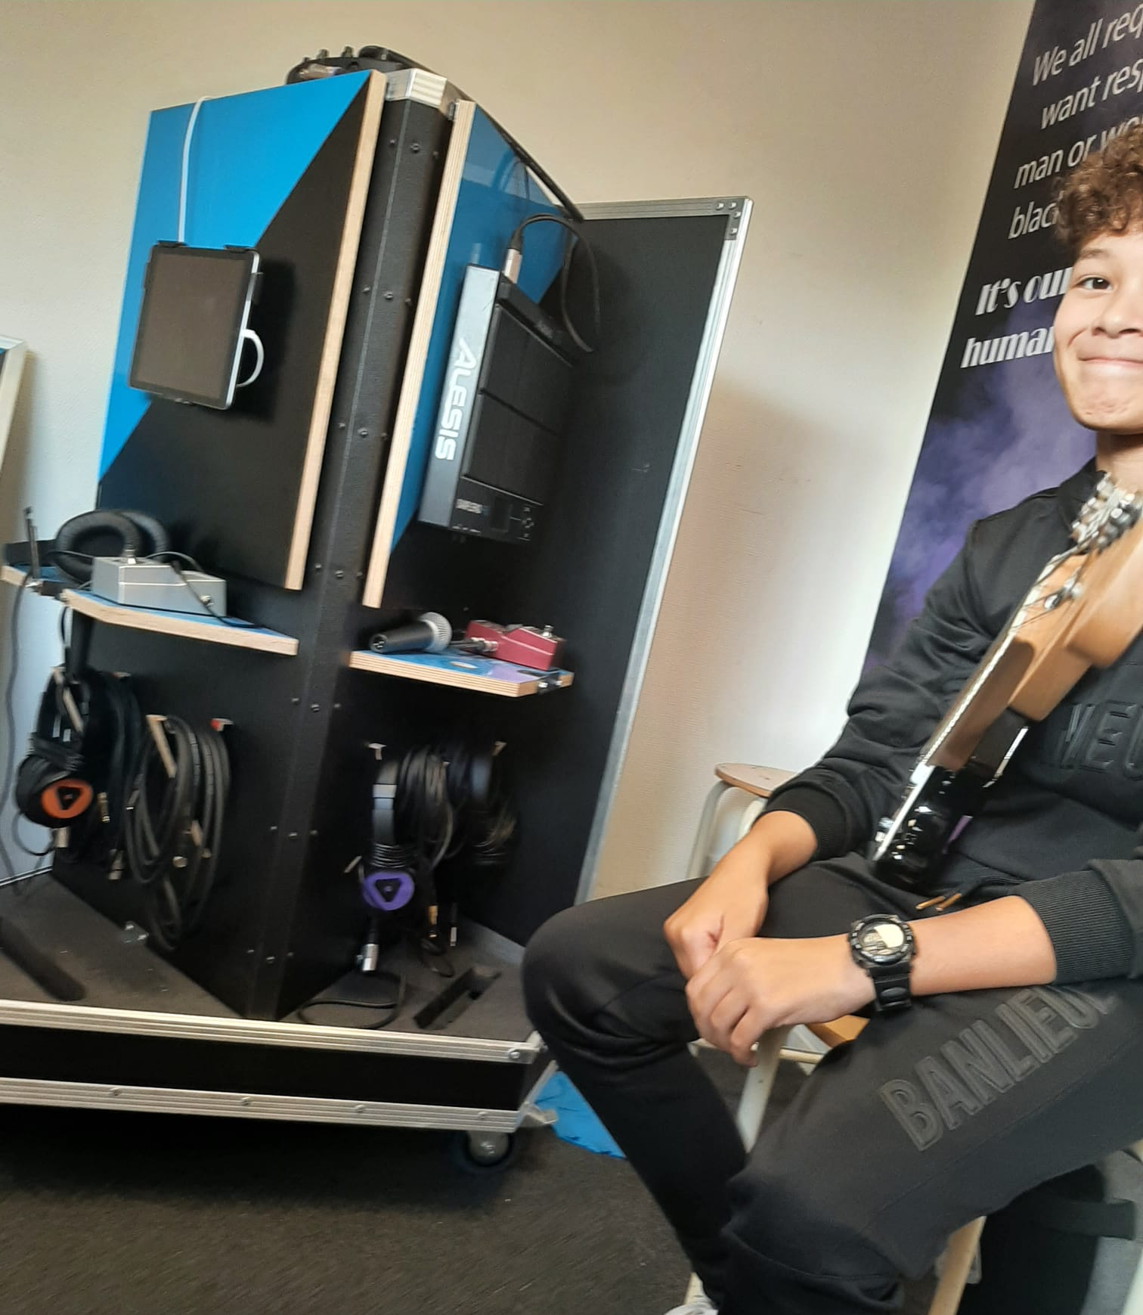
4-12-2023
Today was the last time we could practice before handing it in. Everybody finished their piece except Stan, because he lost the cables to his keyboard. This meant he would have to do it at school during our last lesson, which made the other members a bit anxious because it would have to go perfectly and then it would have to be edited. The editing was also a problem because only the guitar and bass sounded good together, it felt like the drums and vocals didn’t belong at all. Luckily, this was fixed by Aaron during our English class.

Slide 17
Planning
Week | Planning
1. | Getting used to instruments and planning the division.
2. | Practicing chords/notes/rhythm/etc.
3. | Practicing parts of the song together.
4. | Practicing the whole song together.
5. | Recording the final version.
6. | Adding vocals and preparing pitch.
7. | Finish pitch.

