Slide 1
SDDL 101 Intro to Security Descriptor Definition Language
SDDL: Concise and portable text representation of binary security descriptor
Aaron Margosis, SysNocturnals Tools
Notes:
Security Descriptor Definition Language (SDDL) is a concise and portable textual representation of Windows security descriptors. Security descriptors are binary objects that describe the permissions and other information about securable objects in Windows, including files, directories, registry keys, services, processes, and lots more. SDDL is really good for some things, but Microsoft's documentation leads to its sometimes being misunderstood and misinterpreted. This presentation digs into the 100-level (maybe 200-level) details, and also introduces a tool I wrote to help interpret SDDL strings.

Slide 2
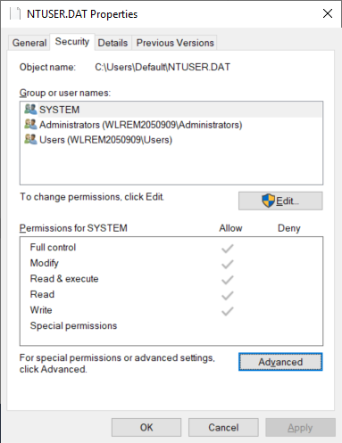
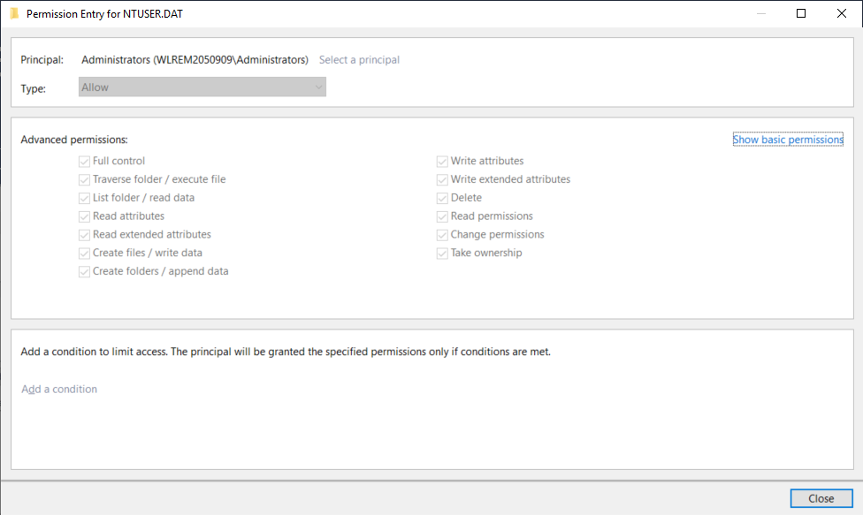
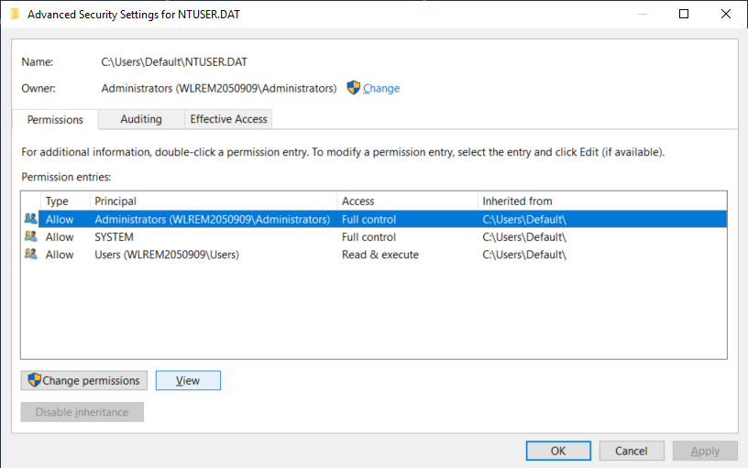
Security descriptor (Windows GUI)

Slide 3
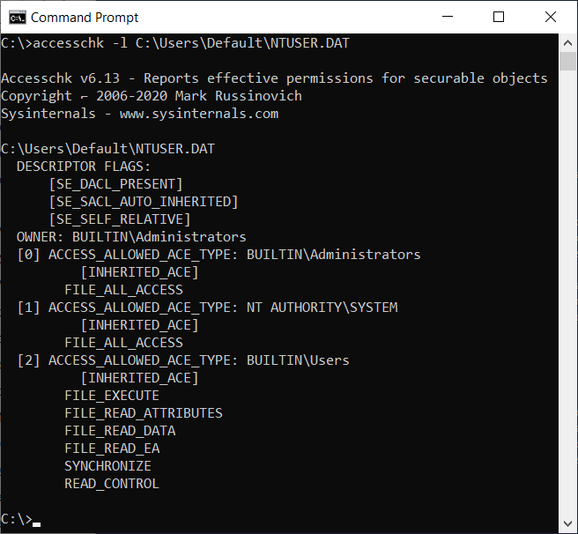
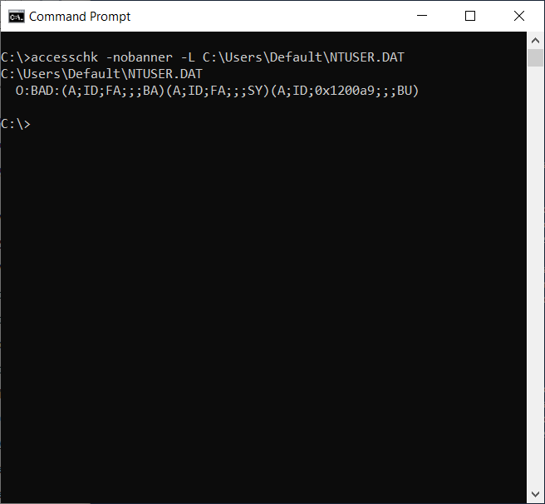
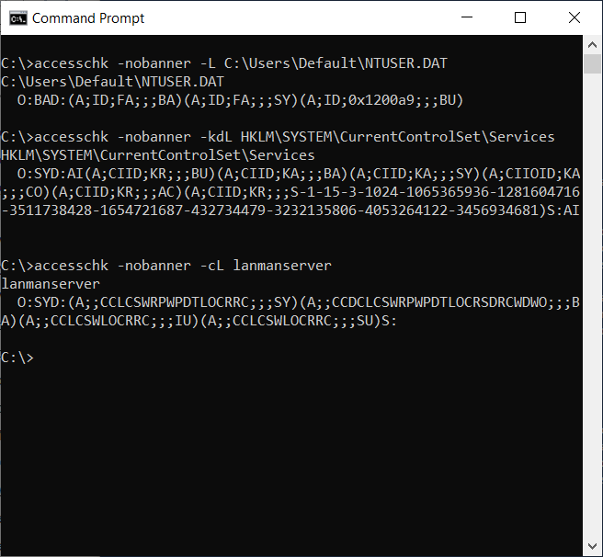
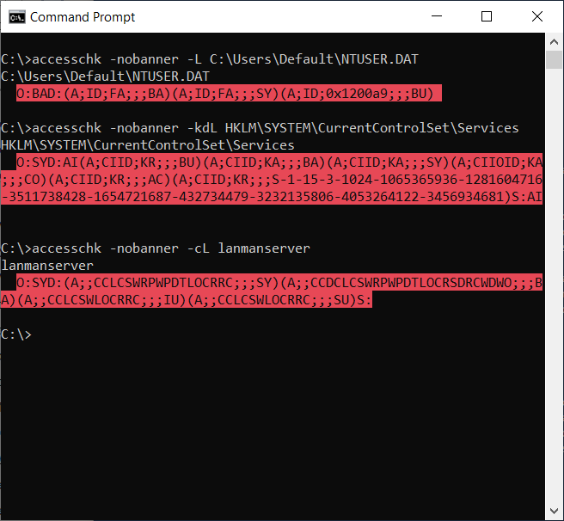
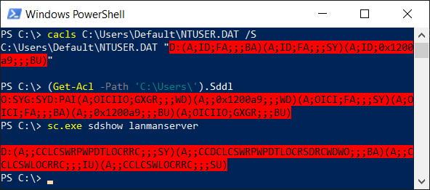
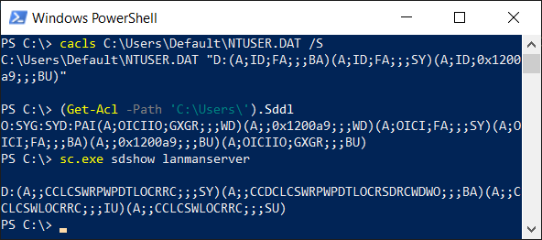
Security descriptor (Sysinternals AccessChk)
This is SDDL

Slide 4
tl;dr – What is SDDL good/not-good for
Really good:
persistence, transmission, and setting of SDs with full fidelity
Kinda good:
quick visual inspection
Not good at all:
detailed visual inspection/verification

Slide 5
Security descriptor (Windows)
Defines an object’s security attributes
Who owns the object
Primary group (not used in Windows)
Who can do what with the object (DACL: Discretionary Access Control List)
What triggers audit logging (SACL: Security Access Control List)
Inheritance properties (for container objects)
Integrity label (defaults to Medium/No-Write-Up if not present)
Same structure for all securable objects
Files, directories, registry keys, processes, threads, Service Control Manager, service and driver entries, synchronization objects, AD directory service objects, …
Access checks performed the same way for all object types
Caller’s access token matched against object’s security descriptor

Slide 6
Who can do what with the object
Object owner can always read/write the object’s SD (*)
DACL is a list of Access Control Entries (ACEs)
ACE includes:
Allow or Deny
Security Identifier (SID) of entity
32-bit access mask – meaning of bits depends on object type
ACE’s inheritance properties (for container objects)
(*) Unless the DACL contains one or more OWNER RIGHTS ACEs

Slide 7
32-bit access mask
31 | 30 | 29 | 28 | 27 | 26 | 25 | 24 | 23 | 22 | 21 | 20 | 19 | 18 | 17 | 16 | 15 | 14 | 13 | 12 | 11 | 10 | 9 | 8 | 7 | 6 | 5 | 4 | 3 | 2 | 1 | 0
Generic rights |  |  |  | Misc. |  |  |  | Standard rights |  |  |  |  |  |  |  | Object-specific rights

Slide 8
32-bit access mask – object-specific rights
31 | 30 | 29 | 28 | 27 | 26 | 25 | 24 | 23 | 22 | 21 | 20 | 19 | 18 | 17 | 16 | 15 | 14 | 13 | 12 | 11 | 10 | 9 | 8 | 7 | 6 | 5 | 4 | 3 | 2 | 1 | 0
Generic rights |  |  |  | Misc. |  |  |  | Standard rights |  |  |  |  |  |  |  | Object-specific rights
Meaning of each bit depends on object type
Examples:
Bit | File rights | Directory rights | Registry key rights | Service rights
0x00000001 | FILE_READ_DATA | FILE_LIST_DIRECTORY | KEY_QUERY_VALUE | SERVICE_QUERY_CONFIG
0x00000002 | FILE_WRITE_DATA | FILE_ADD_FILE | KEY_SET_VALUE | SERVICE_CHANGE_CONFIG
0x00000004 | FILE_APPEND_DATA | FILE_ADD_SUBDIRECTORY | KEY_CREATE_SUB_KEY | SERVICE_QUERY_STATUS
0x00000008 | FILE_READ_EA | FILE_READ_EA | KEY_ENUMERATE_SUB_KEYS | SERVICE_ENUMERATE_DEPENDENTS
0x00000010 | FILE_WRITE_EA | FILE_WRITE_EA | KEY_NOTIFY | SERVICE_START
0x00000020 | FILE_EXECUTE | FILE_TRAVERSE | KEY_CREATE_LINK | SERVICE_STOP
0x00000040 |  | FILE_DELETE_CHILD |  | SERVICE_PAUSE_CONTINUE

Slide 9
32-bit access mask – standard rights
31 | 30 | 29 | 28 | 27 | 26 | 25 | 24 | 23 | 22 | 21 | 20 | 19 | 18 | 17 | 16 | 15 | 14 | 13 | 12 | 11 | 10 | 9 | 8 | 7 | 6 | 5 | 4 | 3 | 2 | 1 | 0
Generic rights |  |  |  | Misc. |  |  |  | Standard rights |  |  |  |  |  |  |  | Object-specific rights
Each bit means the same for all object types
Bit | Standard rights | Explanation
0x00010000 | DELETE | Delete the object
0x00020000 | READ_CONTROL | Read the object’s SD
0x00040000 | WRITE_DAC | Modify the object’s SD
0x00080000 | WRITE_OWNER | Change the object’s owner
0x00100000 | SYNCHRONIZE | Receive signals about the object

Slide 10
32-bit access mask – combined definitions
31 | 30 | 29 | 28 | 27 | 26 | 25 | 24 | 23 | 22 | 21 | 20 | 19 | 18 | 17 | 16 | 15 | 14 | 13 | 12 | 11 | 10 | 9 | 8 | 7 | 6 | 5 | 4 | 3 | 2 | 1 | 0
Generic rights |  |  |  | Misc. |  |  |  | Standard rights |  |  |  |  |  |  |  | Object-specific rights
Examples of combined rights
Access mask | Combined rights | Explanation
0x00020019 | KEY_READ | Includes KEY_QUERY_VALUE, KEY_ENUMERATE_SUBKEYS, KEY_NOTIFY, …
0x00020006 | KEY_WRITE | Includes KEY_SET_VALUE, KEY_CREATE_SUB_KEY, …
0x000f003f | KEY_ALL_ACCESS | Includes KEY_READ, KEY_WRITE, KEY_CREATE_LINK, DELETE, …
0x00120089 | FILE_GENERIC_READ | Includes FILE_READ_DATA, FILE_READ_ATTRIBUTES, FILE_READ_EA, …
0x00120116 | FILE_GENERIC_WRITE | Includes FILE_WRITE_DATA, FILE_APPEND_DATA, FILE_WRITE_EA, …
0x001f01ff | FILE_ALL_ACCESS | Includes almost all Standard and all object-specific rights
0x000f003f | SC_MANAGER_ALL_ACCESS | Includes most Standard and all SCM-specific rights

Slide 11
32-bit access mask – miscellaneous
31 | 30 | 29 | 28 | 27 | 26 | 25 | 24 | 23 | 22 | 21 | 20 | 19 | 18 | 17 | 16 | 15 | 14 | 13 | 12 | 11 | 10 | 9 | 8 | 7 | 6 | 5 | 4 | 3 | 2 | 1 | 0
Generic rights |  |  |  | Misc. |  |  |  | Standard rights |  |  |  |  |  |  |  | Object-specific rights
31 | 30 | 29 | 28 | 27 | 26 | 25 | 24 | 23 | 22 | 21 | 20 | 19 | 18 | 17 | 16 | 15 | 14 | 13 | 12 | 11 | 10 | 9 | 8 | 7 | 6 | 5 | 4 | 3 | 2 | 1 | 0
Generic rights |  |  |  | Misc. |  |  |  | Standard rights |  |  |  |  |  |  |  | Object-specific rights
Used only when requesting access
Not found in security descriptors
No representation in SDDL
Bit | Requested rights | Explanation
0x01000000 | ACCESS_SYSTEM_SECURITY | Read/write the SACL in the object’s SD
0x02000000 | MAXIMUM_ALLOWED | Request whatever permissions the caller is granted

Slide 12
32-bit access mask – generic rights
31 | 30 | 29 | 28 | 27 | 26 | 25 | 24 | 23 | 22 | 21 | 20 | 19 | 18 | 17 | 16 | 15 | 14 | 13 | 12 | 11 | 10 | 9 | 8 | 7 | 6 | 5 | 4 | 3 | 2 | 1 | 0
Generic rights |  |  |  | Misc. |  |  |  | Standard rights |  |  |  |  |  |  |  | Object-specific rights
For requesting access without knowing object-specific access mask.
Each object type defines mapping to Standard + Object-specific rights.
Bit | Generic rights
0x10000000 | GENERIC_ALL
0x20000000 | GENERIC_EXECUTE
0x40000000 | GENERIC_WRITE
0x80000000 | GENERIC_READ
Notes:
Example mapping:
Process
GA - 0x1fffff - PROCESS_ALL_ACCESS
GR - 0x20410 - PROCESS_QUERY_INFORMATION | PROCESS_VM_READ | READ_CONTROL
GW - 0x20bea - PROCESS_CREATE_PROCESS | PROCESS_CREATE_THREAD | PROCESS_DUP_HANDLE | PROCESS_SET_QUOTA | PROCESS_SET_INFORMATION | PROCESS_SUSPEND_RESUME | PROCESS_VM_OPERATION | PROCESS_VM_WRITE | READ_CONTROL
GX - 0x121001 - PROCESS_QUERY_LIMITED_INFORMATION | PROCESS_TERMINATE | SYNCHRONIZE | READ_CONTROL
file
GA - FA - FILE_ALL_ACCESS
GR - FR - FILE_READ_ATTRIBUTES | FILE_READ_DATA | FILE_READ_EA | SYNCHRONIZE | READ_CONTROL
GW - FW - FILE_APPEND_DATA | FILE_WRITE_ATTRIBUTES FILE_WRITE_DATA | FILE_WRITE_EA | SYNCHRONIZE | READ_CONTROL
GX - FX - FILE_EXECUTE | FILE_READ_ATTRIBUTES | SYNCHRONIZE | READ_CONTROL
key
GA - KA - KEY_ALL_ACCESS
GR - KR - KEY_QUERY_VALUE | KEY_ENUMERATE_SUB_KEYS | KEY_NOTIFY | READ_CONTROL
GW - KW - KEY_CREATE_SUB_KEY | KEY_SET_VALUE | READ_CONTROL
GX - CCSWRPWPRC - KEY_QUERY_VALUE | KEY_CREATE_LINK | KEY_ENUMERATE_SUB_KEYS | KEY_NOTIFY | READ_CONTROL

Slide 13
32-bit access mask – generic rights
31 | 30 | 29 | 28 | 27 | 26 | 25 | 24 | 23 | 22 | 21 | 20 | 19 | 18 | 17 | 16 | 15 | 14 | 13 | 12 | 11 | 10 | 9 | 8 | 7 | 6 | 5 | 4 | 3 | 2 | 1 | 0
Generic rights |  |  |  | Misc. |  |  |  | Standard rights |  |  |  |  |  |  |  | Object-specific rights
Examples of mappings for some object types:
Generic rights | File | Registry key | Process
GENERIC_ALL | 0x001f01ff | 0x000f003f | 0x001fffff
GENERIC_EXECUTE | 0x001200a0 | 0x00020039 | 0x00121001
GENERIC_WRITE | 0x00120116 | 0x00020006 | 0x00020bea
GENERIC_READ | 0x00120089 | 0x00020019 | 0x00020410
Notes:
Example mapping:
Process
GA - 0x1fffff - PROCESS_ALL_ACCESS
GR - 0x20410 - PROCESS_QUERY_INFORMATION | PROCESS_VM_READ | READ_CONTROL
GW - 0x20bea - PROCESS_CREATE_PROCESS | PROCESS_CREATE_THREAD | PROCESS_DUP_HANDLE | PROCESS_SET_QUOTA | PROCESS_SET_INFORMATION | PROCESS_SUSPEND_RESUME | PROCESS_VM_OPERATION | PROCESS_VM_WRITE | READ_CONTROL
GX - 0x121001 - PROCESS_QUERY_LIMITED_INFORMATION | PROCESS_TERMINATE | SYNCHRONIZE | READ_CONTROL
file
GA - FA - FILE_ALL_ACCESS
GR - FR - FILE_READ_ATTRIBUTES | FILE_READ_DATA | FILE_READ_EA | SYNCHRONIZE | READ_CONTROL
GW - FW - FILE_APPEND_DATA | FILE_WRITE_ATTRIBUTES FILE_WRITE_DATA | FILE_WRITE_EA | SYNCHRONIZE | READ_CONTROL
GX - FX - FILE_EXECUTE | FILE_READ_ATTRIBUTES | SYNCHRONIZE | READ_CONTROL
key
GA - KA - KEY_ALL_ACCESS
GR - KR - KEY_QUERY_VALUE | KEY_ENUMERATE_SUB_KEYS | KEY_NOTIFY | READ_CONTROL
GW - KW - KEY_CREATE_SUB_KEY | KEY_SET_VALUE | READ_CONTROL
GX - CCSWRPWPRC - KEY_QUERY_VALUE | KEY_CREATE_LINK | KEY_ENUMERATE_SUB_KEYS | KEY_NOTIFY | READ_CONTROL

Slide 14
SDDL format
One or more of these components:
O:owner_sid
G:group_sid
D:dacl_flags(string_ace_1)...(string_ace_n)
S:sacl_flags(string_ace_1)...(string_ace_n)
O:BAD:(A;;FA;;;BA)(A;;FA;;;SY)(A;;0x1200a9;;;BU)

Slide 15
SDDL format
One or more of these components:
O:owner_sid
G:group_sid
D:dacl_flags(string_ace_1)...(string_ace_n)
S:sacl_flags(string_ace_1)...(string_ace_n)
O:BAD:(A;;FA;;;BA)(A;;FA;;;SY)(A;;0x1200a9;;;BU)
Owner: BUILTIN\Administrators
“SID” can be a two-letter “SID string” code, or a full SID
E.g., O:BA or O:S-1-5-32-544

Slide 16
SDDL format
One or more of these components:
O:owner_sid
G:group_sid
D:dacl_flags(string_ace_1)...(string_ace_n)
S:sacl_flags(string_ace_1)...(string_ace_n)
O:BAD:(A;;FA;;;BA)(A;;FA;;;SY)(A;;0x1200a9;;;BU)
DACL with three ACEs and no DACL flags

Slide 17
SDDL format
One or more of these components:
O:owner_sid
G:group_sid
D:dacl_flags(string_ace_1)...(string_ace_n)
S:sacl_flags(string_ace_1)...(string_ace_n)
O:BAD:(A;;FA;;;BA)(A;;FA;;;SY)(A;;0x1200a9;;;BU)
First ACE in the DACL
Allows File All Access to BUILTIN\Administrators

Slide 18
SDDL format
One or more of these components:
O:owner_sid
G:group_sid
D:dacl_flags(string_ace_1)...(string_ace_n)
S:sacl_flags(string_ace_1)...(string_ace_n)
O:BAD:(A;;FA;;;BA)(A;;FA;;;SY)(A;;0x1200a9;;;BU)
Third ACE in the DACL
Allows access mask 0x001200a9 to BUILTIN\Users

Slide 19
String ACE format
One or more of these components:
O:owner_sid
G:group_sid
D:dacl_flags(string_ace_1)...(string_ace_n)
S:sacl_flags(string_ace_1)...(string_ace_n)
O:BAD:(A;;FA;;;BA)(A;;FA;;;SY)(A;;0x1200a9;;;BU)
Third ACE in the DACL
Allows access mask 0x001200a9 to BUILTIN\Users

Slide 20
String ACE format
(ace_type ; ace_flags ; rights ; object_guid ; inherit_object_guid ; account_sid)
(ace_type ; ace_flags ; rights ; object_guid ; inherit_object_guid ; account_sid)
(ace_type ; ace_flags ; rights ;;; account_sid)
(A;;0x1200a9;;;BU)

Slide 21
String ACE format – ace_type
(ace_type ; ace_flags ; rights ;;; account_sid)
Common examples:
A | Access allowed (DACL) | (A;;0x1200a9;;BU)
D | Access denied (DACL) | (D;;CC;;;WD)
AU | Audit (SACL) | S:(AU;SAFA;GA;;;WD)
ML | Mandatory integrity label (SACL) | S:AI(ML;OICI;NW;;;LW)

Slide 22
String ACE format – ace_flags
(ace_type ; ace_flags ; rights ;;; account_sid)
Zero or more of these:
CI OI NP IO | Inheritance instructions | (A;OICI;FA;;;SY)
ID | Inherited from parent | (A;ID;FA;;;BA)
SA FA | Success audit (SACL) Failure audit (SACL) | S:(AU;SAFA;GA;;;WD)

Slide 23

String ACE format – account_sid
(ace_type ; ace_flags ; rights ;;; account_sid)
Two-letter SID string code, or full SID. Examples:
SY | NT AUTHORITY\SYSTEM (S-1-5-18)
BA | BUILTIN\Administrators (S-1-5-32-544)
BU | BUILTIN\Users (S-1-5-32-545)
AU | NT AUTHORITY\Authenticated Users (S-1-5-11)
CO | \CREATOR OWNER (S-1-3-0)
S-1-5-80-956008885-3418522649-1831038044-1853292631-2271478464 |  | NT SERVICE\TrustedInstaller
AUTORITE NT\Système
BUILTIN\Administrateurs
BUILTIN\Utilisateurs
AUTORITE NT\Utilisateurs authentifiés
\CREATEUR PROPRIETAIRE
https://docs.microsoft.com/en-us/windows/win32/secauthz/sid-strings

Slide 24
String ACE format – rights
(ace_type ; ace_flags ; rights ;;; account_sid)
One or more two-letter codes, or hex number. Examples:
(A;OICI;FA;;;SY)
(A;;CCLCSWLOCRRC;;;IU)
(A;OICI;0x1200a9;;;BU)
OK, but what do those two-letter codes mean?

Slide 25
Generic access rights
 | Code | Constant in Sddl.h | Access right value | Access mask
 | GA | SDDL_GENERIC_ALL | GENERIC_ALL | 0x10000000
 | GX | SDDL_GENERIC_EXECUTE | GENERIC_EXECUTE | 0x20000000
 | GW | SDDL_GENERIC_WRITE | GENERIC_WRITE | 0x40000000
 | GR | SDDL_GENERIC_READ | GENERIC_READ | 0x80000000
Standard access rights
 | Code | Constant in Sddl.h | Access right value | Access mask
 | SD | SDDL_STANDARD_DELETE | DELETE | 0x00010000
 | RC | SDDL_READ_CONTROL | READ_CONTROL | 0x00020000
 | WD | SDDL_WRITE_DAC | WRITE_DAC | 0x00040000
 | WO | SDDL_WRITE_OWNER | WRITE_OWNER | 0x00080000
Directory service object access rights
 | Code | Constant in Sddl.h | Access right value | Access mask
 | CC | SDDL_CREATE_CHILD | ADS_RIGHT_DS_CREATE_CHILD | 0x00000001
 | DC | SDDL_DELETE_CHILD | ADS_RIGHT_DS_DELETE_CHILD | 0x00000002
 | LC | SDDL_LIST_CHILDREN | ADS_RIGHT_ACTRL_DS_LIST | 0x00000004
 | SW | SDDL_SELF_WRITE | ADS_RIGHT_DS_SELF | 0x00000008
 | RP | SDDL_READ_PROPERTY | ADS_RIGHT_DS_READ_PROP | 0x00000010
 | WP | SDDL_WRITE_PROPERTY | ADS_RIGHT_DS_WRITE_PROP | 0x00000020
 | DT | SDDL_DELETE_TREE | ADS_RIGHT_DS_DELETE_TREE | 0x00000040
 | LO | SDDL_LIST_OBJECT | ADS_RIGHT_DS_LIST_OBJECT | 0x00000080
 | CR | SDDL_CONTROL_ACCESS | ADS_RIGHT_DS_CONTROL_ACCESS | 0x00000100
File access rights
 | Code | Constant in Sddl.h | Access right value | Access mask
 | FR | SDDL_FILE_READ | FILE_GENERIC_READ | 0x00120089
 | FX | SDDL_FILE_EXECUTE | FILE_GENERIC_EXECUTE | 0x001200a0
 | FW | SDDL_FILE_WRITE | FILE_GENERIC_WRITE | 0x00120116
 | FA | SDDL_FILE_ALL | FILE_ALL_ACCESS | 0x001f01ff
Registry key access rights
 | Code | Constant in Sddl.h | Access right value | Access mask
 | KW | SDDL_KEY_WRITE | KEY_WRITE | 0x00020006
 | KR | SDDL_KEY_READ | KEY_READ | 0x00020019
 | KX | SDDL_KEY_EXECUTE | KEY_EXECUTE | 0x00020019
 | KA | SDDL_KEY_ALL | KEY_ALL_ACCESS | 0x000f003f

Slide 26
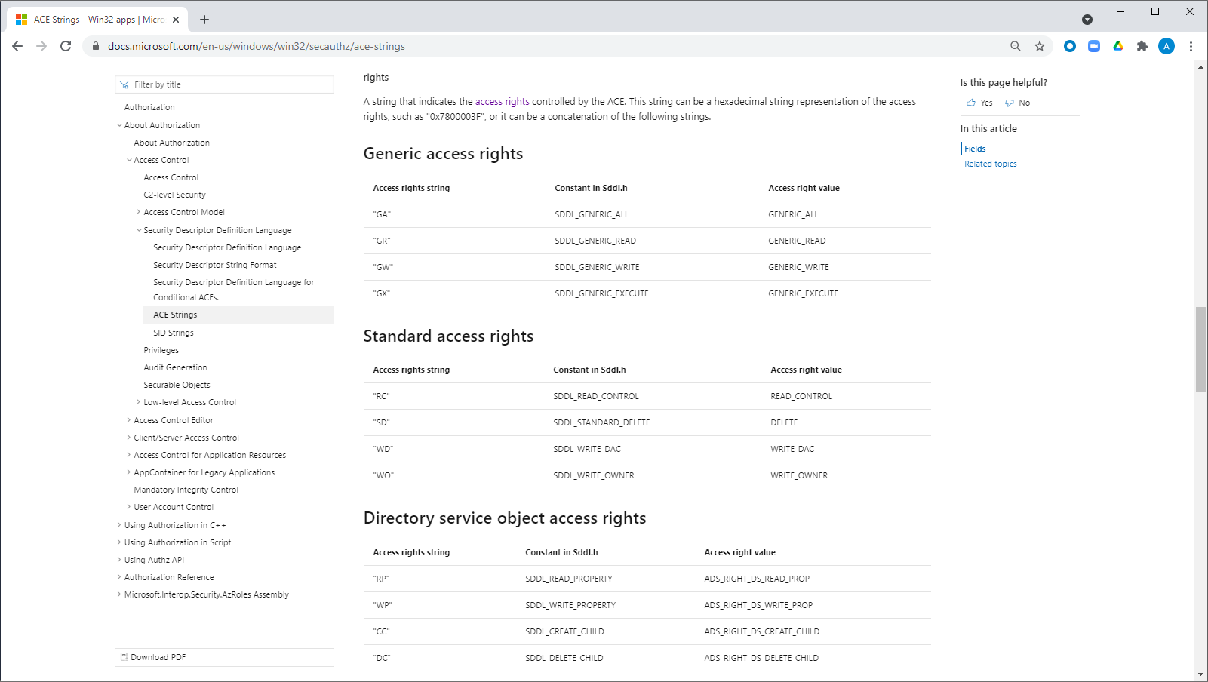

Slide 27
Generic access rights
 | Code | Constant in Sddl.h | Access right value | Access mask
 | GA | SDDL_GENERIC_ALL | GENERIC_ALL | 0x10000000
 | GX | SDDL_GENERIC_EXECUTE | GENERIC_EXECUTE | 0x20000000
 | GW | SDDL_GENERIC_WRITE | GENERIC_WRITE | 0x40000000
 | GR | SDDL_GENERIC_READ | GENERIC_READ | 0x80000000
Standard access rights
 | Code | Constant in Sddl.h | Access right value | Access mask
 | SD | SDDL_STANDARD_DELETE | DELETE | 0x00010000
 | RC | SDDL_READ_CONTROL | READ_CONTROL | 0x00020000
 | WD | SDDL_WRITE_DAC | WRITE_DAC | 0x00040000
 | WO | SDDL_WRITE_OWNER | WRITE_OWNER | 0x00080000
File access rights
 | Code | Constant in Sddl.h | Access right value | Access mask
 | FR | SDDL_FILE_READ | FILE_GENERIC_READ | 0x00120089
 | FX | SDDL_FILE_EXECUTE | FILE_GENERIC_EXECUTE | 0x001200a0
 | FW | SDDL_FILE_WRITE | FILE_GENERIC_WRITE | 0x00120116
 | FA | SDDL_FILE_ALL | FILE_ALL_ACCESS | 0x001f01ff
Registry key access rights
 | Code | Constant in Sddl.h | Access right value | Access mask
 | KW | SDDL_KEY_WRITE | KEY_WRITE | 0x00020006
 | KR | SDDL_KEY_READ | KEY_READ | 0x00020019
 | KX | SDDL_KEY_EXECUTE | KEY_EXECUTE | 0x00020019
 | KA | SDDL_KEY_ALL | KEY_ALL_ACCESS | 0x000f003f
Directory service object access rights
 | Code | Constant in Sddl.h | Access right value | Access mask
 | CC | SDDL_CREATE_CHILD | ADS_RIGHT_DS_CREATE_CHILD | 0x00000001
 | DC | SDDL_DELETE_CHILD | ADS_RIGHT_DS_DELETE_CHILD | 0x00000002
 | LC | SDDL_LIST_CHILDREN | ADS_RIGHT_ACTRL_DS_LIST | 0x00000004
 | SW | SDDL_SELF_WRITE | ADS_RIGHT_DS_SELF | 0x00000008
 | RP | SDDL_READ_PROPERTY | ADS_RIGHT_DS_READ_PROP | 0x00000010
 | WP | SDDL_WRITE_PROPERTY | ADS_RIGHT_DS_WRITE_PROP | 0x00000020
 | DT | SDDL_DELETE_TREE | ADS_RIGHT_DS_DELETE_TREE | 0x00000040
 | LO | SDDL_LIST_OBJECT | ADS_RIGHT_DS_LIST_OBJECT | 0x00000080
 | CR | SDDL_CONTROL_ACCESS | ADS_RIGHT_DS_CONTROL_ACCESS | 0x00000100

Slide 28
Generic access rights
 | Code | Constant in Sddl.h | Access right value | Access mask
 | GA | SDDL_GENERIC_ALL | GENERIC_ALL | 0x10000000
 | GX | SDDL_GENERIC_EXECUTE | GENERIC_EXECUTE | 0x20000000
 | GW | SDDL_GENERIC_WRITE | GENERIC_WRITE | 0x40000000
 | GR | SDDL_GENERIC_READ | GENERIC_READ | 0x80000000
Standard access rights
 | Code | Constant in Sddl.h | Access right value | Access mask
 | SD | SDDL_STANDARD_DELETE | DELETE | 0x00010000
 | RC | SDDL_READ_CONTROL | READ_CONTROL | 0x00020000
 | WD | SDDL_WRITE_DAC | WRITE_DAC | 0x00040000
 | WO | SDDL_WRITE_OWNER | WRITE_OWNER | 0x00080000
File access rights – combined standard and object-specific rights
 | Code | Constant in Sddl.h | Access right value | Access mask
 | FR | SDDL_FILE_READ | FILE_GENERIC_READ | 0x00120089
 | FX | SDDL_FILE_EXECUTE | FILE_GENERIC_EXECUTE | 0x001200a0
 | FW | SDDL_FILE_WRITE | FILE_GENERIC_WRITE | 0x00120116
 | FA | SDDL_FILE_ALL | FILE_ALL_ACCESS | 0x001f01ff
Registry key access rights – combined standard and object-specific rights
 | Code | Constant in Sddl.h | Access right value | Access mask
 | KW | SDDL_KEY_WRITE | KEY_WRITE | 0x00020006
 | KR | SDDL_KEY_READ | KEY_READ | 0x00020019
 | KX | SDDL_KEY_EXECUTE | KEY_EXECUTE | 0x00020019
 | KA | SDDL_KEY_ALL | KEY_ALL_ACCESS | 0x000f003f
Directory service object access rights OBJECT-SPECIFIC RIGHTS
 | Code | Constant in Sddl.h | Access right value | Access mask
 | CC | SDDL_CREATE_CHILD | ADS_RIGHT_DS_CREATE_CHILD | 0x00000001
 | DC | SDDL_DELETE_CHILD | ADS_RIGHT_DS_DELETE_CHILD | 0x00000002
 | LC | SDDL_LIST_CHILDREN | ADS_RIGHT_ACTRL_DS_LIST | 0x00000004
 | SW | SDDL_SELF_WRITE | ADS_RIGHT_DS_SELF | 0x00000008
 | RP | SDDL_READ_PROPERTY | ADS_RIGHT_DS_READ_PROP | 0x00000010
 | WP | SDDL_WRITE_PROPERTY | ADS_RIGHT_DS_WRITE_PROP | 0x00000020
 | DT | SDDL_DELETE_TREE | ADS_RIGHT_DS_DELETE_TREE | 0x00000040
 | LO | SDDL_LIST_OBJECT | ADS_RIGHT_DS_LIST_OBJECT | 0x00000080
 | CR | SDDL_CONTROL_ACCESS | ADS_RIGHT_DS_CONTROL_ACCESS | 0x00000100

Slide 29
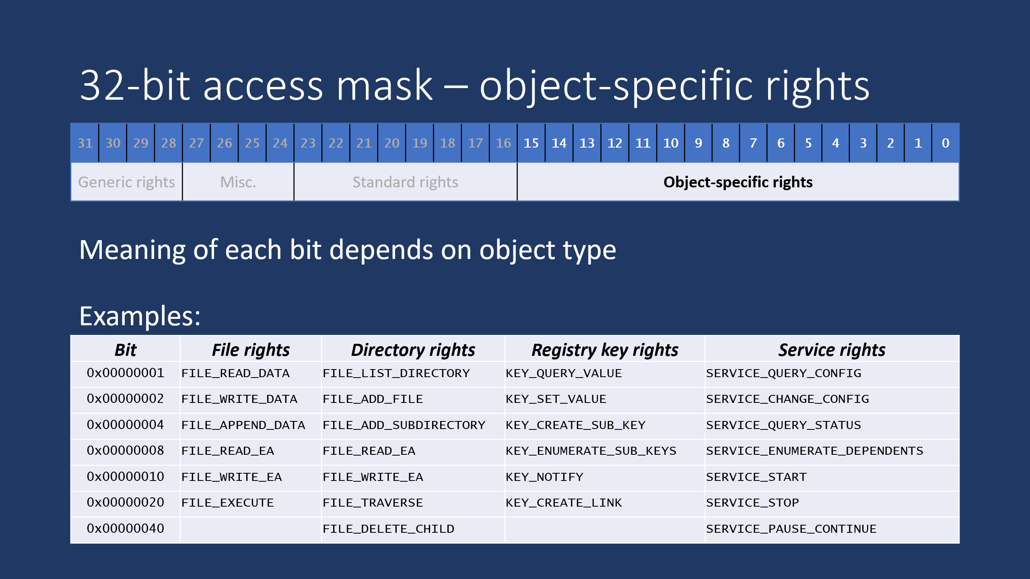
Meaning of 2-letter code depends on object type
DC | SDDL_DELETE_CHILD | 0x00000002
KA | SDDL_KEY_ALL | 0x000f003f
CC | SDDL_CREATE_CHILD | 0x00000001
Object type | Object-specific right
AD directory services | ADS_RIGHT_DS_DELETE_CHILD
File | FILE_WRITE_DATA
Directory | FILE_ADD_FILE
Pipe | FILE_WRITE_DATA
Registry key | KEY_SET_VALUE
Service | SERVICE_CHANGE_CONFIG
Service Control Mgr | SC_MANAGER_CREATE_SERVICE
Process | PROCESS_CREATE_THREAD
Thread | THREAD_SUSPEND_RESUME
SMB share | SRVSVC_PAUSED_SHARE_CONNECT
COM | COM_RIGHTS_EXECUTE_LOCAL
Window station | WINSTA_READATTRIBUTES
Desktop | DESKTOP_CREATEWINDOW
Object type | Object-specific right
Registry key | KEY_ALL_ACCESS
Service Control Mgr | SC_MANAGER_ALL_ACCESS
Object type | Object-specific right
AD directory services | ADS_RIGHT_DS_CREATE_CHILD
File | FILE_READ_DATA
Directory | FILE_LIST_DIRECTORY
Pipe | FILE_READ_DATA
Registry key | KEY_QUERY_VALUE
Service | SERVICE_QUERY_CONFIG
Service Control Mgr | SC_MANAGER_CONNECT
Process | PROCESS_TERMINATE
Thread | THREAD_TERMINATE
SMB share | SRVSVC_SHARE_CONNECT
COM | COM_RIGHTS_EXECUTE
Window station | WINSTA_ENUMDESKTOPS
Desktop | DESKTOP_READOBJECTS

Slide 30
Misinterpreting SDDL
D:
(A;;CC;;;AU)
(A;;CCLCRPRC;;;IU)
(A;;CCLCRPRC;;;SU)
(A;;CCLCRPWPRC;;;SY)
(A;;KA;;;BA)
(A;;CC;;;AC)
(A;;CC;;;S-1-15-3-1024-528118966-3876874398-709513571-1907873084-3598227634-3698730060-278077788-3990600205)
D:
(A;;CC;;;AU) → ADS_RIGHT_DS_CREATE_CHILD
(A;;CCLCRPRC;;;IU) → ADS rights: create child, list children,
(A;;CCLCRPRC;;;SU) read property, read control
(A;;CCLCRPWPRC;;;SY)→ ADS rights: above + write property
(A;;KA;;;BA) → KEY_ALL_ACCESS
(A;;CC;;;AC)
(A;;CC;;;S-1-15-3-1024-528118966-3876874398-709513571-1907873084-3598227634-3698730060-278077788-3990600205)
C:\>sc.exe sdshow scmanager
D:(A;;CC;;;AU)(A;;CCLCRPRC;;;IU)(A;;CCLCRPRC;;;SU)(A;;CCLCRPWPRC;;;SY)(A;;KA;;;BA)(A;;CC;;;AC)(A;;CC;;;S-1-15-3-1024-528118966-3876874398-709513571-1907873084-3598227634-3698730060-278077788-3990600205)
C:\>

Slide 31
Correct interpretation for SCM object
D:
(A;;CC;;;AU) → SC_MANAGER_CONNECT
(A;;CCLCRPRC;;;IU) → SCM rights: connect, enum services,
(A;;CCLCRPRC;;;SU) query lock status, read control
(A;;CCLCRPWPRC;;;SY)→ SCM rights: above + modify boot cfg
(A;;KA;;;BA) → SC_MANAGER_ALL_ACCESS
(A;;CC;;;AC)
(A;;CC;;;S-1-15-3-1024-528118966-3876874398-709513571-1907873084-3598227634-3698730060-278077788-3990600205)

Slide 32
What is SDDL really good for?
Persistence, transmission, and setting of security descriptors, with full fidelity
It’s what SDDL was designed for.

Slide 33
What is SDDL kinda good for?
Quick visual inspection and verification.
Examples:
Does it grant broad access? E.g., GA, FA, KA
Who is granted access? E.g., SY, BA, AU
Does it have a SACL? Does it audit success, failure, or both?
Does it have a NULL DACL? → D:NO_ACCESS_CONTROL

Slide 34
What is SDDL not particularly good for?
Detailed visual inspection and verification of rights.
Examples:
What permissions does this grant? (A;ID;0x1301bf;;;AU)
What about this – anything dangerous? (A;;CCLCSWLOCRRC;;;IU)

Slide 35
SddlHelp.exe
C:\> SddlHelp.exe
Usage:
SddlHelp.exe -sid sidSpec [...]
SddlHelp.exe -rights option [...]
SddlHelp.exe -translate sddlString [objType]
where "sidSpec" is one or more SIDs or SDDL string SID codes; examples:
SddlHelp.exe -sid BA
SddlHelp.exe -sid S-1-5-18
SddlHelp.exe -sid S-1-1-0 LS BU
where "option" is one or more of:
sddl Listing of all SDDL two-letter access rights codes and name of constant
ntds Mapping of AD Directory Services constants to defined SDDL codes
file Mapping of file permission constants to defined SDDL codes
dir Mapping of directory permission constants to defined SDDL codes
pipe Mapping of pipe permission constants to defined SDDL codes
key Mapping of registry key permission constants to defined SDDL codes
service Mapping of service permission constants to defined SDDL codes
scm Mapping of service control manager permission constants to defined SDDL codes
process Mapping of process permission constants to defined SDDL codes
thread Mapping of thread permission constants to defined SDDL codes
share Mapping of file share permission constants to defined SDDL codes
com Mapping of COM permission constants to defined SDDL codes
winsta Mapping of window station permission constants to defined SDDL codes
desktop Mapping of desktop permission constants to defined SDDL codes
standard Mapping of standard and generic permission constants to defined SDDL codes
where "sddlString" is an SDDL string and objType is one of: sddl ntds file dir pipe key service scm process thread share com winsta desktop standard
C:\>

Slide 36
SddlHelp.exe -sid
C:\> SddlHelp.exe -sid BA SY CO IU AU S-1-1-0
BA S-1-5-32-544 BUILTIN\Administrators
SY S-1-5-18 NT AUTHORITY\SYSTEM
CO S-1-3-0 \CREATOR OWNER
IU S-1-5-4 NT AUTHORITY\INTERACTIVE
AU S-1-5-11 NT AUTHORITY\Authenticated Users
WD S-1-1-0 \Everyone

Slide 37
SddlHelp.exe -rights
C:\> SddlHelp.exe -rights file
0x00000001 CC FILE_READ_DATA
0x00000002 DC FILE_WRITE_DATA
0x00000004 LC FILE_APPEND_DATA
0x00000008 SW FILE_READ_EA
0x00000010 RP FILE_WRITE_EA
0x00000020 WP FILE_EXECUTE
0x00000080 LO FILE_READ_ATTRIBUTES
0x00000100 CR FILE_WRITE_ATTRIBUTES
0x001f01ff FA FILE_ALL_ACCESS
0x00120089 FR FILE_GENERIC_READ
0x00120116 FW FILE_GENERIC_WRITE
0x001200a0 FX FILE_GENERIC_EXECUTE
C:\> SddlHelp.exe -rights scm
0x00000001 CC SC_MANAGER_CONNECT
0x00000002 DC SC_MANAGER_CREATE_SERVICE
0x00000004 LC SC_MANAGER_ENUMERATE_SERVICE
0x00000008 SW SC_MANAGER_LOCK
0x00000010 RP SC_MANAGER_QUERY_LOCK_STATUS
0x00000020 WP SC_MANAGER_MODIFY_BOOT_CONFIG
0x000f003f KA SC_MANAGER_ALL_ACCESS
C:\> SddlHelp.exe -rights key standard
0x00000001 CC KEY_QUERY_VALUE
0x00000002 DC KEY_SET_VALUE
0x00000004 LC KEY_CREATE_SUB_KEY
0x00000008 SW KEY_ENUMERATE_SUB_KEYS
0x00000010 RP KEY_NOTIFY
0x00000020 WP KEY_CREATE_LINK
0x00000200 KEY_WOW64_32KEY
0x00000100 CR KEY_WOW64_64KEY
0x00020019 KR KEY_READ
0x00020006 KW KEY_WRITE
0x00020019 KR KEY_EXECUTE
0x000f003f KA KEY_ALL_ACCESS
0x00010000 SD DELETE
0x00020000 RC READ_CONTROL
0x00040000 WD WRITE_DAC
0x00080000 WO WRITE_OWNER
0x00100000 SYNCHRONIZE
0x000f0000 STANDARD_RIGHTS_REQUIRED
0x01000000 ACCESS_SYSTEM_SECURITY
0x02000000 MAXIMUM_ALLOWED
0x80000000 GR GENERIC_READ
0x40000000 GW GENERIC_WRITE
0x20000000 GX GENERIC_EXECUTE
0x10000000 GA GENERIC_ALL

Slide 38
SddlHelp.exe -translate
C:\> SddlHelp.exe -translate "O:BAD:(A;ID;FA;;;BA)(A;ID;FA;;;SY)(A;ID;0x1200a9;;;BU)"
Control: 0x00008004 (SE_DACL_PRESENT SE_SELF_RELATIVE )
Owner: BUILTIN\Administrators (S-1-5-32-544)
ACEs in DACL: 3
ACE 0.
ACCESS_ALLOWED_ACE_TYPE
SID: BUILTIN\Administrators (S-1-5-32-544)
Flags: [00000010] INHERITED_ACE
Perms: [001f01ff]
ACE 1.
ACCESS_ALLOWED_ACE_TYPE
SID: NT AUTHORITY\SYSTEM (S-1-5-18)
Flags: [00000010] INHERITED_ACE
Perms: [001f01ff]
ACE 2.
ACCESS_ALLOWED_ACE_TYPE
SID: BUILTIN\Users (S-1-5-32-545)
Flags: [00000010] INHERITED_ACE
Perms: [001200a9]
C:\>
C:\> SddlHelp.exe -translate "O:BAD:(A;ID;FA;;;BA)(A;ID;FA;;;SY)(A;ID;0x1200a9;;;BU)" file
Control: 0x00008004 (SE_DACL_PRESENT SE_SELF_RELATIVE )
Owner: BUILTIN\Administrators (S-1-5-32-544)
ACEs in DACL: 3
ACE 0.
ACCESS_ALLOWED_ACE_TYPE
SID: BUILTIN\Administrators (S-1-5-32-544)
Flags: [00000010] INHERITED_ACE
Perms: [001f01ff]
FILE_ALL_ACCESS
ACE 1.
ACCESS_ALLOWED_ACE_TYPE
SID: NT AUTHORITY\SYSTEM (S-1-5-18)
Flags: [00000010] INHERITED_ACE
Perms: [001f01ff]
FILE_ALL_ACCESS
ACE 2.
ACCESS_ALLOWED_ACE_TYPE
SID: BUILTIN\Users (S-1-5-32-545)
Flags: [00000010] INHERITED_ACE
Perms: [001200a9]
FILE_READ_DATA
FILE_READ_EA
FILE_EXECUTE
FILE_READ_ATTRIBUTES
READ_CONTROL
SYNCHRONIZE
C:\>

Slide 39
References
SDDL documentation for Windows developers https://docs.microsoft.com/en-us/windows/win32/secauthz/security-descriptor-definition-language
SDDL open specification documentation https://docs.microsoft.com/en-us/openspecs/windows_protocols/ms-dtyp/4f4251cc-23b6-44b6-93ba-69688422cb06
Sysinternals AccessChk https://docs.microsoft.com/en-us/sysinternals/downloads/accesschk
SetObjectSecurity (part of MS Security Compliance Toolkit) https://aka.ms/sct https://www.microsoft.com/download/details.aspx?id=55319

Slide 40
Implementation: SECURITY_DESCRIPTOR
SECURITY_DESCRIPTOR is a binary object
“Absolute” format
Contains memory pointers to different pieces of the SD
Might not be in a contiguous block of memory
“Self-relative” format
Memory is in a contiguous block
Uses offsets rather than pointers
More portable – can be saved or transmitted as-is.

Slide 41
Thank you for your time

