Slide 1
ZombieFinder Detecting zombie processes on Windows and the Things keeping them [un]dead
Aaron Margosis
Notes:
PREP:
Have a new Excel instance already running
Call out that this is about Windows

Slide 2
TODO
LESS TEXT. REPLACE TEXT WITH IMAGES. SCRIPT IN THE NOTES.
POWERPOINT IS A PRESENTATION AID, NOT A PRESENTATION REPLACEMENT.

Slide 3
SPOILER
Notes:
Show ZombieFinder.exe very briefly:
Summary output,
detailed output to Excel

Slide 4
What is a “zombie?”
Specific type of resource leak:
Process or thread object in kernel memory long after the process has exited
Can be serious performance killer
Reliably detectable… but invisible to standard tools

Slide 5
What causes zombies?
A long-running process …
gets a HANDLE to another process or thread
never closes the HANDLE… and the other process exits
or
Kernel code references a process/thread and forgets
→ Hard/impossible to identify the guilty party

Slide 6

Handles (oversimplified)
User mode
Kernel mode
SampleApp process object
Handle table
Processes…
0004
0008
000C
0010
0014
SampleApp.exe
h = OpenExistingFile(C:\file.txt)
data = ReadFile(h)
CloseFile(h)
I/O Manager
File obj.
Notes:
Handles are the mechanism through which user mode processes access resources managed by the kernel, such as files, registry keys, processes, threads, synchronization objects.
Here we have SampleApp.exe running in user mode. It has a corresponding process object in kernel mode that has a handle table with references to the resources it can access.
-*-
SampleApp.exe wants to open a file, so it calls an API that interfaces with the I/O manager in kernel mode.
-*-
The I/O manager allocates memory for and creates a file object which is used to access the corresponding bits on disk.
-*-
A pointer to this file object is added to SampleApp’s handle table, which increments the file object’s handle count. The user mode process gets the handle value, which is actually the index into its handle table that references the file object. Here it assigns it to a variable called h.
-*-
When SampleApp.exe wants to access the file, reading the file in this example, it passes that handle value to the corresponding API
-*-
The I/O manager performs the requested work using the referenced file object, in this case returning the requested data
-*-
This part is important. When SampleApp.exe is done using the resource, it needs to release, or “close” the handle it received.
-*-
Objects are reference counted. When the last reference to an object is released, it is deallocated and the memory it had been consuming are available for other use.

Slide 7
Handle leaks (oversimplified)
User mode
Kernel mode
SampleApp process object
Handle table
Processes…
0004
0008
000C
0010
0014
DifferentApp.exe
SampleApp.exe
h = OpenExistingFile(C:\file.txt)
data = ReadFile(h)
h = OpenExistingFile(C:\file2.txt)
I/O Manager
File obj.
File obj.
Notes:
What happens if the process doesn’t close those handles?
-*-
Kernel objects just accumulate and consume system resources. And note that process objects are the most resource-intensive of the object types.
When a process exits…
-*-
all the handles in its handle table are closed, …
-*-
And objects with no remaining references are freed.
But when you have a long-running process, that might never happen.

Slide 8
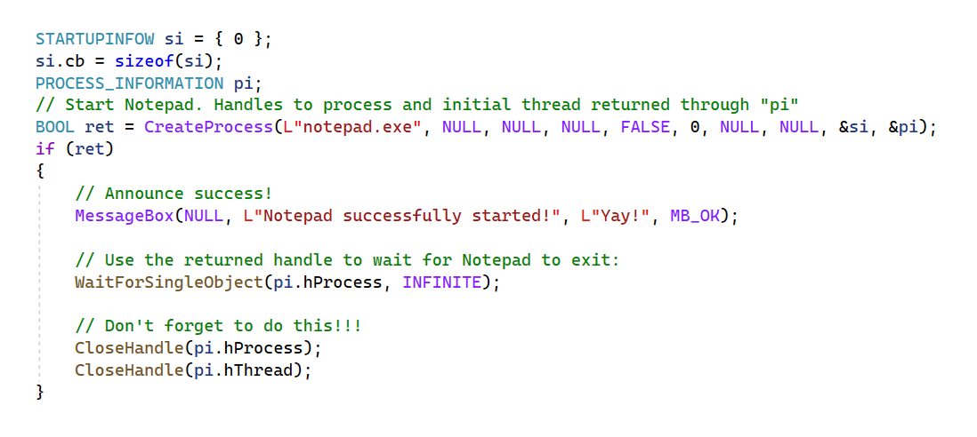

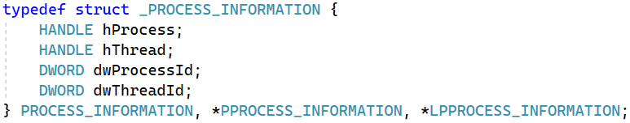
One frequent zombie cause:
Devs forget to do both of these!
Notes:
One frequent cause of zombie processes is incorrect use of the API used to start new processes on Windows
-*-
When CreateProcess succeeds, it returns two handles to the caller through a PROCESS_INFORMATION structure.
-*-
One to the new process and one to its initial thread. These are now in the calling process’ handle table and it’s the calling process’ responsibility to close those handles when they’re no longer needed.
-*-
For example, the caller could use the process handle to wait for the process to exit, as shown here.
But in any case, it must at some point close both of those handles
-*-
And this is something that sometimes devs fail to do.
And even if the process handle is closed but the thread handle isn’t, the corresponding thread object will remain in kernel memory, which will keep the process object from being freed.

Slide 9
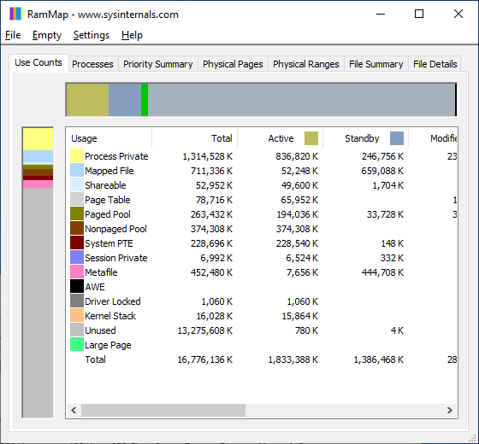
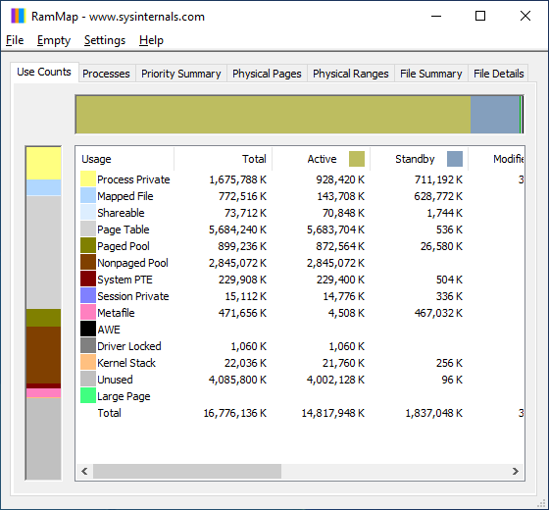
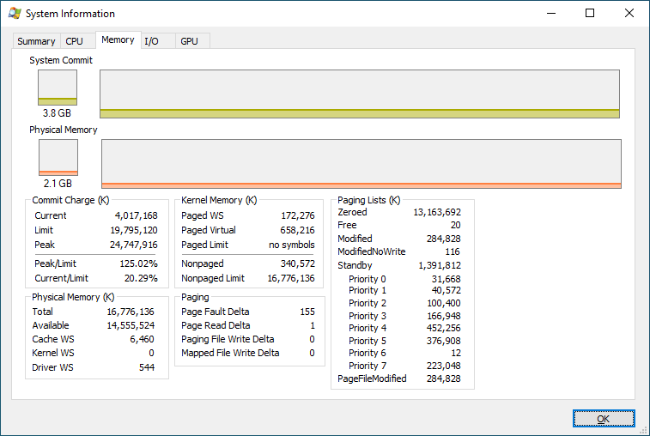
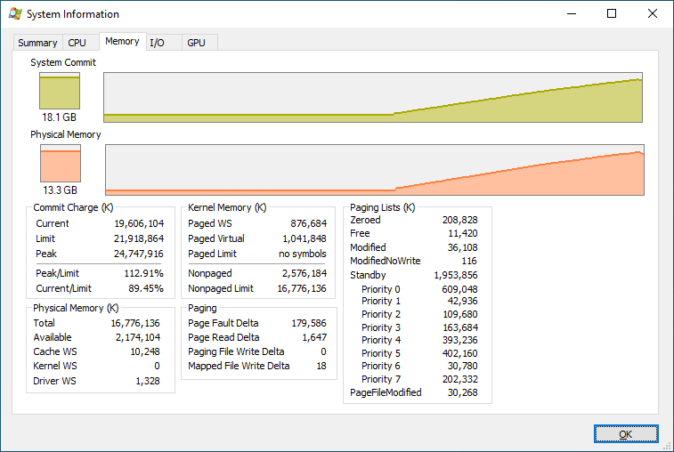
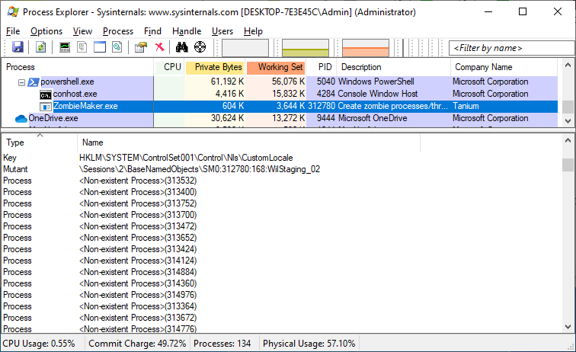
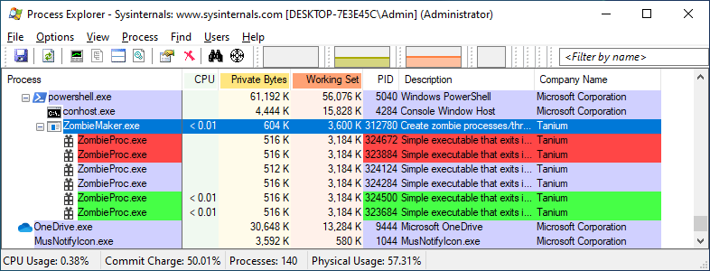
Impact of zombies
Notes:
System starts out with these portions of kernel memory taking up very little RAM; plenty of system commit and physical memory available.
-*-
A long-running process starts a whole bunch of short-lived processes (the green are newly-started processes, the red ones have already exited), but doesn’t close the returned handles.
-*-
At this point, with the child processes all gone, the ZombieMaker sample takes up very little memory, but has a bunch of Process handles that it hasn’t released.
-*-
So what happens to system resources?
-*-
Kernel memory taking up lots more RAM, including nonpaged pool which must remain resident in memory, system commit nearly exhausted.
The system becomes increasingly unresponsive.

Slide 10
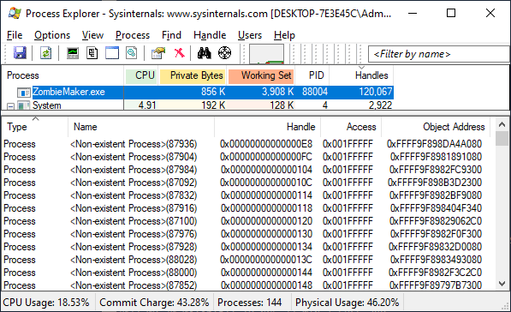
Why are zombies invisible to standard tools?
Limited Win32 API support
Notes:
Limited support in the Win32 API set for identifying processes that have exited.
The process-enumeration APIs don’t report processes that have exited. You won’t see them in Task Manager or any other standard process listing tool.
And many of the process-query APIs don’t work for processes that have exited. For example here, Process Explorer using Win32 APIs can’t report the name of those processes.

Slide 11
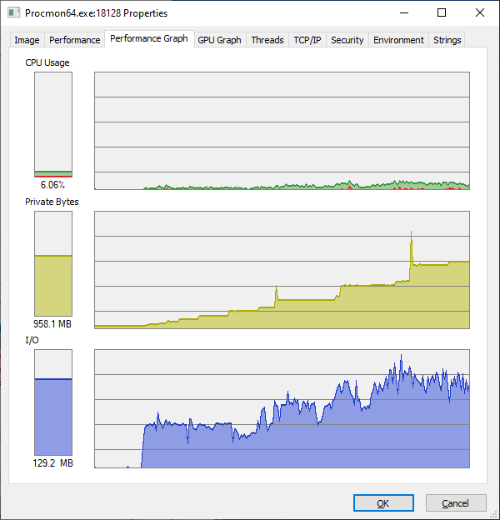
Zombie leaks more detectable than others?
Define resource “leak” →
Process loses track of it
Can’t use it
Can’t release it
Can you tell?
Memory, files, keys, synch objects, … ?
Processes/threads that are long gone … (!!!)
Notes:
So, I said earlier that zombie process leaks are reliably detectable where other leak types aren’t.
Let’s clarify what constitutes a leak:
-*-
Basically, a process has had a resource allocated, but has lost track of it.
So, it can’t use the resource, and it never frees the resource because it’s incapable of doing so.
-*-
But when you see a process that’s increasing its consumption of resources, can you tell whether it’s actually a leak?
-*-
So, for example, we can see when a process’ memory use continually increases. Is it leaking? Maybe, maybe not.
-*-
Run Sysinternals Process Monitor for a while and you’ll see it consuming more and more memory – but it has to, because it’s gathering more and more data about all the events it’s monitoring.
The thing about resources like memory, files, etc., is that as long as you’ve got them they’re still usable. So in most cases, it’s not feasible to determine reliably whether a process is losing track of its resources without actual source code access.
-*-
But when a process or a thread has exited, it can’t be used anymore. It can’t be brought back to life. You can get its exit code but that’s about it. So when a process is holding handles to lots of these things, you can be pretty sure it’s a leak.

Slide 12
Finding zombies and their owners… Cleverness in Bruce Dawson’s FindZombieHandles
Enumerate all processes (NtGetNextProcess) and identify those that have exited
Enumerate any remaining thread objects in those zombie processes (NtGetNextThread)
Get all the handles in all running process’ handle tables (NtQuerySystemInformation(SystemExtendedHandleInformation, …)
Match up those handles to those zombie processes/threads
For developers
For developers
Notes:
[This slide for developer audiences; can be hidden for others.]
These are native APIs, not Win32 APIs. Microsoft hasn’t publicly documented NtGetNextProcess, NtGetNextThread, nor the SystemExtendedHandleInformation enum for the NtQuerySystemInformation native API.

Slide 13
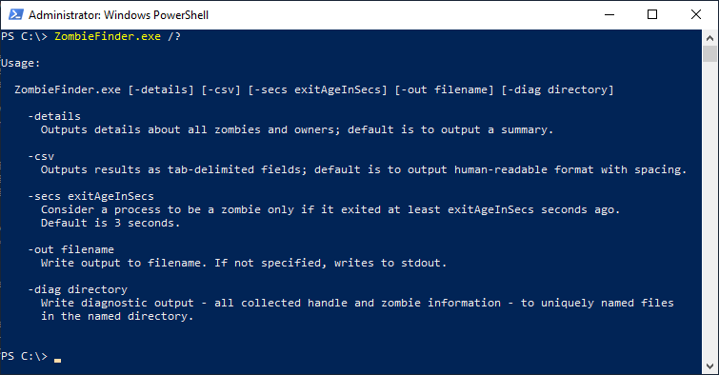
Introducing ZombieFinder.exe
(*) and ZombieFinder32.exe for x86
Notes:
Inspired by Bruce Dawson’s very clever FindZombieHandles which identifies zombie processes, and importantly, what existing processes are holding the handles keeping them from being deallocated
But:
C++, no .NET dependency
Faster, more efficient, releases resources more quickly
Process isn’t considered a zombie if it just exited
Identifies zombies that are being caused by kernel references
If responsible process hosts one or more services, lists them
Option for tab-delimited output
Summary is concise; -details option gives lots more detail than FindZombieHandles

Slide 14
DEMO
Notes:
Demo ZombieFinder.exe
Show different options, including –csv + paste into Excel
Demo with ZombieMaker.exe
Demo with Explorer.exe/LogonUI.exe
Depending on audience, show in Windbg

Slide 15
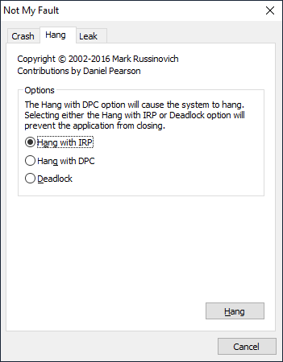
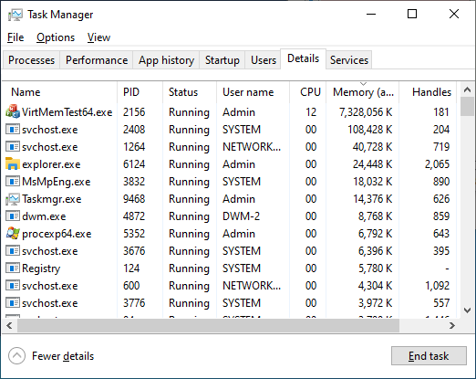
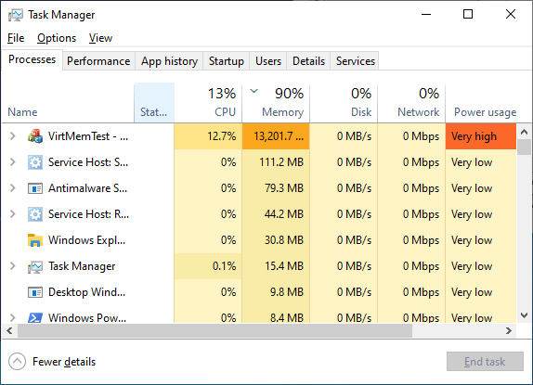
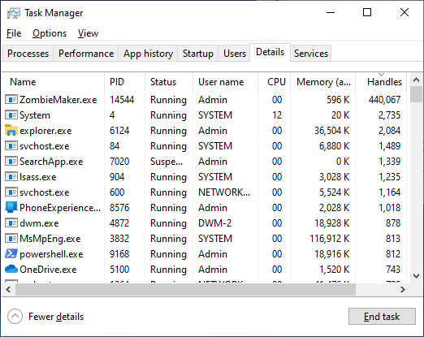
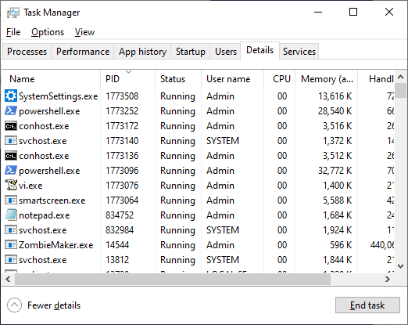
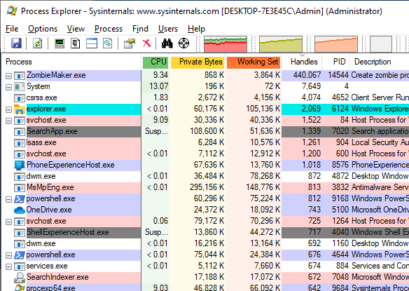
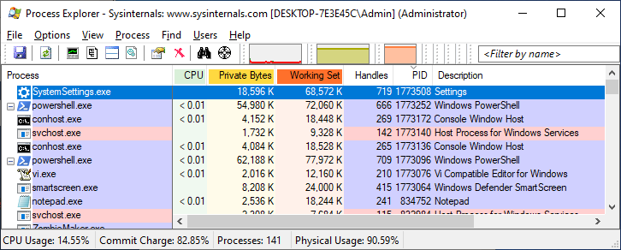
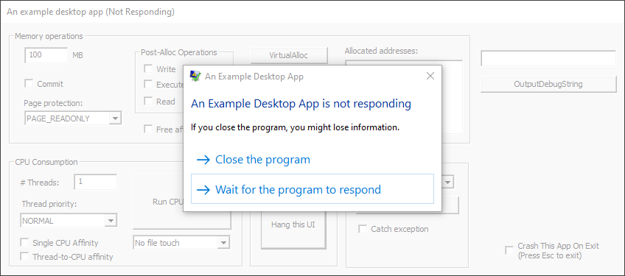
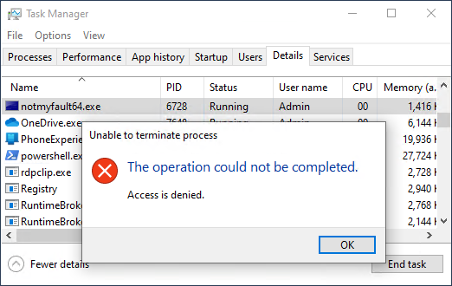
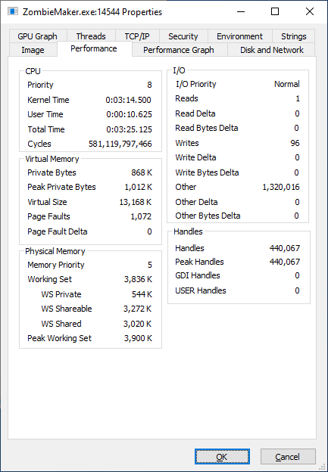
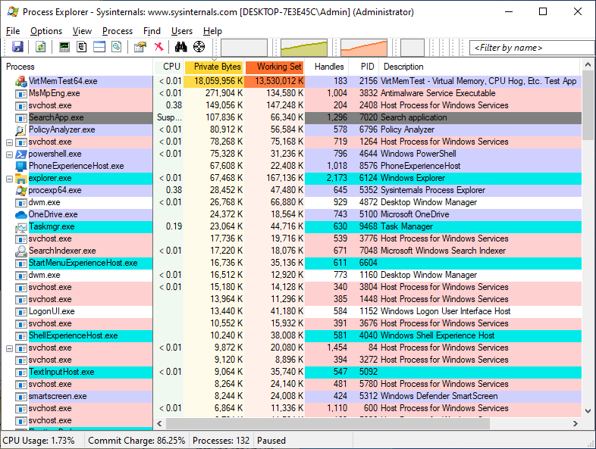
Zombie symptoms and non-symptoms
Notes:
Let’s have a quick look at some zombie-specific symptoms and things that aren’t symptoms of zombie processes.
-*-
This is not a zombie – it’s hung – it’s a GUI app that isn’t responding to window messages such as notifications about keyboard or mouse events.
-*-
Here’s an example of an unkillable process, not because of a failed access check but because there’s an I/O request that’s not returned from the kernel, neither completing nor cancelling. This is sometimes called a zombie, but it’s a different kind because the process hasn’t actually exited. Not the kind of zombie we’re interested in.
-*-
Here we’ve got a process consuming a lot of memory – might be a memory leak. But that’s not evidence of a zombie process leak. Remember that zombie processes manifest in leakage of kernel memory, not a process’ memory.
-*-
High handle count can be a symptom of zombie leakage. After all, it’s one of the ways that zombies can come into being. It’s not a definitive symptom, though, because those handles could be to other object types, and it could even be lots of duplicated handles pointing to a single kernel object.
[DEMO TASKMGR SELECT COLUMNS]
-*-
Very large Process ID numbers are usually a pretty solid indication that there are a lot of process and/or thread objects that aren’t getting cleaned up. Those objects’ IDs can’t be reused until the objects have been cleaned up, so you end up with really big numbers.

Slide 16
FIN

Slide 17
References
Zombie Processes – Pavel Yosifovich
Zombie Processes are Eating your Memory – Bruce Dawson
FindZombieHandles source (github.com)
Unkillable Processes – Mark Russinovich (2005)

Slide 18
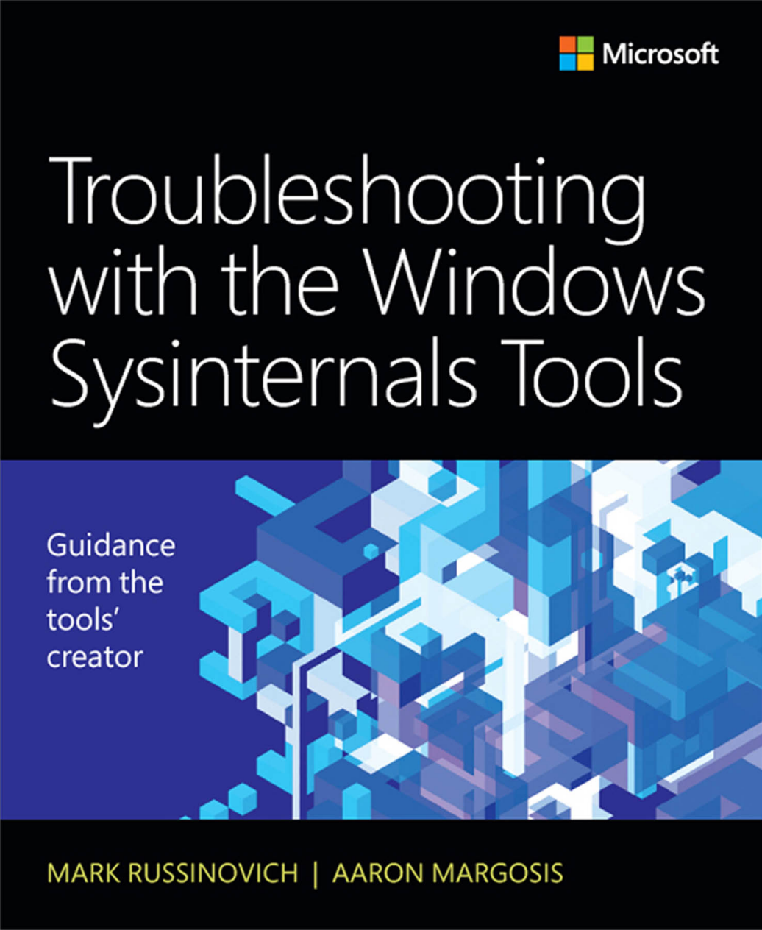

Slide 19
That Excel macro I used…
Sub FormatCSV()
Selection.AutoFilter
With ActiveWindow
.SplitColumn = 0
.SplitRow = 1
End With
ActiveWindow.FreezePanes = True
'ActiveWindow.Zoom = 80 ‘ Uncomment this to zoom everything out a little
Cells.Select
Selection.Font.Size = 9.5
Selection.VerticalAlignment = xlTop
Cells.EntireColumn.AutoFit
Range("A2").Select
Dim ix As Long
Const maxWidth As Long = 45
ix = 1
' Set max column widths for all but the last column
While (Len(Cells(1, ix + 1)) > 0)
If Cells(1, ix).ColumnWidth > maxWidth Then Cells(1, ix).ColumnWidth = maxWidth
ix = ix + 1
Wend
End Sub

