Slide 1

Wealth Tracking Framework
Aaron McKinley
G00299523
Bachelor of Engineering (Honours) in Software and Electronic Engineering

Slide 2
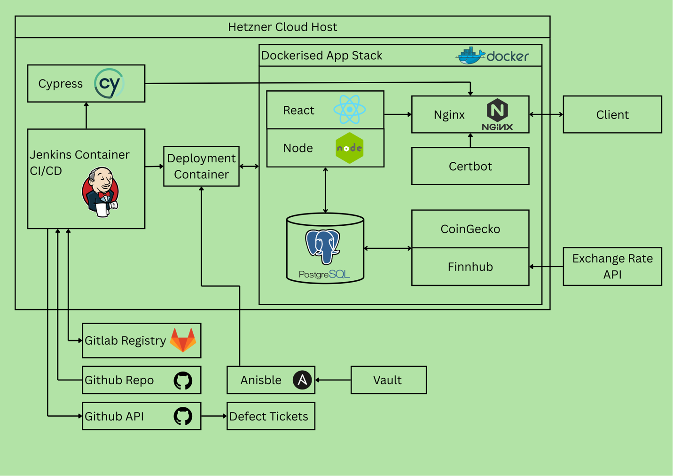
Architecture Diagram
All Services in Dockerised Containers
Hosted on Hetzner
CI/CD Controlled by Jenkins
Cypress Automated tests
Ansible Deployed
React Frontend
Node/Express Backend
PostgreSQL Database
Nginx reverse proxy
CoinGecko and Finnhub APIs
GitHub Issues for test failures
GitLabs Image registry

Slide 3
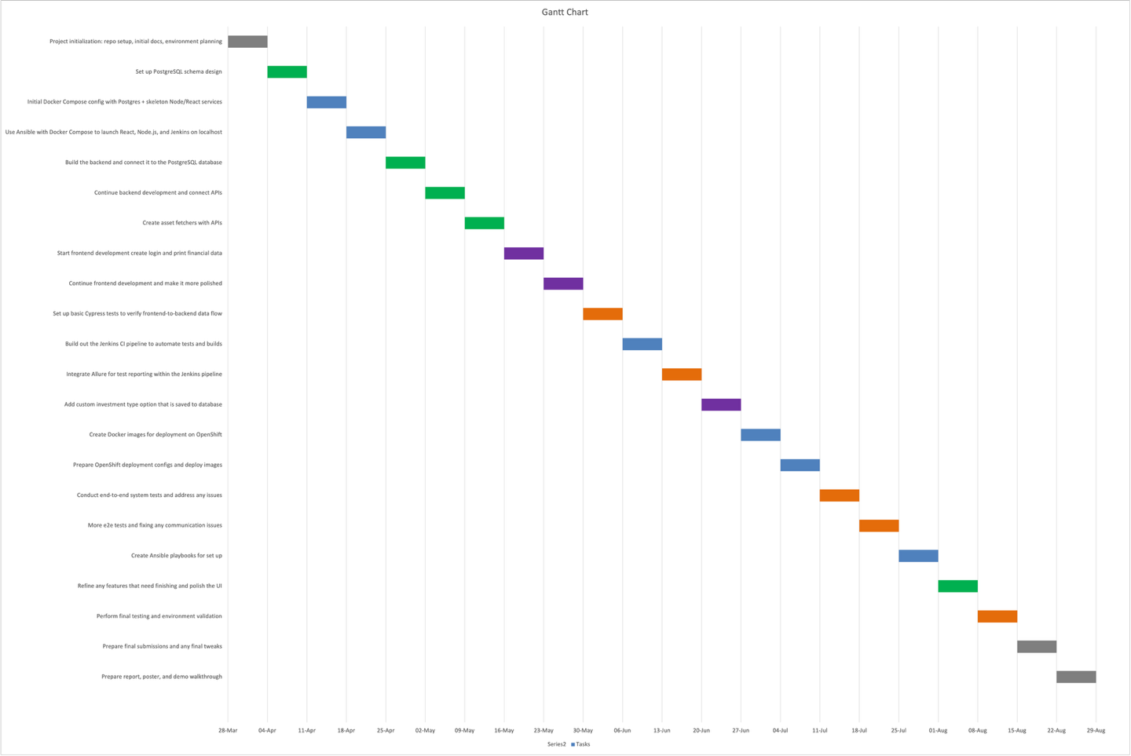
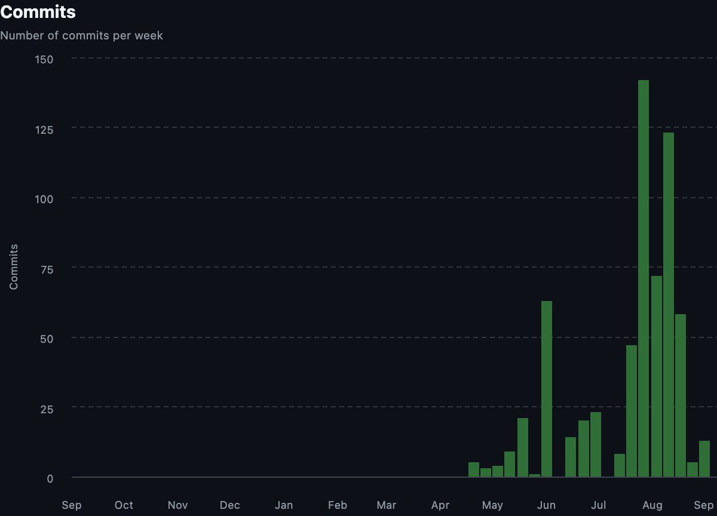
Plan and Commits

Slide 4
Project Reflections
What Worked Well
JWT login
Core CRUD functionality
Cypress End to End tests
Live Pricing from CoinGecko and Finnhub
Ansible for deployment
Containerisation using Docker Compose
CI/CD using Jenkins
What Could Work Better
Jenkins on the same server can cause issues when redeploying
Allure results are not being displayed
Savings Interest needs to remain after Savings removed
Defects opened in GitHub should be moved to Jira

Slide 5


Links
github.com/AaronMcKinley/wealth-tracking-framework
www.wealth-tracking-framework.com/

