Slide 1
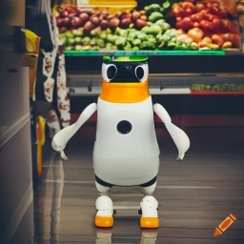
ECE4078 Intelligent robotics
AI art generated by https://www.craiyon.com/
(prompt: “a penguin robot shopping for fruits and vegetables in a supermarket”)
Lab 3-2: Object Location Estimation

Slide 2
ECE4078 Intelligent robotics
Week | Objectives | Milestones
1: M1-1 | Introduction and setup
2: M2-1 | Calibration, ARUCO markers | M1 due
3: M2-2 | SLAM
4: M2-3 | SLAM
5: M3-1 | Object recognition & localisation | M2 due
6: M3-2 | Object recognition & localisation
7: M4-1 | Navigation & Planning | M3 due
8: M4-2 | Navigation & Planning
9: M5 | Integration & Improvement | M4 due
10: Final | Trial run of final demo | M5 due
11: Final | Improving your final demo
12: Final | Final demo | Final demo
*

Slide 3
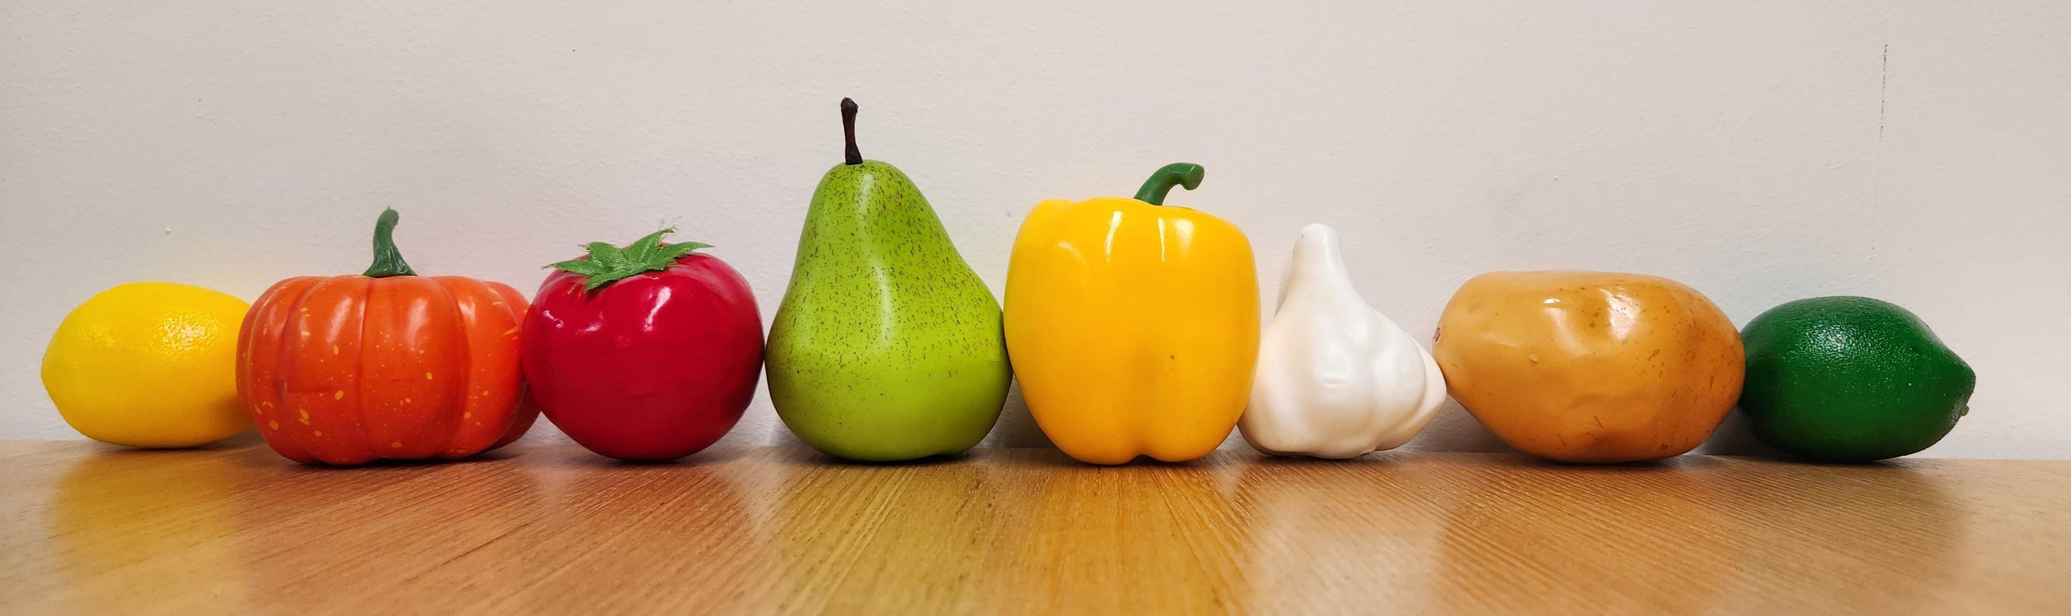
Milestone 3
Your PenguinPi can map the supermarket aisles and itself after M2, but how does it find the fruits and vegs to shop for? In M3, you’ll focus on object recognition and localization using machine learning.
There are 8 types of fruits and vegs selling at the supermarket, and a total of 10 objects in an arena in addition to the 10 ARUCO markers (there may be duplicates or missing target types):
lemon pumpkin tomato pear capsicum garlic potato lime
*we bought these fruit and veg models from Amazon if you want to get some yourself (NOT an endorsement for the vendor)

Slide 4
M3: Overview
Task 1: collecting a dataset of target fruits and vegs (Week 5)
Task 2: Training a YOLO model for object detection and segmentation (Week 5)
Task 3: Estimating object poses (Week 6)
Live demo marking of M3 in Week 7: detector performance + object pose estimation performance
Note: for M3 we DO NOT recommend developing your detector in the simulator, as an object detector trained in the simulator is likely to have significantly worse performance when applied in real world.
You can still use the simulator to develop the target post estimation part (Week 6), but you may need to train two detectors, one for the real world, one for the simulator.

Slide 5
M3: Estimating Object Location (wk6)
Task 3: Estimating object poses (Week 6)
Given YOLO’s bounding boxes, true dimensions of the objects, and the robot’s pose (estimated by SLAM) at the time of observation, calculate the X-Y coordinates of the object in the arena
You will modify “TargetPoseEst.py”
Here we use a human for illustrating pose estimation, however human is not a target in M3

Slide 6
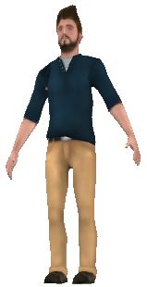
Estimating Relative Pose
Given any standard RGB image, can we calculate the 3D position of any pixel within an image?
Image plane
Camera center

Slide 7
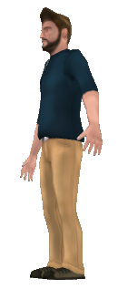
Estimating Relative Pose
What if we had 2 RGB images?
We can triangulate the projected light rays to figure out the 3D position of the corresponding point
Image plane
Image taken from a different viewpoint
Camera center

Slide 8
Estimating Relative Pose
This is difficult to do however as it is reliant on us being confident on the relative poses of both cameras and choosing a pixel in both images that correspond to the exact same spot on the human
First image
Second image

Slide 9
Estimating Relative Pose
What if we project two lines from the camera?
If the human were to walk backwards, away from the camera, they should appear smaller in the image

Slide 10





Estimating Relative Pose
This will ONLY work if:
We know the height of the object we are looking at
The object’s height does not change
$$H$$
$$H_{3}$$
$$H$$
$$H_{2}$$
$$H_{1}$$

Slide 11
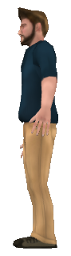


Estimating Relative Pose
Image plane
Observed pixels
Object height
Z-axis
Camera origin
X
Z-axis
Focal length
Z (depth)
$$x − u_{0}$$
A
Z (depth)
Image plane
Focal length
b
$$\frac{a}{b}=\frac{A}{B}$$
B
a

Slide 12

Estimating Relative Pose
To calculate target pose in a single image, you need:
- Camera’s intrinsic parameters, which you have calculated in M2 (camera calibration)
$$\left[\begin{matrix}F_{x} & 0 & c_{x} \\ 0 & F_{y} & c_{y} \\ 0 & 0 & 1\end{matrix}\right]$$
${(F}_{x}$, $F_{y}$): focal length in pixels
${(c}_{x}$, $c_{y}$): optical centre in pixels
- Height in pixels and x-pixel coordinate of object: given by YOLO
- Physical height of the objects: you’ve measured this in Week 6.
- Hints
- estimate_pose() is only one possible solution. You are encouraged to make changes, e.g., you can use object width as an additional estimate if it has a constant width from all viewing angles
- If your network is trained on a different image size or your robot has a different camera resolution, remember to change “image_width” on line 54 in TargetPoseEst.py and “imgsz” on line 69 in detector.py

Slide 13
Estimating Target Map
To generate a map of all 10 targets in the arena based on relative poses in individual observations:
When driving your robot around the arena, M2 allows you to estimate the robot’s pose (x,y,θ) when it’s taking a photo and estimating relative pose of the target object
Combining the robot’s pose at the time of observation and the relative target pose estimated from the photo the robot takes, we can estimate the pose of the target in the world
Your robot can see the same object from multiple locations and produce multiple estimations, but there are also duplicate objects. How to distinguish if multiple estimations for an object type are for different objects and thus should be kept separate, or are for the same object and thus should be merged?

Slide 14
Estimating Target Map
To generate a map of all 10 targets in the arena based on relative poses in individual observations:
TODO: complete the merge_estimations function in TargetPoseEst.py to use some kind of filtering or clustering method to merge observations of the same object.
Hints:
the target map accuracy relates to how you drive the robot, when you take the photos, what’s in a photo, how you merge the estimations, how you correct the estimations, and accuracy of your SLAM
take some photos of the physical fruits and vegs from known distances and at know robot locations so you can validate your pose estimation and target map estimation at home

Slide 15
M3: Evaluation
Detector performance:
Classification performance of your trained YOLO on a set of 10 testing images. You will need to pass the testing images into your model using detector.py (inside YOLO folder)
detector_score = 2 x NumberOfCorrectPredictions (0 ≤ detector_score ≤ 20)
Target map performance:
Driving your robot around the arena to generate slam.txt and targets.txt, then mapping_eval.py will be used to calculate the estimation error.
mapping_eval.py takes your slam.txt to get the alignments for best SLAM, then the target positions from targets.txt are re-aligned accordingly. The Euclidean distance between each target and its closest estimation is recorded as target_score.
target_score[object] = (1 - estimation_error[object]) / (1-0.025) x 8
target_est_score = sum(target_score) – 5 x NumberOfCollisions 0 ≤ target_est_score ≤ 80
M3_score = detector_score + target_est_score 0 ≤ M3_score ≤ 100

Slide 16
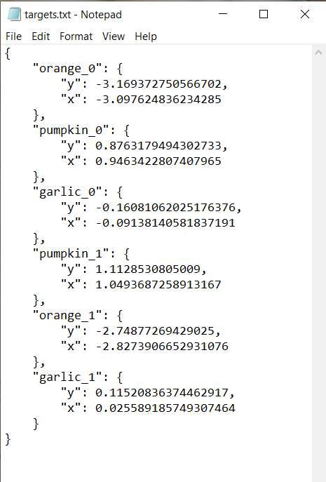
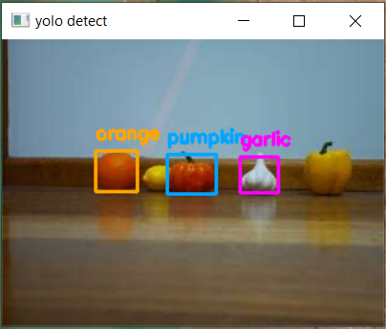
M3: Evaluation
Submission of your codes (before next week’s lab):
Scripts required to run your M3, e.g., util folder, modified TargetPoseEst.py
YOLO model weights - If weights are too large for moodle you can submit a link to a google drive file
Don’t include your training dataset or the python venv
Live demo marking in wk8:
20min time limit
detector visualization (10 testing images, each containing one target object, 2pt for each correct label given)
target map generation (max 3 collisions/out-of-bound per run), make sure the generated map is in the right format
Submit slam.txt & targets.txt

