Slide 1
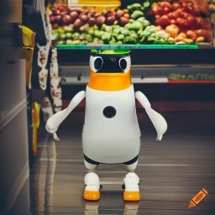
ECE4078 Intelligent robotics
AI art generated by https://www.craiyon.com/
(prompt: “a penguin robot shopping for fruits and vegetables in a supermarket”)
Lab 2: Additional Contents (credit: Kal Backman, PhD candidate, Monash Robotics)

Slide 2
Extended Kalman filter example
We want to track the position of a 1D object that has an accelerometer and a GPS attached
Accelerometer: - High update rate
- Prone to drift after successive time integrations
GPS:
- Slow update rate
- Immune to drift
- Not accurate
3 states:
(Remember, the example shown in the slides is for a 1D ball NOT for the PenguinPi)

Slide 3
Extended Kalman filter example
Prediction step:
Step 1: Apply dynamics
Step 2: Calculate Jacobian of dynamics
Step 3: Estimate uncertainty
$\begin{matrix}dx & d\overset{˙}{x} & d\overset{¨}{x}\end{matrix}$
$\begin{matrix}x \\ \overset{˙}{x} \\ \overset{¨}{x}\end{matrix}$
This matrix is denoted as “A” in the lecture slides however many other people may denote this as “F”
This matrix represents your uncertainty in the process / dynamics.
Commonly referred to as “Q”, and is normally tuned. There is an alternate form which uses where V is the Jacobian of the states with respect to “” from the lecture slides.
Covariance matrix of the states, this is also commonly denoted as “P”

Slide 4
Extended Kalman filter example
Observation / correction / update step:
Step 1: Calculate error between the observation and prediction
Step 2: Calculate Jacobian of error (multiplied by -1)
Step 3: Update Kalman gain and states
X = + K Y
The error term Y is more generally denoted as where z is the sensor measurement and h( ) is a function that allows you to compare the state with the sensor measurement
$\begin{matrix}dx & d\overset{˙}{x} & d\overset{¨}{x}\end{matrix}$
This matrix is denoted as “C” in the lecture slides however many other people may denote this as “H”.
For extended Kalman it is calculated as
$\begin{matrix}x_{t} \\ {\overset{¨}{x}}_{t}\end{matrix}$
This is why we multiply the Jacobian of the error by -1 because we took the derivative of instead
This matrix represents your uncertainty in the observation
and is normally tuned. “” is also denoted as “S”
Is the Kalman gain and it acts as a step size as to how much you should update your states based on an observation

Slide 5
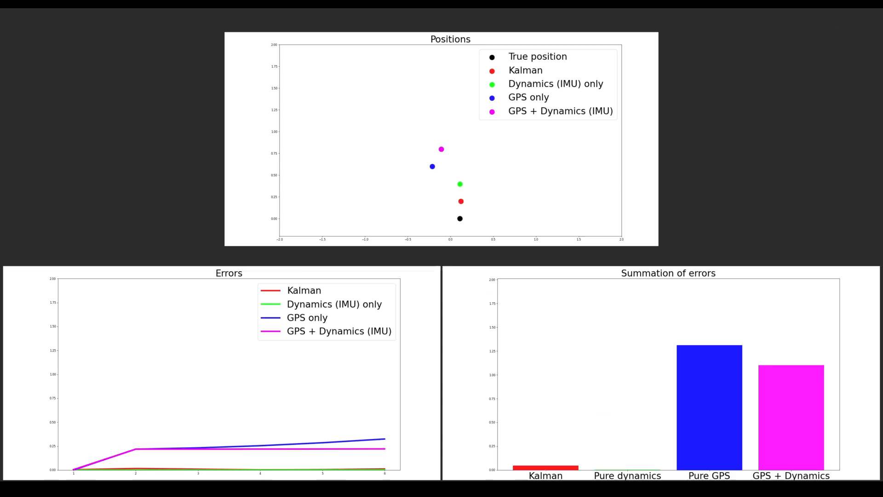
Extended Kalman filter example
Here is an example of why we should use a Kalman filter to fuse sensor readings with a dynamic model compared to other simpler and naïve approaches.

Slide 6
Additional recommendations (optional)
Here is a list of additional things you may like to implement that may give you better performance
These recommendations are ranked on difficulty to implement and are not compulsory to use but serve as potential ideas if you’re looking to do better
There is no guarantee that by attempting these recommendations that you will definitely get better results, each of these recommendations have risks of failure and wasting time if not done correctly.
It is also up to you to develop these on your own, as these are optional the demonstrators will not provide any code or give assistance except for high level discussions.
You are strongly encouraged to attempt the “easy” difficulty recommendations as these are not only the easiest to implement but also offer the greatest performance increase.
You are also encouraged to be as creative as possible and think of your own improvements
(However, don’t assume the arena layouts, such that markers will be placed in a grid world pattern, we have in the past placed markers in fractional positions eg: x=0.579513m)

Slide 7
Additional recommendations (optional)
- (Easy) Isolated Kalman predict and update step validation
To validate predict() function:
Spawn the robot in an empty arena with no markers Drive around the arena whilst printing out the ekf state [x, y, theta]
Compare your printed state with that of the simulator If there is a substantial difference, review code related to the predict() or modify wheel parameters
To validate update() function:
Place the robot at the origin with some markers visible in front of it
Whilst at the origin, print out the marker’s position and compare to the simulator
Drive around the markers whilst looking at them and print out the ekf state [x, y, theta]
Compare your printed state with that of the simulator
If there is a substantial difference between the initial marker positions or the robot state, review code related to the update() or modify camera parameters

Slide 8
Additional recommendations (optional)
- (Easy) Practice practice practice!
By far the easiest and most influential recommendation
With your group make sure you practice the ENTIRE marking procedure that includes:
Starting a 20 min timer
Downloading your submission from moodle (validate your submitted files are correct)
Performing all the setup steps
Driving around the arena and saving your slam.txt with sufficient time reserved to upload
Practice on a wide range of maps and understand what kind of driving strategies works best
Make sure when practicing you try your best to replicate EXACTLY how you will do the live demo:
same computer, driver and submission
- (Easy) Drive as a team
Even though there can only be one driver that doesn’t mean your teammates can’t help
Historically the best teams help the driver by calling out important information such as missing markers, poor marker estimates and recommendations of what path the robot should take so the driver can solely focus on providing optimal keyboard inputs
Before you start operate.py it is worth spending some time discussing with your teammates what strategy you will use and plan out a rough path to take

Slide 9
Additional recommendations (optional)
- (Medium) Kalman uncertainty tuning
Tune and to better reflect the uncertainty in your system
When testing what is the greatest source of error? Does your and reflect this?
What conditions may affect uncertainty? Are we more/less confident in observations of ARUCO markers if they are closer/further away? Are we more/less confident if we are moving in a strait line / turning?
- (Medium) Fixed marker estimates
The uncertainty in a markers position is: uncertainty in robot position + uncertainty in observation
Is there a time where we are absolute 100% certain of the robot’s position?
If so, then any observations of an ARUCO marker will be the best they can possibly be and maybe we should fix these estimates, or at least set our confidence in these markers to be high
${\overline{∑}}_{K}=A∑_{K−1}A^{T}+∑_{Q}$
(Predict step) (Update step)

Slide 10
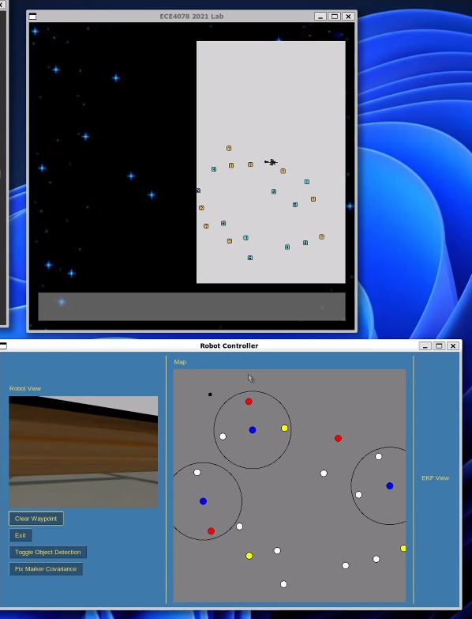
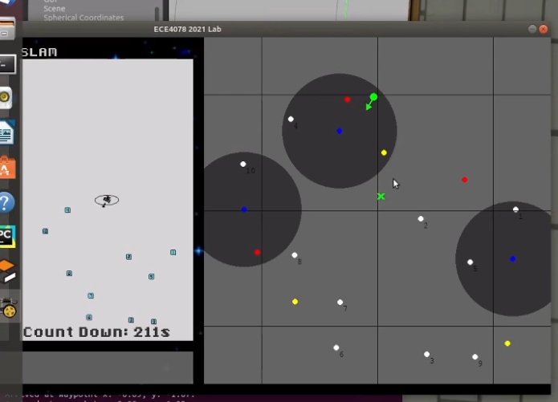
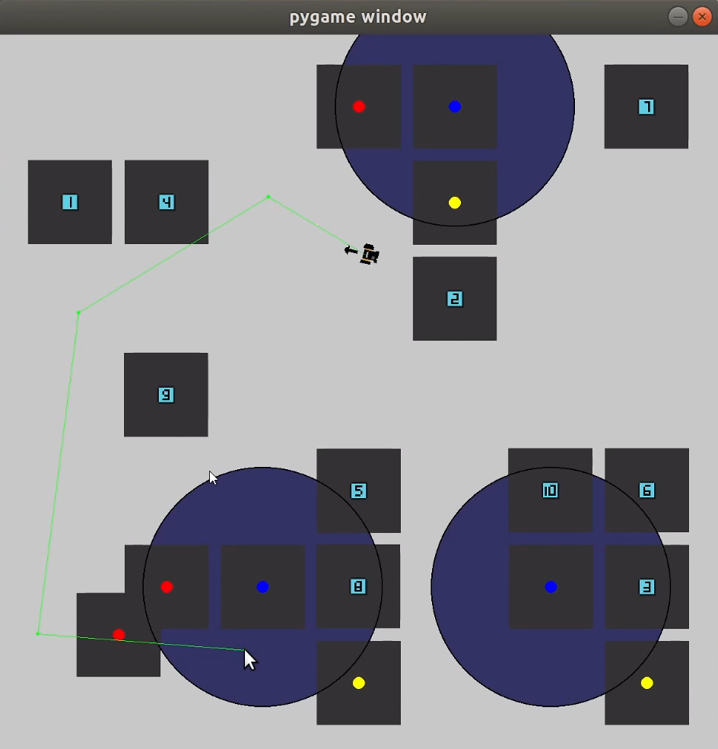
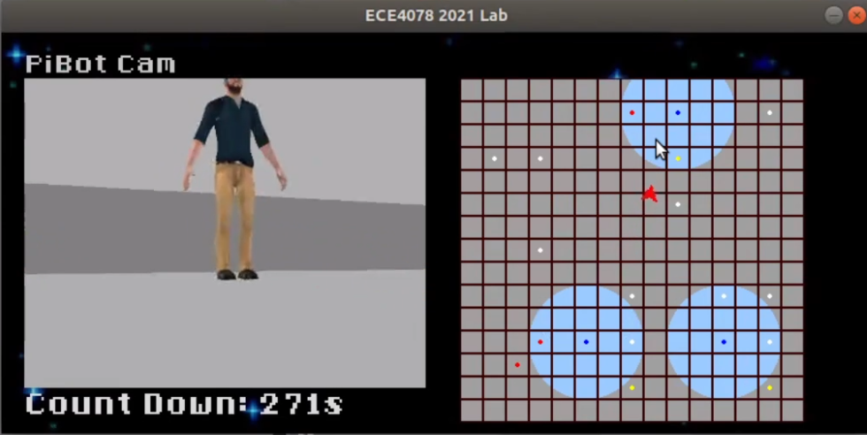
Additional recommendations (optional)
- (Medium) Improved GUI
Some teams have implemented an improved GUI catered to their implementation
Here are some examples:
(This becomes more important for M4 but can be worked on now)
- (Medium) What we want vs what we are observing
Our goal is to find the position of the centre of the cube however we can only observe the side of it.
Can we use information of our current pose, tvec & rvec of cv2.aruco.estimatePoseSingleMarkers and the knowledge that the cubes are aligned to the principle axis to get an estimate of the cube’s centre?

Slide 11
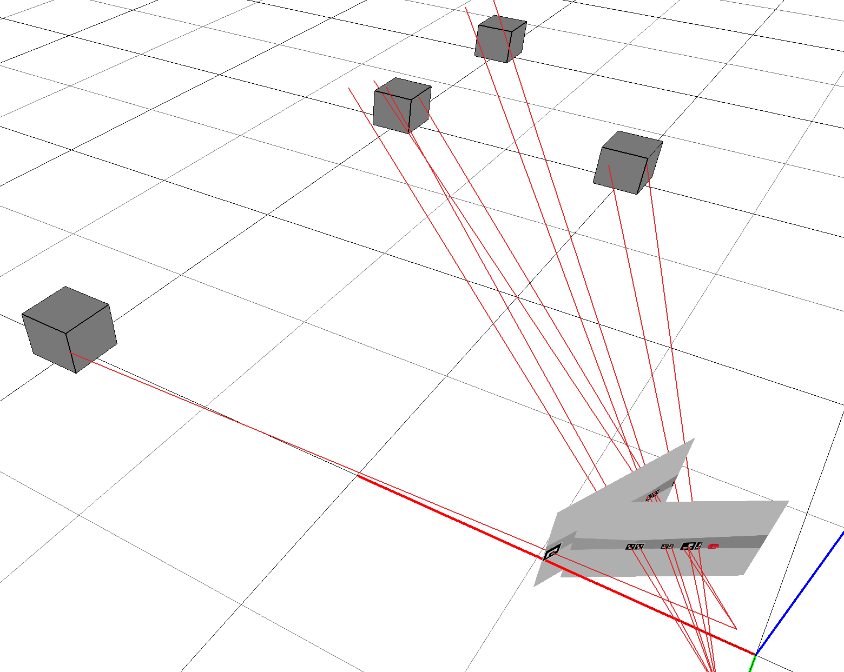
Additional recommendations (optional)
- (Hard) Joint camera pose and ARUCO pose estimation
The Kalman filter is a great algorithm however it is technically not designed for our goal, to estimate the entire map of ALL the ARUCO markers.
The Kalman filter creates a map that is “locally consistent”
where as we want a map that is “globally consistent”
Given that we have an image that can see multiple markers
we can create a “link” between those markers so when we
see any one of those markers in a different image we know to
update our estimate of all those “linked” markers

Slide 12
Additional recommendations (optional)
- (Hard) Joint camera pose and ARUCO pose estimation (continued)
This problem is similar to the bundle adjustment problem except much simpler
- We will do this in 2D instead of 3D
- We will use 2D vectors instead of image points (due to Tvec from ARUCO markers)
The aim is to create as many links as possible by taking images with multiple markers present
If those links form a loop then we can perform loop closure
The rough steps to implement this are:
1 - Record images containing multiple markers and an initial pose [X, Y, θ] from Kalman filter
2 - For each recorded image, detect ARUCO markers (ID) and calculate Tvec (cv2.aruco.estimatePoseSingleMarkers)
(throw away images that do not contain more than 2 unique markers, can break otherwise)
3 - Calculate the error between current estimate of an ARUCO marker with that of observation
: ARUCO marker of ID
: X position of robot for the image
: Tvec corresponding to Marker taken from image

Slide 13
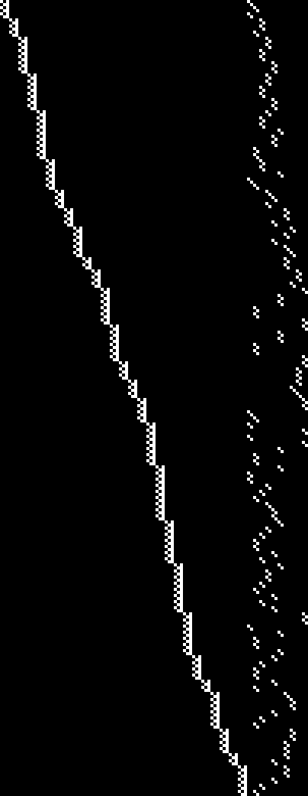
Additional recommendations (optional)
- (Hard) Joint camera pose and ARUCO pose estimation (continued)
4 - Calculate the Jacobian of the error
Jacobian will be of size: (Height) nTvecs * 2 and (Width) nImages * 3 + nMarkers * 2
5 - Minimise error using the non-linear optimization algorithm Levenberg-Marquardt
: All parameters (Image poses and ARUCO markers) in the next iteration : Jacobian
: Scaling parameter which is decayed after successive iterations (tuned)
Will also have to use the pseudoinverse (np.linalg.pinv) to take the inverse of
6 - Repeat step 3 onwards until convergence
Diagonal component represents the
parameters for each of the image poses
Right hand side represents the parameters
for the ARUCO marker positions

Slide 14
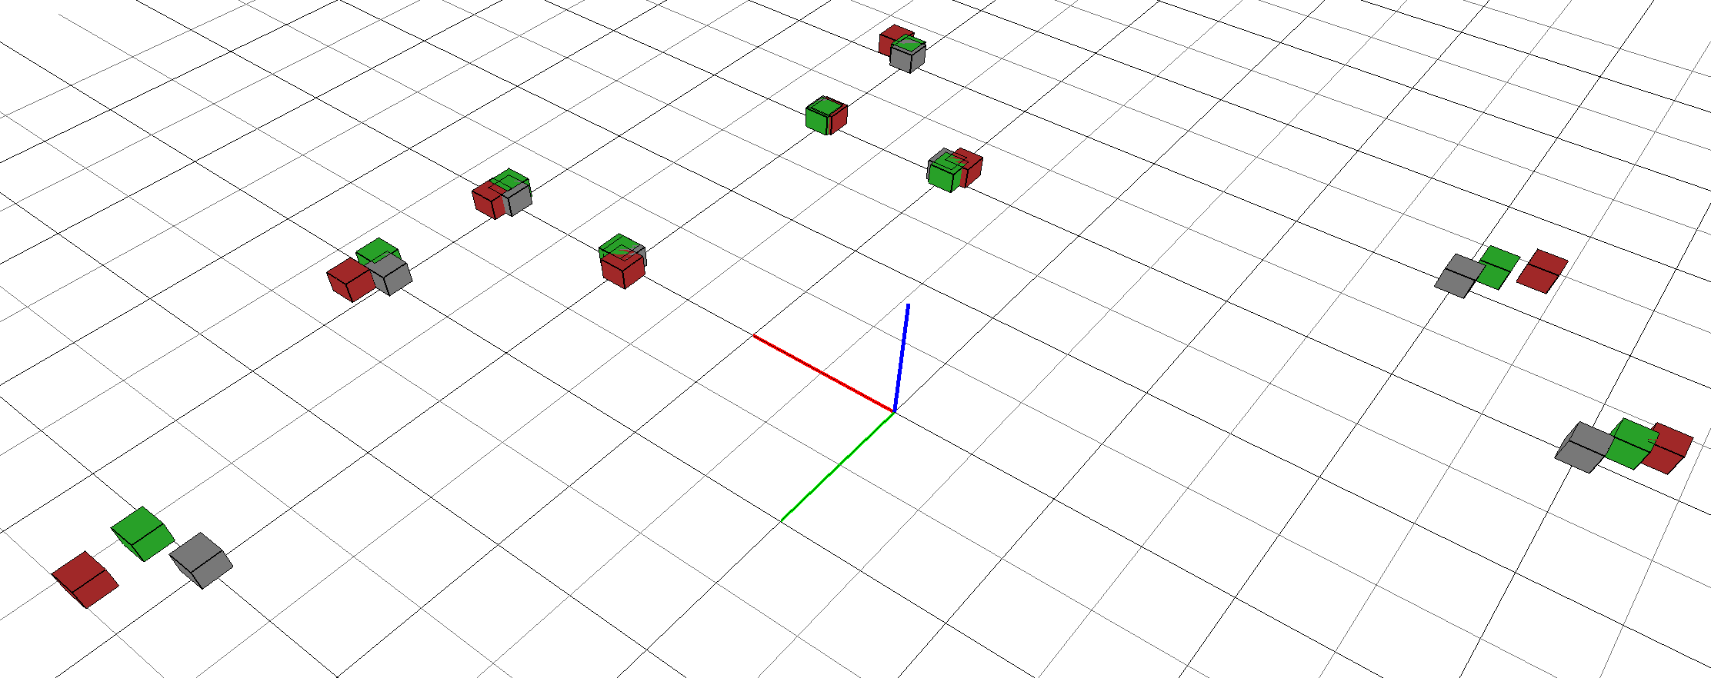
Additional recommendations (optional)
- (Hard) Joint camera pose and ARUCO pose estimation (continued)
For reference driving around using the default solution with no improvements (and no practice) received an RMSE error of ~0.12, performing joint optimisation as a post processing operation from 27 images lowered the RMSE down to 0.07 (62% of the original error)
No team in the past has implemented this before so let me know if you’re giving it a go
Grey: True positions
Red: Initial Kalman estimates
Green: Joint optimised estimates

