Slide 1

ECE4078 Intelligent robotics
AI art generated by https://www.craiyon.com/
(prompt: “a penguin robot shopping for fruits and vegetables in a supermarket”)
Lab 5: Integrated System

Slide 2
ECE4078 Intelligent robotics
Week | Objectives | Milestones
1: M1-1 | Introduction and setup
2: M2-1 | Calibration, ARUCO markers | M1 due
3: M2-2 | SLAM
4: M2-3 | SLAM
5: M3-1 | Object recognition & localisation | M2 due
6: M3-2 | Object recognition & localisation
7: M4-1 | Navigation & Planning | M3 due
8: M4-2 | Navigation & Planning
9: M5 | Integration & Improvement | M4 due
10: Final | Trial run of final demo | M5 due
11: Final | Improving your final demo
12: Final | Final demo | Final demo
*

Slide 3
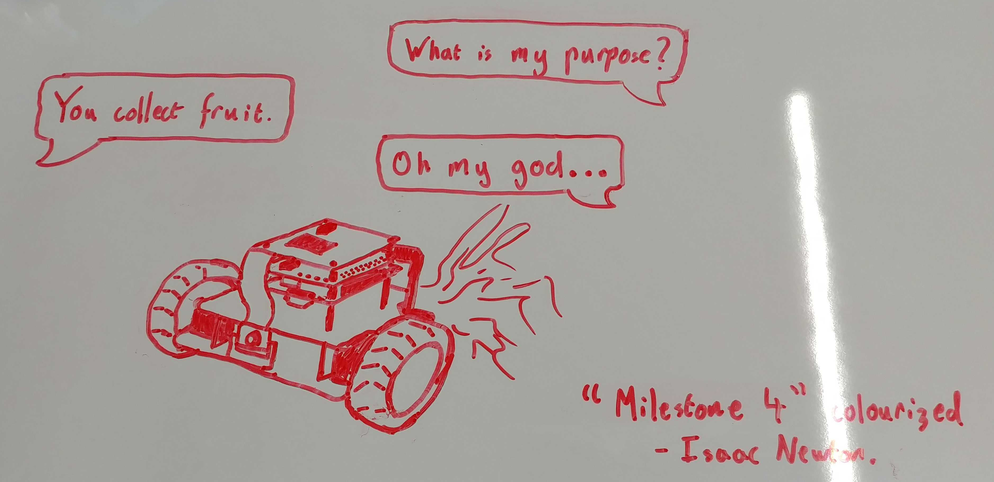
ECE4078 in a nutshell
- By unknown 2022 student

Slide 4
Milestone 5: Integration
M5 focuses on integrating all the previous milestones to allow PenguinPi to go grocery shopping
Your task will be to first map out the arena of all 10 ArUco markers (M2) and 10 targets (M3) which you can do so by manually driving around the arena (M1). Once the arena is mapped you will then be tasked to navigate to targets on a shopping list following the given order (M4).
M5 is a trial run of your final demo.
The arena will always contain:
10 ArUco markers
5 unique fruits&vegs as targets for navigation (given shopping list)
5 obstacle fruits&vegs (containing duplicates)
There are two evaluation components:
Arena mapping: 60pts
SLAM map: 30pts
Target map: 30pts
Grocery shopping / navigation: 40pts
Semi-auto waypoint navigation: max 15pts
Full auto navigation: max 40pts
SLAM test case provided to help your development. Remember that all skeleton codes are for ref only.

Slide 5
M5: Task
You can perform the mapping and navigation task independently
You can first manually drive around the arena creating a map of the ArUco markers and targets.
You may attempt to map out and save your estimate of the arena as many times as you’d like.
For the mapping and navigation task the robot must start at the origin (0,0,0)
You can load your previously saved estimate map of the arena during navigation.
You can attempt the navigation task as many times as you’d like.
You may also alternate between arena mapping and navigation if you’d like
You may stop your robot after you have a qualified run.
You can also perform the mapping and navigation together (you can’t teleoperate for navigation) as long as the SLAM and target maps are generated for evaluation.
You are NOT given the true map for evaluation or navigation during M5, only the shopping list is given.

Slide 6

M5: Evaluation
Mapping (60 points):
ArUco slam map (0 ≤ slam_score ≤ 30pt):
$24∗\frac{\text{0.12} \text{− }\text{Aligned}\text{_}\text{RMSE}}{\text{0.12}\text{− 0.02}} \text{+} \text{0.}\text{6}\text{ ∗ }\text{NumberOfFoundMarkers}$
Target map (0 ≤ target_est_score ≤ 30pt):
TargetScore[object] $=3∗\frac{\text{1} \text{−} \text{estimation}\text{_}\text{error}\text{[}\text{object}\text{]}}{\text{1 − 0.025}}$
TargetEstScore = sum(TargetScore)
Mapping score (0 ≤ map_score ≤ 60pt) = slam_score + target_est_score
Waypoint navigation (max 15 points):
2pts for each success navigation. 5pts for code or demo evidence.
Full auto navigation (max 40 points):
6pts for each success navigation. 10pts total for code or demo evidence (includes 5 pts for waypoint navigation and 5 pts for path planning).
Penalties (Max of 5 penalties total, 4 applied):
-3 (or -2 if you perform semi auto navigation) points for object collisions or leaving boundary (Does not apply to evidence marks)
Marks for reaching objects will always count, however you cannot stop a run manually until a run is qualified (same definition as M4)
More info see M5_marking.md

Slide 7
Additional recommendations (optional)
- Practice practice practice! (again)
The easiest and most influential recommendation.
Remember this ALSO includes setting up the environment as quick as you can.
Try and practice on a wide range of maps whilst trying your best to replicate the EXACT same conditions you will be performing the live demo under.
- Develop, plan and discuss a strategy Try and find a “meta” strategy that will give you the most marks in the limited live demo time Is it better to brute force the task with many fast attempts as possible? Or is it better to try and take it slow and be more consistent?
Is there a specific driving strategy you should follow when mapping the arena?
Discuss and solidify a plan with your group with what kind of strategy you should use.

Slide 8
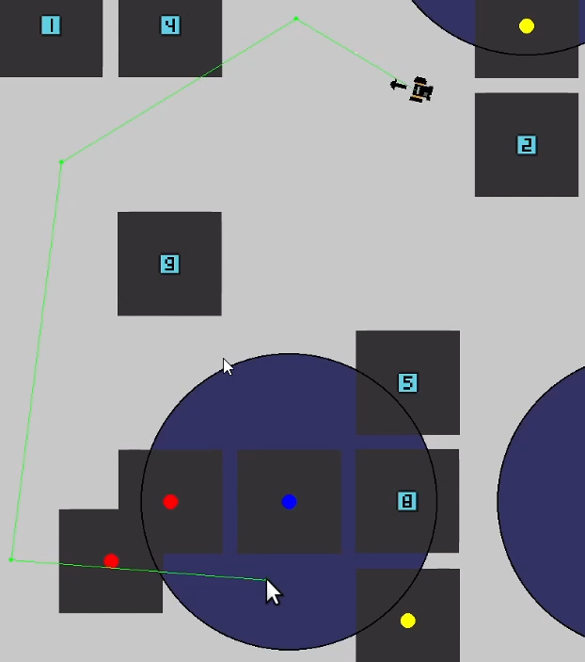
Additional recommendations (optional)
- Improved GUI
An improved GUI can really help out the mapping and navigation
Rendering the trajectory on screen can be helpful to check early on if the generated path of the robot is a viable one (and for you to decide if you want to go ahead with this path / waypoint or to generate a new one before starting the navigation)
- Path planning selection If you are using a stochastic path planning algorithm (or multiple path planning algorithms), it may be beneficial to initially generate multiple potential trajectories which the robot can select from
Remember, you can only press ONE button to start your script

Slide 9
Additional recommendations (optional)
- Waypoint thresholding
You can set an appropriate threshold so the robot doesn’t have to get too close to a waypoint point and get fixated at trying to do so
If this fixation is due to the robot thinking it “teleported” due to an update of its position from seeing an ArUco marker, then you may need to decrease the uncertainty in the predict step so it relies on the robot’s dynamics a bit more
Remember, the skeleton codes are for reference only and you’ll have to improve the codes or write your own to get better marks. As long as your codes perform the task and generate estimation maps that can be marked according to the evaluation schemes and scripts you are free to modify the skeleton codes.

Slide 10
M4: Evaluation
Live demo marking in wk9 using new arena
Each of the 3 levels have different marks associated
Level 1: (Total marks: 50pt)
For each successful navigation in order +10pts
Level 2: (Total marks: 30pt)
You get the Lv1 50pt if you can achieve a qualified run in Lv2
For each successful navigation in order +6pts
Level 3: (Total marks: 20pt)
You get the Lv1+Lv2 80pt if you can achieve a qualified run in Lv3
For each successful navigation in order +4pts
You will receive penalties if:
Robot collides with a marker/object or goes out of bounds (-5pt) (Max 4 applied)
After the 5th collision/out of bounds, the run is stopped and marks awarded if the run is qualified or it is Level 1
Once you have a qualified run, you are allowed to stop the robot at any time.

