Slide 1
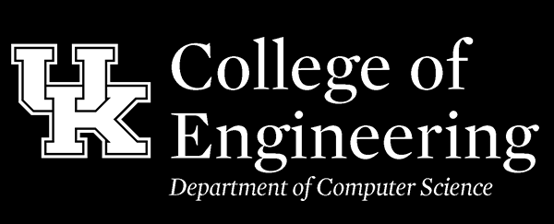
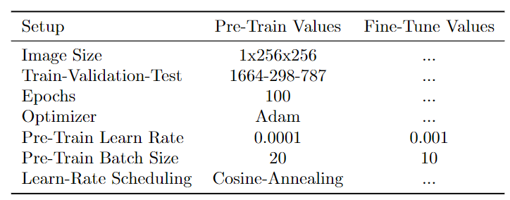
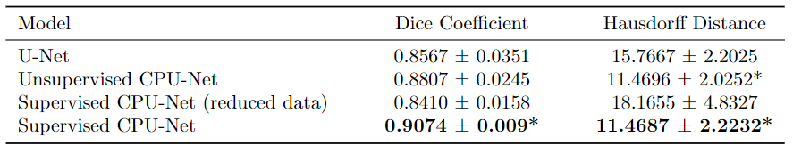
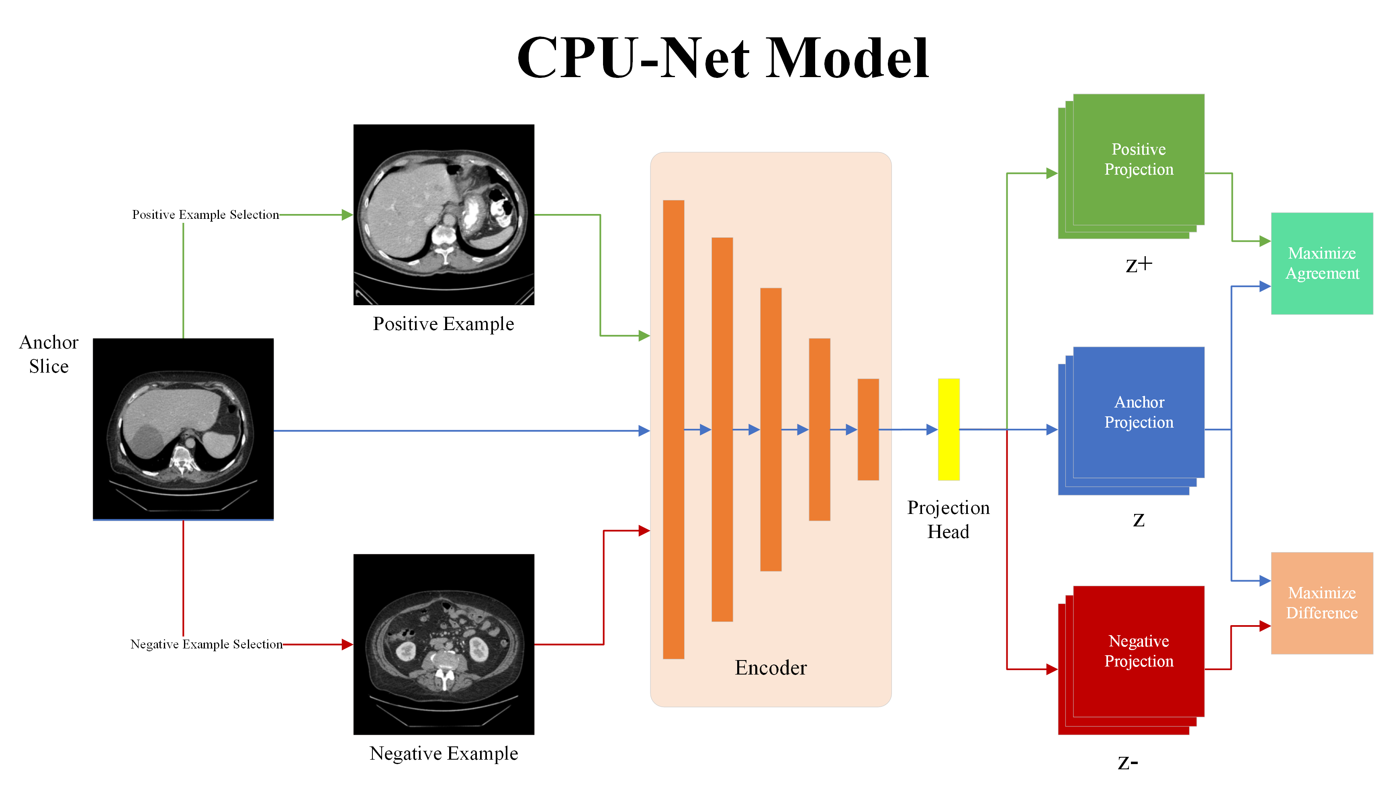
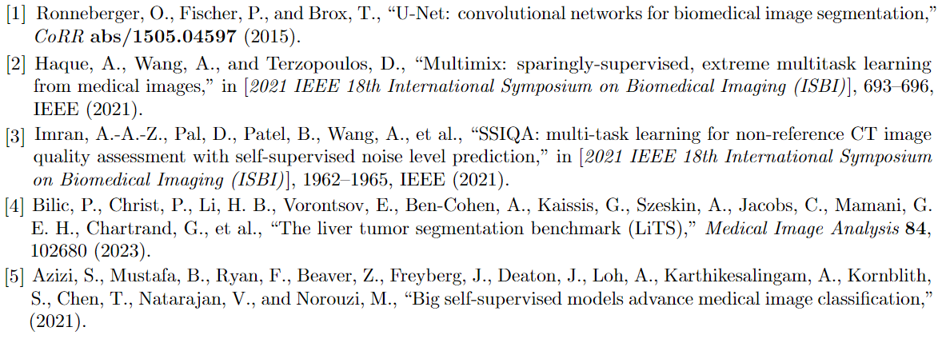
Context-Aware Contrastive Pre-Training for Improved Medical Image Segmentation
Aaron Moseley, Adam Wang, Abdullah-Al-Zubaer Imran
Motivation:
Image segmentation data requires a lengthy and expensive annotation process
We must learn as efficiently as possible from the limited available segmentation labels
Solution/Contributions:
Perform contrastive pre-training on the encoder of segmentation models
Organ-based example selection
CT scan-based example selection
Methods:
Supervised Contrastive Pre-Training
Examples selected from any CT volume
Uses binary class label based on containment of target organ
Positive examples have same class label as anchor, negative examples have opposite label
Unsupervised Contrastive Pre-Training
Positive examples selected randomly from same CT volume
Negative examples selected randomly from different CT volume
Experiments/Results:
Contrastive Loss:
Note: Supervised CPU-Net (reduced data) was fine-tuned with 45% of the entire training set
* indicates statistical significance over baseline U-Net (p < 0.01)
Conclusions:
Contrastive pre-training with prior knowledge significantly outperforms baseline training in Dice Coefficient and Hausdorff Distance (p < 0.01)
Unsupervised scan-based contrastive pre-training provides promising improvements over baselines
When fine-tuning on less than half the dataset, supervised contrastive pre-training results in an insignificant impact on performance (p > 0.15), reducing the need for fully-labeled segmentation data
References:

