Slide 1


Deep State-Value Estimation for Long-Term Planning: A Generic Strategy Game Test Case
Aaron Moseley | Aaron Moseley
Faculty Advisors | Dr. Jerzy W. Jaromczyk, Dr. Neil F. Moore
Presented on | May 2, 2024
University of Kentucky

Slide 2

Agenda
Introduction and Motivation
Previous Approaches
Methods
Experimental Setup
Results
Conclusions
University of Kentucky

Slide 3

Introduction
UNIVERSITY OF KENTUCKY

Slide 4
Introduction and Motivation
Strategy games have been widely used in AI research as analogs for long-term planning tasks
Deep reinforcement learning models have shown great promise in these tasks
Previous strategies rely too much on expert human knowledge
Approaches not using human knowledge don’t take advantage of using simpler opponents during training
University of Kentucky

Slide 5
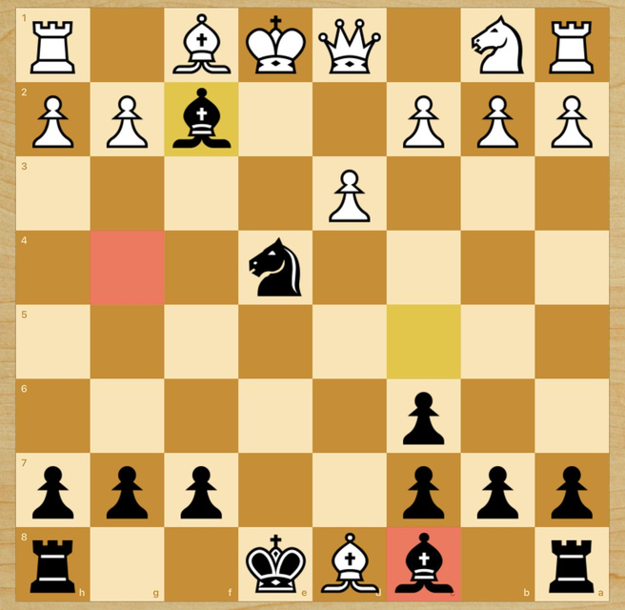
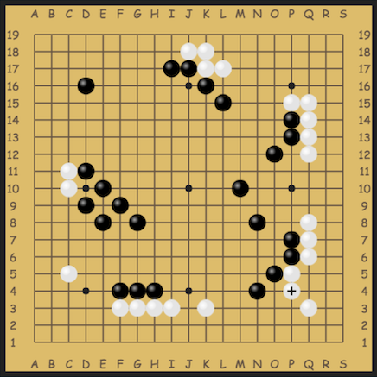
Previous Approaches
Deep Blue - plays chess using hard-coded utility functions for state evaluations
AlphaGo - plays Go with neural networks using a combination of self-play and supervised learning from expert play
AlphaGo Zero - plays Go with neural networks solely trained on self-play
https://www.chess.com/
https://go.mattle.online/welcome
University of Kentucky

Slide 6
Methods
University of Kentucky

Slide 7
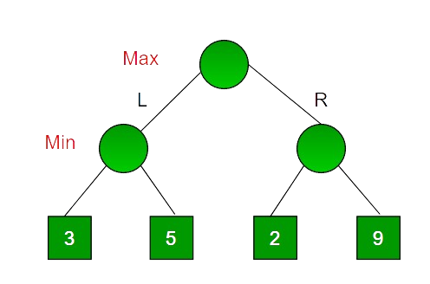
Methods - Minimax Search
https://www.geeksforgeeks.org/minimax-algorithm-in-game-theory-set-1-introduction/
University of Kentucky

Slide 8
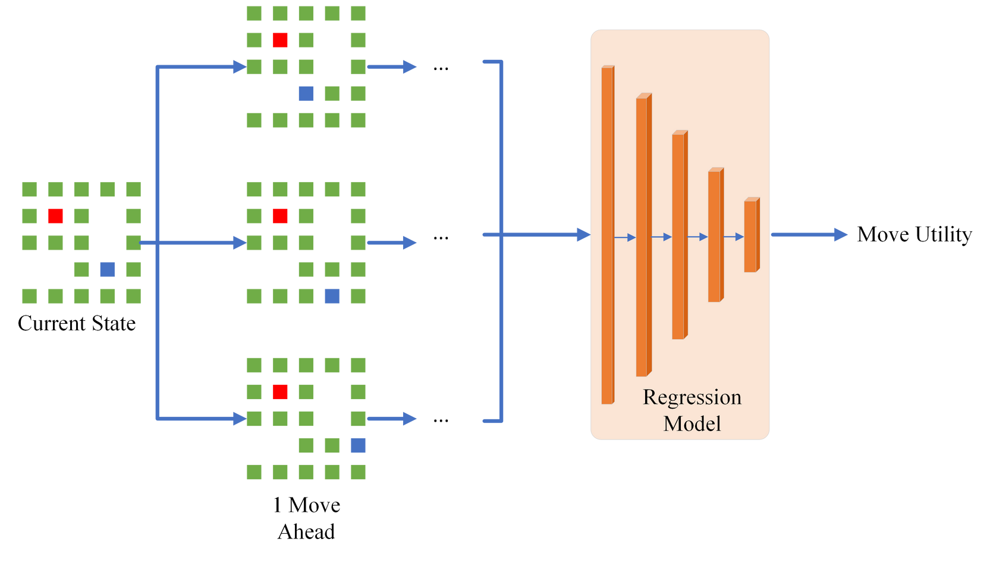
Methods - Deep Minimax Search
University of Kentucky

Slide 9
Methods - Q-Learning
A model-free reinforcement learning strategy
Represents the expected reward from each state-action pair in a Q-table
Learns the Q-values in this table over time through reinforcement learning
Limited to simple environments because of the size of the Q-table
University of Kentucky

Slide 10










Methods - Deep Q-Network Training
At the beginning of each game, the weights of the evaluation network are copied to a target network
At each state , the best action is selected with Deep Minimax Search and state results
The reward is calculated from this and is added to an experience replay array
A Q-value is calculated as and a target Q-value is calculated as
Loss is determined as and is used to train
University of Kentucky

Slide 11
Methods - Opponent Selection
We use a combination of self-play and simple opponents equipped with Minimax tree search
The first section of training only involves simple opponents
After this section, the opponent type alternates between a slightly mutated network and the simple opponents
University of Kentucky

Slide 12
Experiments
University of Kentucky

Slide 13
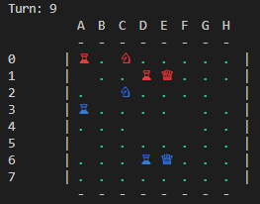
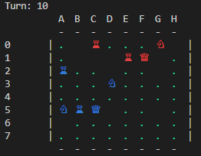
Experiments - Generic Strategy Game
Name | Display Character | Lifespan | Description
Town | ♕ | 30 | Produces a worker every 6 turns
Worker | ♗ | 40 | Creates a barracks
Barracks | ♖ | 8 | Produces a soldier every 4 turns
Soldier | ♘ | 40 | Attacks opponent’s units
University of Kentucky

Slide 14
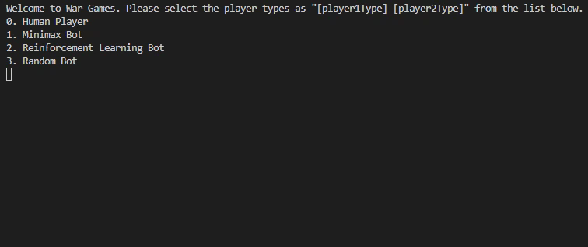
Experiments - Generic Strategy Game
University of Kentucky

Slide 15
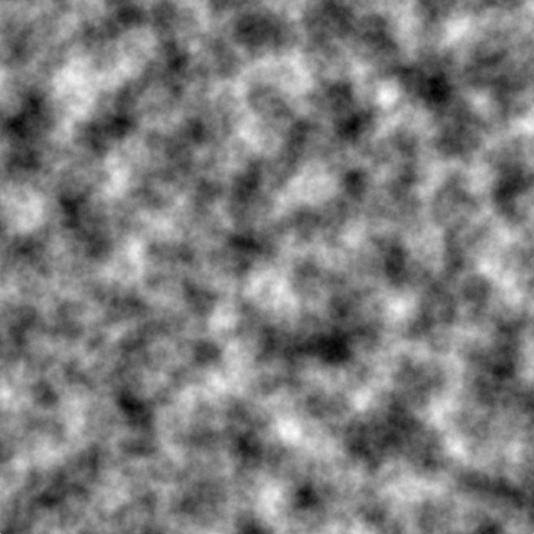
Experiments - Level Generation/Randomization
Level Generation - used Perlin Noise to create 7 distinct 8x8 levels
Training Randomization
Random level selected each game
50% of vertically flipping the level
80% chance of randomly adding extra units at the beginning of the level (15.625% chance for each tile)
https://medium.com/@yvanscher/playing-with-perlin-noise-generating-realistic-archipelagos-b59f004d8401
University of Kentucky

Slide 16
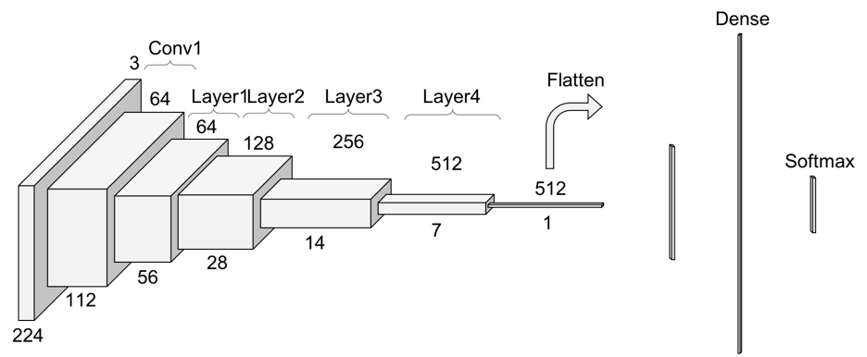
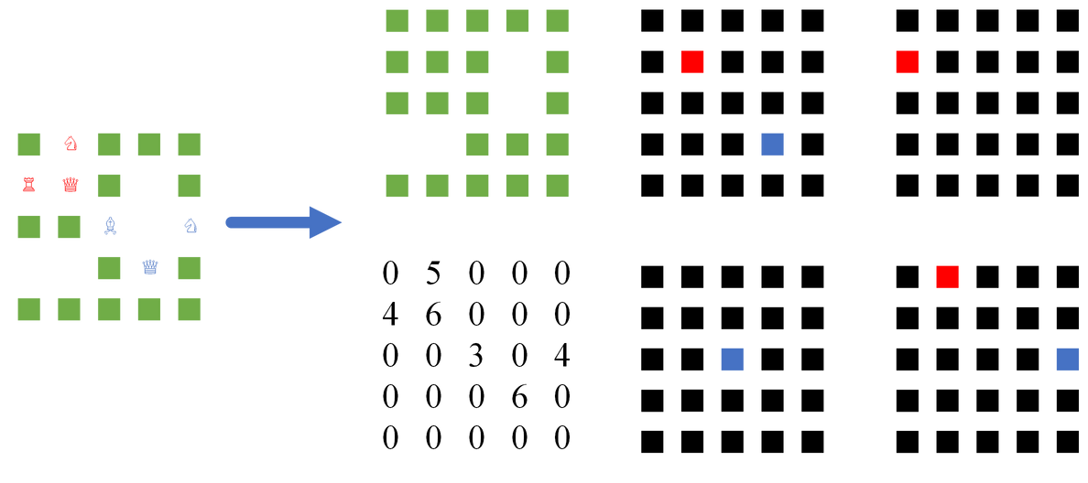
Experiments - Model and Implementation
Modified ResNet18
Input Parsing
https://towardsdatascience.com/understanding-and-visualizing-resnets-442284831be8
University of Kentucky

Slide 17
Experiments - Baselines and Comparisons
Random
Makes any valid random move
Greedy
Whenever possible, captures opponent’s piece or creates a barracks
Otherwise, makes a random move
Standard Minimax
Uses the model’s reward function as a utility function with standard Minimax search
Self-Play
Model trained in the same way but solely using self-play
University of Kentucky

Slide 18
Results
University of Kentucky

Slide 19
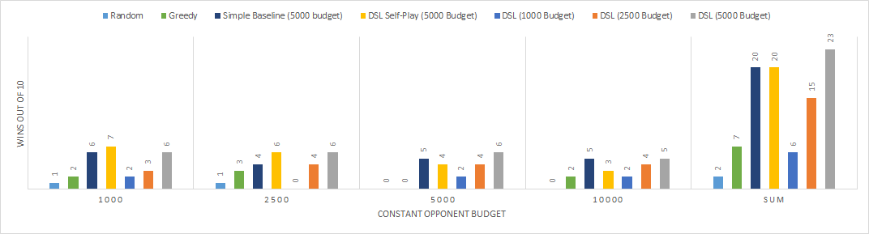
Results - Seen Results
University of Kentucky

Slide 20
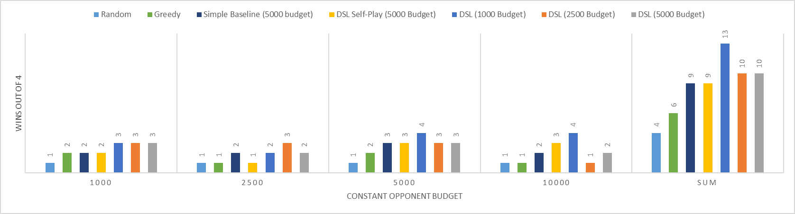
Results - Unseen Results
University of Kentucky

Slide 21
Conclusions
University of Kentucky

Slide 22
Conclusions and Discussion
Conclusions:
Our approach effectively combines traditional tree search algorithms and image analysis models
This model consistently surpasses all similar baselines and shows that integrating simple opponents in the training process provides substantial benefits
Future Work:
Different image regression models
More advanced reward function
More recent tree-search algorithms
University of Kentucky

Slide 23

Questions?

