Slide 1
End-to-end YANG-based Configuration Management
A Yang Parser and Browser implementation
E. Nataf, O. Festor
Nancy University, Madynes – INRIA project
Loria
Notes:
Networked resources are of increasing complexity and have to be configured to guarantee proper operation. Within the IETF, current efforts are focused on both a protocol and a data model definition language for configuration management. The NETCONF protocol describes the communication between devices to be configured and configuration applications. NETCONF does not describe how configuration data is represented. This is addressed by the YANG data modeling language, the emerging proposal of the netmod standard working group.
We present in this paper the result of the integration of YANG and NETCONF in the ENSUITE open source framework. We illustrate this integration through a YANG-based configuration navigation and edition application that works with YANG-enabled devices.

Slide 2



Devices
with NETCONF server
Standard Configuration Management
Configuration Application
Data Model
Ref:Host
Data Model
Ref:Router
NETCONF
NETCONF PDU
XML Data
Data Model Ref:Host
Data Model
Ref:Host
Data Model
Ref:Router
Data Model
: YANG data model
Notes:
Configuration management importance is increasing with the growing size and the complexity of network resources and applications. In the Internet context, the netconf working group has proposed the NETCONF protocol [1] as a standard to manage configuration of network devices. This protocol is tailored to configuration operation i.e. setting and/or getting configuration data values to/from devices with an RPC mechanism. Data values are transmitted inside XML document. The standardization body acknowledges this should be improved by a data modeling language that will describes these data values.
When the data exchanged are XML formatted, it is usual to describe the hierarchy by XML Schema or Relax NG [5,6]. Even if these schema languages are powerful, standardization body choose to define by itself a language that it can control the evolutions and that is enough descriptive and more focused on configuration management.
YANG [2] is the data modeling language proposed by the netmod working group. YANG can be compared to SMI [3] in the SNMP [4] framework because it is a data modeling language where data values are distributed and accessible through a protocol. In the same way, a YANG specification is a reference document used by device vendor and application developer.
The objective of this paper is to demonstrate the feasibility of an End-to-End YANG-aware management framework and to describe how it can be implemented in an open source framework. First we describe the YANG language, focusing on its major concepts. Secondly we present a parser for YANG specifications : jYang, an open source implementation we provide to the community. The third part shows how we did integrate YANG into the used NETCONF server. Finally we show a YANG browsing application and its functionalities to get and edit configuration data.

Slide 3
YANG Modeling
module
header
(1) module network {
(2) namespace
« urn:loria:madynes:ensuite:yencap:1.0:module:Interfaces:1.0 »;
(3) import ietf-yang-types { prefix yt;}
(4) typedef ifName {
(5) type string;
(6) length 3-8;
(7) }
(8) grouping v4add {
(9) container v4 {
(10) leaf ip { type ip;}
(11) leaf mask {type m;
(12) }
(13) }
(14) container interfaces {
(15) list interface {
(16) key name
(17) leaf name { type ifName};
(18) leaf mac { type yt:mac-address;}
(19) leaf mtu { type uint32};
(20) choice ad-type {
(21) case v4 uses v4add;
(22) case v6 uses v6add;
(23) }
(24) }
(25) }
(26) }
typedef
grouping
namespace
import
container
leaf
container
leaf
list
leaf
leaf
leaf
choice
case
case
uses
uses
Notes:
Data models written with YANG describe hierarchical organization of configuration data. A YANG module is one data model related to a specific configuration purpose, as for example network configuration, or a generic, reusable, set of data models. The left part of the figure 3 shows a YANG module called network. A module must first defines its name space (line 2) to ensure a globally unique naming of its model. If needed, a module can import data models from other modules to defines its model (line 3, the “ietf-yang-types” reference is a YANG module [7] with useful types intended to be used by other modules). Not shown in the figure, but if a module seems to be too big or a mix of contrastive configuration data then it can be split in several submodules and the main module have to include them.
YANG defines a limited set of build-in types such as string, boolean, signed or unsigned integer on several sizes (8, 16, 32, 64 bits). These basic types can be used to create other types with a “typedef “ statement (line 4) and to add them some constraints as shown at line 6 where the length of a string is limited. Another construct that improves reusability is the “grouping” statement (line 8) that can be used at separate places in the current module (line 21).
Data models are mainly expressed with the following statements that are called datadef statement:
Leaf : a value of one type.
Container : a set of values.
List : an ordered set of datadefs, called an entry. An instance is a set of entry values and one value (a column) should be the key of the list (that is the value that distinguish each line).
Leaf-list : a list of values of the same type.
Choice ; an alternative of different cases of datadefs.
The example shows two containers (lines 9 and 14) a list (line 15) and a choice (line 20).
The API we propose reflects YANG statements of the data model. For each YANG statement we have a corresponding java class (see class diagram on the slide 3). A YANG module is represented as a tree of java instances (what the standard call the schema tree). The slide 3 shows as an example the java classes organization for the network module. Each java object have getters methods to follow the tree of instances. About hundred of java classes have been needed to represent any YANG specification.

Slide 4
jYang Parser
a’
errors
b’
b’
Data tree
sa1
a
b
YangSpecification
YangTreeNode
jYang
<
>
<
>
<
>
<
>
</
>
</
>
</
>
<
>
</
>
YANG module
a
<
>
<
>
<
>
</
>
</
>
XML Data
</
>
YANG module
b
YANG sub-module
sa1
NETCONF
</
>
NETCONF
Notes:
jYang is an open source parser for the YANG language. It is written in java with the javaCC library (https://javacc.dev.java.net/). A jYang compilation starts with one or more YANG files references that will be loaded by the parser. All import and include statements are followed without parsing twice the same file. So for example if one just gives the sa1 sub-module to check then the modules a and b will be too, because sa1 belongs-to a and a import b. The internal representation of YANG specifications is one of the output of jYang and is composed of the java objects tree we show in slide 3. Another output can be a list of errors encountered during the parsing. Full syntax checking is done and some constraints (as default value that must fit to its type range) are covered. YANG allows data modelers to express some constraints like range number or string pattern. The constraints are checked when sub typing is used or when default values are set. Other constraints that can be expressed on the data value level are not checked. For example one can specify conditional presence of data depending on other data values (or hosting device capabilities).
Another useful output of jYang is the YangTreeNode that is also a java object tree where each node contains a reference to a YANG statement. This tree represents YANG specification but where typedef and grouping are copied at places where they are used. YangTreeNode is an intermediary representation of YANG specifications between static data model and data values on the wire. Its goal is to alleviate the work of any backend that focuses on NETCONF data values. As an example on the slide 4 the module b only contains a grouping definition that is used two times in the module a so the YangTreeNode from a that we note a’, contains two YangTreeNode b’ from b (we do not show sa1’ for readability of the picture).
The YangTreeNode is used to produce the YANG standard data tree from XML data of NETCONF operations. The slide 4 suggests that the data tree has more nodes than the YangTreeNode and that these nodes have a common pattern. This can be the case when a YANG list (or leaf-list) is defined because the data tree will contain each entry of the list (or each value of a leaf list). At the opposite if a specification is made with plenty of choice statements then the data tree will only show one of the cases from the NETCONF data values.

Slide 5
YencaP : a NETCONF server
<NETCONF>
Module
Module
Module
Module
Data Store Manager
NETCONF Operation
NETCONF RPC
SSH
Data Store
<module>
<name>Interfaces</name>
<xpath>/NETCONF/network/interfaces</xpath>
<namespace pref="ifs">urn:loria:madynes:ensuite:yencap:1.0:module:Interfaces:1.0</namespace>
<parameters>
<parameter name="yang" value="interfaces"/>
</parameters>
</module>
Notes:
YencaP [8] is an implementation of the server side of NETCONF. It is an open source software initially created by our research team. It is built on top of an SSH layer to ensure security, session and connection-oriented communication as stated by the standard. The RPC layer implements the RPC mechanism with <rpc> and <rpc-reply> primitives that carries basic operations of the NETCONF operation layer as <get>, <get-config> and <edit-config> (notification are planned). The Data store Manager layer entity is responsible for maintaining a virtual database of configuration (and state) data and provides a read / write access to these data (state data being read-olny).
At the starting of a session the Data Store Manager looks for modules in a text configuration file and dynamically loads them. A module is a piece of code that accesses to specific configuration and state information with an interface compliant with NETCONF operations. For example there are modules for network interfaces, system, protocols like RIP or OLSR... When a module is loaded it must provide the location of its data by giving a path from the global root (the <netconf> node) to the root node of the module. This path is expressed with the Xpath notation. For example, the interfaces module is localized with the “/netconf/network/interfaces” expression and it maintains data under the <interfaces> node. Thus, part of the global Data Store is managed by the Data Store Manager (light grey on slide 5) and the rest is distributed among modules (dark grey sub trees). This enables modularity of the server without increasing the complexity of the Data Store Manager.
The format for the YencaP configuration file is open to any extends through a <parameters> markup that contains <parameter> items with name and value attributes. The integration of YANG into YencaP is made by adding a parameter with the “yang” name attribute and the module name as value attribute. For each module inside the YencaP server there is one and only one YANG module. One can see on the example that there is a <namespace> markup before the module parameters list. This name space is needed inside NETCONF requests to distinguish its XML naming. It must be the same as the one defined in the YANG module and can easily be extracted from the YangTreeNode.

Slide 6
YencaP Manager : a NETCONF Client
YencaP
applet
YangTreeNode
HTTPS
Server
NETCONF
Client
Configuration
Management
Web user interface
<hello>
<capability>
YANG module reference
</capability>
</hello>
YangTree
Node
ENSUITE framework
YANG
Loader
+
jYang
YANG specs.
repository
YencaP Manager
Notes:
YencaP Manager is an open source NETCONF application that can send queries and receive responses with any NETCONF server. The NETCONF Client can have several NETCONF sessions with different servers at one time. Each of theses sessions is initialized from the HTTPS server inside the YencaP Manager when a user opens a HTTPS session. There is a one to one mapping between HTTPS and NETCONF sessions even if two users are accessing the same NETCONF server. The couple (YencaP / YencaP Manager) forms the ENSUITE framework.
As shown in slide 5 we had to extend YencaP to announce which YANG modules it implements (together with version and revision information) as a capability in its standard hello message. On the client side, a YANG loader will be used by the YencaP Manager when such a capability is detected. We do not constraint the YencaP Manager to only work with YANG but to accept servers that are YANG enabled or not. The YANG loader gets the specifications from an external repository and builds a specific YangTreeNode for the data model maintained by the server. The YANG loader is a java program that uses jYang to dynamically parse YANG specifications. We took this choice because we suppose the YencaP Manager will discover servers without knowledge of their configuration and thus must be able to dynamically load and parse any YANG specification. There is also the creation of “glue” parts in the YangTreeNode as a virtual netconf container, that are needed to built one YangTreeNode from several YANG modules. The YANG specification repository is shown as an external element of the YencaP Manager as it should be a global repository implemented for example as a web service.
Once a HTTPS session is opened the user can ask for the configuration of a YANG enabled device. In doing so it receives a java applet that contains the YangTreeNode for this server only. The applet will be loaded by the web interface to provide the user with a graphical interface representing the configuration.
Modules are the largest unit of granularity and a network device should announce which YANG modules it implements

Slide 7
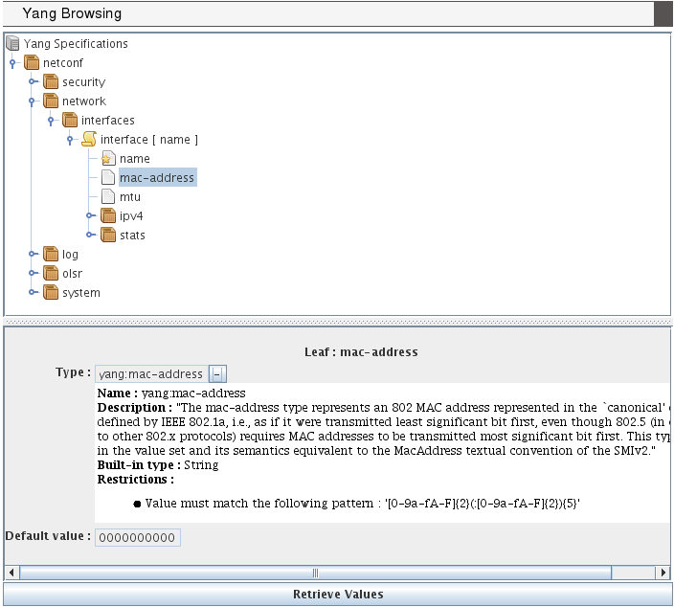
Browsing YANG Specifications
Notes:
Slide 7 shows the applet part of the web interface, the user gets when asking for the configuration of a device. This first view can be used as a YANG specification browser that looks like a file system browser (we use the swing Jtree interface). The tree view matches well with YANG because it defines a schema tree. Specific icons are used to distinct nodes, here NETCONF, network and interfaces are all YANG containers, interface is a YANG list and name, mac-address, mtu are YANG leaves. A YANG list can have some key inside its leaf as is the “name” leaf referenced inside brackets in the “interface” list and by a little star on its leaf icon. When selecting a leaf in this tree, the lower part of the applet shows details of the YANG specification, as the type of a leaf and constraints such default value or range intervals. A leaf type is always at least of a built-in types (as string, int8,…) and can be refined by other types with added constraints or to use an existing useful type (as a mac-address). This is the meaning of the “-” (or “+”) behind the name type. When “+” is set (by one mouse click on the “-”) then only the built-in type is displayed.
As we said in the previous page there is a “netconf” container while there is no YANG module called “netconf”. The YANG loader has created a virtual container called “netconf” and has plug it on top of the existing “network” module (as for security, log, olsr and system YANG modules).

Slide 8
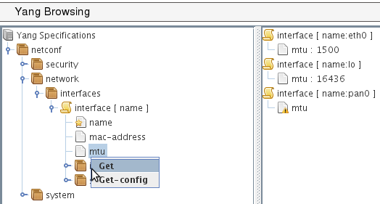
YANG-based client
POST
operation : get
<netconf
xmlns=«urn:loria:madynes:ensuite:yencap:1.0:module:Interfaces:1.0»>
<network>
<interfaces>
<interface>
<name>
<mtu>
</interface>
</interface>
</network>
</netconf>
HTTP
<rpc-reply>
…
<interface>
<name>eth0</name>
<mtu>1500</mtu>
</interface>
<interface>
<name>lo0</name>
<mtu>16436</mtu>
</interface>
...
</rpc-reply>
YencaP Manager
<xml…>
<rpc-query>
<get>
…
</get>
</rpc-query>
NETCONF
YencaP
Notes:
From the slide 7 one can request the indirectly connected NETCONF device by a mouse contextual menu that pops-up when the right button is pressed on a YANG data type. When one of the standard NETCONF operations is chosen, the request is built from the root node (here the netconf virtual container) to the tree position of the selected node. The resulting XML document is sent inside a HTTP POST request. A specific header called “operation” is used to specify which NETCONF operation must be performed on the server (get, get-config or edit-config). Note that the key of the list is added to the request while it is not explicitly asked. This is an optimization because subsequent requests on lists (and especially on list entries) will likely need the key.
When the request is received by the YencaP Manager, the latter adds the rpc and filter mechanisms to surround the XML document received and sends a valid NETCONF request. From this step we are independent of any YANG concern because we are in a full NETCONF session. So the reply is sent by the NETCONF server to the YencaP Manager and this finish the NETCONF operation. Following is simply a cleaning of NETCONF XML data until the first node of the Data Store and its forwarding to the client applet that is waiting for the response. The slide 8 shows the response on the right part of the management applet. The request is synchronous because even if one request contains several data (as can be a request on a list) all of them are returned by one response. Note we have made our protocol synchronous on top of HTTP with several asynchronous requests. We plan to allow multiple selections for the same NETCONF operation to give access to the separate part of the NETCONF Data Store in one request.

Slide 9
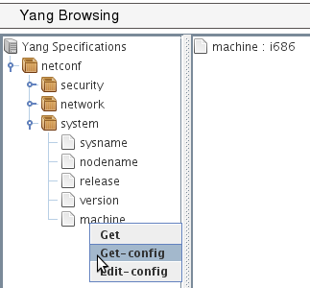
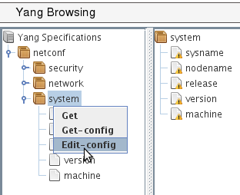
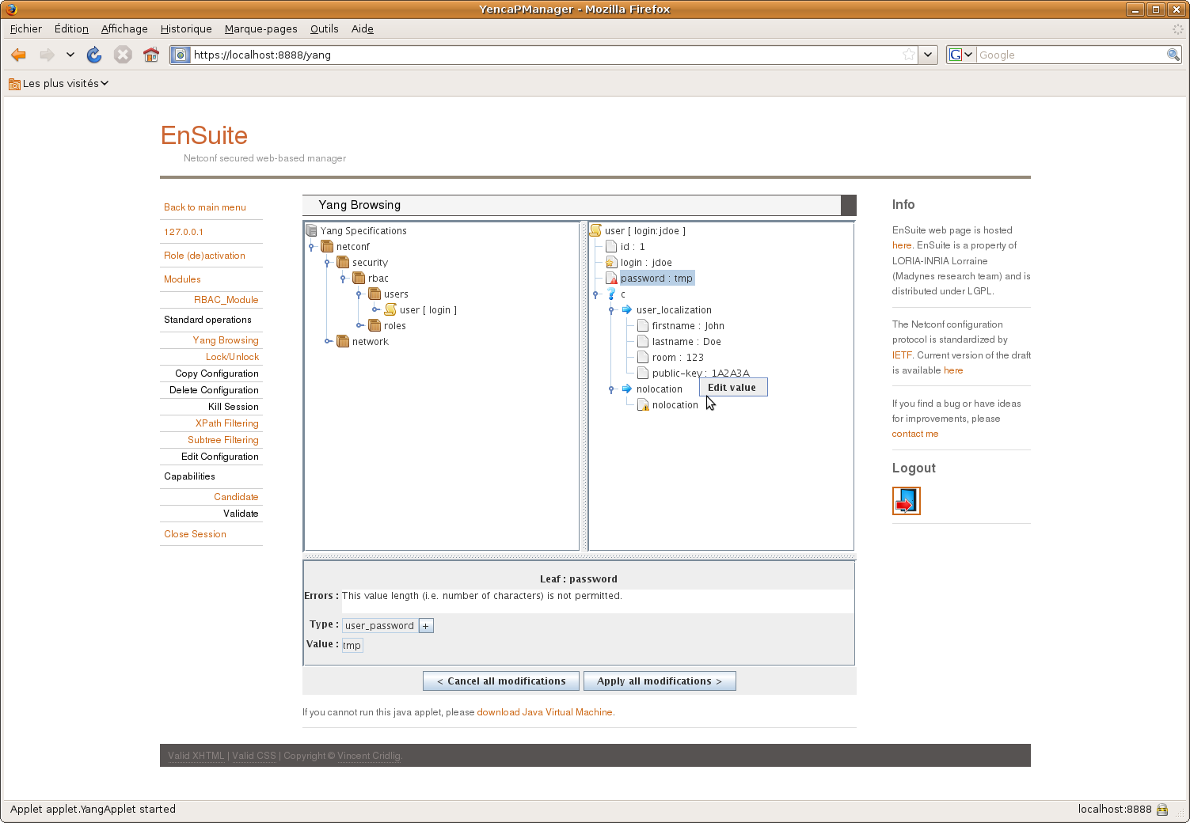
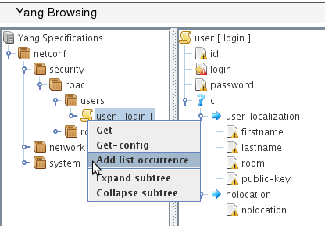
a)
b)
c)
d)
Notes:
The slide 9 depicts some functionalities of the Yang Browsing client. Part (a) is a simple access to a leaf in a container and where we get the response of a get-config operation. Part (b) shows that when editing a container, its components are listed with a warning until a correct value is given. Part (c) is an edit-config for a list. Here a list is edited entry by entry (that we call a list occurrence) and one can see an empty list entry ready to be filled. Note that a red mark is on the “login” leaf because it is the key of the list and so its value must be set. Part (d) illustrates the choice representation and its edition. A choice case (“user-localization” or “nolocation”) can only be edited if all of its components are set. On the same part the leaf called “password” is read marked because the value is not long enough. This is an example of dynamic constraint one can check with the tool. Range values of integer or float, pattern matching of string are also checked.

Slide 10
Conclusions and future works
jYang: a YANG parser
ENSUITE framework : YANG enable
YencaP : server announces
YencaP Manager : YANG view applet
YencaP : agent builder
YANG constraints
YencaP : configuration self check
YencaP Manager : user input control
Notes:
We provide two contribution to the network configuration domain. The first one is a YANG parser and semantic checker close to the actual version of the draft definition of YANG. The second contribution is the support within the ENSUITE framework of YANG based models both on the server and the client side.
We plan to extend YencaP to be able to generate parts of its code from YANG specifications, or build generic parts, to ensure the server maintains a valid Data Store compliant with YANG . The server has to be able to send notifications especially those defined in YANG and must also accept user defined operations as there are YANG rpc and notification statements to do this.
We are also interested by all YANG constraints one can specify. Default value, must and presence conditions, references between values, length or pattern matching are some examples of such constraints. If one can have a NETCONF server with such knowledge this server will be enabled to autonomously checks its configuration. At the client side the constraints can ensure the manager does not make mistakes in its configuration operations and can notify users if constraints are not respected.

Slide 11
Références
[1] R. Enns
NETCONF Configuration Protocol, RFC 4741, December 2006
[2] M. Bjorklund
YANG - A data modeling language for NETCONF
draft-ietf-netmod-yang-07, Network Working Group, Internet-Draft, 13 July 2009
[3] K. McCloghrie, D. Perkins, J. Schoenwaelder.
Structure of Management Information Version 2 (SMIv2), RFC 2578, April 1999.
[4] Case, J., Fedor, M., Schoffstall, M. and J. Davin,
Simple Network Management Protocol, RFC 1157, May 1990.
[5] Huiyang Cui; Bin Zhang; Guohui Li; Xuesong Gao; Yan Li
Contrast Analysis of NETCONF Modeling Languages: XML Schema, Relax NG and YANG
International Conference on Communication Software and Network, 2009, ICCSN’09, 27-28 Feb 2009 Page(s):322 - 326
[6] Hui Xu; Debao Xiao
Data modeling for NETCONF-based network management: XML schema or YANG
11th IEEE International Conference on Communication Technology, 2008, ICCT 2008, 10-12 Nov 2008 Page(s):561 – 564
[7] J. Schoenwaelder
Common YANG Data Types
draft-ietf-netmod-yang-types-03, Network Working Group, Internet-Draft, 13 Mai 2009
[8] V. Cridlig; R. State
YencaP Documentation
Technical Report, 2005, 25 Pages,http://hal.inria.fr/inria-00000804/fr

Slide 12
<NETCONF>
<network>
<interfaces>
<interface>
<name>eth0</name>
<mtu>1500</mtu>
…
</interface>
<interface>
…
</interfaces>
…
</network>
…
</NETCONF>
NETCONF
NETCONF
<NETCONF>
<network>
<interfaces>
<interface>
<name>eth0</name>
<mtu>1500</mtu>
…
</interface>
<interface>
…
</interfaces>
…
</network>
…
</NETCONF>
YANG
YANG
NETCONF
NETCONF

Slide 13
foreach node in the YangTreeNode : ytn
if ytn is a choice node then
foreach case of the choice
foreach node in the case nc
foreach node in the DataTree : dtn
if dtn == ytn then
create a browsing picture

Slide 14
HTTPS
server
NETCONF
Manager
https
OLSR
NETCONF
ENSUITE
Framework
(python)
Notes:
Our testbed is made of one or more NETCONF agent implementation provided by the ENSUITE framework. These agents run on wireless routers interconnected by a mesh network with an ad-hoc multi hop mode and allow the configuration of the OLSR protocol that maintains a consistent and evoluting routing plane. Each router has two wireless interfaces where one is dedicated to user sub-network access-point and the other to communicate with other routers of the mesh.

Slide 15
module network {
…
container interfaces {
list interface {
leaf name {…
leaf mtu {…
}
}
}
Data Model Agent
container interfaces
xsd
list
interface
jYang parser
leaf
name
leaf
mtu
Schema Tree :
- no typedef, grouping, uses, augments
- just data nodes (and choice)

Slide 16
NETCONF
Manager
https
HTTPS
Server
NETCONF
Manager
Schema tree
Java applet
Data Model
agent
Data Model
agent

Slide 17
If https connection could be used by the applet
NETCONF
Manager
HTTPS
Server
3
https
…
<get-config>
<NETCONF>
<network>
<interfaces/>
</network>
</NETCONF>
</get-config>
4
NETCONF
Manager
5
NETCONF
1
Data Model
agent
2

Slide 18
NETCONF
Manager
HTTPS
Server
NETCONF
Manager
1
NETCONF
2
Data Model
agent
Checks validity
- XSD document
- Yang constraints
Add default values
3

Slide 19
NETCONF
Manager
HTTPS
Server
NETCONF
Manager
5
NETCONF
4
1
Data Model
agent
3
Checks validity
- Yang constraints
…
<edit-config>
<NETCONF>
<network>
<interfaces>
<interface>
<name>lan0</name>
</interface>
</interfaces>
</network>
</NETCONF>
</get>
2

Slide 20
NETCONF
Agent
autonomous
polling
Yang Proxy
Static time
NETCONF
YANG
Parser
java
Yang specs.

Slide 21
NETCONF
…
network
…
interfaces
…
interface
interface
name
mtu
…
eth0
1500
Notes:
Configuration management we propose is made of one set of network devices and one station (the configuration manager) hosting configuration related applications. Each device has an embedded NETCONF agent that can be requested by the configuration manager station. Data exchanged are XML formatted configuration (and eventually state) information that are different for each device. Because different devices as router and server have nothing common so data are different. As two same devices should have same data types but different values. So there is a need for each device to exhibit which data can be used to manage its configuration and there is a need too for configuration manager application to know what could be requested from each device.
The YANG modeling language is the information model proposed by the ietf working group on network configuration (netmod). This language will allows equipments vendor to formally express their information model, as it is done for network management by SNMP and its SMI data model. But an important difference for us between SMI and YANG is the former is a data model and not an information model. YANG is more abstract and have more complex structures than the hierarchical description of scalars and tables in SMI. Moreover SMI data models contain protocol information that are useful to request data (the SNMP oid) that have permitted the development of a full of generic SNMP manager providing an SMI view of network management information.
The goal of this paper is to show a way to use YANG information model in the same fashion as the SMI could be. We propose a generic configuration manager that will understand YANG specification and provide a YANG view of configuration data maintained inside NETCONF agents. The language is currently in the draft state but sufficiently advanced to allow us a realistic use of it that will show possibilities and limits of such use of YANG.
NETCONF data exchanged between a device and a configuration application are XML documents and it is the responsibility of the agent or the manager to send well formed document. Such schema could be the mean to formally express which configuration data could be exchanged but indeed are not human friendly readable and so limits the understanding of complex data structure. For example a typical network configuration data (but also a network management) is a list (or a table) of the set of network interfaces a network device contains. XML example for such data is given on the slide.

