Slide 1



End-to-end YANG-based Configuration Management
A Yang Parser and Browser implementation on IETF - NETCONF
E. Nataf, O. Festor
Nancy University, Madynes – INRIA project
Loria
Notes:
I’ll present to you some results of our research activity on configuration management.
The configuration about which we work is the one defined by the ITEF netconf protocol, that is a set of configuration data that must be uploaded to network devices in order to function well.
Yang is a data modeling language proposed by the IETF to formally describe the structure, type and meaning of configuration data.
In this presentation we present a Yang parser and how we use it to provide a Yang view of configuration data both at the client and server side of the netconf protocol.
This work was done by Olivier Festor and myself within the Inria Madynes team at the Loria lab in Nancy, France.

Slide 2



Devices with embedded
NETCONF servers
Standard Configuration Management
IETF netconf & netmod WG
Configuration Management Application
Data Model
Host
Data Model
Router
NETCONF
NETCONF PDU
XML Data
<
>
<get-config>
<edit-config>
<copy-config>
Data Model Host
?
<
>
>
<
<
>
</
>
</
</
>
<
>
</
>
>
Data Model
Host
<
>
<
>
>
<
>
</
Data Model
Router
</
</
>
XML Data
</
>
>
Data Model
: YANG data model
Configuration data
State data
Notes:
Our work is based on the standard configuration management defined by the IETF netconf and netmod working groups.
In this context managed network devices have Netconf server that are accessed through the Netconf protocol by configuration management application.
Based on RPC mechanism, netconf protocol defines some operations to upload, download whole or part of configuration data in one request.
They are other operations as copy or delete and new operations can be defined. There is also a notification operation from server to management applications.
Configuration data are XML formatted and the netconf standard acknowledges there is a need to describe structures and meaning of these data.
In a full standard context, each device has configuration data described by a formal document, one call data model and that is written with the Yang language.
On the other side, a configuration management application should know which data models are implemented to match XML data as instances of these models.
State data are data that can not be uploaded but only downloaded.

Slide 3

YANG : What and why
Models XML data (as XSDL)
Yang -> DSDL
Human friendly
IETF
Yang is (will be) a RFC
Standards configuration (as SNMP MIBs and SMI)
Vendors standards
Reusability, extensibility, refinement
urls : www.netconfcentral.com, www.yang-central.org
Notes:
Basically, Yang is used for describe XML data and is similar to XSDL. A mapping from Yang to DSDL is already defined in a draft proposition.
Benefit of using Yang is first its readability, as in this example that shows an XSD specification and the same with Yang.
Yang is certainly less powerful than DSDL but it has sufficient features to model complex configuration data and is really more easy to learn.
Other interest is the IETF standardization context. Yang will be a Request for comment and will not depend on other standardization bodies as W3C.
In such context the next step will be the specification of several configuration published as standards that everyone will be able to use as it is the case for SNMP Management information base and the structure of management information.
Of course vendors of network devices will be able to design their proper configuration data models, specifics to their equipments or derived from existing standards.
Yang facilitates reusability of existing data model, with several possibilities to extend or refine them.

Slide 4
YANG Data Modeling
module
network
(1) module network {
(2) namespace
« urn:loria:madynes:ensuite:yencap:1.0:module:Interfaces:1.0 »;
(3) import ietf-yang-types { prefix yt;}
(4) typedef ifName {
(5) type string;
(6) length 3-8;
(7) }
(8) grouping v4add {
(9) container v4 {
(10) leaf ip { type yt:ip4;}
(11) leaf mask {type yt:ip4;}
(12) }
(13) }
(14) container interfaces {
(15) list interface {
(16) key name
(17) leaf name { type ifName};
(18) leaf mac { type yt:mac-address;}
(19) leaf mtu { type uint32;}
(20) choice ad-type {
(21) case v4 uses v4add;
(22) case v6 uses v6add;
(23) }
(24) }
(25) }
(26) }
namespace
urn:…
import
Ietf-yang…
typedef
ifName
grouping
V4add
v4
interfaces
ip
mask
interface
ad-type
name
mac
mtu
Schema Tree /Nodes
v4
v6
Notes:
This is a basic example of Yang data modeling.
Yang Data model are organized in modules. A module should be a collection of data definition related to a configuration subject, as this one on network configuration.
The namespace information allows to uniquely defines data identifiers and the import allows to use data from other modules.
We maps this as java classes tree.
Yang has some built-in types as string or integer and one can defines derived type with a typedef notation.
As example, this is the definition of a new type called ifName, derived from the built-in type string with a restricted number of chars.
The grouping statement is made to defines data model group that will be used elsewhere.
Here one can see two basic data models : a container and a leaf as in a tree structure.
There are also java classes for theses statements.
Following is the data model for interfaces configuration : a container that contains a list of interface.
An interface if defined by its name, mac address, mtu and its network address.
The list must be indexed by one or more of its leaf, here the name leaf that will be unique for each interface.
Yang has a choice construct when configuration needs it as in this example where an interface is either an ipv4 or 6 address.
The uses statement refers to a grouping
This tree is called the Schema Tree and it is made of Schema nodes.
The grouping v4 is also in the schema tree but not at this place, as we will see in the next slide

Slide 5
jYang : a YANG Parser
NETCONF Configuration
browser
YANG specification
browser
<
>
YANG data tree
<
>
<
>
<
>
</
>
</
>
matching
</
>
<
>
</
>
<
>
<
>
<
>
</
>
</
>
XML Data
</
>
NETCONF
</
>
NETCONF
YANG
Schema Tree
a
b
use b;
Expanded YANG Schema Tree
Notes:
We have made an open source YANG parser we call jYang because it’s a java code.
This parser reads YANG modules and build their YANG schema trees if no error is detected.
Some Yang schema nodes can have relationship each other, as for example If we suppose two nodes in the module a are using a grouping called b, defined in the module b.
So we expand YANG schema tree with corresponding schema trees. They must be copied because YANG allows to modify such sub trees.
This tree is first used as a YANG specification browser. Manager can read YANG data model like browsing a file system.
The expanded YANG schema tree is also used to find out the YANG data tree from XML Data of the NETCONF protocol through a matching process.
This data tree is now the interface between manager and the configuration of its managed devices.

Slide 6
YencaP : a NETCONF server
<netconf>
YANG
YANG
YANG
YANG
Module
Module
Module
Module
<network>
Data Store Manager
<interfaces>
NETCONF Operation
NETCONF RPC
SSH
Data Store
XML Data tree
<module>
<name>Interfaces</name>
<xpath>/netconf/network/interfaces</xpath>
<namespace pref="ifs">urn:loria:madynes:ensuite:yencap:1.0:module:Interfaces:1.0</namespace>
<parameters>
<parameter name="yang" value="interfaces"/>
<parameter name="yang-revision" value= "01"/>
</parameters>
</module>
Notes:
We propose an end to end Yang based configuration management and I’ll begin with the server side of the Netconf protocol.
YencaP is our open source implementation of the NETCONF server side.
It is conformant with the standard architecture, that is : a secure transport, remote procedure call and configuration oriented operation like get-config and edit config.
Configuration data is organized by the Data Store Manager as a virtual global XML data tree.
Each module is responsible of a sub tree and is placed by the data store manager with a configuration file where one specify the path of its root
Neither of the modules and the data store manager is aware of the existence of Yang and they only understand XML formatted data.
So we have extended YencaP with YANG capabilities without change any internal XML data in the core of the server.
Now each module has its Yang model and we extend the configuration file with parameters that list its Yang module and eventually a version number.
We had to do some reverse engineering from the XML flow of data to a Yang model of these data. It shows that our work can be useful with Netconf serveur that doesn’t understand Yang.
A next step will be to add the server with an internal Yang view.

Slide 7
YencaP Manager : a NETCONF Client
YencaP
applet
HTTPS
Server
Device
Device
NETCONF
Client
SSH
Device
Configuration
Management
Web user interface
<hello>
<capability>
YANG module reference
</capability>
</hello>
YangTree
Node
ENSUITE framework
YANG
Loader
+
jYang
YANG specs.
repository
YencaP Manager
Notes:
After the netconf server, let see the netconf client we have build and called YencaP Manager
At the bootstrap, the manager is just a secure web server with a list of known managed devices.
When an human manager is identified and connected, it receives the list of devices and can choose one device.
After that, a netconf client is created in the Manager and a ssh session is initialized with the device.
As we seen in the previous slide, yang module references of the YencaP configuration file are send in the netconf hello message.
The YencaP Manager, on the center part in the figure 6, is an open source NETCONF client application that can send queries and receive responses with any NETCONF-compliant server. The NETCONF client can have several NETCONF sessions with several servers at one time. Each session is initialized by the HTTPS server inside the YencaP Manager when a user opens an HTTPS session. There is a one to one mapping between HTTPS and NETCONF sessions. The couple (YencaP / YencaP Manager) forms the ENSUITE framework.
On the right part of the figure 6, we extends YencaP to give it the possibility of announcing which YANG modules it implements as a capability in its standard hello message (together with version and revision information). This was easily realized with the information in the configuration file we show figure 5. On the YencaP Manager side, a YANG loader will be used when such a capability is detected. We do not constraint the YencaP Manager to only work with YANG but to accept servers that are YANG enabled or not. The YANG loader gets the specifications from an external repository and builds a specific YangTreeNode for the data model maintained by the server. The YANG loader is a java program that uses jYang to dynamically parse YANG data model. We took this choice because we suppose the YencaP Manager will discover servers without knowledge of their configuration and thus must be able to dynamically load and parse any YANG model. It is also necessary to create the root node in the YangTreeNode as a virtual netconf container. The YANG specification repository is shown as an external element of the YencaP Manager as it should be a global repository implemented for example as a web service.
Once a HTTPS session is opened the user can ask for the configuration of a YANG enabled device. In doing so it receives a java applet that contains the YangTreeNode for this server only (left part of the figure 6). The applet will be loaded by the web interface to provide the user with a graphical interface representing the configuration.

Slide 8
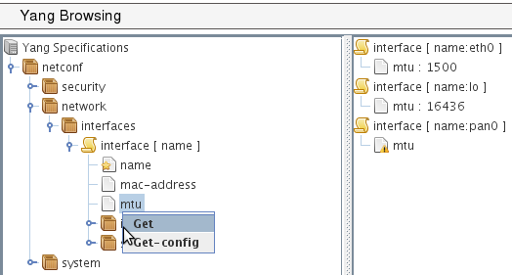
YANG-based client
POST
operation : get
<netconf
xmlns=«urn:loria:madynes:ensuite:yencap:1.0:module:Interfaces:1.0»>
<network>
<interfaces>
<interface>
<name>
<mtu>
</interface>
</interface>
</network>
</netconf>
YencaP Manager
HTTPS
HTTPS
NETCONF
<rpc-reply>
…
<interface>
<name>eth0</name>
<mtu>1500</mtu>
</interface>
<interface>
<name>lo0</name>
<mtu>16436</mtu>
</interface>
...
</rpc-reply>
Tree
jYang
<xml…>
<rpc-query>
<get>
…
</get>
</rpc-query>
NETCONF
YencaP
Notes:
One can request the indirectly connected NETCONF device by a mouse contextual menu that pops-up when the right button is pressed on a YANG node. When one of the standard NETCONF operations is chosen, the request is built from the root node (here the netconf virtual container) to the tree position of the selected node. At this step, the applet is vertically separated to show result of request on the right. The resulting XML document is sent inside a HTTP POST request. A specific header called “operation” is used to specify which NETCONF operation must be performed on the server (get, get-config or edit-config). The figure 8 shows a get request on the leaf mtu and this leaf is inside the interface list. Note that the key of the list is added to the request while it is not explicitly asked. This is an optimization because subsequent requests on lists (and especially on list entries) will likely need the key.
When the request is received by the YencaP Manager, the latter surrounds it by the rpc and filter mechanisms and sends a valid NETCONF request. From this step we are independent of any YANG concern because we are in a full NETCONF session. Following is simply a cleaning of NETCONF XML data until the first node of the Data Store and its forwarding to the client applet that is waiting for the response. The figure 8 shows the response on the right part of the management applet. The request is synchronous because even if one request contains several data (as can be a request on a list) all of them are returned by one response. Note we have made our protocol synchronous on top of HTTP with several asynchronous requests. We plan to allow multiple selections for the same NETCONF operation to give access to the separate part of the NETCONF Data Store in one request.

Slide 9
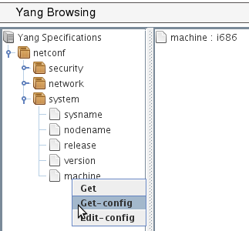
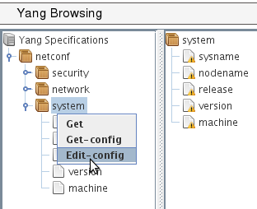
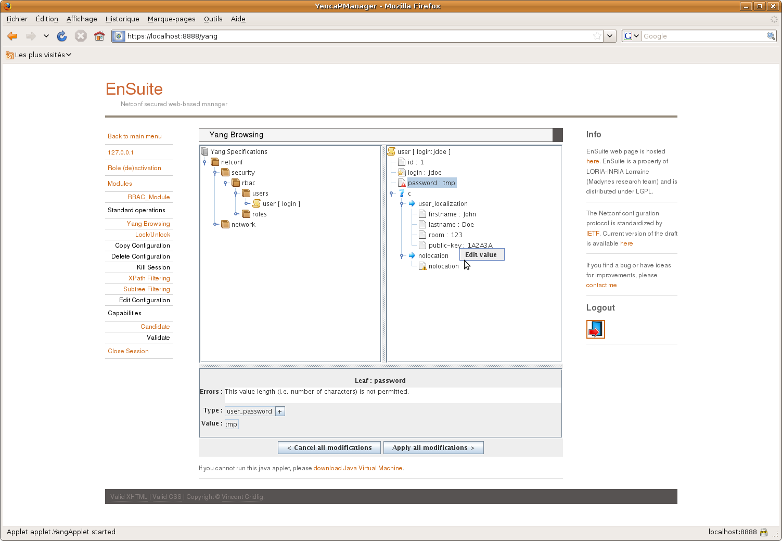
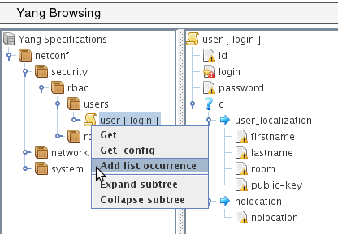
a)
b)
c)
d)
Notes:
The figure 9 depicts some functionalities of the applet related to NETCONF get and edit config operations.
Part (a) is a simple access to a leaf in a container and where we get the response of a get-config operation.
Part (b) is an edit-config for a container. When editing a container, its components are listed with a warning until a correct value is given. The applet shows warning messages and have editing functionalities (as in part d) to set values on edited data.
Part (c) is an edit-config for a list. Here a list is edited entry by entry (that we call a list occurrence) and one can see an empty list entry ready to be filled. Note that a red mark is on the “login” leaf because it is the key of the list and so its value must be set.
Part (d) illustrates the choice representation and its edition. A choice case (“user-localization” or “nolocation”) can only be edited if all of its components are set. On the same part the leaf called “password” is read marked because the value is not long enough. This is an example of dynamic constraint one can check with the tool. Range values of integer or float, pattern matching of string are also checked.

Slide 10
Conclusions and future works
jYang: a YANG parser
ENSUITE framework : YANG enable
YencaP : server announces
YencaP Manager : YANG view applet
YencaP : agent builder
YANG constraints
YencaP : configuration self checking
YencaP Manager : user input control
Notes:
We provide two contribution to the network configuration domain. The first one is a YANG parser and semantic checker close to the actual version of the draft definition of YANG. The second contribution is the support within the ENSUITE framework of YANG based models both on the server and the client side.
We plan to extend YencaP to be able to generate parts of its code from YANG data model, or build generic parts, to ensure the server maintains a valid Data Store compliant with YANG. The server has to be able to send notifications especially those defined in YANG and must also accept user defined operations as there are YANG rpc and notification statements to do this.
We are also interested by all YANG constraints one can specify. Default value, must and presence conditions, references between values, length or pattern matching are some examples of such constraints. If one can have a NETCONF server with such knowledge this server will be enabled to autonomously checks its configuration. At the client side the constraints can ensure the manager does not make mistakes in its configuration operations and can notify users if constraints are not respected.

Slide 11
<simpleType name="contextIDType">
<restriction base="string"></restriction>
</simpleType>
<simpleType name="definitionIDType">
<restriction base="string"></restriction>
</simpleType>
<simpleType name="vetoIDType">
<restriction base="string"></restriction>
</simpleType>
<complexType name="contextBlocComplexType">
<sequence>
<element minOccurs="0" maxOccurs="unbounded" name="target">
<complexType>
<sequence>
<element name="uri">
<complexType>
<sequence>
<element minOccurs="0" name="proto">
<simpleType>
<restriction base="string">
<enumeration value="tcp">
</enumeration>
<enumeration value="udp">
</enumeration>
<enumeration value="sip">
</enumeration>
</restriction>
</simpleType>
</element>
<element name="address" type="string">
</element>
<element minOccurs="0" name="port">
<simpleType>
<restriction base="int">
<minInclusive value="0">
</minInclusive>
<maxInclusive value="65535">
</maxInclusive>
</restriction>
</simpleType>
</element>
</sequence>
</complexType>
</element>
<element minOccurs="0" name="date" type="date">
</element>
<element minOccurs="0" name="version" type="string">
</element>
</sequence>
</complexType>
</element>
<element minOccurs="0" maxOccurs="unbounded" name="include" type="tns:contextIDType">
</element>
<element minOccurs="0" name="locality">
<simpleType>
<restriction base="string">
<enumeration value="very low"></enumeration>
<enumeration value="low"></enumeration>
<enumeration value="medium"></enumeration>
<enumeration value="high"></enumeration>
<enumeration value="very high"></enumeration>
</restriction>
</simpleType>
</element>
<element minOccurs="0" maxOccurs="unbounded" name="resource">
<complexType>
<sequence>
<element maxOccurs="unbounded" name="value" type="string">
</element>
</sequence>
<attribute name="name" type="string" use="required"></attribute>
</complexType>
</element>
</sequence>
<attribute name="id" type="tns:contextIDType" use="required"></attribute>
</complexType>

Slide 12
list context {
description "A list of veto context blocs";
key id;
leaf id { type vetoIdType; }
list target {
key uri/address;
container uri {
leaf proto { type vtProto; }
leaf address {
type string;
mandatory true;
}
leaf port { type vtPort; }
}
leaf date { type string; }
leaf version { type string; }
}
leaf-list include { type contextIdType; }
leaf locality { type vtLocality; }
list resource {
key name;
leaf name { type string; }
leaf-list value {
type string;
min-element 1;
}
}
}
typedef contextIdType { type string;}
typedef definitionIDType { type string;}
typedef vetoIdType { type string;}
typedef vtProto {
type string {
pattern "tcp|udp|sip";
}
}
typedef vtLocality {
type string {
pattern "very low|low|medium|high|very high";
}
}

Slide 13
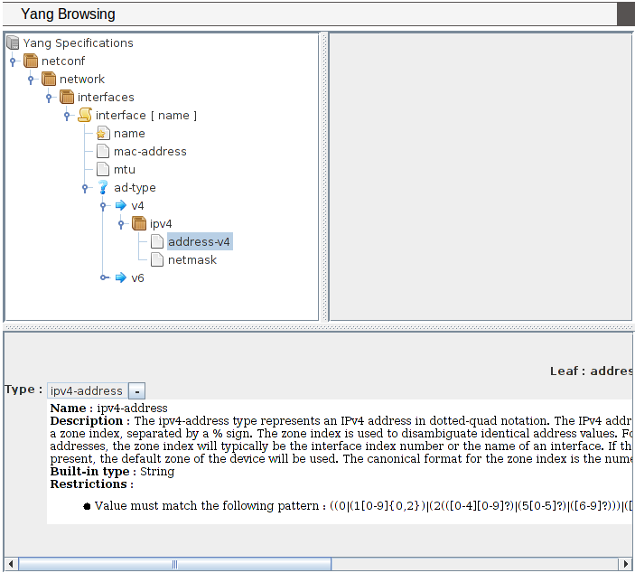
Browsing YANG Specifications
Notes:
The figure 7 shows the applet part of the web interface displayed when a user is connected for the configuration of a device. This first view can be used as a YANG specification browser looking like a file system browser (we use the swing Jtree interface). The tree view matches well with YANG because it defines a schema tree. Specific icons are used to distinct container, list, key or leaf nodes.
When selecting a node, the lower part of the applet shows details of its YANG specification, as the type of a leaf and constraints such default value or range intervals. A leaf type is always at least of a built-in types (as string, int8,…) and can be refined by other types with added constraints or to use an existing useful type (as a mac-address). This is the meaning of the “-” (or “+”) behind the name type. When “+” is set (by one mouse click on the “-”) then the built-in type is displayed.
This same applet is used in the following figures for sending request to the NETCONF device and receiving response. The matching of XML data with the YANG tree node is made at each response by the same applet.

Slide 14
