Slide 1



End-to-end YANG-based Configuration Management
A Yang Parser and Browser implementation on NETCONF
E. Nataf, O. Festor
Nancy University, Madynes – INRIA project
Loria
Notes:
I’ll present an implementation work in the context of the IETF configuration management.
Yang is a data modeling language and we propose to provide a Yang view of configuration data both to management applications and, on the other side of the netconf protocol, to network devices.
I’ll briefly describe a parser of Yang data model and how we use it to provide a browser like application that gives access to Yang data model instances.
This work was done by Olivier Festor and myself within the Inria Madynes team at the Loria lab in Nancy, France.

Slide 2



Devices with embedded
NETCONF servers
Standard Configuration Management
IETF netconf & netmod WG
Configuration Management Application
Data Model
Host
Data Model
Router
NETCONF
NETCONF PDU
XML Data
<
>
<get-config>
<edit-config>
<copy-config>
Data Model Host
?
<
>
>
<
<
>
</
>
</
</
>
<
>
</
>
>
Data Model
Host
<
>
<
>
>
<
>
</
Data Model
Router
</
</
>
XML Data
</
>
>
Data Model
: YANG data model
Configuration data
State data
Notes:
Our work is based on the standard configuration management defined by the IETF netconf and netmod working groups.
In this context managed network devices have Netconf server that are accessed through the Netconf protocol by configuration management application.
Based on RPC mechanism, netconf protocol defines some operations to read, write or copy whole or part of configuration data in one request.
New operations can be defined and there is also a notification operation from server to management applications.
Configuration data are XML formatted and the netconf standard acknowledge there is a need to describe structures and meaning of these data.
In a full standard context, each device has configuration data described by a formal document, one call data model and that is written with the Yang language.
On the other side, a configuration management application should know which data models are implemented to match XML data as instances of these models.
Yang data model describes configuration and state data for each network devices like router or host and services. Configuration data can be read and written but not for state data that are read only.
In a full standard framework a device must announce which Yang data models it implements. In this example these two servers announce they implement an Host YANG data model and the wireless router announce a Router model.
Host and Router Yang data model names must be unique so configuration management application could retrieve from somewhere the Yang model to have the knowledge of conveyed data.

Slide 3
YANG : What and why
Models XML data (as XSDL)
Yang -> DSDL
Human friendly
IETF
Yang is (will be) a RFC
Standards configuration (as SNMP MIBs and SMI)
Vendors standards
Reusability, extensibility, refinement
urls : www.netconfcentral.com, www.yang-central.org
Notes:
Basically, Yang is used for describe XML data and is similar to XSDL. A mapping from Yang to DSDL is already defined in a draft proposition.
Benefit of using Yang is first its readability, as in this example that shows an XSD specification and the same with Yang.
Yang is certainly less powerful than DSDL but it has sufficient features to model complex configuration data and is really more easy to learn.
Other interest is the IETF standardization context. Yang will be a Request for comment and will not depend on other standardization bodies as W3C.
In such context the next step will be the specification of several configuration published as standards that everyone will be able to use as it is the case for SNMP Management information base and the structure of management information.
Of course vendors of network devices will be able to design their proper configuration data models, specifics to their equipments or derived from existing standards.
Yang facilitates reusability of existing data model, with several possibilities to extend or refine them.

Slide 4
<simpleType name="contextIDType">
<restriction base="string"></restriction>
</simpleType>
<simpleType name="definitionIDType">
<restriction base="string"></restriction>
</simpleType>
<simpleType name="vetoIDType">
<restriction base="string"></restriction>
</simpleType>
<complexType name="contextBlocComplexType">
<sequence>
<element minOccurs="0" maxOccurs="unbounded" name="target">
<complexType>
<sequence>
<element name="uri">
<complexType>
<sequence>
<element minOccurs="0" name="proto">
<simpleType>
<restriction base="string">
<enumeration value="tcp">
</enumeration>
<enumeration value="udp">
</enumeration>
<enumeration value="sip">
</enumeration>
</restriction>
</simpleType>
</element>
<element name="address" type="string">
</element>
<element minOccurs="0" name="port">
<simpleType>
<restriction base="int">
<minInclusive value="0">
</minInclusive>
<maxInclusive value="65535">
</maxInclusive>
</restriction>
</simpleType>
</element>
</sequence>
</complexType>
</element>
<element minOccurs="0" name="date" type="date">
</element>
<element minOccurs="0" name="version" type="string">
</element>
</sequence>
</complexType>
</element>
<element minOccurs="0" maxOccurs="unbounded" name="include" type="tns:contextIDType">
</element>
<element minOccurs="0" name="locality">
<simpleType>
<restriction base="string">
<enumeration value="very low"></enumeration>
<enumeration value="low"></enumeration>
<enumeration value="medium"></enumeration>
<enumeration value="high"></enumeration>
<enumeration value="very high"></enumeration>
</restriction>
</simpleType>
</element>
<element minOccurs="0" maxOccurs="unbounded" name="resource">
<complexType>
<sequence>
<element maxOccurs="unbounded" name="value" type="string">
</element>
</sequence>
<attribute name="name" type="string" use="required"></attribute>
</complexType>
</element>
</sequence>
<attribute name="id" type="tns:contextIDType" use="required"></attribute>
</complexType>

Slide 5
list context {
description "A list of veto context blocs";
key id;
leaf id { type vetoIdType; }
list target {
key uri/address;
container uri {
leaf proto { type vtProto; }
leaf address {
type string;
mandatory true;
}
leaf port { type vtPort; }
}
leaf date { type string; }
leaf version { type string; }
}
leaf-list include { type contextIdType; }
leaf locality { type vtLocality; }
list resource {
key name;
leaf name { type string; }
leaf-list value {
type string;
min-element 1;
}
}
}
typedef contextIdType { type string;}
typedef definitionIDType { type string;}
typedef vetoIdType { type string;}
typedef vtProto {
type string {
pattern "tcp|udp|sip";
}
}
typedef vtLocality {
type string {
pattern "very low|low|medium|high|very high";
}
}

Slide 6
YANG Data Modeling
module
network
(1) module network {
(2) namespace
« urn:loria:madynes:ensuite:yencap:1.0:module:Interfaces:1.0 »;
(3) import ietf-yang-types { prefix yt;}
(4) typedef ifName {
(5) type string;
(6) length 3-8;
(7) }
(8) grouping v4add {
(9) container v4 {
(10) leaf ip { type yt:ip4;}
(11) leaf mask {type yt:ip4;}
(12) }
(13) }
(14) container interfaces {
(15) list interface {
(16) key name
(17) leaf name { type ifName};
(18) leaf mac { type yt:mac-address;}
(19) leaf mtu { type uint32;}
(20) choice ad-type {
(21) case v4 uses v4add;
(22) case v6 uses v6add;
(23) }
(24) }
(25) }
(26) }
namespace
urn:…
import
Ietf-yang…
typedef
ifName
grouping
V4add
v4
interfaces
ip
mask
interface
ad-type
name
mac
mtu
Schema Tree /Nodes
v4
v6
Notes:
This is a basic example of Yang data modeling.
Yang Data model are organized in modules.
A module should be a collection of data definition related to a configuration subject, as this one on network configuration.
The namespace information allows to uniquely defines data identifiers and the import allows to use data from other modules.
We maps this as java classes tree.
Yang has some built-in types as string or integer and one can defines derived type with a typedef notation.
As example, this is the definition of a new type called ifName, derived from the built-in type string with a restricted number of chars.
The grouping statement is made to defines data model group that will be used elsewhere.
Here one can see two basic data models : a container and a leaf as in a tree structure.
There are also java classes for theses statements.
Following is the data model for interfaces configuration : a container that contains a list of interface.
An interface if defined by its name, mac address, mtu and its network address.
The list must be indexed by one or more of its leaf, here the name leaf that will be unique for each interface.
Yang has a choice construct when configuration needs it as in this example where an interface is either an ipv4 or 6 address.
The uses statement refers to a grouping
This tree is called the Schema Tree and it is made of Schema nodes.
The grouping v4 is also in the schema tree but not at this place, as we will see in the next slide

Slide 7
jYang : a YANG Parser
NETCONF Configuration
browser
YANG specification
browser
<
>
YANG data tree
<
>
<
>
<
>
</
>
</
>
</
>
<
>
</
>
<
>
<
>
<
>
</
>
</
>
XML Data
</
>
NETCONF
</
>
NETCONF
YANG
Schema Tree
a
b
use b;
Notes:
We have made a YANG parser in java called jYang.
This parser reads YANG modules and build their YANG schema trees.
If we suppose two nodes in the module a are using a grouping called b, defined in the module b, we expand YANG schema tree with corresponding schema trees.
This tree is first used as a YANG specification browser. Manager can read YANG data model like browsing a file system.
The YANG schema tree is also used to find out the YANG data tree from XML Data of the NETCONF protocol.
This data tree is now the interface between manager and the configuration of its managed devices.

Slide 8
YencaP : a NETCONF server
<netconf>
YANG
YANG
YANG
YANG
Module
Module
Module
Module
<network>
Data Store Manager
<interfaces>
NETCONF Operation
NETCONF RPC
SSH
Data Store
<module>
<name>Interfaces</name>
<xpath>/netconf/network/interfaces</xpath>
<namespace pref="ifs">urn:loria:madynes:ensuite:yencap:1.0:module:Interfaces:1.0</namespace>
<parameters>
<parameter name="yang" value="interfaces"/>
<parameter name="yang-revision" value= "01"/>
</parameters>
</module>
Notes:
YencaP is an open source implementation of the NETCONF server side. It is written in python and we are maintaining it.
It is conformant with the standard architecture with secure transport, remote procedure call and configuration oriented operation like get and edit config.
Configuration information interface is organized by the Data Store Manager. It places these information somewhere in the global data tree and delegates the implementation to specific modules.
We have extended YencaP with YANG capabilities in order to have a corresponding YANG module for YencaP modules.
To do so we simply have to update a configuration file of YencaP. This file describes for each module its name, its path in the data store from the root of the configuration data tree to the begin of the module configuration data tree.
The parameters is an optional markup used to defines any parameter with a name and a value. We use this to specify which YANG module is implemented, which revision, because a YANG module can have several versions and whatever one need.

Slide 9
YencaP Manager : a NETCONF Client
YencaP
applet
HTTPS
Server
Device
Device
NETCONF
Client
SSH
Device
Configuration
Management
Web user interface
<hello>
<capability>
YANG module reference
</capability>
</hello>
YangTree
Node
ENSUITE framework
YANG
Loader
+
jYang
YANG specs.
repository
YencaP Manager
Notes:
The YencaP Manager, on the center part in the figure 6, is an open source NETCONF client application that can send queries and receive responses with any NETCONF-compliant server. The NETCONF client can have several NETCONF sessions with several servers at one time. Each session is initialized by the HTTPS server inside the YencaP Manager when a user opens an HTTPS session. There is a one to one mapping between HTTPS and NETCONF sessions. The couple (YencaP / YencaP Manager) forms the ENSUITE framework.
On the right part of the figure 6, we extends YencaP to give it the possibility of announcing which YANG modules it implements as a capability in its standard hello message (together with version and revision information). This was easily realized with the information in the configuration file we show figure 5. On the YencaP Manager side, a YANG loader will be used when such a capability is detected. We do not constraint the YencaP Manager to only work with YANG but to accept servers that are YANG enabled or not. The YANG loader gets the specifications from an external repository and builds a specific YangTreeNode for the data model maintained by the server. The YANG loader is a java program that uses jYang to dynamically parse YANG data model. We took this choice because we suppose the YencaP Manager will discover servers without knowledge of their configuration and thus must be able to dynamically load and parse any YANG model. It is also necessary to create the root node in the YangTreeNode as a virtual netconf container. The YANG specification repository is shown as an external element of the YencaP Manager as it should be a global repository implemented for example as a web service.
Once a HTTPS session is opened the user can ask for the configuration of a YANG enabled device. In doing so it receives a java applet that contains the YangTreeNode for this server only (left part of the figure 6). The applet will be loaded by the web interface to provide the user with a graphical interface representing the configuration.

Slide 10
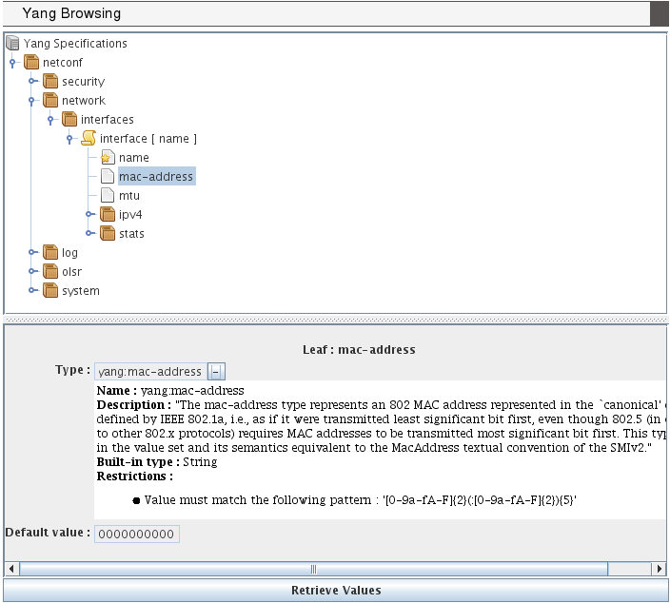
Browsing YANG Specifications
Notes:
The figure 7 shows the applet part of the web interface displayed when a user is connected for the configuration of a device. This first view can be used as a YANG specification browser looking like a file system browser (we use the swing Jtree interface). The tree view matches well with YANG because it defines a schema tree. Specific icons are used to distinct container, list, key or leaf nodes.
When selecting a node, the lower part of the applet shows details of its YANG specification, as the type of a leaf and constraints such default value or range intervals. A leaf type is always at least of a built-in types (as string, int8,…) and can be refined by other types with added constraints or to use an existing useful type (as a mac-address). This is the meaning of the “-” (or “+”) behind the name type. When “+” is set (by one mouse click on the “-”) then the built-in type is displayed.
This same applet is used in the following figures for sending request to the NETCONF device and receiving response. The matching of XML data with the YANG tree node is made at each response by the same applet.

Slide 11
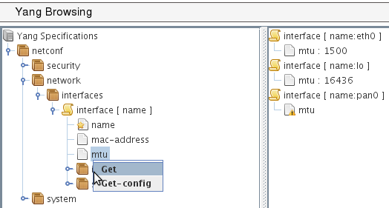
YANG-based client
POST
operation : get
<netconf
xmlns=«urn:loria:madynes:ensuite:yencap:1.0:module:Interfaces:1.0»>
<network>
<interfaces>
<interface>
<name>
<mtu>
</interface>
</interface>
</network>
</netconf>
HTTP
<rpc-reply>
…
<interface>
<name>eth0</name>
<mtu>1500</mtu>
</interface>
<interface>
<name>lo0</name>
<mtu>16436</mtu>
</interface>
...
</rpc-reply>
YencaP Manager
<xml…>
<rpc-query>
<get>
…
</get>
</rpc-query>
NETCONF
YencaP
Notes:
One can request the indirectly connected NETCONF device by a mouse contextual menu that pops-up when the right button is pressed on a YANG node. When one of the standard NETCONF operations is chosen, the request is built from the root node (here the netconf virtual container) to the tree position of the selected node. At this step, the applet is vertically separated to show result of request on the right. The resulting XML document is sent inside a HTTP POST request. A specific header called “operation” is used to specify which NETCONF operation must be performed on the server (get, get-config or edit-config). The figure 8 shows a get request on the leaf mtu and this leaf is inside the interface list. Note that the key of the list is added to the request while it is not explicitly asked. This is an optimization because subsequent requests on lists (and especially on list entries) will likely need the key.
When the request is received by the YencaP Manager, the latter surrounds it by the rpc and filter mechanisms and sends a valid NETCONF request. From this step we are independent of any YANG concern because we are in a full NETCONF session. Following is simply a cleaning of NETCONF XML data until the first node of the Data Store and its forwarding to the client applet that is waiting for the response. The figure 8 shows the response on the right part of the management applet. The request is synchronous because even if one request contains several data (as can be a request on a list) all of them are returned by one response. Note we have made our protocol synchronous on top of HTTP with several asynchronous requests. We plan to allow multiple selections for the same NETCONF operation to give access to the separate part of the NETCONF Data Store in one request.

Slide 12
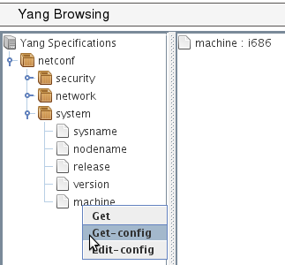
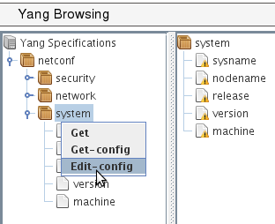
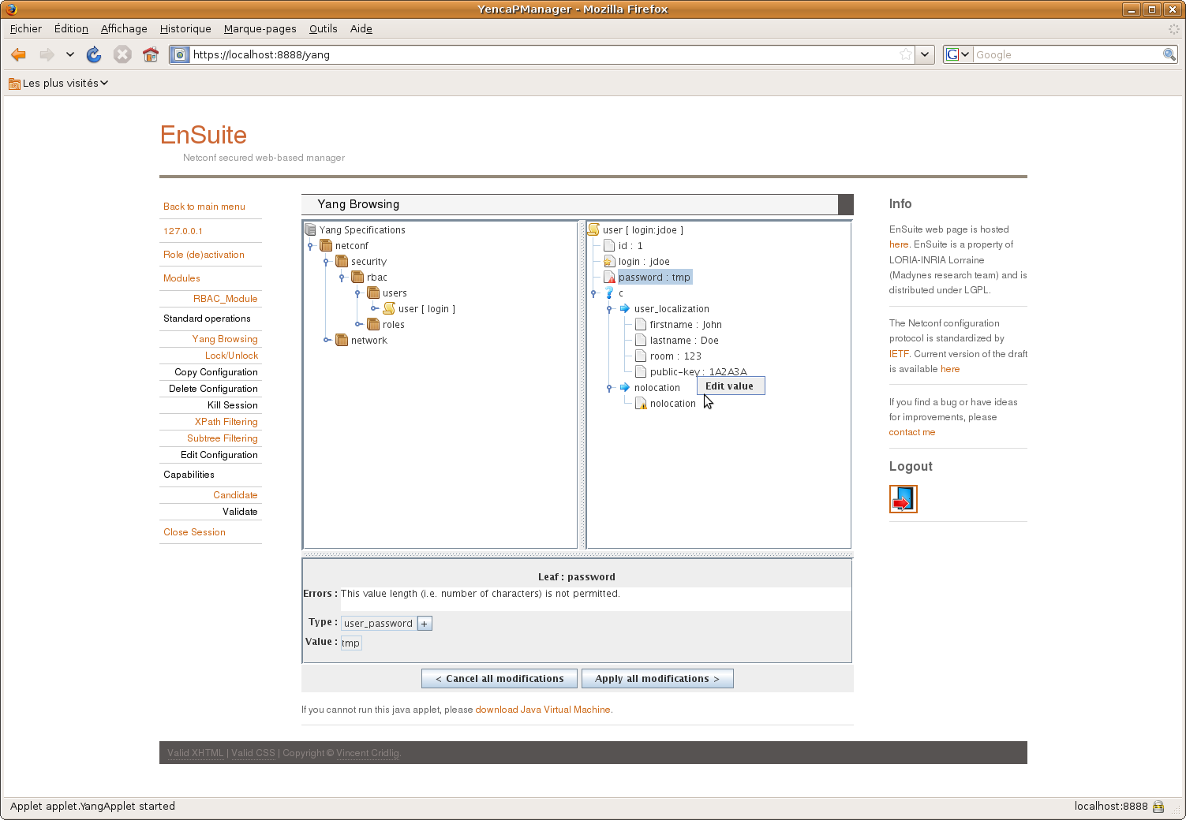
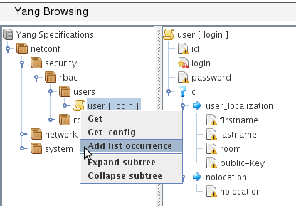
a)
b)
c)
d)
Notes:
The figure 9 depicts some functionalities of the applet related to NETCONF get and edit config operations.
Part (a) is a simple access to a leaf in a container and where we get the response of a get-config operation.
Part (b) is an edit-config for a container. When editing a container, its components are listed with a warning until a correct value is given. The applet shows warning messages and have editing functionalities (as in part d) to set values on edited data.
Part (c) is an edit-config for a list. Here a list is edited entry by entry (that we call a list occurrence) and one can see an empty list entry ready to be filled. Note that a red mark is on the “login” leaf because it is the key of the list and so its value must be set.
Part (d) illustrates the choice representation and its edition. A choice case (“user-localization” or “nolocation”) can only be edited if all of its components are set. On the same part the leaf called “password” is read marked because the value is not long enough. This is an example of dynamic constraint one can check with the tool. Range values of integer or float, pattern matching of string are also checked.

Slide 13
Conclusions and future works
jYang: a YANG parser
ENSUITE framework : YANG enable
YencaP : server announces
YencaP Manager : YANG view applet
YencaP : agent builder
YANG constraints
YencaP : configuration self checking
YencaP Manager : user input control
Notes:
We provide two contribution to the network configuration domain. The first one is a YANG parser and semantic checker close to the actual version of the draft definition of YANG. The second contribution is the support within the ENSUITE framework of YANG based models both on the server and the client side.
We plan to extend YencaP to be able to generate parts of its code from YANG data model, or build generic parts, to ensure the server maintains a valid Data Store compliant with YANG. The server has to be able to send notifications especially those defined in YANG and must also accept user defined operations as there are YANG rpc and notification statements to do this.
We are also interested by all YANG constraints one can specify. Default value, must and presence conditions, references between values, length or pattern matching are some examples of such constraints. If one can have a NETCONF server with such knowledge this server will be enabled to autonomously checks its configuration. At the client side the constraints can ensure the manager does not make mistakes in its configuration operations and can notify users if constraints are not respected.

Slide 14
Références
[1] R. Enns
NETCONF Configuration Protocol, RFC 4741, December 2006
[2] M. Bjorklund
YANG - A data modeling language for NETCONF
draft-ietf-netmod-yang-07, Network Working Group, Internet-Draft, 13 July 2009
[3] K. McCloghrie, D. Perkins, J. Schoenwaelder.
Structure of Management Information Version 2 (SMIv2), RFC 2578, April 1999.
[4] Case, J., Fedor, M., Schoffstall, M. and J. Davin,
Simple Network Management Protocol, RFC 1157, May 1990.
[5] Huiyang Cui; Bin Zhang; Guohui Li; Xuesong Gao; Yan Li
Contrast Analysis of NETCONF Modeling Languages: XML Schema, Relax NG and YANG
International Conference on Communication Software and Network, 2009, ICCSN’09, 27-28 Feb 2009 Page(s):322 - 326
[6] Hui Xu; Debao Xiao
Data modeling for NETCONF-based network management: XML schema or YANG
11th IEEE International Conference on Communication Technology, 2008, ICCT 2008, 10-12 Nov 2008 Page(s):561 – 564
[7] J. Schoenwaelder
Common YANG Data Types
draft-ietf-netmod-yang-types-03, Network Working Group, Internet-Draft, 13 Mai 2009
[8] V. Cridlig; R. State
YencaP Documentation
Technical Report, 2005, 25 Pages,http://hal.inria.fr/inria-00000804/fr

Slide 15
<NETCONF>
<network>
<interfaces>
<interface>
<name>eth0</name>
<mtu>1500</mtu>
…
</interface>
<interface>
…
</interfaces>
…
</network>
…
</NETCONF>
NETCONF
NETCONF
<NETCONF>
<network>
<interfaces>
<interface>
<name>eth0</name>
<mtu>1500</mtu>
…
</interface>
<interface>
…
</interfaces>
…
</network>
…
</NETCONF>
YANG
YANG
NETCONF
NETCONF

Slide 16
foreach node in the YangTreeNode : ytn
if ytn is a choice node then
foreach case of the choice
foreach node in the case nc
foreach node in the DataTree : dtn
if dtn == ytn then
create a browsing picture

Slide 17
HTTPS
server
NETCONF
Manager
https
OLSR
NETCONF
ENSUITE
Framework
(python)
Notes:
Our testbed is made of one or more NETCONF agent implementation provided by the ENSUITE framework. These agents run on wireless routers interconnected by a mesh network with an ad-hoc multi hop mode and allow the configuration of the OLSR protocol that maintains a consistent and evoluting routing plane. Each router has two wireless interfaces where one is dedicated to user sub-network access-point and the other to communicate with other routers of the mesh.

Slide 18
module network {
…
container interfaces {
list interface {
leaf name {…
leaf mtu {…
}
}
}
Data Model Agent
container interfaces
xsd
list
interface
jYang parser
leaf
name
leaf
mtu
Schema Tree :
- no typedef, grouping, uses, augments
- just data nodes (and choice)

Slide 19
NETCONF
Manager
https
HTTPS
Server
NETCONF
Manager
Schema tree
Java applet
Data Model
agent
Data Model
agent

Slide 20
If https connection could be used by the applet
NETCONF
Manager
HTTPS
Server
3
https
…
<get-config>
<NETCONF>
<network>
<interfaces/>
</network>
</NETCONF>
</get-config>
4
NETCONF
Manager
5
NETCONF
1
Data Model
agent
2

Slide 21
NETCONF
Manager
HTTPS
Server
NETCONF
Manager
1
NETCONF
2
Data Model
agent
Checks validity
- XSD document
- Yang constraints
Add default values
3

Slide 22
NETCONF
Manager
HTTPS
Server
NETCONF
Manager
5
NETCONF
4
1
Data Model
agent
3
Checks validity
- Yang constraints
…
<edit-config>
<NETCONF>
<network>
<interfaces>
<interface>
<name>lan0</name>
</interface>
</interfaces>
</network>
</NETCONF>
</get>
2

Slide 23
NETCONF
Agent
autonomous
polling
Yang Proxy
Static time
NETCONF
YANG
Parser
java
Yang specs.

Slide 24
NETCONF
…
network
…
interfaces
…
interface
interface
name
mtu
…
eth0
1500
Notes:
Configuration management we propose is made of one set of network devices and one station (the configuration manager) hosting configuration related applications. Each device has an embedded NETCONF agent that can be requested by the configuration manager station. Data exchanged are XML formatted configuration (and eventually state) information that are different for each device. Because different devices as router and server have nothing common so data are different. As two same devices should have same data types but different values. So there is a need for each device to exhibit which data can be used to manage its configuration and there is a need too for configuration manager application to know what could be requested from each device.
The YANG modeling language is the information model proposed by the ietf working group on network configuration (netmod). This language will allows equipments vendor to formally express their information model, as it is done for network management by SNMP and its SMI data model. But an important difference for us between SMI and YANG is the former is a data model and not an information model. YANG is more abstract and have more complex structures than the hierarchical description of scalars and tables in SMI. Moreover SMI data models contain protocol information that are useful to request data (the SNMP oid) that have permitted the development of a full of generic SNMP manager providing an SMI view of network management information.
The goal of this paper is to show a way to use YANG information model in the same fashion as the SMI could be. We propose a generic configuration manager that will understand YANG specification and provide a YANG view of configuration data maintained inside NETCONF agents. The language is currently in the draft state but sufficiently advanced to allow us a realistic use of it that will show possibilities and limits of such use of YANG.
NETCONF data exchanged between a device and a configuration application are XML documents and it is the responsibility of the agent or the manager to send well formed document. Such schema could be the mean to formally express which configuration data could be exchanged but indeed are not human friendly readable and so limits the understanding of complex data structure. For example a typical network configuration data (but also a network management) is a list (or a table) of the set of network interfaces a network device contains. XML example for such data is given on the slide.

Slide 25
interfaces
<interfaces>
<ifNumber>2</ifNumber>
<interface>
<name>eth0</name>
<mac>01:52:AB:D4:EF:EE</mac>
<mtu>1500</mtu>
</interface>
<interface>
<name>lan0</name>
<mac>FF:00:00:00:00:00</mac>
<mtu>1500</mtu>
</interface>
</interfaces>
<interfaces>
<ifNumber> </ifNumber>
<interface>
<name> </name>
<mac> </mac>
<mtu> </mtu>
</interface>
<interface>
<name> </name>
<mac> </mac>
<mtu> </mtu>
</interface>
</interfaces>
ifNumber
interface
interface
name
mac
mtu
name
mac
mtu
Data Tree / Nodes
XML Configuration
Notes:
YANG is used to model data that are XML formated configuration information like this example.
If we remove data values,it is more easy to see that some markup pattern are repeated as interface with name, physical address and mtu.
One can also see these patterns are inside an interfaces markup with a ifNumber.
As XML describes data like a tree, it is easy to build such tree from it.
But it is only with the help of a data model that we can say there is two instances of the same interface pattern.

