Slide 1



End-to-end YANG-based Configuration Management
A Yang Parser and Browser implementation on NETCONF
E. Nataf, O. Festor
Nancy University, Madynes – INRIA project
Loria
Notes:
Networked resources are of increasing complexity and have to be configured to guarantee proper operation. Within the IETF, current efforts are focused on both a protocol and a data model definition language for configuration management. The NETCONF protocol describes the communication between devices to be configured and configuration applications. NETCONF does not describe how configuration data is represented. This is addressed by the YANG data modeling language, the emerging proposal of the netmod standard working group.
We present in this paper the result of the integration of YANG and NETCONF in the ENSUITE open source framework. We illustrate this integration through a YANG-based configuration navigation and edition application that works with YANG-enabled devices.

Slide 2



Devices
with NETCONF server
Standard Configuration Management
IETF netconf & netmod WG
Configuration Management Application
Data Model
Ref:Host
Data Model
Ref:Router
NETCONF
NETCONF PDU
XML Data
Data Model Ref:Host
Data Model
Ref:Host
Data Model
Ref:Router
Data Model
: YANG data model
Configuration data
State data
Notes:
Configuration management importance is increasing with the growing size and the complexity of network resources and applications. In the Internet context, the netconf working group has proposed the NETCONF protocol [1] as a standard to manage configuration of network devices. This protocol is tailored to configuration operation i.e. setting and/or getting configuration data values to/from devices with an RPC mechanism. Data values are transmitted inside XML document. The standardization body acknowledges this should be improved by a data modeling language that will describes these data values.
When the data exchanged are XML formatted, it is usual to describe the hierarchy by XML Schema or Relax NG [5,6]. Even if these schema languages are powerful, standardization body choose to define by itself a language that it can control the evolutions and that is enough descriptive and more focused on configuration management.
YANG [2] is the data modeling language proposed by the netmod working group. YANG can be compared to SMI [3] in the SNMP [4] framework because it is a data modeling language where data values are distributed and accessible through a protocol. In the same way, a YANG specification is a reference document used by device vendor and application developer.
The objective of this paper is to demonstrate the feasibility of an End-to-End YANG-aware management framework and to describe how it can be implemented in an open source framework. First we describe the YANG language, focusing on its major concepts. Secondly we present a parser for YANG specifications : jYang, an open source implementation we provide to the community. The third part shows how we did integrate YANG into the used NETCONF server. Finally we show a YANG browsing application and its functionalities to get and edit configuration data.

Slide 3
YANG Modeling
module
header
(1) module network {
(2) namespace
« urn:loria:madynes:ensuite:yencap:1.0:module:Interfaces:1.0 »;
(3) import ietf-yang-types { prefix yt;}
(4) typedef ifName {
(5) type string;
(6) length 3-8;
(7) }
(8) grouping v4add {
(9) container v4 {
(10) leaf ip { type ip;}
(11) leaf mask {type m;
(12) }
(13) }
(14) container interfaces {
(15) list interface {
(16) key name
(17) leaf name { type ifName};
(18) leaf mac { type yt:mac-address;}
(19) leaf mtu { type uint32};
(20) choice ad-type {
(21) case v4 uses v4add;
(22) case v6 uses v6add;
(23) }
(24) }
(25) }
(26) }
typedef
grouping
namespace
import
container
leaf
container
leaf
list
leaf
leaf
leaf
choice
case
case
uses
uses
Notes:
Data models written with YANG describe hierarchical organization of configuration data. A YANG module is one data model related to a specific configuration purpose, as for example network configuration, or a generic, reusable, set of data models. The left part of the figure 3 shows a YANG module called network. A module must first defines its name space (line 2) that must be unique among all YANG models. If needed, a module can import other YANG models (line 3, the “ietf-yang-types” reference is a YANG module [7] with useful types intended to be used by other modules). Not shown in the figure, a module can be split in several submodules if it seems to be too much complex or contains a mix of contrastive configuration data.
YANG defines a limited set of build-in types such as string, boolean and integer. These basic types can be used to create other types with a “typedef “ statement (line 4). A typedef allows to add some constraints on its base type as the length of a string (line 6). Another construct that improves reusability is the “grouping” statement (line 8) that can be used, with an “use” statement at separate places (line 21 for example).
Data models are mainly expressed with the following statements that are called datadef statement:
Leaf : a value of one type.
Container : a set of datadefs.
List : an ordered set of entries and all entries are made from the same set of datadefs. One or more datadefs of the set entry must be defined as list key.
Leaf-list : a list of values of the same type.
Choice ; an alternative of different cases of datadefs.
The example shows two containers (lines 9 and 14) a list (line 15) and a choice (line 20).
The API we propose reflects YANG statements hierarchy. For each YANG statement we have a corresponding java class (see class diagram on the right part of the figure 3). Each java object have getters methods to follow the tree of instances. About hundred java classes were necessaries to represent any YANG model.

Slide 4
jYang Parser
a
errors
b’’
YANG data tree
b’
sa1
a
b
YangSpecification
YangTreeNode
jYang
<
>
<
>
<
>
<
>
</
>
</
>
</
>
<
>
</
>
YANG module
a
<
>
<
>
<
>
</
>
</
>
XML Data
</
>
YANG module
b
YANG sub-module
sa1
NETCONF
</
>
NETCONF
Imported module
Included module
Notes:
jYang is an open source parser for the YANG language. It is written in java with the javaCC library (https://javacc.dev.java.net/). The parsing of one YANG data model generate other ones when a module imports or includes other module or submodule. On the example in the figure 4, the module a imports the module b and include the submodule sa1. Either the parsing finish with error listing or it produces a java representation of the YANG data model.
Full syntax checking is done and some constraints are checked. YANG allows data modelers to express static constraints like default values or key indexing specification that can be checked at parsing time. Also when range number or string pattern defined for a type are modified by a new type (with the typedef statement). YANG allows dynamic constraints on the data value, as the conditional presence of data depending on other data values or hosting device capabilities, that obviously can not be checked at parsing time.
When no error are encountered the YANG data model is represented by what we call a YangTreeNode. This tree, build from java instances of classes shown in the figure 3, is an interpretation of YANG data model where only YANG statement describing data values are present. For example on the upper part of the figure 4, suppose the module b is only a grouping statement that is used by some statements in the module a (those with a dashed arrow). Then the final YangTreeNode reflects this by a tree with a full copy of all needed statements, we call b’ and b’’. In the same way, when there are choice statements in the YANG data model then all cases are represented. But this is not the true for type definition because a type is not a value but is used inside a statement. In our example the submodule sa1 is only a typedef collection and so there is no copy of them in the final tree.
The YangTreeNode is used to match the YANG data tree with raw NETCONF XML data. The YANG data tree is the hierarchy of all configuration data values in a NETCONF server. The matching process take place in the configuration manager when receiving NETCONF responses. Note the right part of the figure 4 shows that the YANG data tree has more nodes than the YangTreeNode and these extra nodes have a common pattern. This is the case when a YANG list (or leaf-list) is defined and when the YANG data tree has several entries (or values). At the opposite some data could be optional depending of the device itself, or when YANG data model has choice statements, then the YANG data tree will only have one case instantiated.

Slide 5
YencaP : a NETCONF server
<netconf>
Module
Module
Module
Module
Data Store Manager
NETCONF Operation
NETCONF RPC
SSH
Data Store
<module>
<name>Interfaces</name>
<xpath>/netconf/network/interfaces</xpath>
<namespace pref="ifs">urn:loria:madynes:ensuite:yencap:1.0:module:Interfaces:1.0</namespace>
<parameters>
<parameter name="yang" value="interfaces"/>
</parameters>
</module>
Notes:
YencaP [8] is an open source implementation of the NETCONF server side. The bottom part of its architecture is an SSH layer to ensure security, session and connection-oriented communication as stated by the standard. The RPC layer implements the RPC mechanism with <rpc> and <rpc-reply> primitives that carries basic operations of the upper NETCONF operation layer as <get>, <get-config> and <edit-config> (notification are planned). The Data store Manager layer entity is responsible for maintaining a virtual database of configuration (and state) data and provides a read / write access to these data (state data being read-only). The Data Store, illustrated in the figure 5, can be see as a global XML data tree where each module has its place.
When bootstrapping, the Data Store Manager looks for modules through a local configuration file and dynamically loads them. A module is a piece of code that accesses to specific configuration and state information with an interface compliant with NETCONF operations. For example there are modules for network interfaces, system, protocols like RIP or OLSR... Although YencaP was written before YANG, the module concept of the former fits well with the YANG one. For each module, the configuration file contains some directives as for the interface module in the figure 5. The location of data mocule in the Data Store by giving a path (an Xpath expression) from the root <netconf> node to the root node of the module. For example, the interfaces module is localized with the “/netconf/network/interfaces” expression and it maintains data under the <interfaces> node. Thus, one part of the Data Store is managed by the Data Store Manager (light grey on figure 5) and the other parts are managed by the modules (dark grey sub trees). This enables modularity of the server without increasing the complexity of the Data Store Manager.
The format for the YencaP configuration file is extensible through a <parameters> markup that contains <parameter> items with name and value attributes. The integration of YANG into YencaP is made through the addition of a parameter with the “yang” name attribute and the module name as value attribute (interface in the example). For each module inside the YencaP server there is one and only one YANG module. One can see on the figure that there is a <namespace> markup before the module parameters list. This name space is needed inside NETCONF requests to distinguish its XML naming. We choose that It must be the same as the one defined in the corresponding YANG module.

Slide 6
YencaP Manager : a NETCONF Client
YencaP
applet
YangTreeNode
HTTPS
Server
NETCONF
Client
Configuration
Management
Web user interface
<hello>
<capability>
YANG module reference
</capability>
</hello>
YangTree
Node
ENSUITE framework
YANG
Loader
+
jYang
YANG specs.
repository
YencaP Manager
Notes:
The YencaP Manager, on the center part in the figure 6, is an open source NETCONF client application that can send queries and receive responses with any NETCONF-compliant server. The NETCONF client can have several NETCONF sessions with several servers at one time. Each session is initialized by the HTTPS server inside the YencaP Manager when a user opens an HTTPS session. There is a one to one mapping between HTTPS and NETCONF sessions. The couple (YencaP / YencaP Manager) forms the ENSUITE framework.
On the right part of the figure 6, we extends YencaP to give it the possibility of announcing which YANG modules it implements as a capability in its standard hello message (together with version and revision information). This was easily realized with the information in the configuration file we show figure 5. On the YencaP Manager side, a YANG loader will be used when such a capability is detected. We do not constraint the YencaP Manager to only work with YANG but to accept servers that are YANG enabled or not. The YANG loader gets the specifications from an external repository and builds a specific YangTreeNode for the data model maintained by the server. The YANG loader is a java program that uses jYang to dynamically parse YANG data model. We took this choice because we suppose the YencaP Manager will discover servers without knowledge of their configuration and thus must be able to dynamically load and parse any YANG model. It is also necessary to create the root node in the YangTreeNode as a virtual netconf container. The YANG specification repository is shown as an external element of the YencaP Manager as it should be a global repository implemented for example as a web service.
Once a HTTPS session is opened the user can ask for the configuration of a YANG enabled device. In doing so it receives a java applet that contains the YangTreeNode for this server only (left part of the figure 6). The applet will be loaded by the web interface to provide the user with a graphical interface representing the configuration.

Slide 7
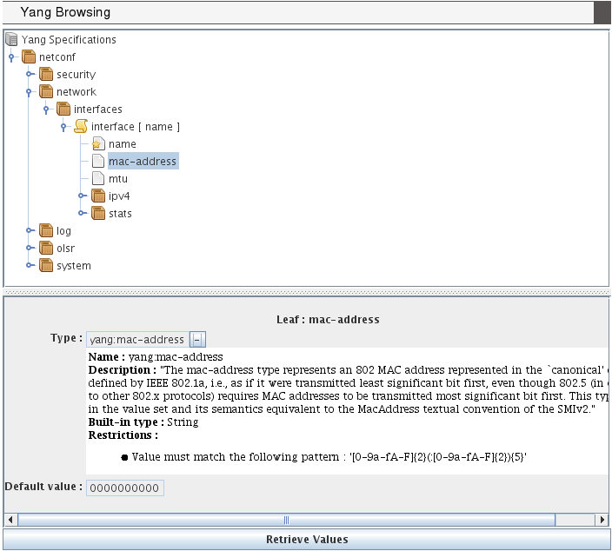
Browsing YANG Specifications
Notes:
The figure 7 shows the applet part of the web interface displayed when a user is connected for the configuration of a device. This first view can be used as a YANG specification browser looking like a file system browser (we use the swing Jtree interface). The tree view matches well with YANG because it defines a schema tree. Specific icons are used to distinct container, list, key or leaf nodes.
When selecting a node, the lower part of the applet shows details of its YANG specification, as the type of a leaf and constraints such default value or range intervals. A leaf type is always at least of a built-in types (as string, int8,…) and can be refined by other types with added constraints or to use an existing useful type (as a mac-address). This is the meaning of the “-” (or “+”) behind the name type. When “+” is set (by one mouse click on the “-”) then the built-in type is displayed.
This same applet is used in the following figures for sending request to the NETCONF device and receiving response. The matching of XML data with the YANG tree node is made at each response by the same applet.

Slide 8
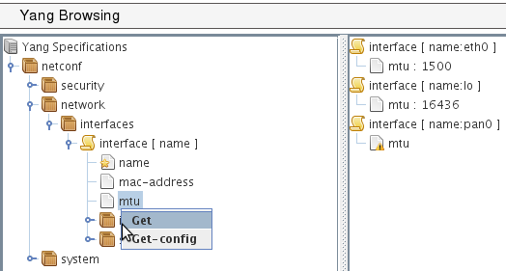
YANG-based client
POST
operation : get
<netconf
xmlns=«urn:loria:madynes:ensuite:yencap:1.0:module:Interfaces:1.0»>
<network>
<interfaces>
<interface>
<name>
<mtu>
</interface>
</interface>
</network>
</netconf>
HTTP
<rpc-reply>
…
<interface>
<name>eth0</name>
<mtu>1500</mtu>
</interface>
<interface>
<name>lo0</name>
<mtu>16436</mtu>
</interface>
...
</rpc-reply>
YencaP Manager
<xml…>
<rpc-query>
<get>
…
</get>
</rpc-query>
NETCONF
YencaP
Notes:
One can request the indirectly connected NETCONF device by a mouse contextual menu that pops-up when the right button is pressed on a YANG node. When one of the standard NETCONF operations is chosen, the request is built from the root node (here the netconf virtual container) to the tree position of the selected node. At this step, the applet is vertically separated to show result of request on the right. The resulting XML document is sent inside a HTTP POST request. A specific header called “operation” is used to specify which NETCONF operation must be performed on the server (get, get-config or edit-config). The figure 8 shows a get request on the leaf mtu and this leaf is inside the interface list. Note that the key of the list is added to the request while it is not explicitly asked. This is an optimization because subsequent requests on lists (and especially on list entries) will likely need the key.
When the request is received by the YencaP Manager, the latter surrounds it by the rpc and filter mechanisms and sends a valid NETCONF request. From this step we are independent of any YANG concern because we are in a full NETCONF session. Following is simply a cleaning of NETCONF XML data until the first node of the Data Store and its forwarding to the client applet that is waiting for the response. The figure 8 shows the response on the right part of the management applet. The request is synchronous because even if one request contains several data (as can be a request on a list) all of them are returned by one response. Note we have made our protocol synchronous on top of HTTP with several asynchronous requests. We plan to allow multiple selections for the same NETCONF operation to give access to the separate part of the NETCONF Data Store in one request.

Slide 9
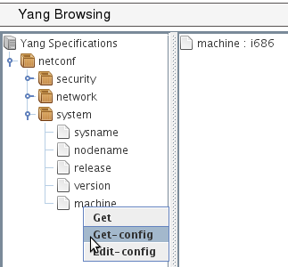
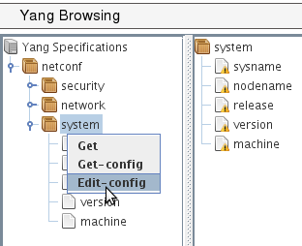
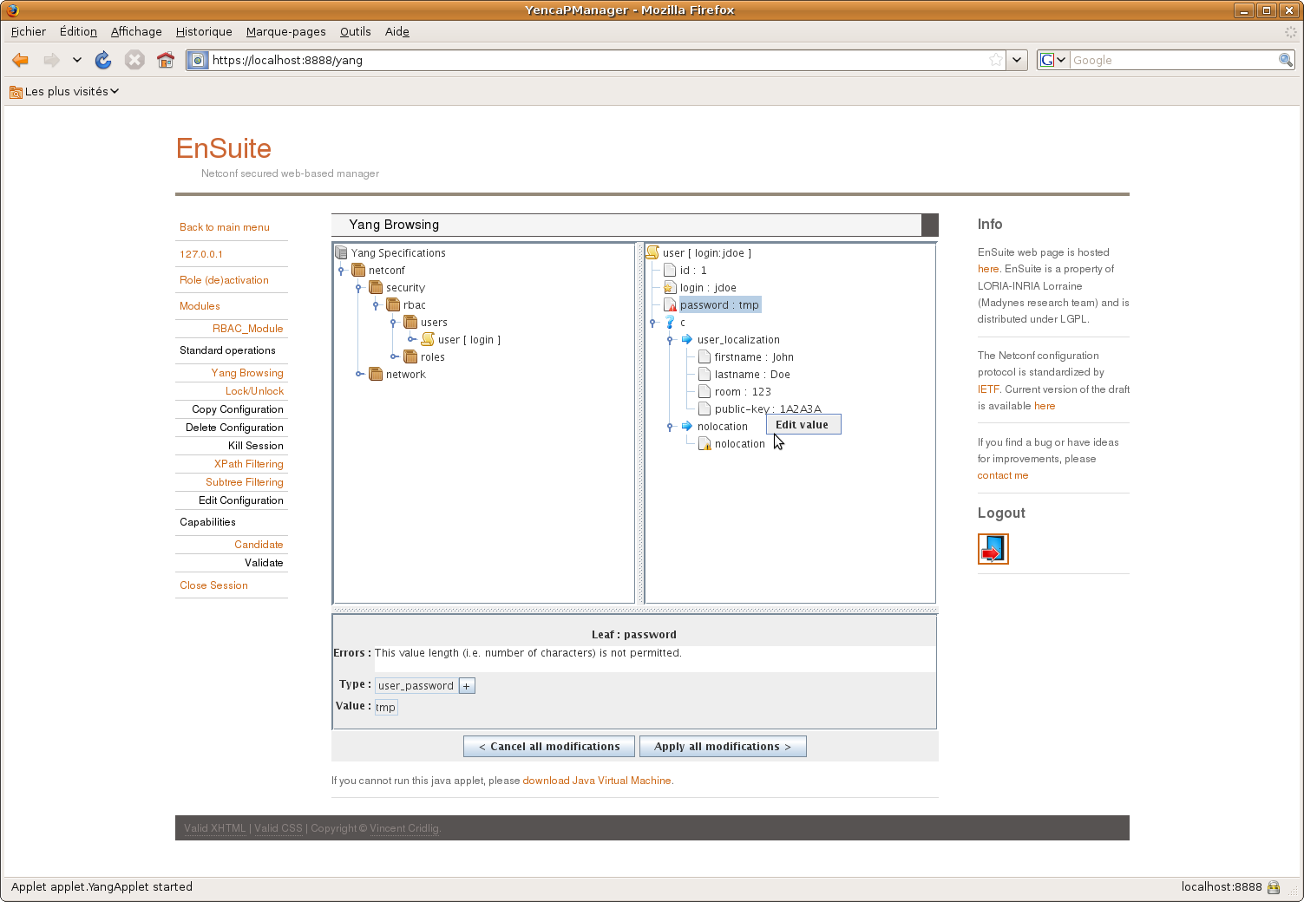
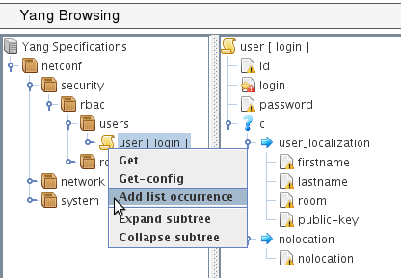
a)
b)
c)
d)
Notes:
The figure 9 depicts some functionalities of the applet related to NETCONF get and edit config operations.
Part (a) is a simple access to a leaf in a container and where we get the response of a get-config operation.
Part (b) is an edit-config for a container. When editing a container, its components are listed with a warning until a correct value is given. The applet shows warning messages and have editing functionalities (as in part d) to set values on edited data.
Part (c) is an edit-config for a list. Here a list is edited entry by entry (that we call a list occurrence) and one can see an empty list entry ready to be filled. Note that a red mark is on the “login” leaf because it is the key of the list and so its value must be set.
Part (d) illustrates the choice representation and its edition. A choice case (“user-localization” or “nolocation”) can only be edited if all of its components are set. On the same part the leaf called “password” is read marked because the value is not long enough. This is an example of dynamic constraint one can check with the tool. Range values of integer or float, pattern matching of string are also checked.

Slide 10
Conclusions and future works
jYang: a YANG parser
ENSUITE framework : YANG enable
YencaP : server announces
YencaP Manager : YANG view applet
YencaP : agent builder
YANG constraints
YencaP : configuration self check
YencaP Manager : user input control
Notes:
We provide two contribution to the network configuration domain. The first one is a YANG parser and semantic checker close to the actual version of the draft definition of YANG. The second contribution is the support within the ENSUITE framework of YANG based models both on the server and the client side.
We plan to extend YencaP to be able to generate parts of its code from YANG data model, or build generic parts, to ensure the server maintains a valid Data Store compliant with YANG. The server has to be able to send notifications especially those defined in YANG and must also accept user defined operations as there are YANG rpc and notification statements to do this.
We are also interested by all YANG constraints one can specify. Default value, must and presence conditions, references between values, length or pattern matching are some examples of such constraints. If one can have a NETCONF server with such knowledge this server will be enabled to autonomously checks its configuration. At the client side the constraints can ensure the manager does not make mistakes in its configuration operations and can notify users if constraints are not respected.

Slide 11
Références
[1] R. Enns
NETCONF Configuration Protocol, RFC 4741, December 2006
[2] M. Bjorklund
YANG - A data modeling language for NETCONF
draft-ietf-netmod-yang-07, Network Working Group, Internet-Draft, 13 July 2009
[3] K. McCloghrie, D. Perkins, J. Schoenwaelder.
Structure of Management Information Version 2 (SMIv2), RFC 2578, April 1999.
[4] Case, J., Fedor, M., Schoffstall, M. and J. Davin,
Simple Network Management Protocol, RFC 1157, May 1990.
[5] Huiyang Cui; Bin Zhang; Guohui Li; Xuesong Gao; Yan Li
Contrast Analysis of NETCONF Modeling Languages: XML Schema, Relax NG and YANG
International Conference on Communication Software and Network, 2009, ICCSN’09, 27-28 Feb 2009 Page(s):322 - 326
[6] Hui Xu; Debao Xiao
Data modeling for NETCONF-based network management: XML schema or YANG
11th IEEE International Conference on Communication Technology, 2008, ICCT 2008, 10-12 Nov 2008 Page(s):561 – 564
[7] J. Schoenwaelder
Common YANG Data Types
draft-ietf-netmod-yang-types-03, Network Working Group, Internet-Draft, 13 Mai 2009
[8] V. Cridlig; R. State
YencaP Documentation
Technical Report, 2005, 25 Pages,http://hal.inria.fr/inria-00000804/fr

Slide 12
<NETCONF>
<network>
<interfaces>
<interface>
<name>eth0</name>
<mtu>1500</mtu>
…
</interface>
<interface>
…
</interfaces>
…
</network>
…
</NETCONF>
NETCONF
NETCONF
<NETCONF>
<network>
<interfaces>
<interface>
<name>eth0</name>
<mtu>1500</mtu>
…
</interface>
<interface>
…
</interfaces>
…
</network>
…
</NETCONF>
YANG
YANG
NETCONF
NETCONF

Slide 13
foreach node in the YangTreeNode : ytn
if ytn is a choice node then
foreach case of the choice
foreach node in the case nc
foreach node in the DataTree : dtn
if dtn == ytn then
create a browsing picture

Slide 14
HTTPS
server
NETCONF
Manager
https
OLSR
NETCONF
ENSUITE
Framework
(python)
Notes:
Our testbed is made of one or more NETCONF agent implementation provided by the ENSUITE framework. These agents run on wireless routers interconnected by a mesh network with an ad-hoc multi hop mode and allow the configuration of the OLSR protocol that maintains a consistent and evoluting routing plane. Each router has two wireless interfaces where one is dedicated to user sub-network access-point and the other to communicate with other routers of the mesh.

Slide 15
module network {
…
container interfaces {
list interface {
leaf name {…
leaf mtu {…
}
}
}
Data Model Agent
container interfaces
xsd
list
interface
jYang parser
leaf
name
leaf
mtu
Schema Tree :
- no typedef, grouping, uses, augments
- just data nodes (and choice)

Slide 16
NETCONF
Manager
https
HTTPS
Server
NETCONF
Manager
Schema tree
Java applet
Data Model
agent
Data Model
agent

Slide 17
If https connection could be used by the applet
NETCONF
Manager
HTTPS
Server
3
https
…
<get-config>
<NETCONF>
<network>
<interfaces/>
</network>
</NETCONF>
</get-config>
4
NETCONF
Manager
5
NETCONF
1
Data Model
agent
2

Slide 18
NETCONF
Manager
HTTPS
Server
NETCONF
Manager
1
NETCONF
2
Data Model
agent
Checks validity
- XSD document
- Yang constraints
Add default values
3

Slide 19
NETCONF
Manager
HTTPS
Server
NETCONF
Manager
5
NETCONF
4
1
Data Model
agent
3
Checks validity
- Yang constraints
…
<edit-config>
<NETCONF>
<network>
<interfaces>
<interface>
<name>lan0</name>
</interface>
</interfaces>
</network>
</NETCONF>
</get>
2

Slide 20
NETCONF
Agent
autonomous
polling
Yang Proxy
Static time
NETCONF
YANG
Parser
java
Yang specs.

Slide 21
NETCONF
…
network
…
interfaces
…
interface
interface
name
mtu
…
eth0
1500
Notes:
Configuration management we propose is made of one set of network devices and one station (the configuration manager) hosting configuration related applications. Each device has an embedded NETCONF agent that can be requested by the configuration manager station. Data exchanged are XML formatted configuration (and eventually state) information that are different for each device. Because different devices as router and server have nothing common so data are different. As two same devices should have same data types but different values. So there is a need for each device to exhibit which data can be used to manage its configuration and there is a need too for configuration manager application to know what could be requested from each device.
The YANG modeling language is the information model proposed by the ietf working group on network configuration (netmod). This language will allows equipments vendor to formally express their information model, as it is done for network management by SNMP and its SMI data model. But an important difference for us between SMI and YANG is the former is a data model and not an information model. YANG is more abstract and have more complex structures than the hierarchical description of scalars and tables in SMI. Moreover SMI data models contain protocol information that are useful to request data (the SNMP oid) that have permitted the development of a full of generic SNMP manager providing an SMI view of network management information.
The goal of this paper is to show a way to use YANG information model in the same fashion as the SMI could be. We propose a generic configuration manager that will understand YANG specification and provide a YANG view of configuration data maintained inside NETCONF agents. The language is currently in the draft state but sufficiently advanced to allow us a realistic use of it that will show possibilities and limits of such use of YANG.
NETCONF data exchanged between a device and a configuration application are XML documents and it is the responsibility of the agent or the manager to send well formed document. Such schema could be the mean to formally express which configuration data could be exchanged but indeed are not human friendly readable and so limits the understanding of complex data structure. For example a typical network configuration data (but also a network management) is a list (or a table) of the set of network interfaces a network device contains. XML example for such data is given on the slide.

