Slide 1



End-to-end YANG-based Configuration Management
A Yang Parser and Browser implementation on IETF - NETCONF
E. Nataf, O. Festor
Nancy University, Madynes – INRIA project
Loria
Notes:
I’ll present to you some results of our research activity on configuration management.
The configuration about which we work is the one defined by the ITEF netconf protocol, that is a set of configuration data that must be uploaded to network devices in order to function well.
Yang is a data modeling language proposed by the IETF to formally describe the structure, type and meaning of configuration data.
In this presentation we present a Yang parser and how we use it to provide a Yang view of configuration data both at the client and server side of the netconf protocol.
This work was done by Olivier Festor and myself within the Inria Madynes team at the Loria lab in Nancy, France.

Slide 2



Devices with embedded
NETCONF servers
Standard Configuration Management
IETF netconf & netmod WG
Configuration Management Application
Data Model
Host
Data Model
Router
NETCONF
NETCONF PDU
XML Data
<
>
<get-config>
<edit-config>
<copy-config>
Data Model Host
?
<
>
>
<
<
>
</
>
</
</
>
<
>
</
>
>
Data Model
Host
<
>
<
>
>
<
>
</
Data Model
Router
</
</
>
XML Data
</
>
>
Data Model
: YANG data model
Configuration data
State data
Notes:
Our work is based on the standard configuration management defined by the IETF netconf and netmod working groups.
In this context managed network devices have Netconf server that are accessed through the Netconf protocol by configuration management application.
Based on RPC mechanism, netconf protocol defines some operations to upload, download whole or part of configuration data in one request.
They are other operations as copy or delete and new operations can be defined. There is also a notification operation from server to management applications.
Configuration data are XML formatted and the netconf standard acknowledges there is a need to describe structures and meaning of these data.
In a full standard context, each device has configuration data described by a formal document, one call data model and that is written with the Yang language.
On the other side, a configuration management application should know which data models are implemented to match XML data as instances of these models.
State data are data that can not be uploaded but only downloaded.

Slide 3

YANG : What and why
Models XML data (as XSDL)
Yang -> DSDL
Human friendly
IETF
Yang is (will be) a RFC
Standards configuration (as SNMP MIBs and SMI)
Vendors standards
Reusability, extensibility, refinement
urls : www.netconfcentral.com, www.yang-central.org
Notes:
Basically, Yang is used for describe XML data and is similar to XSDL. A mapping from Yang to DSDL is already defined in a draft proposition.
Benefit of using Yang is first its readability, as in this example that shows an XSD specification and the same with Yang.
Yang is certainly less powerful than DSDL but it has sufficient features to model complex configuration data and is really more easy to learn.
Other interest is the IETF standardization context. Yang will be a Request for comment and will not depend on other standardization bodies as W3C.
In such context the next step will be the specification of several configuration published as standards that everyone will be able to use as it is the case for SNMP Management information base and the structure of management information.
Of course vendors of network devices will be able to design their proper configuration data models, specifics to their equipments or derived from existing standards.
Yang facilitates reusability of existing data model, with several possibilities to extend or refine them.

Slide 4
YANG Data Modeling
module
network
(1) module network {
(2) namespace
« urn:loria:madynes:ensuite:yencap:1.0:module:Interfaces:1.0 »;
(3) import ietf-yang-types { prefix yt;}
(4) typedef ifName {
(5) type string;
(6) length 3-8;
(7) }
(8) grouping v4add {
(9) container v4 {
(10) leaf ip { type yt:ip4;}
(11) leaf mask {type yt:ip4;}
(12) }
(13) }
(14) container interfaces {
(15) list interface {
(16) key name
(17) leaf name { type ifName};
(18) leaf mac { type yt:mac-address;}
(19) leaf mtu { type uint32;}
(20) choice ad-type {
(21) case v4 uses v4add;
(22) case v6 uses v6add;
(23) }
(24) }
(25) }
(26) }
namespace
urn:…
import
Ietf-yang…
typedef
ifName
grouping
V4add
v4
interfaces
ip
mask
interface
ad-type
name
mac
mtu
Schema Tree /Nodes
v4
v6
Notes:
This is a basic example of Yang data modeling.
Yang Data model are organized in modules. A module should be a collection of data definition related to a configuration subject, as this one on network configuration.
The namespace information allows to uniquely defines data identifiers and the import allows to use data from other modules.
We maps this as java classes tree.
Yang has some built-in types as string or integer and one can defines derived type with a typedef notation.
As example, this is the definition of a new type called ifName, derived from the built-in type string with a restricted number of chars.
The grouping statement is made to defines data model group that will be used elsewhere.
Here one can see two basic data models : a container and a leaf as in a tree structure.
There are also java classes for theses statements.
Following is the data model for interfaces configuration : a container that contains a list of interface.
An interface if defined by its name, mac address, mtu and its network address.
The list must be indexed by one or more of its leaf, here the name leaf that will be unique for each interface.
Yang has a choice construct when configuration needs it as in this example where an interface is either an ipv4 or 6 address.
The uses statement refers to a grouping
This tree is called the Schema Tree and it is made of Schema nodes.
The grouping v4 is also in the schema tree but not at this place, as we will see in the next slide

Slide 5
jYang : a YANG Parser
NETCONF Configuration
browser
YANG specification
browser
<
>
YANG data tree
<
>
<
>
<
>
</
>
</
>
matching
</
>
<
>
</
>
<
>
<
>
<
>
</
>
</
>
XML Data
</
>
NETCONF
</
>
NETCONF
YANG
Schema Tree
a
b
use b;
Expanded YANG Schema Tree
Notes:
We have made an open source YANG parser we call jYang because it’s a java code.
This parser reads YANG modules and build their YANG schema trees if no error is detected.
Some Yang schema nodes can have relationship each other, as for example If we suppose two nodes in the module a are using a grouping called b, defined in the module b.
So we expand YANG schema tree with corresponding schema trees. They must be copied because YANG allows to modify such sub trees.
This tree is first used as a YANG specification browser. Manager can read YANG data model like browsing a file system.
The expanded YANG schema tree is also used to find out the YANG data tree from XML Data of the NETCONF protocol through a matching process.
This data tree is now the interface between manager and the configuration of its managed devices.

Slide 6
YencaP : a NETCONF server
<netconf>
YANG
YANG
YANG
YANG
Module
Module
Module
Module
<network>
Data Store Manager
<interfaces>
NETCONF Operation
NETCONF RPC
SSH
Data Store
XML Data tree
<module>
<name>Interfaces</name>
<xpath>/netconf/network/interfaces</xpath>
<namespace pref="ifs">urn:loria:madynes:ensuite:yencap:1.0:module:Interfaces:1.0</namespace>
<parameters>
<parameter name="yang" value="interfaces"/>
<parameter name="yang-revision" value= "01"/>
</parameters>
</module>
Notes:
We propose an end to end Yang based configuration management and I’ll begin with the server side of the Netconf protocol.
YencaP is our open source implementation of the NETCONF server side.
It is conformant with the standard architecture, that is : a secure transport, remote procedure call and configuration oriented operation like get-config and edit config.
Configuration data is organized by the Data Store Manager as a virtual global XML data tree.
Each module is responsible of a sub tree and is placed by the data store manager with a configuration file where one specify the path of its root
Neither of the modules and the data store manager is aware of the existence of Yang and they only understand XML formatted data.
So we have extended YencaP with YANG capabilities without change any internal XML data in the core of the server.
Now each module has its Yang model and we extend the configuration file with parameters that list its Yang module and eventually a version number.
We had to do some reverse engineering from the XML flow of data to a Yang model of these data. It shows that our work can be useful with Netconf serveur that doesn’t understand Yang.
A next step will be to add the server with an internal Yang view.

Slide 7
YencaP Manager : a NETCONF Client
YencaP
applet
HTTPS
Server
Device
Device
NETCONF
Client
SSH
Device
Configuration
Management
Web user interface
<hello>
<capability>
YANG module reference
</capability>
</hello>
Yang schema
Tree
ENSUITE framework
YANG
Loader
+
jYang
YANG specs.
repository
YencaP Manager
Notes:
After the netconf server, let see the netconf client we have build and called YencaP Manager.
At the bootstrap, the manager is just a secure web server with a list of known managed devices.
When an human manager is identified and connected, it receives the list of devices and can choose one device.
After that, a netconf client is created in the Manager and a ssh session is initialized with the device.
As we seen in the previous slide, yang module references of the YencaP configuration file are send in the netconf hello message.
When detecting that Yang capability, the netconf client calls the Yang loader to find and parse the given yang modules.
If no file is found or worst if errors are found in the module the netconf client can continue with a XML based interface.
If correct file is found then the loader generates the expanded Yang schema tree that is sended to the web interface.
As we are working with java and http we choose to package the tree in a java applet.

Slide 8
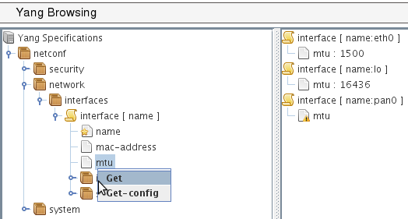
YANG-based client
POST
operation : get
<netconf
xmlns=«urn:loria:madynes:ensuite:yencap:1.0:module:Interfaces:1.0»>
<network>
<interfaces>
<interface>
<name>
<mtu>
</interface>
</interface>
</network>
</netconf>
YencaP Manager
HTTPS
HTTPS
NETCONF
<rpc-reply>
…
<interface>
<name>eth0</name>
<mtu>1500</mtu>
</interface>
<interface>
<name>lo0</name>
<mtu>16436</mtu>
</interface>
...
</rpc-reply>
Tree
jYang
<xml…>
<rpc-query>
<get>
…
</get>
</rpc-query>
NETCONF
YencaP
Notes:
The first view for the manager is the static one where one can browse yang module. If we want to see or edit configuration data there is a contextual mouse menu.
In this example I choose to get the value of the MTU values of all my network interfaces.
With the tree, the applet can produce well formed XML request that is sended by the Http POST service.
The YencaP Manager that receives this request has to build a real Netconf request and forward it to the Netconf client.
The response is processed in the other way that is from an XML netconf response to an Http response that contains the data tree.
Finally, the applet do the matching of data tree to Yang data tree and shows it.

Slide 9
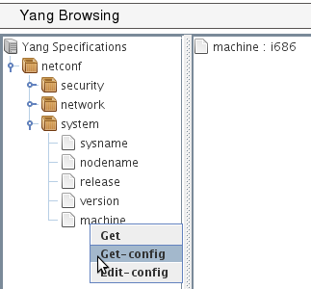
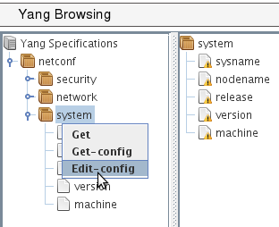
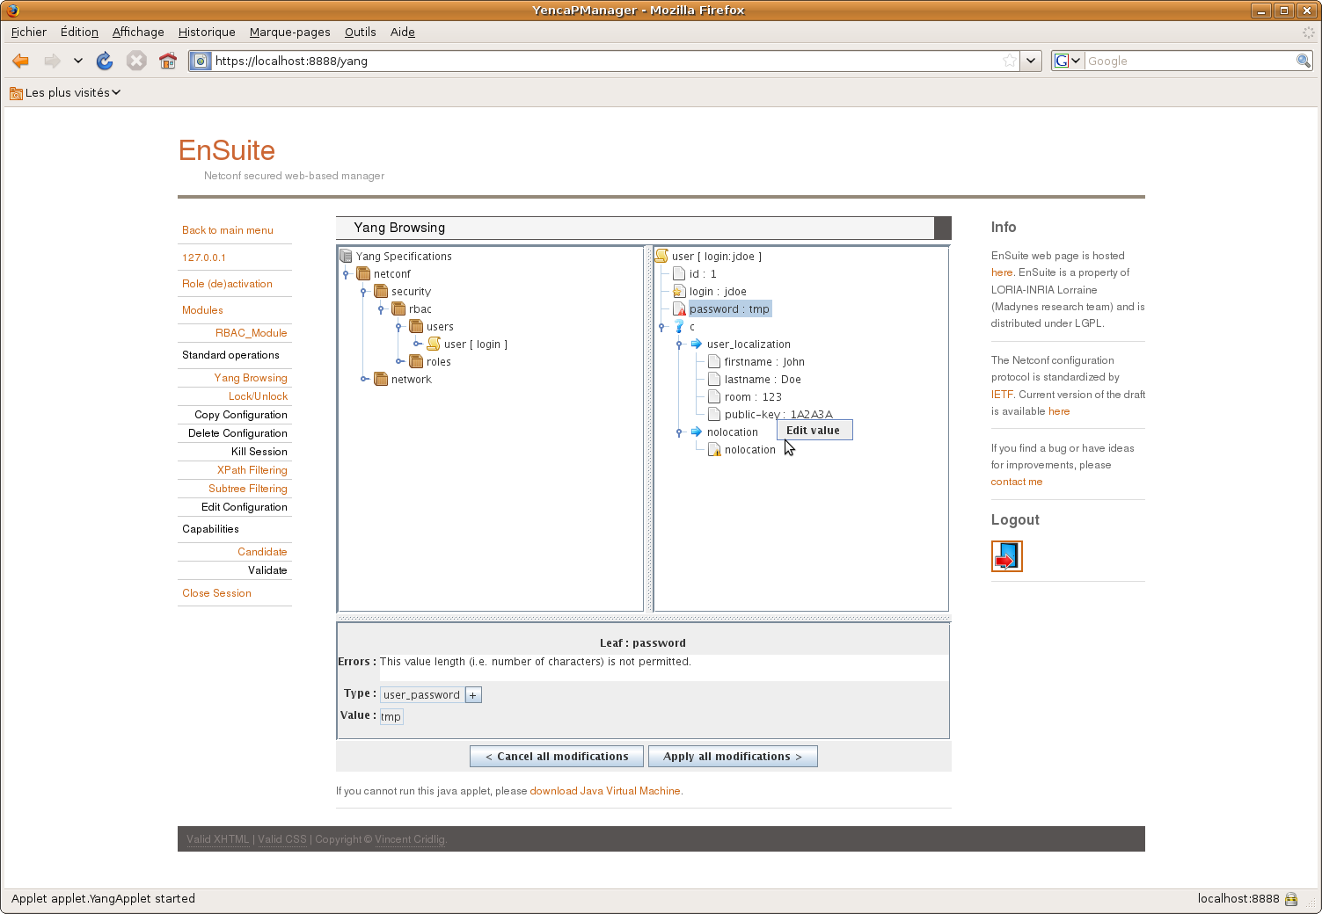
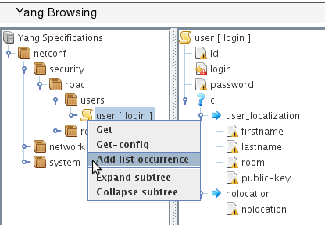
a)
b)
c)
d)
Notes:
The figure 9 depicts some functionalities of the applet related to NETCONF get and edit config operations.
Part (a) is a simple access to a leaf in a container and where we get the response of a get-config operation.
Part (b) is an edit-config for a container. When editing a container, its components are listed with a warning until a correct value is given. The applet shows warning messages and have editing functionalities (as in part d) to set values on edited data.
Part (c) is an edit-config for a list. Here a list is edited entry by entry (that we call a list occurrence) and one can see an empty list entry ready to be filled. Note that a red mark is on the “login” leaf because it is the key of the list and so its value must be set.
Part (d) illustrates the choice representation and its edition. A choice case (“user-localization” or “nolocation”) can only be edited if all of its components are set. On the same part the leaf called “password” is read marked because the value is not long enough. This is an example of dynamic constraint one can check with the tool. Range values of integer or float, pattern matching of string are also checked.

Slide 10
Conclusions and future works
jYang: a YANG parser
ENSUITE framework : YANG enable
YencaP : server announces
YencaP Manager : YANG view applet
YencaP : agent builder
YANG constraints
YencaP : configuration self checking
YencaP Manager : user input control
Distributed Data Tree
Notes:
We provide two contributions to the network configuration domain. The first one is a YANG parser and semantic checker close to the actual version of the draft definition of YANG.
The second contribution is the support within the ENSUITE framework of YANG based models both on the server and the client side.
We plan to extend YencaP to be able to generate parts of its code from YANG data model, to ensure the server maintains a valid Data Store compliant with YANG.
The server has to be able to send notifications especially those defined in YANG and must also accept user defined operations as there are YANG rpc and notification statements to do this.
We are also interested by all YANG constraints one can specify. Default value, must and presence conditions, references between values, length or pattern matching are some examples of such constraints. If one can have a NETCONF server with such knowledge this server will be enabled to autonomously checks its configuration.
At the client side the constraints can ensure the manager does not make mistakes in its configuration operations and can notify users if constraints are not respected.
Up to now a Yang schema tree contains configuration of one device and we are interested to have a top Yang schema tree on several devices and so be able to specify configuration constraints among theses devices

Slide 11
<simpleType name="contextIDType">
<restriction base="string"></restriction>
</simpleType>
<simpleType name="definitionIDType">
<restriction base="string"></restriction>
</simpleType>
<simpleType name="vetoIDType">
<restriction base="string"></restriction>
</simpleType>
<complexType name="contextBlocComplexType">
<sequence>
<element minOccurs="0" maxOccurs="unbounded" name="target">
<complexType>
<sequence>
<element name="uri">
<complexType>
<sequence>
<element minOccurs="0" name="proto">
<simpleType>
<restriction base="string">
<enumeration value="tcp">
</enumeration>
<enumeration value="udp">
</enumeration>
<enumeration value="sip">
</enumeration>
</restriction>
</simpleType>
</element>
<element name="address" type="string">
</element>
<element minOccurs="0" name="port">
<simpleType>
<restriction base="int">
<minInclusive value="0">
</minInclusive>
<maxInclusive value="65535">
</maxInclusive>
</restriction>
</simpleType>
</element>
</sequence>
</complexType>
</element>
<element minOccurs="0" name="date" type="date">
</element>
<element minOccurs="0" name="version" type="string">
</element>
</sequence>
</complexType>
</element>
<element minOccurs="0" maxOccurs="unbounded" name="include" type="tns:contextIDType">
</element>
<element minOccurs="0" name="locality">
<simpleType>
<restriction base="string">
<enumeration value="very low"></enumeration>
<enumeration value="low"></enumeration>
<enumeration value="medium"></enumeration>
<enumeration value="high"></enumeration>
<enumeration value="very high"></enumeration>
</restriction>
</simpleType>
</element>
<element minOccurs="0" maxOccurs="unbounded" name="resource">
<complexType>
<sequence>
<element maxOccurs="unbounded" name="value" type="string">
</element>
</sequence>
<attribute name="name" type="string" use="required"></attribute>
</complexType>
</element>
</sequence>
<attribute name="id" type="tns:contextIDType" use="required"></attribute>
</complexType>

Slide 12
list context {
description "A list of veto context blocs";
key id;
leaf id { type vetoIdType; }
list target {
key uri/address;
container uri {
leaf proto { type vtProto; }
leaf address {
type string;
mandatory true;
}
leaf port { type vtPort; }
}
leaf date { type string; }
leaf version { type string; }
}
leaf-list include { type contextIdType; }
leaf locality { type vtLocality; }
list resource {
key name;
leaf name { type string; }
leaf-list value {
type string;
min-element 1;
}
}
}
typedef contextIdType { type string;}
typedef definitionIDType { type string;}
typedef vetoIdType { type string;}
typedef vtProto {
type string {
pattern "tcp|udp|sip";
}
}
typedef vtLocality {
type string {
pattern "very low|low|medium|high|very high";
}
}

Slide 13
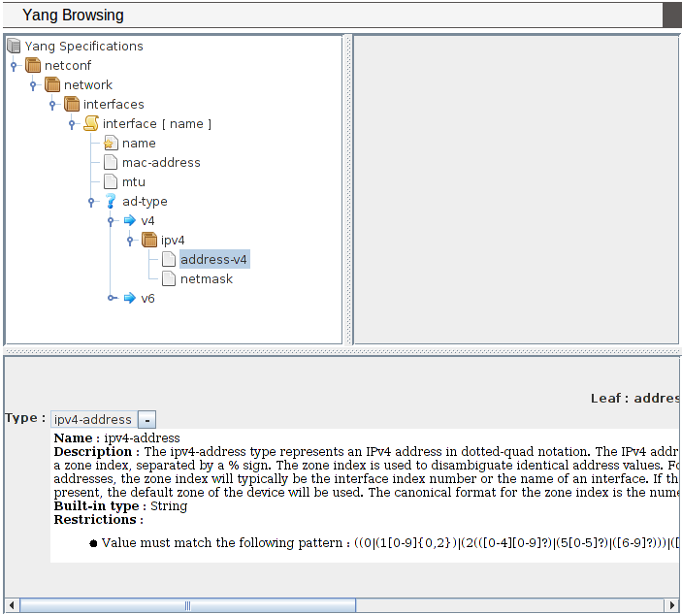
Browsing YANG Specifications
Notes:
The figure 7 shows the applet part of the web interface displayed when a user is connected for the configuration of a device. This first view can be used as a YANG specification browser looking like a file system browser (we use the swing Jtree interface). The tree view matches well with YANG because it defines a schema tree. Specific icons are used to distinct container, list, key or leaf nodes.
When selecting a node, the lower part of the applet shows details of its YANG specification, as the type of a leaf and constraints such default value or range intervals. A leaf type is always at least of a built-in types (as string, int8,…) and can be refined by other types with added constraints or to use an existing useful type (as a mac-address). This is the meaning of the “-” (or “+”) behind the name type. When “+” is set (by one mouse click on the “-”) then the built-in type is displayed.
This same applet is used in the following figures for sending request to the NETCONF device and receiving response. The matching of XML data with the YANG tree node is made at each response by the same applet.

Slide 14
