Slide 1
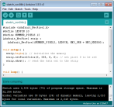
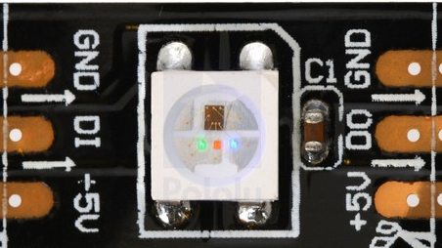
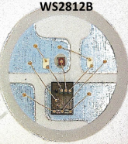
Welcome to the moving rainbow labs. We will learn the basics of programming by learning to turn each of these LEDs on in different patterns. To use these labs connect the USB of the Moving Rainbow kit to your computer and load the labs into the Arduino development system.
usb
Arduino
The Moving Rainbow Kit is based on a strip of 12 "addressable" Red, Green and Blue (RGB) Light Emitting Diodes (LEDs).
Close up of the WS2811B
data in
data out
shift register
green, red and blue LEDs in a segment of the strip.
data out pin
Arduino
We will use a software library provided by Adafruit called the "NeoPixel" library to turn lights on and off. Our LED strip has 12 pixels. However we start numbering at "0" to show how computer science people are usually off by one digit when they access memory locations.
Logical Number
1
2
3
4
5
6
7
8
9
10
11
12
0
1
2
3
4
5
6
7
8
9
10
11
(Illogical) Memory Address Offset
The first pixel is called "0", the second is called "1" etc.

Slide 2
Lab1: set a pixel
Goal: set the color of the first pixel to be red, then green, then blue. We will use the following function:
strip.setPixelColor(pixel-address, red, green-value, blue-value);
Where the color values are 0 for off and 255 for very bright.
#include <Adafruit_NeoPixel.h>
#define LEDPIN 10 // connect the Data from the strip to this pin on the Arduino
#define NUMBER_PIEXELS 12 // the number of pixels in your LED strip
Adafruit_NeoPixel strip = Adafruit_NeoPixel(NUMBER_PIEXELS, LEDPIN, NEO_GRB + NEO_KHZ800);
void setup() {
strip.begin(); // initialize all the variables
strip.show(); // Initialize all pixels in the strip to be off
}
void loop() {
strip.setPixelColor(0, 255, 0, 0); // set pixel 0 to be red
strip.show();
delay(1000);
strip.setPixelColor(0, 255, 0, 0); // set pixel 0 to be green
strip.show();
delay(1000);
strip.setPixelColor(0, 255, 0, 0); // set pixel 0 to be blue
strip.show();
delay(1000);
strip.begin(); // initialize all the variables
strip.show(); // Initialize all pixels in the strip to be off
delay(1000);
}
Explore – change the function delay(1000) to be shorter or longer.
Question: What if you change the address from "0" to be "1".
Can you make pixel 1 red, pixel 2 green and pixel 3 blue?

Slide 3
Lab 2: set each pixel
Goal: set the color of each of the pixels to a color you choose
#include <Adafruit_NeoPixel.h>
#define LEDPIN 10 // connect the Data from the strip to this pin on the Arduino
#define NUMBER_PIEXELS 12 // the number of pixels in your LED strip
Adafruit_NeoPixel strip = Adafruit_NeoPixel(NUMBER_PIEXELS, LEDPIN, NEO_GRB + NEO_KHZ800);
void setup() {
strip.begin(); // initialize all the variables
strip.show(); // Initialize all pixels in the strip to be off
}
void loop() {
strip.setPixelColor(0, 255, 0, 0); // set pixel 0 to be red
strip.setPixelColor(1, 0, 255, 0); // set pixel 0 to be green
strip.setPixelColor(2, 0, 0, 255); // set pixel 0 to be blue
strip.begin(); // initialize all the variables
strip.show(); // Initialize all pixels in the strip to be off
delay(1000);
}
Explore – change the function delay(1000) to be shorter or longer.
Question: What if you change the address from "0" to be "1".
Can you make pixel 1 red, pixel 2 green and pixel 3 blue?

Slide 4
Lab1: set a pixel
Goal: set the color of the first pixel to be red, then green, then blue. We will use the following function:
strip.setPixelColor(pixel-address, red, green-value, blue-value);
Where the color values are 0 for off and 255 for very bright.
#include <Adafruit_NeoPixel.h>
#define LEDPIN 10 // connect the Data from the strip to this pin on the Arduino
#define NUMBER_PIEXELS 12 // the number of pixels in your LED strip
Adafruit_NeoPixel strip = Adafruit_NeoPixel(NUMBER_PIEXELS, LEDPIN, NEO_GRB + NEO_KHZ800);
void setup() {
strip.begin(); // initialize all the variables
strip.show(); // Initialize all pixels in the strip to be off
}
void loop() {
strip.setPixelColor(0, 255, 0, 0); // set pixel 0 to be red
strip.show();
delay(1000);
strip.setPixelColor(0, 0, 255, 0); // set pixel 0 to be green
strip.show();
delay(1000);
strip.setPixelColor(0, 0, 0, 255); // set pixel 0 to be blue
strip.show();
delay(1000);
}
Explore – change the function delay(1000) to be shorter or longer.
Question: What if you change the address from "0" to be "1".
Can you make pixel 1 red, pixel 2 green and pixel 3 blue?

