Slide 1

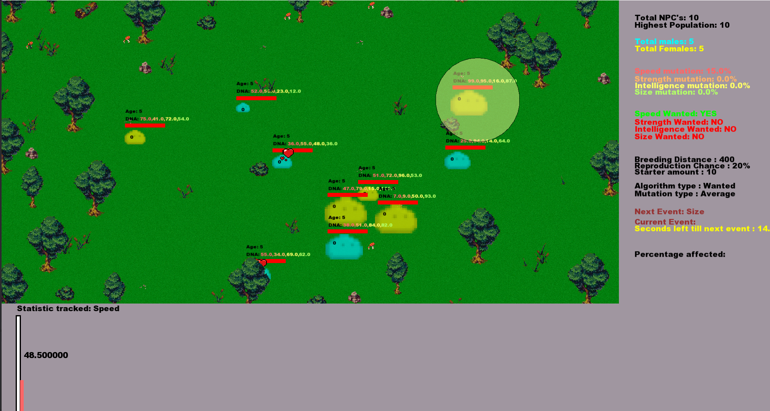
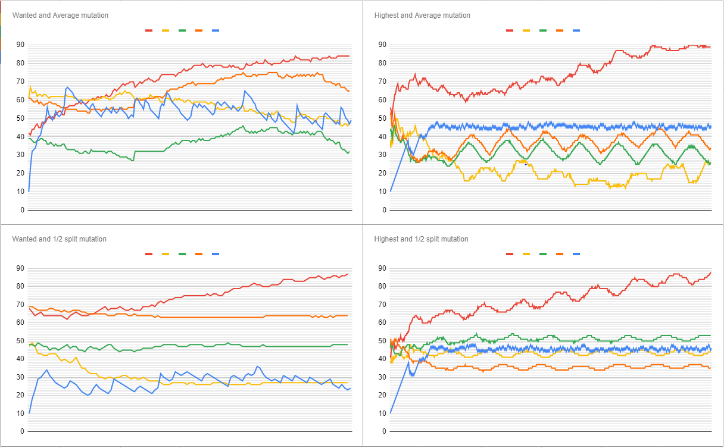
Multi-Object Genetic Algorithm to create a growing Population using Generation Cycles
Aaron O’Dea
Introduction
Methods
Results
Conclusions
The goal of my project to evaluate the use of a genetic algorithm which focuses on trying to realistically breed a population of NPC’s to
reach an overarching goal for the population.
To achieve this goal I created a Genetic algorithm which takes multiple Different variables such as age, sex, distance and wanted stats as well as others these variables contribute to the reproduction chances of the NPC.
I also created a genetic algorithm which focuses on the optimal NPC for the overarching goal
Also so compared these Algorithms with two different ways of mutating the genome of the NPC,s
“½ split mutation” and “Average mutation” found through research.
The models are implemented in C++ and SFM
The environment I made for the NPC’s was an enclosed area which they are able to freely wander around. Commonly found in multi-object simulations.
I used this environment to maintain control of the movement of the NPC’s
I also used multiple Algorithms and mutation types.
Traditional Algorithms :
Most optimal.
Traditional Mutations:
½ splits mutation
Average mutation
my Algorithms :
Most Appropriate
I also allowed the user to be able to change and set multiple environment statistics such as age cap, mutation rates etc.
And the ability to output data.
The following results were obtained:
Most optimal & ½ splits mutation
From the data, the population would average out and the statistics will average out and Fluctuate up and down. The Statistics we wanted to increase steadily grew in the same pattern over a large number of generations.
Most optimal & Average mutation
From the data the population and Statistics would average out and the statistics that we wanted to increase grew steadily over a large number of generations.
Most Appropriate & ½ splits mutation
The total population would fluctuate while the wanted statistic would Quickly grow the other statistics would maintain an average of their original statistics.
Most optimal & ½ splits mutation
The total population would fluctuate while the wanted statistic would Quickly grow in a linear fashion the other statistics would maintain and an average of their original statistics.
In conclusion from the data that I have gather I show a quicker Growth using either of the two different types of genetic algorithm mutation types.
My Algorithm which takes multiple different variables into account when picking another NPC’s to reproduce with.
This growth is specified to a certain statistic of an NPC’s which is predetermined in settings
I determined that for a long term steady growth most optimal and a ½ split mutation is best suited.
While a quick growth in a short amount of time the most Appropriate and average mutation

