Slide 1
Peckham DAZ
Week 2 – 21/01/2025

Slide 2
Coding Basics
Conditional statements
Loops
Functions
Notes:
Fundamental building blocks of coding
Use these constantly
Important things to understand
If you have coded before you will already know these so bear with

Slide 3
Conditional statements

Slide 4
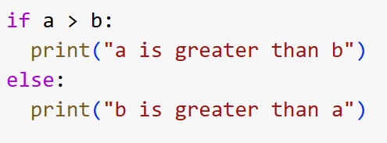
Conditionals – If
Allow us to make decisions about what code is run using variables and/or comparisons

Slide 5
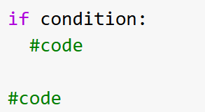
Conditionals – If
If the condition is True, the code within the statement will run
The condition must be a True or False statement, eg:
a is greater than b
It is before 6pm
The user clicked the up-arrow key

Slide 6

Note: Indentation
In python, indentation is VERY important
Other languages, such as Javascript, use brackets to separate statements, eg:
Python just uses indentation, so you have to pay close attention
A Javascript if statement

Slide 7
Note: Indentation
This code is inside the if statement
This code is not

Slide 8
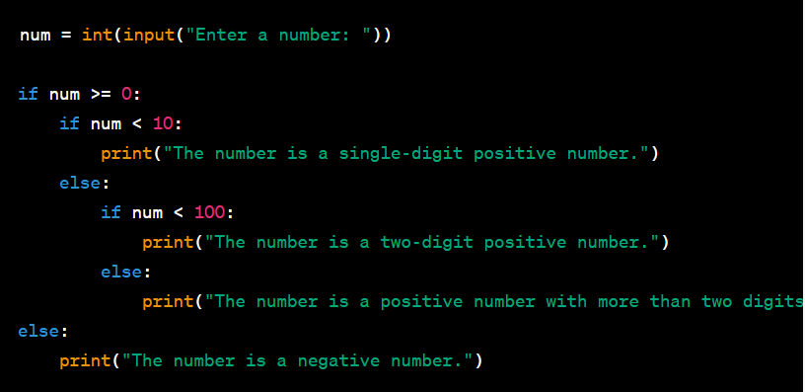
Note: Indentation
It can get complicated!
Notes:
Once you get used to it you will be fine, but make sure you pay attention.
Its something to think about when you are debugging

Slide 9
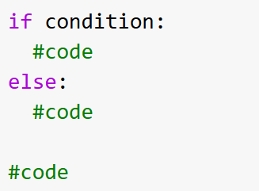
Conditionals – If… else
If the condition is False, the code inside the else will be run
You don’t have to have an else for every if
E.g. the user clicking a button on a webpage
Notes:
If the answer to ‘what do you want to happen if the condition is false’ is ‘nothing’ then you don’t need an else statement

Slide 10
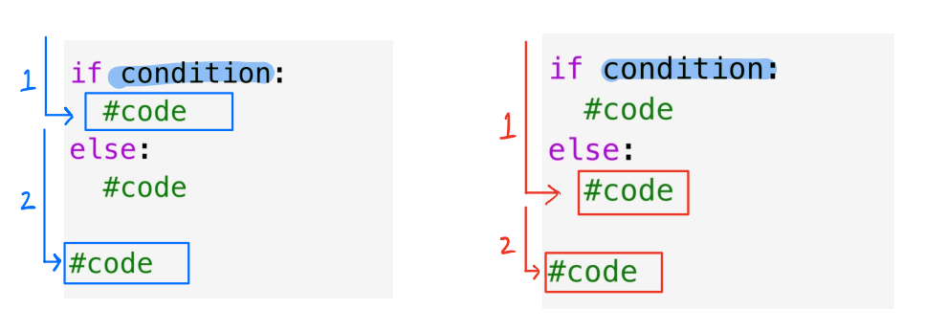
Conditionals – If… else
Condition is True
Condition is False

Slide 11
Conditionals – If… else
However, what if a is equal to b?

Slide 12
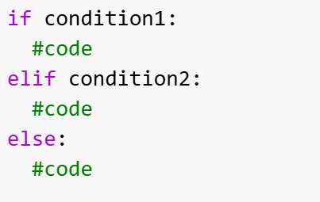
Conditionals – If… elif… else
Comes from the combination of the words ‘else if’
If condition 1 is False, it will then move on to condition 2
Only one block of code within the whole statement can run
Notes:
If condition 1 is true, that will run.
If not then condition 2 will be checked.
If this true it will run, if not the else will run
Once a true statement is found, it will run that then bypass the rest of the statements

Slide 13
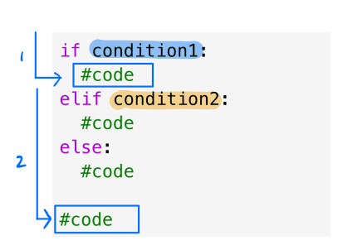
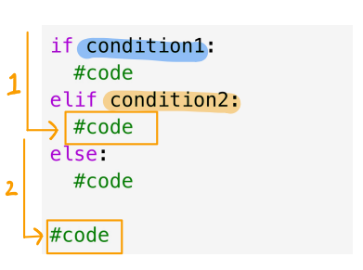
Conditionals – If… elif… else
Condition 1 is False
AND
Condition 2 is True
Condition 1 is True
Notes:
What would happen is both condition 1 and 2 are false?

Slide 14
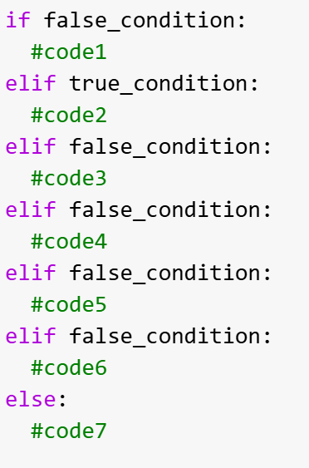
Conditionals – If… elif… else
Which one of these
code blocks will run?
Code 2

Slide 15
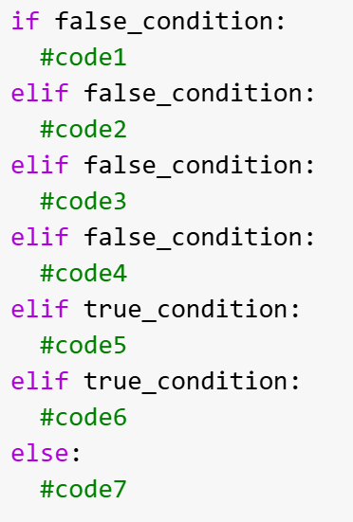
Conditionals – If… elif… else
Which one of these
code blocks will run?
Code 5

Slide 16
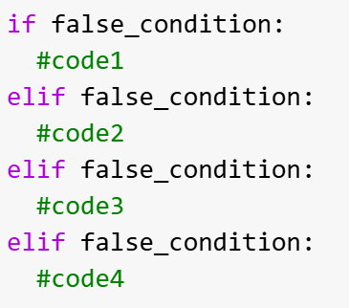
Conditionals – If… elif… else
Which one of these
code blocks will run?
NONE!

Slide 17
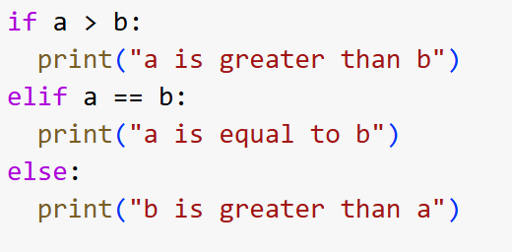


Conditionals – If… elif… else
== is used for comparison
e.g.
= is used for assignment
e.g.

Slide 18
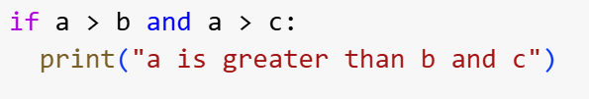
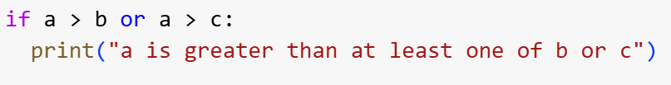

Logical operators
and:
or:
not:
Notes:
Used to combine conditional statements to avoid having to use nested if statements

Slide 19
Loops
While loops
For loops

Slide 20
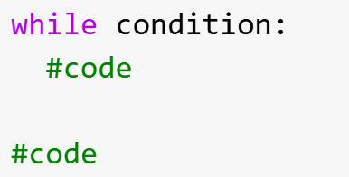
While loops
The code within the loop will run whilst the condition is true
While condition is True
Notes:
Similar to if statements, however where if statements will execute once, while loops will continue until the statement is not true

Slide 21
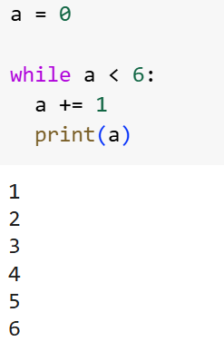

While loops
Equivalent to writing
Notes:
Similar to if statements, however where if statements will execute once, while loops will continue until the statement is not true

Slide 22
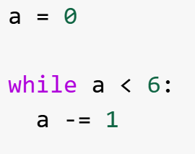
While loops
Beware: it is easy to get stuck in while loops!
This loop will run forever, or until something crashes…
Notes:
If handling large values or data sets, this can easily crash the program/your computer so be careful

Slide 23
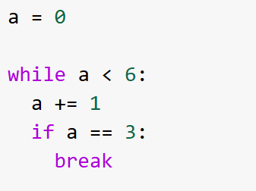
While loops
You can use the break statement to exit a while loop even if the condition is still true
Notes:
Can sometimes be used as a safety mechanism

Slide 24
For loops
Used for iterating over a sequence of objects (list, dictionary, etc)
OR
Running a block of code a specified number of times
Notes:
Runs for a determined number of times
Different to while loops as no conditional

Slide 25
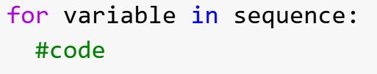
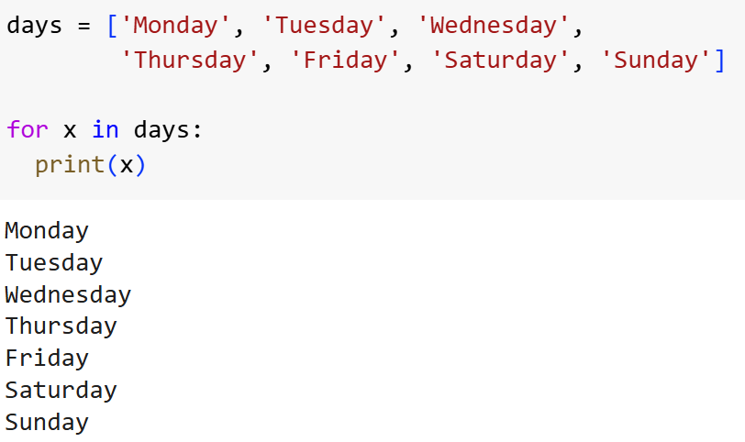
For loops – iterating over a sequence
Running the block of code once for each item in the list
Notes:
The variable used can be anything, it is useful to make it meaningful

Slide 26
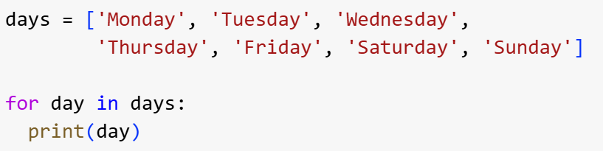
For loops – iterating over a sequence
Running the block of code once for each item in the list
Notes:
This loop seems simple but you can have multiple loops running at the same time or multiple variables so for ease, use a good name

Slide 27
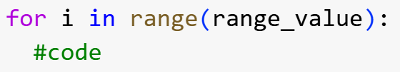

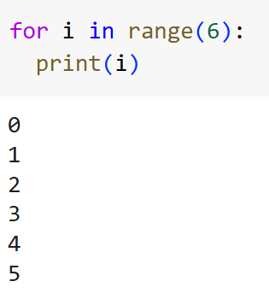
For loops – specified range
Convention to use as the variable name as it will be an integer
To loop through a block of code a specific number of times, we can use the range() function
Notes:
Other way to use for loops

Slide 28
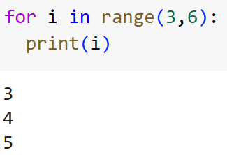
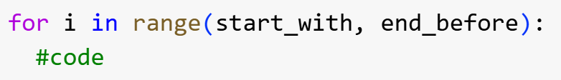
For loops – specified range
As a default, the loop starts at 0 but this can be changed
The loop will START WITH the first number but END BEFORE the last

Slide 29
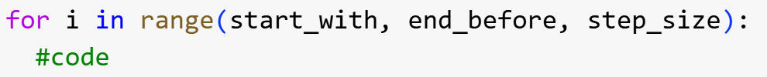
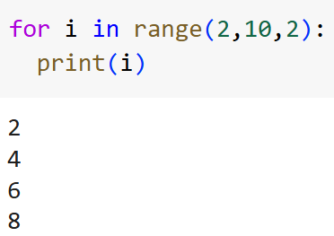
For loops - specified range
You can also specify the step size (default is 1 and it can be negative):
Start at 2
End before 10
Increase by 2 each time

Slide 30
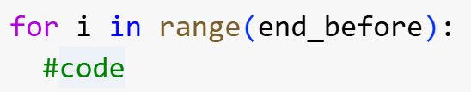
For loops – specified range RECAP
1 argument:
Starts at 0
Step size is 1
2 arguments:
Step size is 1
3 arguments:

Slide 31
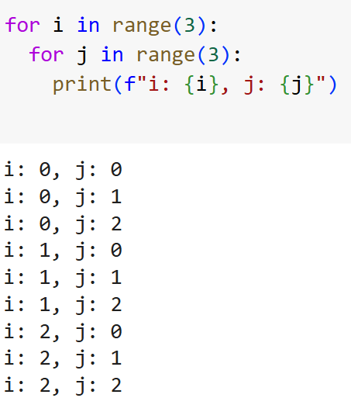
For loops – nested loops
This is a loop within a loop
The inner loop with be run for each iteration of the outer one

Slide 32
For loops - RECAP
1. Used for iterating over a sequence of objects (list, dictionary, etc)
Variable will be an object (e.g. the items in a list)
OR
2. Running a block of code a specified number of times
Variable will be an integer
Uses the range() function
Notes:
Runs for a determined number of times
Different to while loops as no conditional

Slide 33
Functions

Slide 34
Functions
A block of code that will only run when it is called
Makes code more efficient as it reduces repeats
If you have to write a block of code more than once, it should be a function!
Information can be passed into a function
The function can then return information at the end
Notes:
Functions can be as short as a few lines

Slide 35
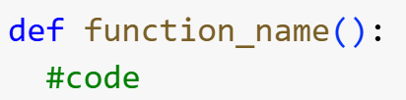

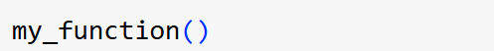
Functions – definition and calling
A function is defined using the def keyword:
It can then be called using the function name followed by brackets:
If a function is not called, it will not run! Just defining a function will not run it, it has to be called.
Notes:
Named using snake case, conventionally
You can create the definition without actually calling the function
Write some instructions then put in your pocket

Slide 36
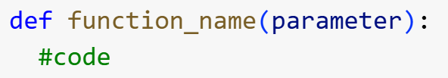

Functions – parameters and arguments
These are used to pass information into the function
A parameter is defined within the brackets after the function name
When the function is called, you specify the value of this parameter, this is called the argument
Notes:
The argument can be called anything (except the name of the function etc) but make it meaningful

Slide 37
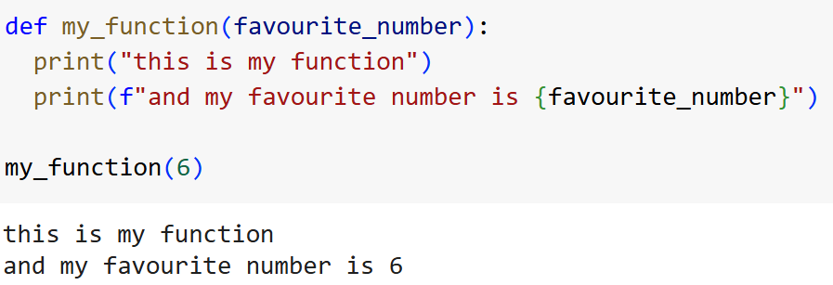
Functions – parameters and arguments
Parameter
Argument
Notes:
Parameter: the variable listed inside the brackets in the function definition
Argument: the value that is sent to the function when it is called
Takes the argument value given and uses it in place of the parameter

Slide 38
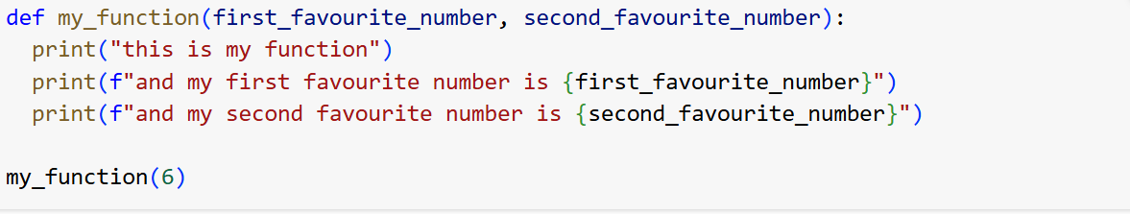
Functions – number of arguments
A function can have multiple parameters, but it MUST be called with the correct number of arguments
Notes:
Parameter: the variable listed inside the brackets in the function definition
Argument: the value that is sent to the function when it is called

Slide 39
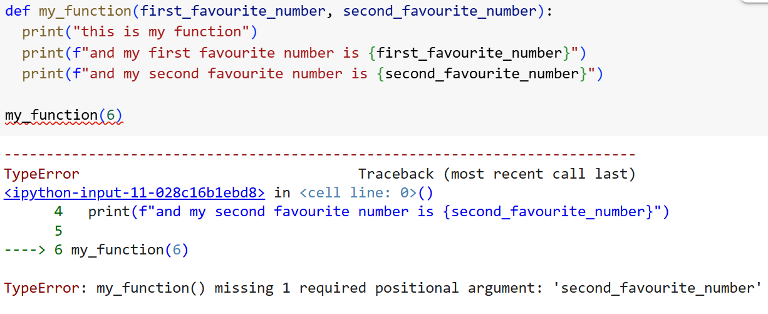
Functions – number of arguments
A function MUST be called with the correct number of arguments
Notes:
Parameter: the variable listed inside the brackets in the function definition
Argument: the value that is sent to the function when it is called

Slide 40
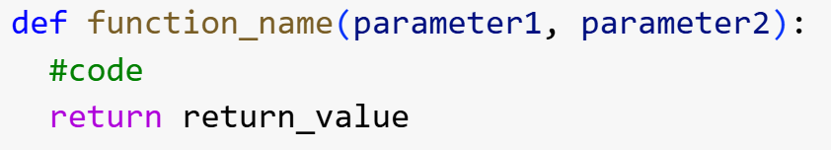
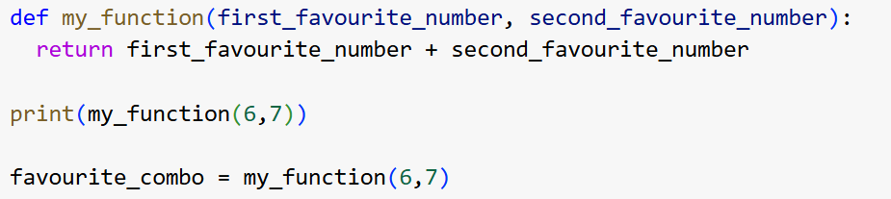
Functions – return values
The function can return information back to you after running using the return keyword
Notes:
You can create the definition without actually calling the function

Slide 41
Libraries, modules, and packages
(some of the following slides were adapted from material credited to James Gibbons-Macgregor)

Slide 42
Modules: Python code libraries you can include in your project
Packages: Contains all the files that you need for a module
From now on we will refer to them as libraries.

Slide 43
Jupyter notebooks
Jupyter notebooks is a web-based interactive computational environment for creating notebook documents
File contains input/output cells which can contain code and be executed individually
Allows you to edit and rerun operations on datasets without having to download, clean, etc every time
File extension .ipynb
Notes:
A regular .py file will all be run together

Slide 44
Libraries
A collection of precompiled code that can be used later in a program for some specific well-defined operations.
It makes programming simpler and more convenient as you don’t need to write the same code again and again for different programs

Slide 45
Useful Python Libraries for Data Science
Numpy
Stands for ‘numerical python
Used for mathematical and numerical calculations from trigonometry and rounding to large matrices and multi-dimensional data
Pandas
Data analysis library
Used for analysis, manipulation, data cleaning, etc
Urllib
URL handling module for python
Used to fetch data from webpages using the URL
Beautiful Soup
Pulls data out of HTML files
Used for easily scraping data from webpages

Slide 46
Pandas
Pandas is a Python library used for working with data sets.
It has functions for analyzing, cleaning, exploring, and manipulating data.
Pandas allows us to analyze big data and make conclusions based on statistical theories.
Pandas can clean messy data sets, and make them readable and relevant.

Slide 47
Web Scraping and Crawling
(some of the following slides are credited to Terence Broad and Rebecca Fiebrink @ UAL CCI)

Slide 48
Web scraping
Web scraping is the process of collecting unstructured and structured data in an automated manner. Then working with that data to find patterns, correlations, trends etc.
Some of the main use cases of web scraping include price monitoring, price intelligence, news monitoring and market research among many others.
In general, it is used by people and businesses who want to make use of publicly available web data to generate valuable insights and make smarter decisions.

Slide 49
Web crawling
Web crawling is the practice of building software that automatically searches for webpages by navigating through hyperlinks — to scrape data from a whole website (or lots of websites)
A web crawler can collect vast amounts of data by exhaustively clicking on every hyperlink on a website
You can set rules for what links to click through and what subdomains you want to retrieve data from

Slide 50
Scraping vs crawling
Web scraping
Identifies and locates specific target data from web pages, we know the exact data set identifier, e.g., an heading, image or table
Web crawling
Used to index the information on the page using bots, also known as crawlers.
The crawler goes through every page and every link, scraping ALL the data from each one
Similar to what search engines do, it’s all about viewing a page as a whole and indexing it.

Slide 51
Technical and ethical issues
Many websites try to stop web crawling by:
Not putting content in HTML, or making the format difficult to parse
Blocking IP address that make lots of requests very quickly
Adding captchas or other interactive elements to prevent software scripts accessing the page
Putting data behind a paywall
Ethical Issues:
It is often against a website or platforms terms of service to scrape all of their data
The dataset may be copyrighted by the website or other party.
The data may contain private or personally identifying information. (especially on social media)
The data may contain offensive or malicious content
The data is full of factually inaccurate content or material

Slide 52
How are websites structured?
A website is structured through a hierarchical organisation, with a homepage followed by various interconnected web-pages
A webpage is the equivalent of a single document
A website has a domain name (e.g wikipedia.org ) and pages all have separate URLs that stem from the domain name (e.g. en.wikipedia.org/wiki/Camberwell)
We can connect web pages together with hyperlinks

Slide 53
How are websites structured?
Web pages are made primarily using three different scripting or markup languages:
HTML: Hypertext Markup Language — Where the content of the web page is stored
CSS: Cascading Stylesheets — Where the instructions on the layout and visual characteristics are stored
JS: Javascript — Code that allows for interactive elements (and other things) on a web page

Slide 54
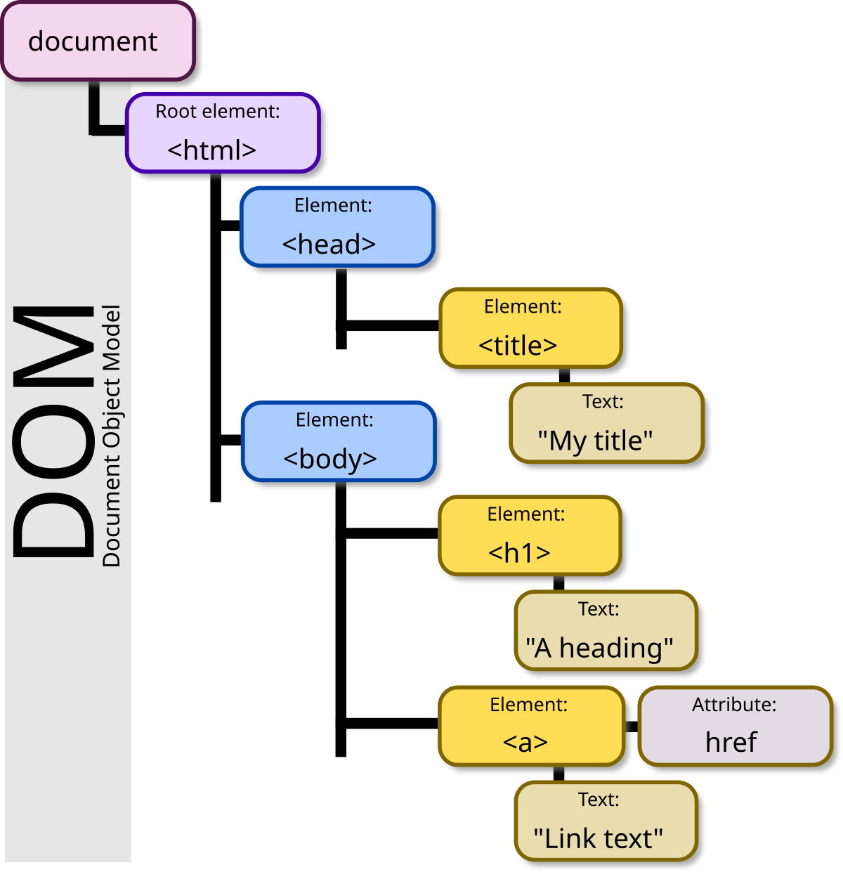
The document object model (DOM)
The DOM is how a web page gets represented by the computer and is built from the content in the HTML (or XML) file
It gives a hierarchy and organisation to how the elements in the web page are structured
Using the DOM specific elements can be manipulated using software scripts
It is always a ‘tree’ structure (a network that only branches)

Slide 55
HTML overview
When we are performing web scraping, we are mostly only interested in parsing HTML – as this is where text dara is usually stored
The HTML defines things like:
Document titles
Headings
Paragraphs
Images
Hyperlinks

Slide 56
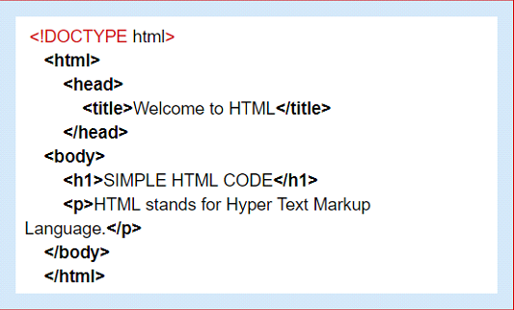
HTML overview
In HTML, elements are enclosed in tags
Opening tag: <tag>
Closing tag: </tag>
We can then put the context between the tags

Slide 57
Parsing
Parsing is taking a set of data and extracting the meaningful information from it
With HTML parsing, you’re looking to read some HTML and return with a structured set of tags and text

Slide 58
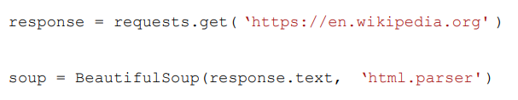
Parsing HTML with Beautiful Soup
Luckily, we don’t have to parse HTML ourselves, the Python library beautifulsoup can do it for us!
We just need to run:
And we get a Python object that we can search and extract information from.

Slide 59

How to find the content you want to scrape
We can use tags to search for specific data you want to collect
<p> text
<h> headings
<a> links
<img> images
We can use the beautifulsoup function find_all() to do this

Slide 60
Cleaning and sorting data after scraping
Data collected from web scraping will generally be messy and disorganised
You will normally need to:
Extract and reformat data from HTML into a structured format (.txt, .csv, etc)
Remove data from unwanted pages
Remove junk/bad data, which could be:
Empty cells
Data in the wrong format
Incorrect data
Duplicates

Slide 61
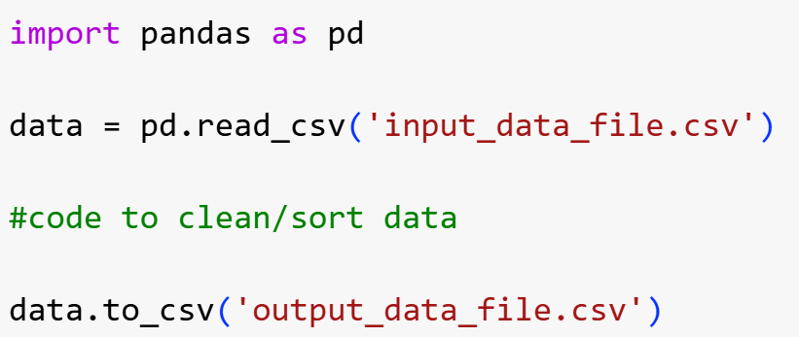
Reading and saving a .csv file with Pandas
A simple way to store big data sets is to use .csv (comma-separated values) files
Pandas .read_csv() function reads the .csv file and puts the data in a pandas DataFrame object which we can then
After cleaning/sorting etc, this can then be saved as a new .csv file using the .to_csv() function

