Slide 1
Waterscope
Aaron, Katie, Monica, Sajan and Nathan

Slide 2
Overview and Context - Aaron
Waterscope - History and Aims
Founded in 2015
Combat lack of safe water access
Design of a simple, fast, water testing kit
The Problem - a new filtration system
Current method details
Proposed Approaches
Additional force applied in original system
Vacuum method

Slide 3
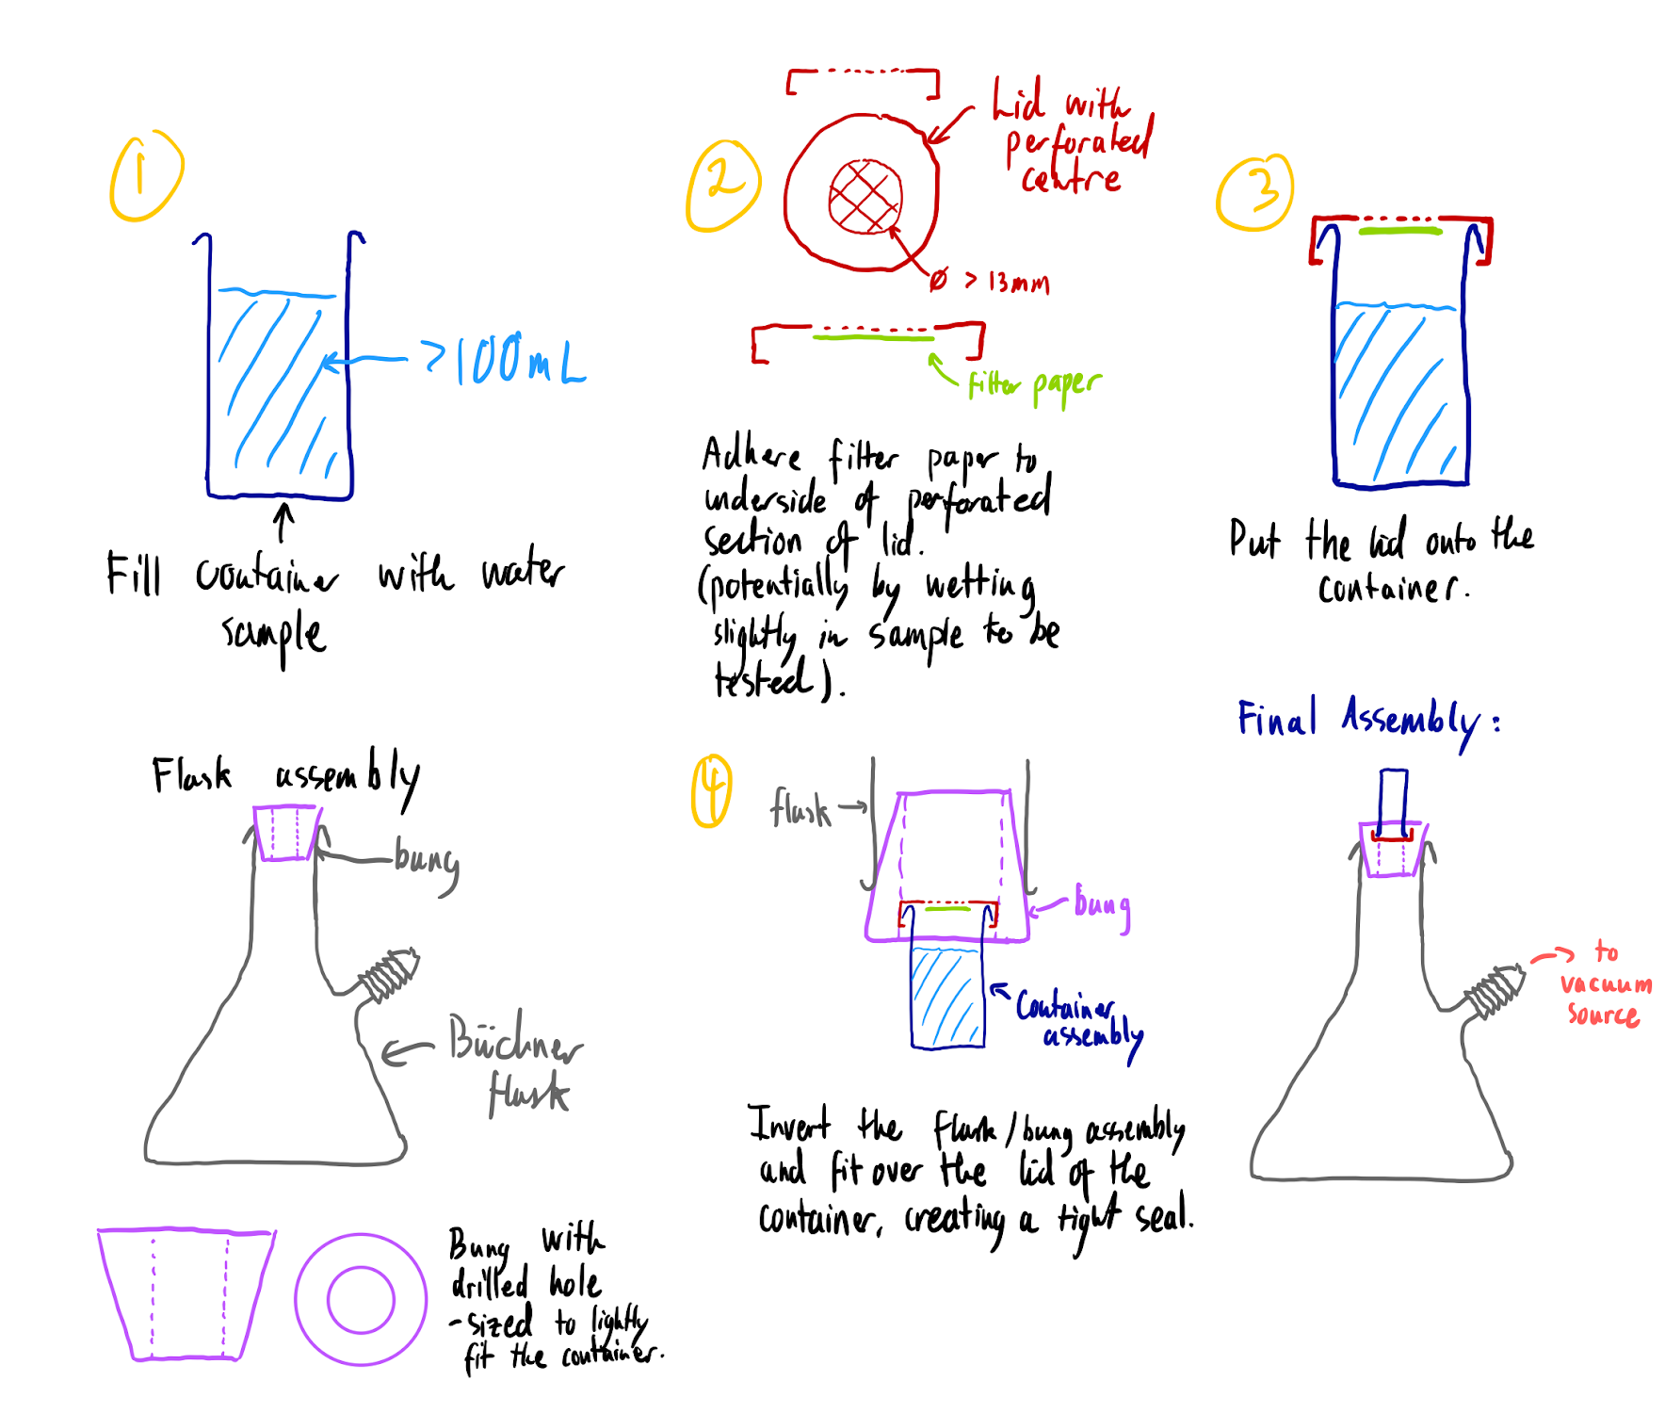
Technical Details
and Models
- Nathan

Slide 4
Project Management Plan - Sajan
Timeline
Gantt Chart
Skills & Training Required
CAD/Modelling
3D Printing
Laser/Plasma Cutting
Web Design
Team Member Strengths & Weaknesses

Slide 5
Costing & Parts - Katie
Supply of certain components from WaterScope
Filters
Pump
Syringes to compare methods
External Ordering
Vacuum Flask
Bungs
Rubber tubing
Funnel

Slide 6
Risk Assessment & Contingency Plan - Monica
Potential Risks
Glass breaking
Tool-related injuries
Potential Project Issues
Sealing problems
Insufficient vacuum generation
Contact problems with WaterScope
Work distribution errors

