Slide 1
Password Manager
CIS293 – Project 1
Peter Fleischhacker, Aaron Pierson, Maren VanDenTop

Slide 2
SCOPE
This program was created to consolidate a user’s password information and assist the user with their new website registrations by integrating a random password generator.

Slide 3
LANGUAGES USED
Python
wxPython
SQLite
Shell
CSV
IDE: Visual Studio Code, wx(Whatever the name was)

Slide 4
ABOUT THE LANGUAGES
Python:
Ranked #2 programming language (RedMonk, 2020), known for its readability and comprehensive library. No compilation step, so the edit-test-debug cycle is efficient and errors don’t crash the program (python.org).
wxPython
A cross-platform GUI toolkit for Python, helped us create the dialog windows for our program and maximize UX.
Shell script
We had to learn the language for our Command Prompt / Power Shell / Terminal scripting in order to successfully export our program as an independent application.

Slide 5
ABOUT THE LANGUAGES
SQLite
A serverless, self-contained SQL database engine, it is one of the most widely deployed database engines and is compatible with many programming languages.
CSV
We used CSV to export the ListCtrl information to a spreadsheet so that the user

Slide 6
CORE FUNCTIONS
Load or create SQLite database
Display All passwords
Search passwords
Insert, Update, and Delete passwords
Generate random password
2 upper case, 2 lower case, 2 digits, 2 special characters – shuffled.
Export to CSV / Excel

Slide 7
HURDLES
Different operating systems
Peter and Aaron on PC, Maren on Mac
Different work schedules
Creating and running the program with wx
Getting the wx.ListCtrl to read and write to a database
SQLite >> TXT >> CSV >> SQLite

Slide 8
CODE

Slide 9
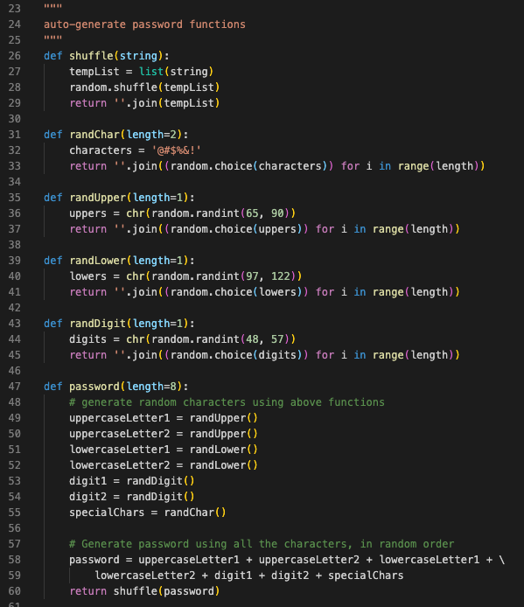

Program Outline

Slide 10
Random Password Generator

Slide 11
Database Connection

Slide 12
Insert

Slide 13
Update

Slide 14
Delete

Slide 15
Export

