Slide 1
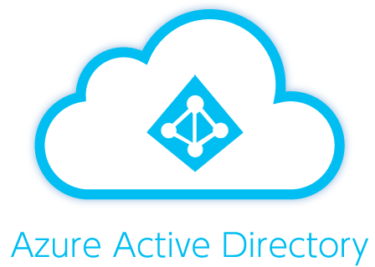



Host
Get: User’s Access Token
postMessage({
signature: "queryExplorer",
type: "getToken",
scope: <scopes[0] ?? “query”>,
}
postMessage({
message: “[JWTToken]",
type: “postToken",
scope: event.data.scope,
}
Azure Data Explorer Embed iframe
Auth Provider
getToken()
getToken(‘https://rtd-metadata.
azurewebsites.net
/user_impersonation’)
getToken(‘People.Read’,
‘User.ReadBasic.All’,
‘Group.Read.All’)
ADX
Client
Dashboard
Client
Graph
Client
Dashboard Service
Azure Data Explorer
Cluster

