Slide 1

Jenkins
Aaron Shaneen
Nathan Romriell

Slide 2
The World before Continuous Integration
Developers had to wait until software was completely developed before testing
There was a high possibility that the test results might show multiple bugs
Missing continuous feedback pertaining to things like coding, build failures, and test status
The whole process was manual which increased the risk of introducing more mistakes

Slide 3
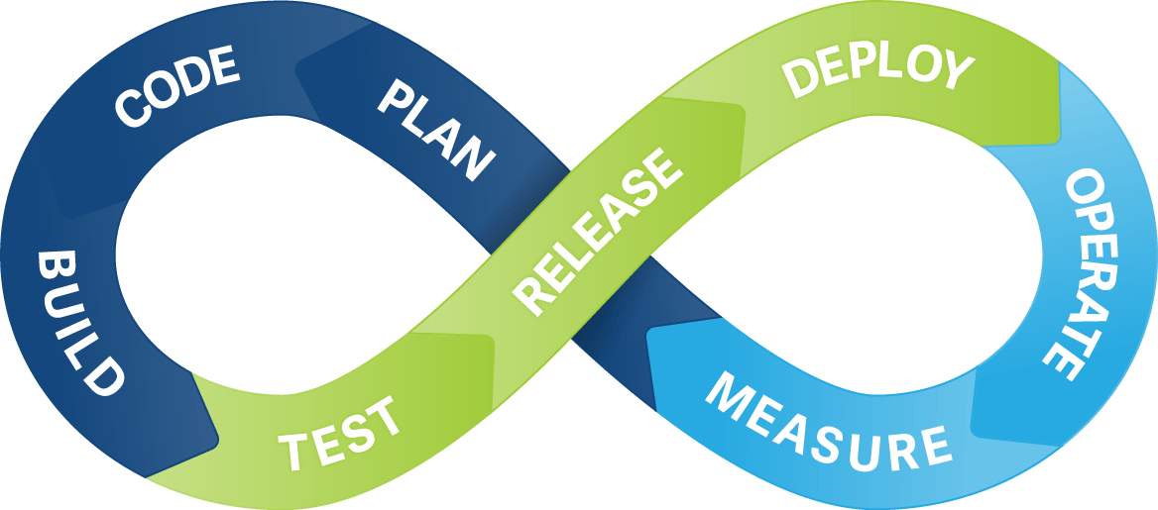
Continuous Integration and Delivery
A method of software development for a group environment
Automates an entire section of the software cycle to streamline development
Allows you to integrate multiple changes to a project at a time
Accommodates the ability to constantly push fresh builds to production

Slide 4
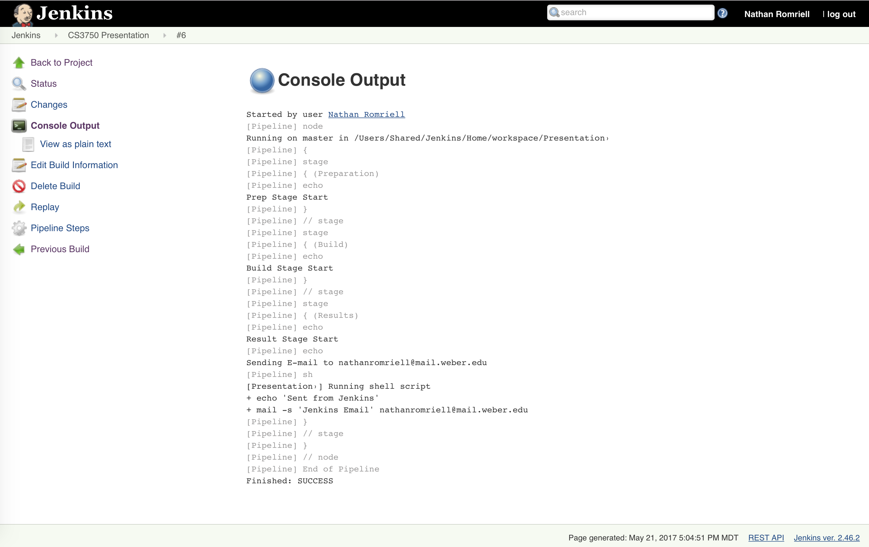
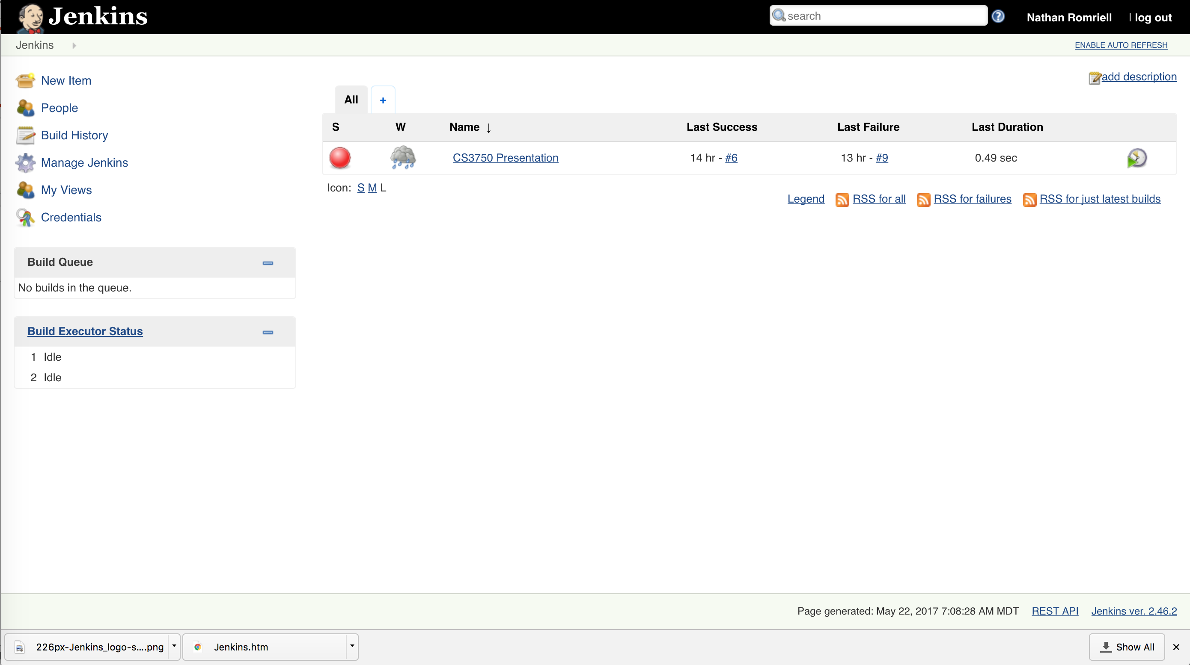
What is Jenkins?
Jenkins is an open source automation tool written in Java with plugins built for continuous integration and delivery
Jenkins is essentially a middle man between a code repository and production server
Jenkins runs a server that provides a web interface to create continuous pipelines for builds and deliveries
Notes:
Jenkins provides a server platform that you can use to build and run continuous delivery pipelines. It uses a GUI based web interface that runs on the server where you can manage and view project pipelines and console output.

Slide 5
How to Jenkins
A developer commits the code to the source code repository
The Jenkins server checks the repository at regular intervals for changes
The Jenkins server detects the changes that have occurred in the source code repository
Jenkins will pull those changes and will start preparing a new build
If the build fails, then developers will be notified
If the build is successful, then Jenkins deploys the build to the test server
After testing, Jenkins generates feedback and then notifies the developers about the build and test results
It will continue to check the source code repository for changes made in the source code and the whole process keeps on repeating

Slide 6
Benefits
Open Source/Free
Very easy installation and setup
Many plugins to support a number of tools
Auto runs tests and confirms valid builds – makes development and delivery faster and easier
Very flexible - allows you to use scripts to setup your continuous delivery environment
Written in Java so accessible to all major platforms
Notes:
Jenkins is open source with a large supporting community that provide a number of plugins to extend the functionality. The GUI based interface makes it easy to set up projects and pipelines. It has native support for a number of scripting languages and using the server’s shell or console it can provide even more functionality. Jenkins provides you with a free way to auto run builds, tests, and other scripts.

