Slide 1
Mancala
Game rules, requirements and features

Slide 2
The game is played on a board of two rows, each consisting of six round pits. The rows have a large store at either end.
A player owns the six pits closest to him and the store on his right side.
Beginners may start with 4 seeds in each pit.
Play is counterclockwise. The seeds are distributed one by one in the pits and the players own store, but not into the opponent's store.
If the last seed is dropped into an opponent's pit or a non-empty pit of the player, the move ends without anything being captured.
If the last seed falls into the player's store, he must move again.
If the last seed is put into an empty pit owned by the player, he captures all contents of the opposite pit together with the capturing piece and puts them in his store. If the opposite pit is empty, nothing is captured. A capture ends the move.
The game ends when one player no longer has any seeds in any of his holes. The remaining pieces are captured by his adversary. The player who has captured most pieces is declared the winner.

Slide 3
This game is for two human players. (No computer player is considered in this project. Two players will take a turn to play this game.)
Initially, the program displays a board with four stones in each pit. A player selects a pit by clicking the mouse on the pit.
Then, the program updates the board according to the game rule explained above.
Diagram 1 show’s how the board will initially be set up before the game starts. Diagram 2 shows how the game board will look after player one move’s his stones from the second pit to the right counter clockwise around the board.
(1)
4 4 4 4 4 4
0 a b c d e f 0
4 4 4 4 4 4
(2)
4 4 4 4 5 5
0 a b c d e f 1
4 4 4 4 0 5

Slide 4
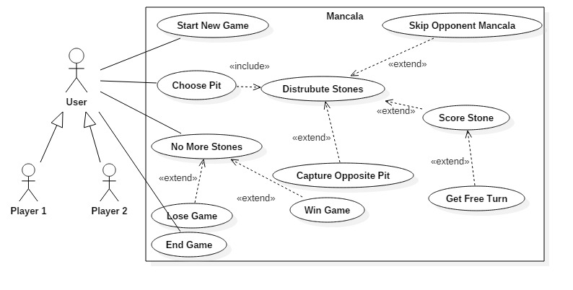
Use case diagram

Slide 5
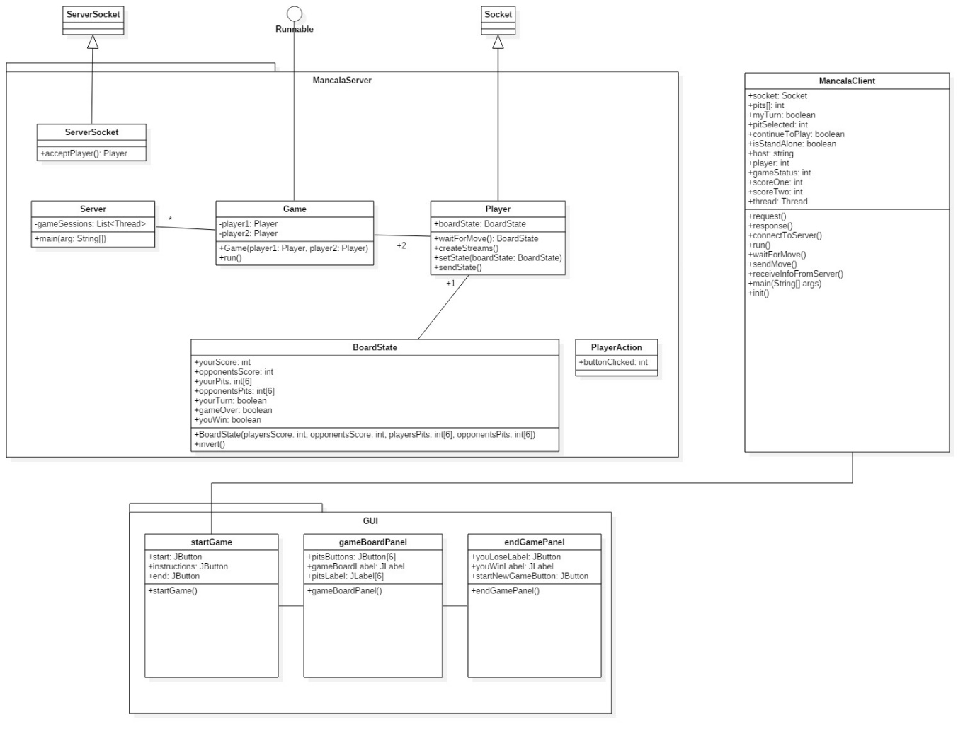
UML Diagram

