Slide 1
Digital Signature
Group member : Fulong Wang
Xincan Wang
Yicong Wang

Slide 2




Digital Signature
Digital signatures are like electronic “fingerprints.” In the form of a coded message, the digital signature securely associates a signer with a document in a recorded transaction.
Bob’s public key
Bob
Bob’s private key
Tom
Bob’s public key

Slide 3
“Hey Tom, how about lunch at Taco Bell “
Bob’s
information
HtlAkvhksdnHIKdHiuegfbi/udaighiunhciuf/A
sign
Bob
Signed
information
Bob’s
Private key
HtlAkvhksdnHIKdHiuegfbi/udaighiunhciuf/A
Signed
information
verify
“Hey Tom, how about lunch at Taco Bell “
Bob’s
information
Tom
Bob’s
Public key

Slide 4
Digital Signature Algorithm (DSA)
The Digital Signature Algorithm (DSA) is a Federal Information Processing Standard for digital signatures.
Key generation has two phases.
The first phase is a choice of algorithm parameters which may be shared between different users of the system, while the second phase computes public and private keys for a single user.

Slide 5
The digital signature included:
1.generate the public key and private key.
2.generate the signature by the Digital Signature Algorithm using the private key.
3.verify the signature using the public key.
Some of the core methods are imported from java.security.

Slide 6
Package java.security
java.security.KeyPair
This class is a simple holder for a key pair (a public key and a private key)
java.security.KeyPairGenerator
The KeyPairGenerator class is used to generate pairs of public and private keys. Key pair generators are constructed using the getInstance method.
getInstance(String alogrithm)
Returns a KeyPairGenerator object that generates public/private key pairs for the specified algorithm.

Slide 7
java.security.Signature
The Signature class is used to provide applications the functionality of a digital signature algorithm.
3 steps to use Signature object for either signing or verifying:
Initialization,with either
a public key, which initializes the signature for verification, or
a private key ,which initializes the signature for signing
Updating: Depending on the type of initialization, this will update the bytes to be signed or verified.
Signing or Verifying a signature on all updated bytes.

Slide 8
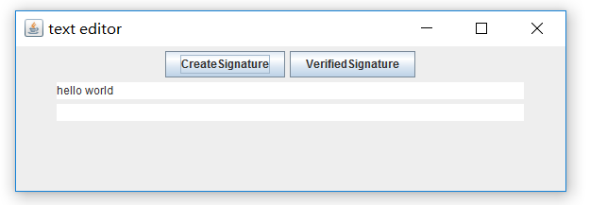

Generate signature

Slide 9
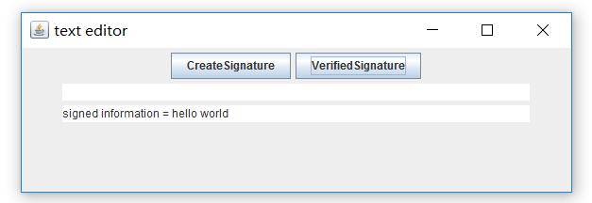

Verify signature

