Slide 1

Drugs Overdose Deaths US
Aaron Tan
Mini-Project 1
#2025-07-08-ds-pt-wa-sg

Slide 2



Agenda
1
2
3
Background
Data Understanding
Recommendations
Objectives
EDA
Summary

Slide 3
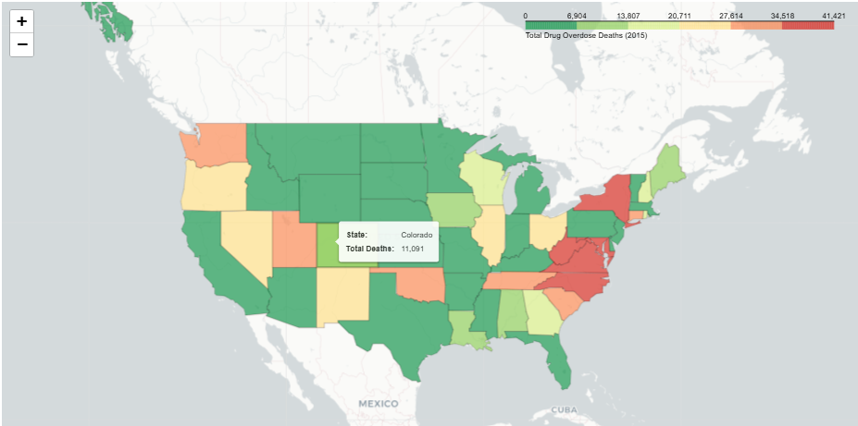
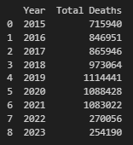
Background
1
2015 Folium map
visualisation to showcase actual deaths
2015-2023 Overdose of Death Drugs:
Simulated dataset to represent the number of deaths due to prohibited drugs.
Reference dataset:
https://www.kaggle.com/datasets/joebeachcapital/drug-overdose-deaths

Slide 4

Objectives
1
Stakeholders:
Public US Health Agencies (e.g., CDC, WHO)
Pharmaceutical Companies: Responsible for safer medication development and transparency.
Addiction & Mental Health Services: Educate the public on prevention and recovery options
Problem Statements:
Why are drug overdoses currently occurring?
How have drug overdose trends evolved over time, and what regions or populations are most affected?
Key Insights Discovery:
Identify which drugs have the highest and lowest impact on overdose deaths.
Analyze regional trends to determine which areas are most affected in each year.
Examine year-over-year changes to detect patterns or spikes in drug usage and deaths.

Slide 5

Objectives
1
Why this problem worth investigating?
Drug Crisis: Drug usage and overdose deaths are at record-high levels in the US.
Coordination Gap: Health organizations and law enforcement show slow collaboration in addressing the issue.
Suicide Link: Rising suicide rates are connected to drug misuse and mental health struggles
Investigation Impact: Research helps create targeted prevention, intervention, and support programs.
Awareness Importance: Educating communities empowers action and stronger policy development.

Slide 6



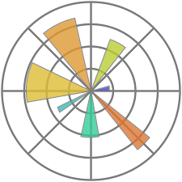





Data Understanding
2
Data and Workflow Overall Tools:
Item | Description | Icon
Data Source | https://www.kaggle.com/datasets/joebeachcapital/drug-overdose-deaths
EDA and packages | Pandas, Folium, Matplotlib
IDLE | Visual Studio Code
Programming Language | Python (Jupyter)
Presentation | PowerPoint
Version Control | GitHub

Slide 7

Data Understanding (Assumptions)
2
There is no column that links between mental health illness, providing correlation between deaths or illnesses are not applicable in this case study.
Dataset is completely arbitrary; no actual data is linked from US Bureau of Statistics, or an official US source.
Purpose of Case Study:
This analysis is not intended to identify behavioral factors linked to deaths.
Its primary goal is to highlight trends and provide insights into which US states report the highest drug-related deaths, categorized by drug type.
Meta AI response assumption 😂
https://www.reddit.com/r/whatsapp/comments/1k5cx04/is_this_concerning_disclaimer_clearly_states_meta/

Slide 8
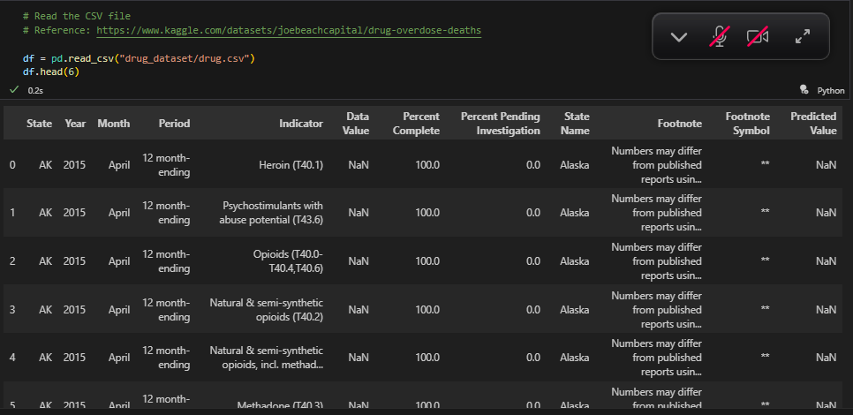
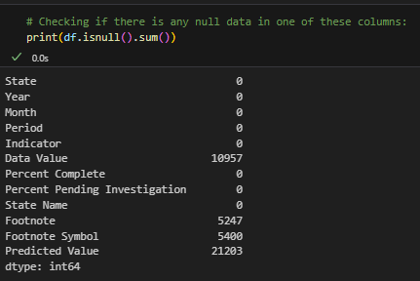
Data Understanding
2
1. Current Dataset:
59,400 rows with 12 columns
3 columns (Data Value, Footnote and Footnote Symbols) contained null values

Slide 9
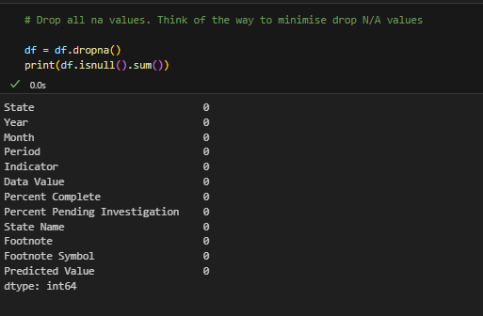

Data Understanding
2
2. Data Cleaning Process:
Drop 5 irrelevant columns (“Period”, “Percent Complete”, “Footnote”, “Footnote Symbol”, “Predicted Deaths”)
Remove N/A values
Sort year to ascending order
Redefine column names

Slide 10
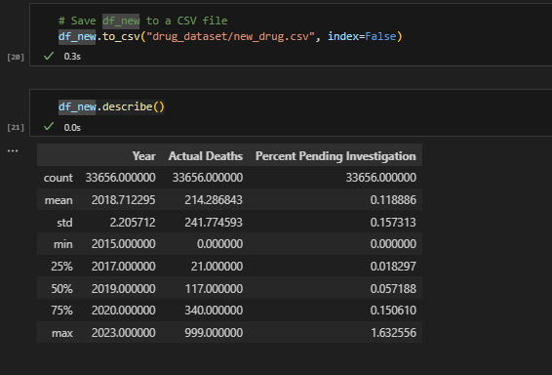
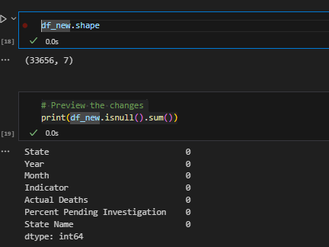
Data Understanding
2
3. New Dataset:
33656 rows and 7 columns
No N/A values
Convert new_csv file and summary statistics.

Slide 11
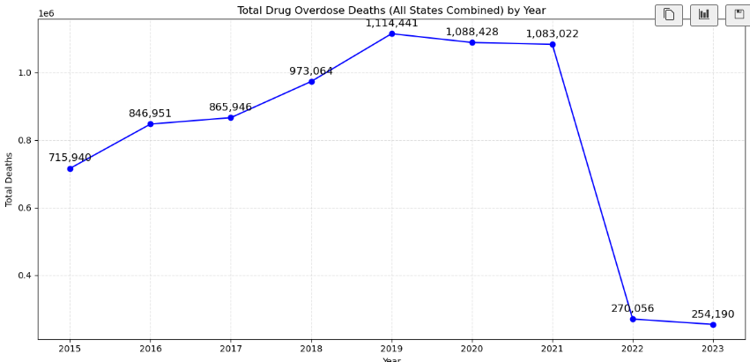
EDA
2
2022 and 2023: missing months causing to an unusual spike decrease. For this purpose, we will not include 2022 and 2023
Drug overdoes deaths for all states and year increases.

Slide 12
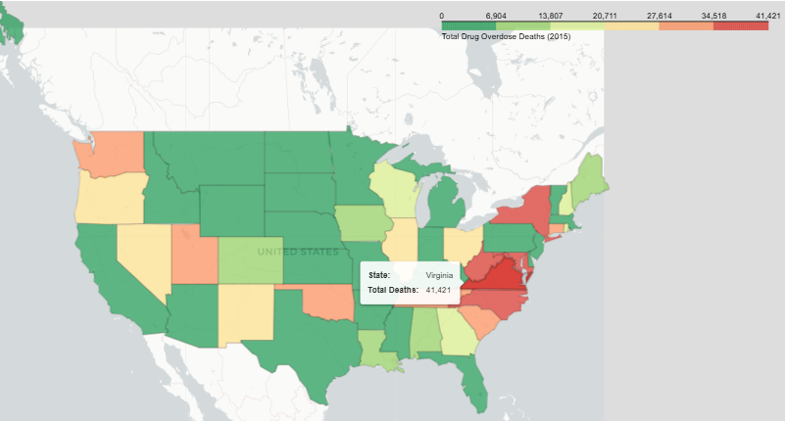
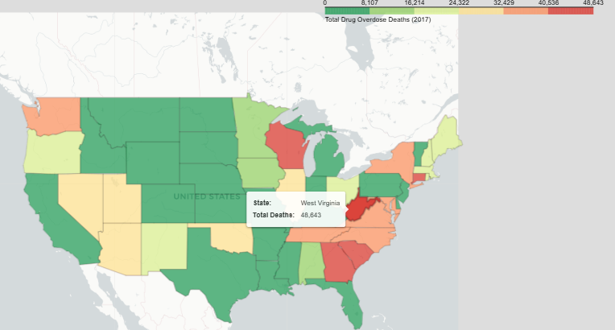
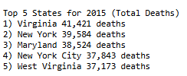

EDA
2
Insight 1: 2015 till 2017 (omitted 2016) Total Drug Deaths
2015
2017

Slide 13
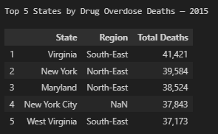
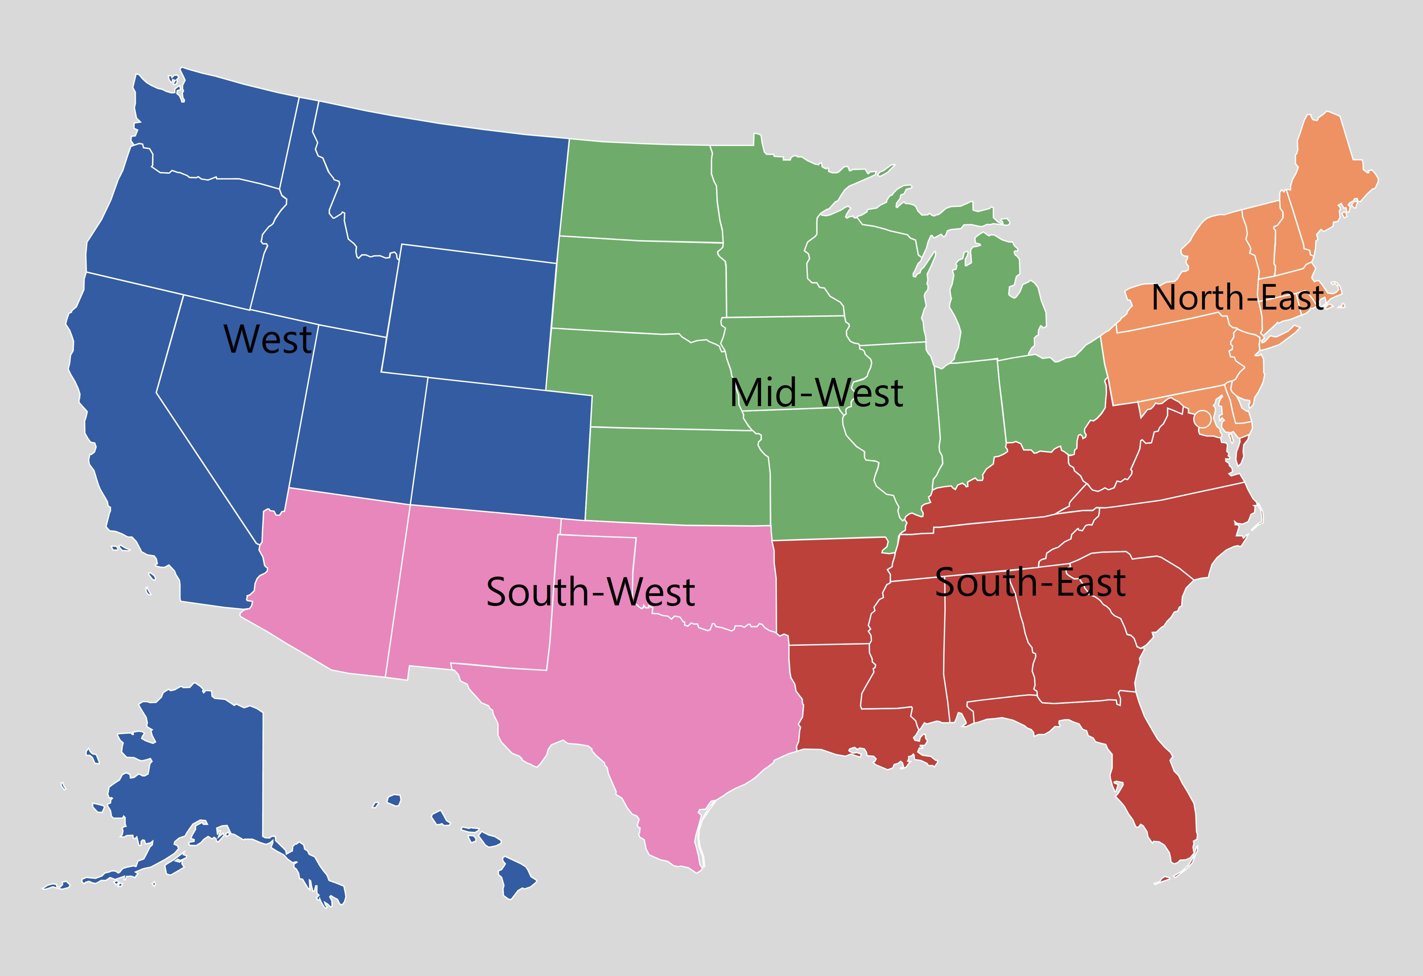
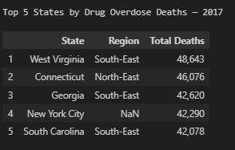
EDA
2
Insight 1: 2015 till 2017
South-East followed by North-East

Slide 14
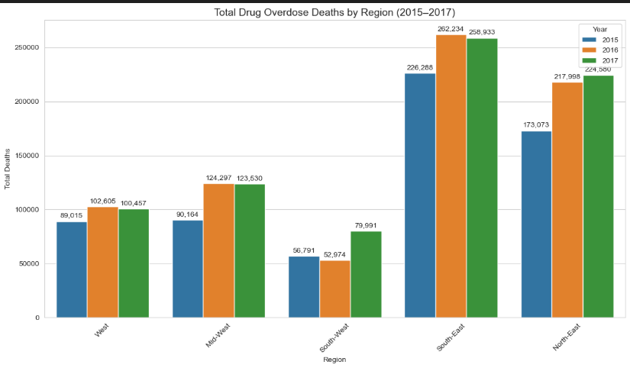
EDA
2
Insight 1: 2015 till 2017 relationship
The South-East region consistently recorded the highest number of drug overdose deaths.
The North-East region followed as the second most affected, showing similarly high overdose counts.
The South-West region had the lowest overdose deaths, indicating it was the least at-risk region from 2015 to 2017.
This trend highlights a clear geographic concentration of overdose deaths in the South-East, while the South-West remains comparatively less impacted.

Slide 15
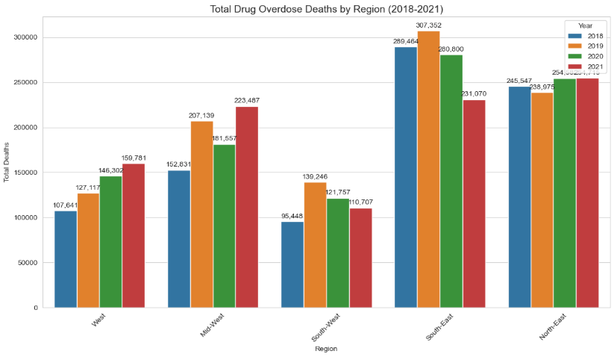
EDA
2
Insight 1: 2018 till 2021 relationship
The South-East region consistently recorded the highest number of drug overdose deaths.
The North-East region followed as the second most affected, showing similarly high overdose counts.
The South-West region had the lowest overdose deaths, indicating it was the least at-risk region from 2015 to 2017.
This trend highlights a clear geographic concentration of overdose deaths in the South-East, while the South-West remains comparatively less impacted.

Slide 16
EDA
2
Comparison Distribution Shape Region between 2015-2017 and 2018-2021:
This trend highlights a clear geographic concentration of overdose deaths in the South-East, while the South-West remains comparatively less impacted.

Slide 17
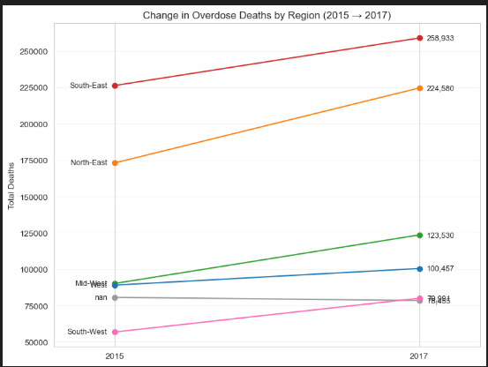
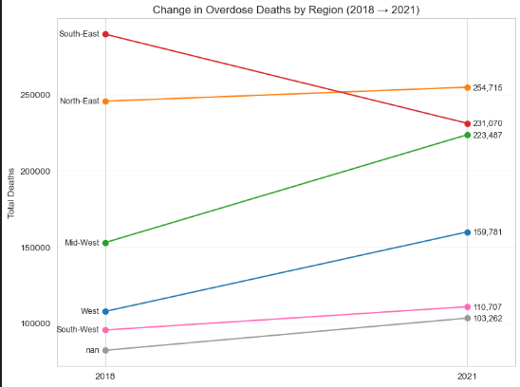
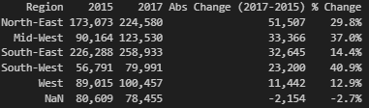
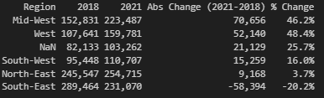
EDA
2
Insight 2: Drug deaths correlation region changes after 2017:

Slide 18
EDA
2
Insight 2: Drug deaths correlation region changes after 2017:
South-East tends to be the most overdoses drug use before 2017. After 2018, it drops by a difference of 58,394 (-20.2%).
Mid-West tends to have a strong percentage (from 37% to 46.2%) of drug overdoses deaths in terms of correlation increase.
West tends to also have a strong percentage (from 12.9% to 48.4%) of drug overdoses deaths in terms of correlation increase.
This trend highlights the clear evidence that the overdose deaths in the South-East decreasing, while as Mid-West and West increasing remains comparatively less impacted.

Slide 19
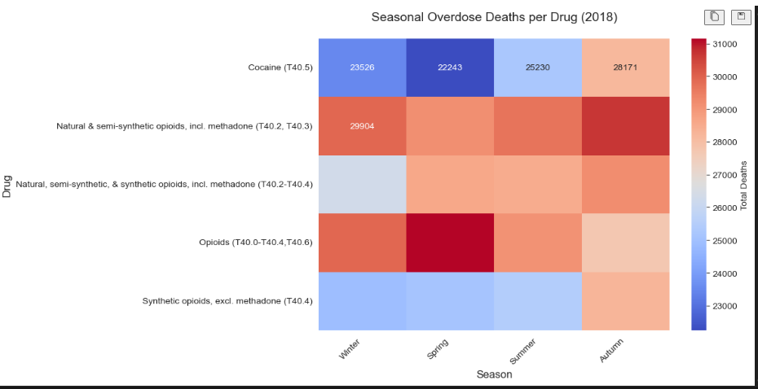
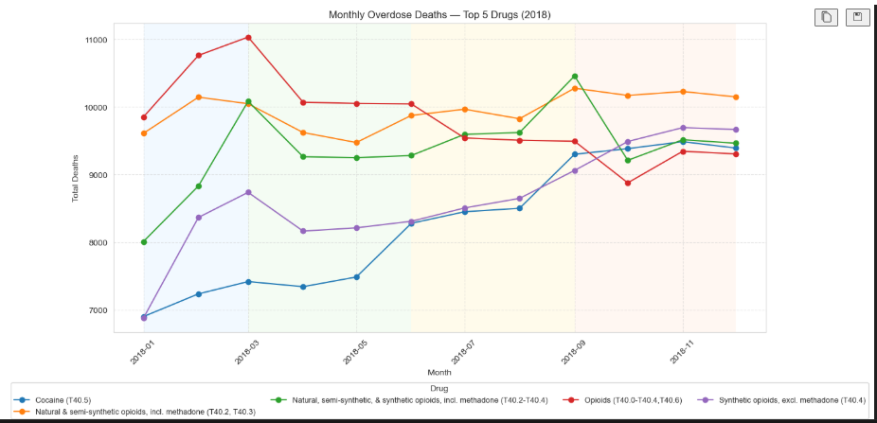
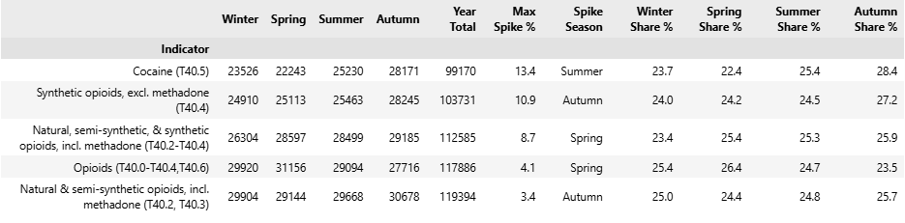
EDA
2
Insight 3: 2018 Correlation Drug Spikes

Slide 20
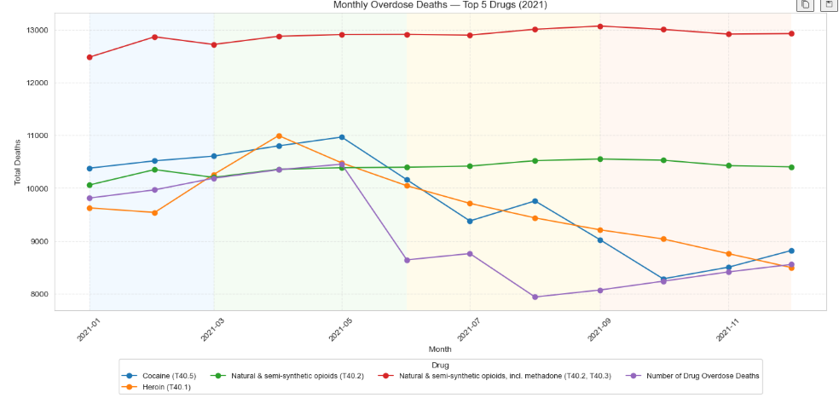
EDA
2
2018 and beyond 2021 Comparison:
There is no seasonal changes beyond 2018 difference either in the past of 2018 nor 2012.
Meaning that if an unusual spike occur back in 2018, we can detect early on which drugs or what external factors that may cause the spike to prevent that from happening again within the near future.

Slide 21
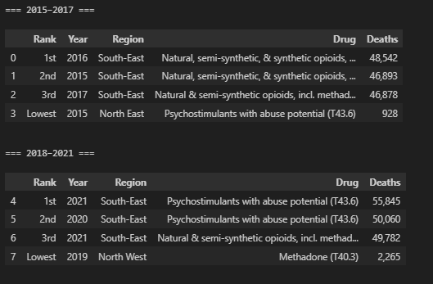
EDA
2
Insight 4: Highest and Lowest Drugs within year blocks
Era: 2015 till 2017:
Natural & Semi-synthetic opioids: highest deaths.
Psychostimulants: lowest deaths.
Era: 2018 till 2021:
Psychostimulants: highest deaths.
Methadone: lowest deaths.
All Era:
South = Highest Deaths
North = Lowest Deaths

Slide 22

Recommendations
3
Recommendations Agenda:
Improve Dataset Quality and Analysis
🔑 Stakeholders Action Plan:
Public US Health Agencies
Pharmaceutical Companies
Addiction & Mental Health Services

Slide 23
Recommendations
3
1. Recommendations for Improving Dataset Quality and Analysis:
📅 Data Coverage
Ensure complete aggregation of 2022–2023 data with all 12 months.
👥 Demographic Insights
Add gender, age group, and region columns for deeper trend analysis.
📈 Data Volume & Balance
Aim for 30K+ records to strengthen analysis accuracy.
Balance dataset by reducing skew and handling outliers.
🌍 External Context
Include analysis of political, social, or policy impacts to understand external factors influencing trends.

Slide 24

Recommendations
3
🔑 2. Key Question: What actions should stakeholders take next*?
*Note: This is a high-level, generalized objective to guide decision-making, as domain-specific stakeholder details are limited at this stage.

Slide 25

Recommendations
3
2. Stakeholders Action Plan
Public US Health Agencies (e.g., CDC, WHO):
Centers for Disease Control and Prevention (CDC):
Highlight the Midwest and West regions’ upward trends in 2021 and implement a robust monitoring system to detect and respond to future spikes early.
World Health Organization (WHO):
Enhance global collaboration and data consistency to speed international responses to drug and health crises, recognizing deaths will rise without action.

Slide 26

Recommendations
3
2. Stakeholder Action Plan
Pharmaceutical Companies:
Share anonymized prescription data with agencies to detect misuse trends early.
Invest in non-opioid alternatives and medications for stimulant addiction treatment.
Partner in education campaigns to promote safe prescribing practices.

Slide 27

Recommendations
3
2. Stakeholder Action Plan
Addiction & Mental Health Services:
Expand dual-diagnosis treatment programs for patients with both addiction and mental health issues.
Train clinicians on stimulant-focused treatment approaches as overdose trends shift post-2018.
Develop community-based recovery hubs integrating mental health, housing, and job training specifically in Midwest and West regions.

Slide 28
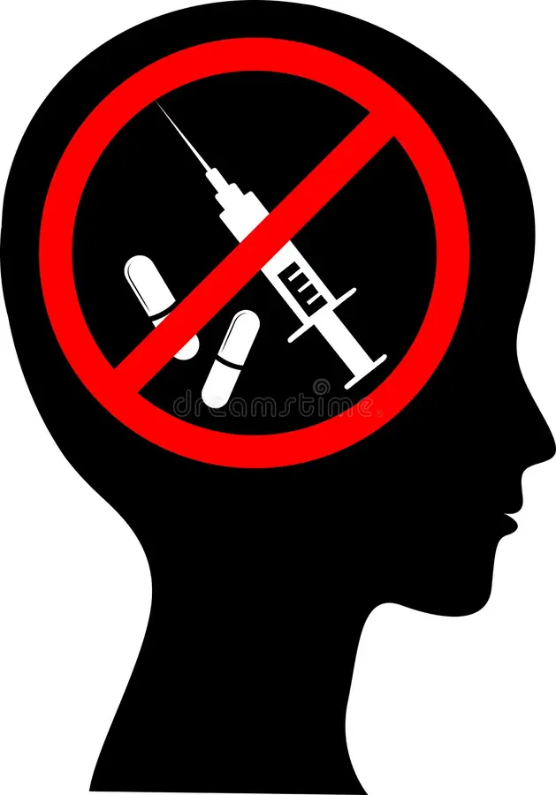
Summary
3
4 insights founds:
Overdose deaths: in the South-East is the highest, while the South-West is the lowest
Correlation after 2018: South-East decreasing, while as Mid-West and West increasing remains comparatively less impacted.
Awareness of 2018 spike: No clear seasonal correlation and other year patterns.
2015-2017 Drug Summary:
Highest: Natural & Semi-synthetic opioids
Lowest: Psychostimulants
2018-2021 Drug Summary:
Psychostimulants: highest deaths
Methadone: lowest deaths.

Slide 29
Summary
3
Improving Dataset Quality and Analysis:
📅 Data Coverage
Ensure complete aggregation of 2022–2023 data with all 12 months.
👥 Demographic Insights
Add gender, age group, and region columns for deeper trend analysis.
📈 Data Volume & Balance
Aim for 30K+ records to strengthen analysis accuracy.
Balance dataset by reducing skew and handling outliers.
🌍 External Context
Include analysis of political, social, or policy impacts to understand external factors influencing trends.

Slide 30
Summary
3
Stakeholders Action Plan:
1. US Public Agencies:
CDC: Midwest and West regions’ upward trends in 2021 and implement robust monitoring system.
WHO: Enhance global collaboration for drug and health crises, recognizing deaths will rise without action.
2. Pharmaceutical Companies:
Pharmaceutical companies should share anonymized prescription data, invest in safer treatment options, and lead education campaigns for responsible prescribing.
3. Addiction & Mental Health Services:
Expand dual-diagnosis care, train clinicians for stimulant-focused treatments, and build integrated recovery hubs in the Midwest and West.

Slide 31
Summary
3
Reminder why this analysis is important:
Drug use and overdose deaths in the U.S. are at record highs, with rising suicide rates linked to drug misuse and mental health struggles.
Slow coordination between health organizations and law enforcement hinders effective responses.
Research and community education are critical for targeted prevention, stronger interventions, and informed policy development.
Stakeholders should consistently analyze patterns and anomalies to identify opportunities for reducing drug overdose rates, recognizing that while complete elimination may be unattainable, significant reductions are achievable.

Slide 32

QUESTIONS?

