Slide 1

The Genetic Effects of Red Meat Intervention in Inflammatory Bowel Disease
Aaron Upchurch
Team #7
11/20/2021

Slide 2
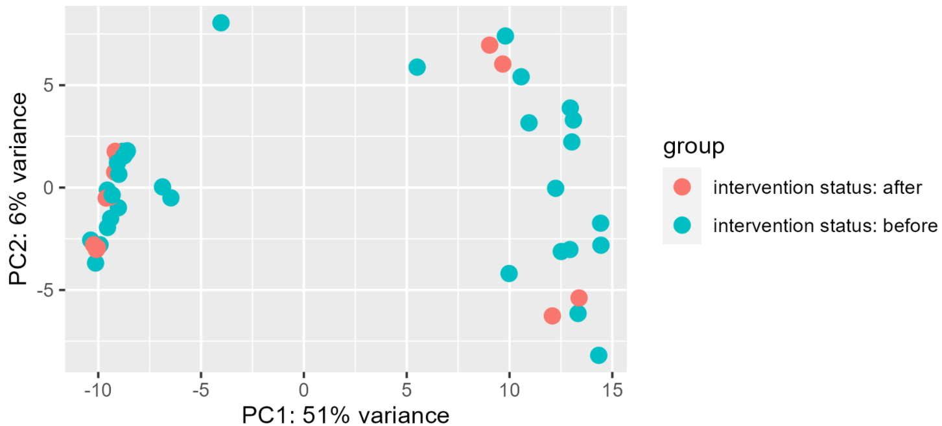
Introduction
Inflammatory bowel disease
An umbrella diagnosis of diseases that feature the chronic inflammation of the digestive track
Despite extensive research, the cause of the disease is still unknown
This study used array-based gene expression profiling data from colon tissue samples of diagnosed patients
The dataset included 44 samples with 41,094 gene expression counts

Slide 3
Hypothesis
Question
What are the effects of red meat intervention diets on inflammatory bowel disease?
If the diet has a significantly positive effect on a patient’s symptoms, doctors can replace expensive medication with diet recommendations
Hypothesis
Red meat intervention diets produce genetically visible effects on patients with inflammatory bowel disease
Process
The tissue samples were grouped together by their intervention status
The gene expression levels were then analyzed to identify any statistically significant differences

Slide 4
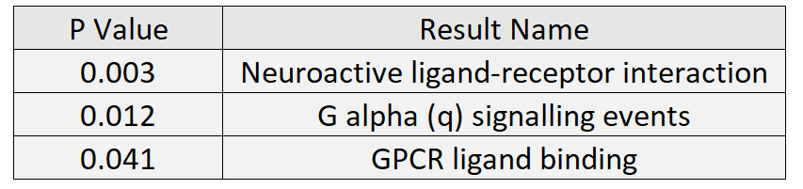
Differential Expression and Enrichment Analysis
Differential expression analysis was performed between the samples collected before and after the intervention
550 genes were determined to be differentially expressed between the two groups
Using the gProfiler2 library, enrichment analysis was performed on the differentially expressed genes
The produced pathways included
Neuroactive ligand receptor interactions
G alpha signaling events
G protein coupled receptor ligand binding
Both neuroactive ligand and G protein coupled receptors have been found to play a role in several colon related illnesses including colon cancer
The existence of many differentially expressed genes and their colon disease related pathways suggests that the dietary intervention may have some effect on inflammatory bowel disease

Slide 5
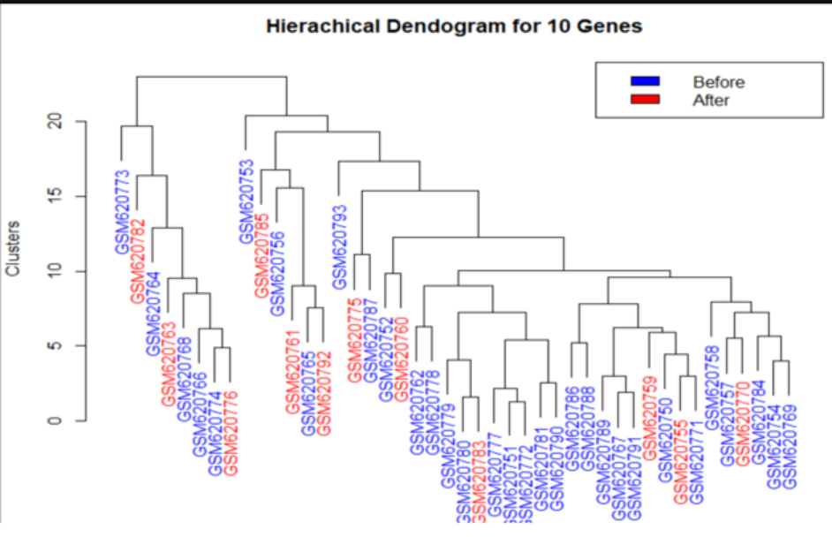
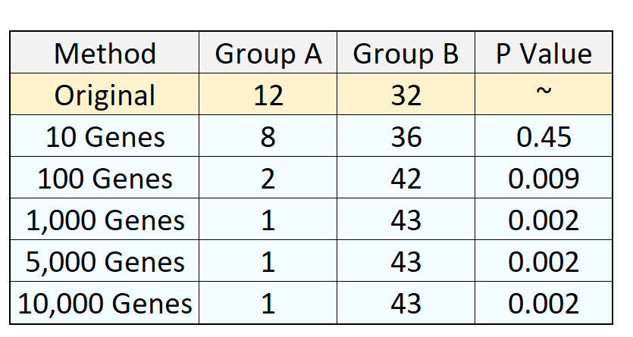
Clustering & Enrichment Analysis
Hierarchical clustering was performed based on the gene expression levels
Using the 10 most variable genes produced clusters that were somewhat similar to the original intervention groups
Clustering performed with 10 genes was the only method to not produce significantly different group sizes
Most hierarchical clustering methods were unable to create clusters that reflected the original groups
The performed clustering methods do not support the presence of a genetically visible affect of the red meat intervention

Slide 6
Conclusions & Future Work
Based on the differential expression analysis and hieratical clustering, there is not enough evidence to support the idea that the intervention had a significant effect on the disease
If we could redo the study, we would have performed more clustering algorithms to compare the results
One new question that arose during the project was how gender and age affected the expression data
If the project were continued, we would have rerun hierarchical clustering with the samples grouped by age and gender
We also wonder if genetically visible differences may become visible if the patients were grouped based on their type of inflammatory bowel disease

