Slide 1
PU learning
In a nutshell:
Problem: You have a lot of unlabelled samples and very few positively labelled samples.
You want to be able to train on positive and negatives.

Slide 2
Benefits
Not relying on bootstrapping or synthetic modelling of data to train models
Not all datasets are labelled (or were meant to be applied to machine learning)
Provides flexibility for ML – not needing to drastically down sample your data

Slide 3
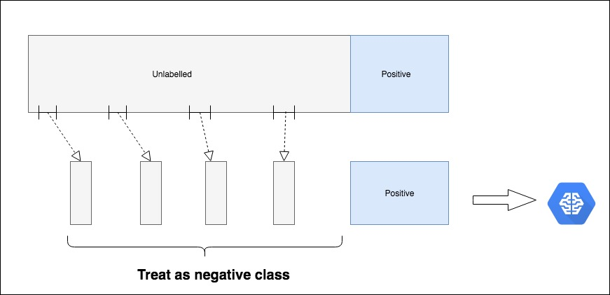
PUBagging
Randomly sample all positives and a subset of unlaballed data
Build a classifier with this bootstrapped dataset -> using positive as 1 and unknown as 0
Predict classes of the unknowns that were not sampled in training (known as Out-of-bag samples)
Repeat many times and get the OOB average scores

Slide 4
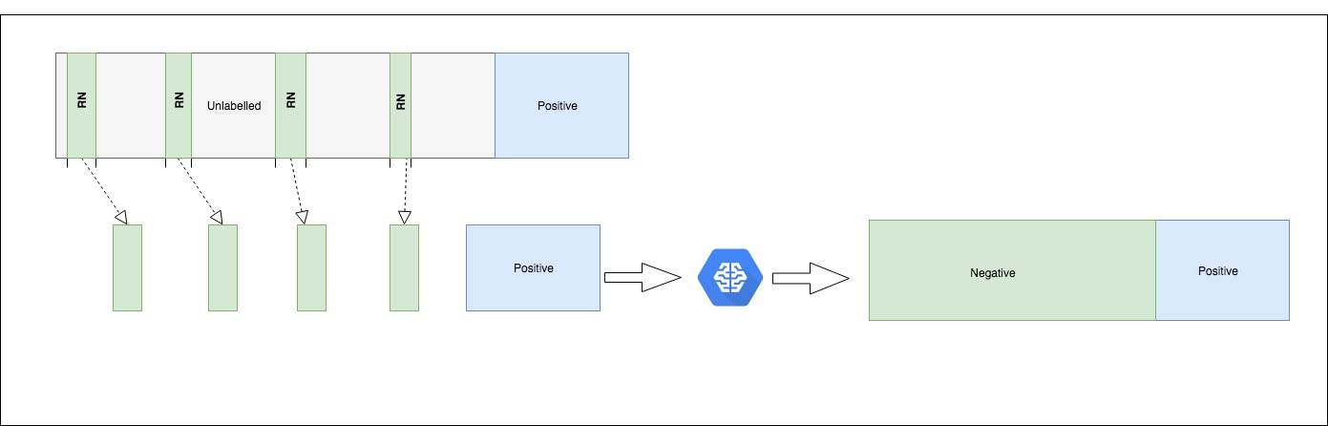
Two Step Approach
Identify a subset of of the data that can be confidently labelled as negative (reliable negatives)
Use reliable negatives and positives on a classifier and use that to label your unknown samples.

Slide 5
Two Step Approach
But it's not always the case that you have reliable negative cases in your dataset.. You only have positive and unknown.
To mitigate this you need to :
Train a RF on Positive and unlaballed cases.
Get the score range from lowest score found for positive case to highest score found for positive case.
Relabelled the data set as Positive for all samples within that score range. And the rest as negative
Train a second RF on the newly labelled data

Slide 6
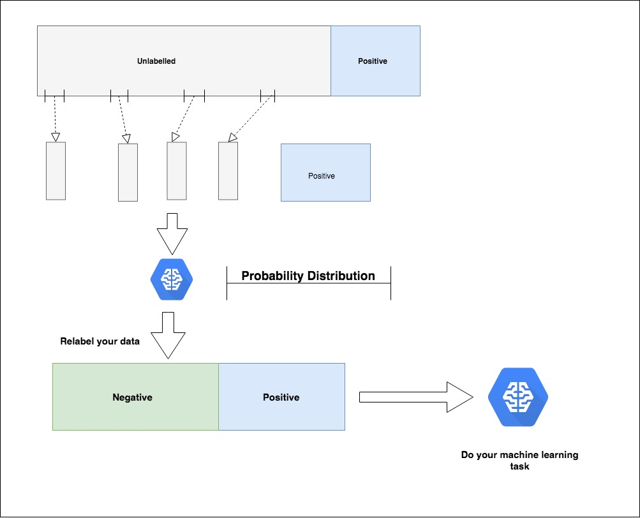
Two Step Approach

Slide 7
Further Research
This “ML to do ML” method is very beneficial
As it stands now this is for binary classification (0 or 1)
I would like to research how to make this applicable to multiclass classification

